Slide 1

Model Robustness Fraj Yassine Lakhal TUM School of Computation, Information and Technology
Functional Neuroimaging, LMU
Supervisor: Dr. med. Stephan Wunderlich
Computer Aided Medical Procedures & Augmented Reality, TUM
Supervisor(s): M.Sc. Chantal Pellegrini, Dr. Shahrooz Faghihroohi
München, 23. June 2026

Slide 2
Outline
Last meeting’s Recap
Cohort Overview
Most Recent Results
Possibility of Deadline Extension
Please find the TODOs in their refernce slides

Slide 3
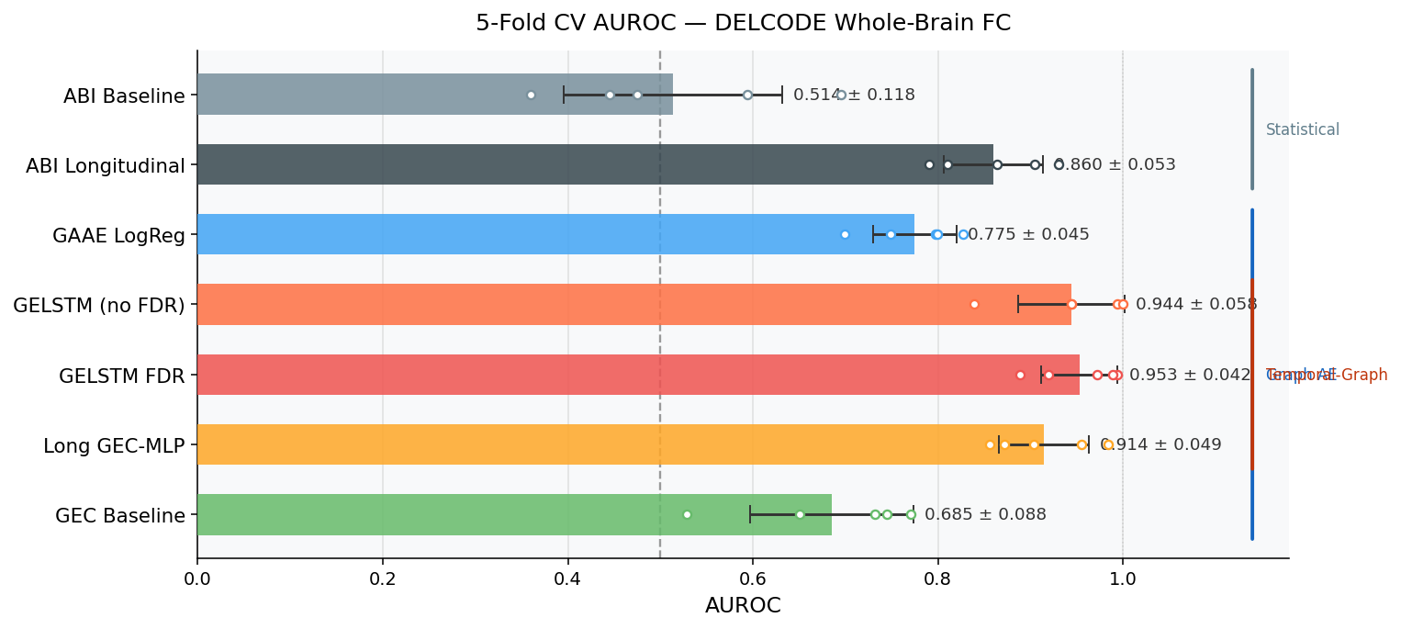
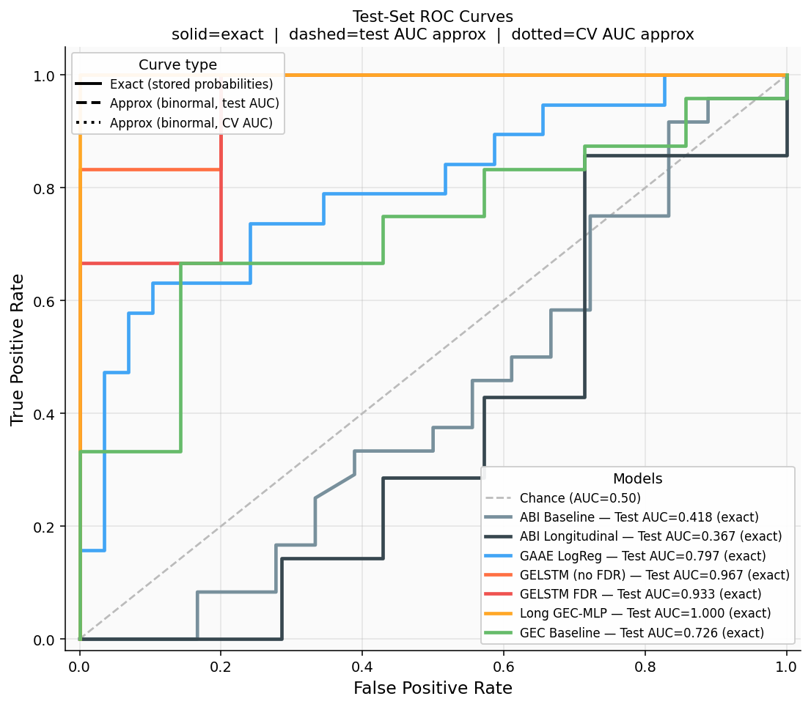
Last meeting’s Recap
Dataset-level n_patients and n_scans
CV Results
Test Dataset Results
Leakage Issue: Patients appeared in the Encoder’s training split, also appeared in the classification’s model test data
TODO 1: (Point raised by Chantal) since the encoder does not see the labels, the AUC should theoretically not be affected, however model AUC dropped on average by around 0,1?

Slide 4
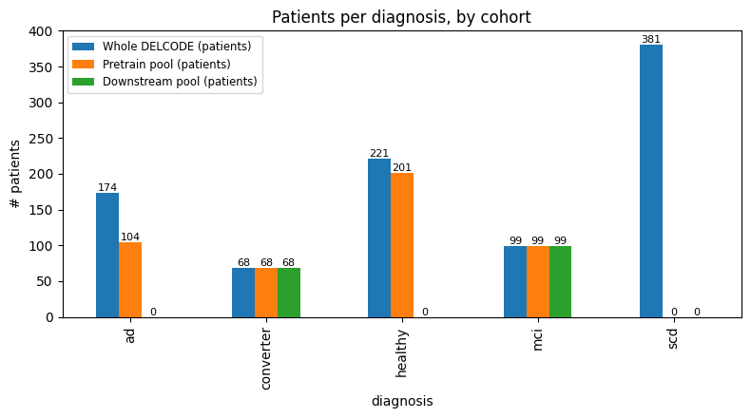
Cohort Overview
Dataset-level n_patients and n_scans
TODO 2: Find out why there is a big difference between ad patients in WHOLE DELCODE and in the pretrain pool
Notes:
I want to present, as per Shahrooz’s wish, what the data looks like:
- How is the data split actually? like how many visits per patient ?( Stephan was wrong here to assume the converters have on average more visits per patient, it’s true they drop early as they convert, but the data says they were screened more often)
- How the models were trained, how the model was tested: was it patient’s history-wise (all visits), or visit-wise? (this might be answered by the static and the longitudinal models)

Slide 5
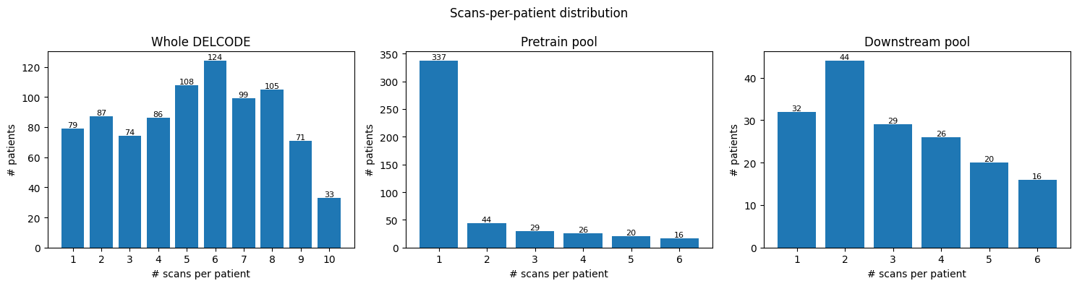
Cohort Overview
Dataset-level n_patients and n_scans
Notes:
I want to present, as per Shahrooz’s wish, what the data looks like:
- How is the data split actually? like how many visits per patient ?( Stephan was wrong here to assume the converters have on average more visits per patient, it’s true they drop early as they convert, but the data says they were screened more often)
- How the models were trained, how the model was tested: was it patient’s history-wise (all visits), or visit-wise? (this might be answered by the static and the longitudinal models)

Slide 6
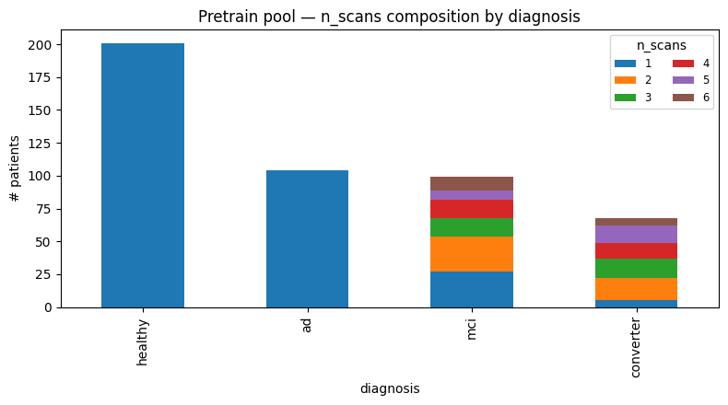
Cohort Overview
Dataset-level n_patients and n_scans
GAAE pretraining treats these as static / cross-sectional:
n_scans = 1 for every single `ad`/`healthy` patient
Notes:
I want to present, as per Shahrooz’s wish, what the data looks like:
- How is the data split actually? like how many visits per patient ?( Stephan was wrong here to assume the converters have on average more visits per patient, it’s true they drop early as they convert, but the data says they were screened more often)
- How the models were trained, how the model was tested: was it patient’s history-wise (all visits), or visit-wise? (this might be answered by the static and the longitudinal models)

Slide 7
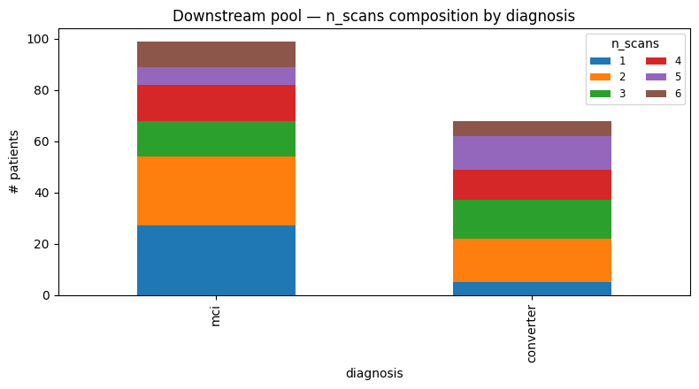
Cohort Overview
Dataset-level n_patients and n_scans
Remark: converters average ~3.4 scans stable MCI ~2.8 scans
It’s true converters get AD scans subtracted but you need to stick around to be called a converter" and leaving early defaults you into the stable bucket
Notes:
I want to present, as per Shahrooz’s wish, what the data looks like:
- How is the data split actually? like how many visits per patient ?( Stephan was wrong here to assume the converters have on average more visits per patient, it’s true they drop early as they convert, but the data says they were screened more often)
- How the models were trained, how the model was tested: was it patient’s history-wise (all visits), or visit-wise? (this might be answered by the static and the longitudinal models)

Slide 8
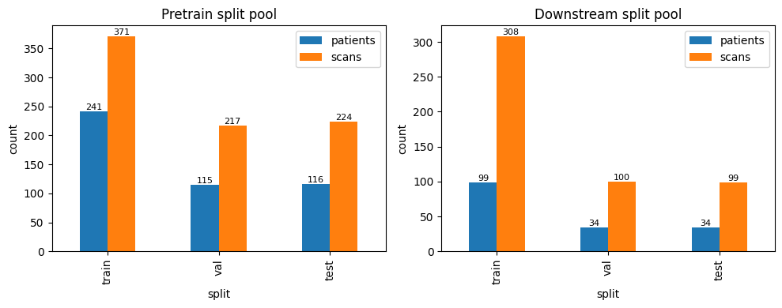
Cohort Overview
Split-level statistics
Notes:
I want to present, as per Shahrooz’s wish, what the data looks like:
- How is the data split actually? like how many visits per patient ?( Stephan was wrong here to assume the converters have on average more visits per patient, it’s true they drop early as they convert, but the data says they were screened more often)
- How the models were trained, how the model was tested: was it patient’s history-wise (all visits), or visit-wise? (this might be answered by the static and the longitudinal models)

Slide 9
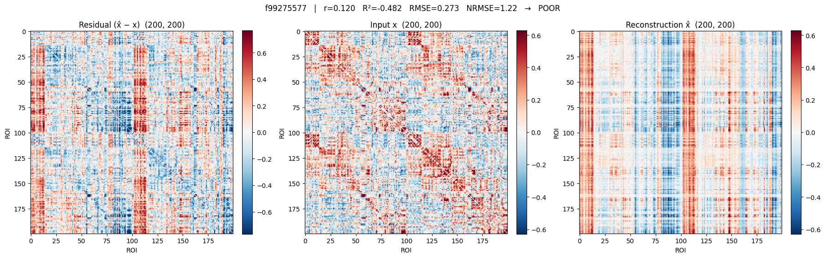
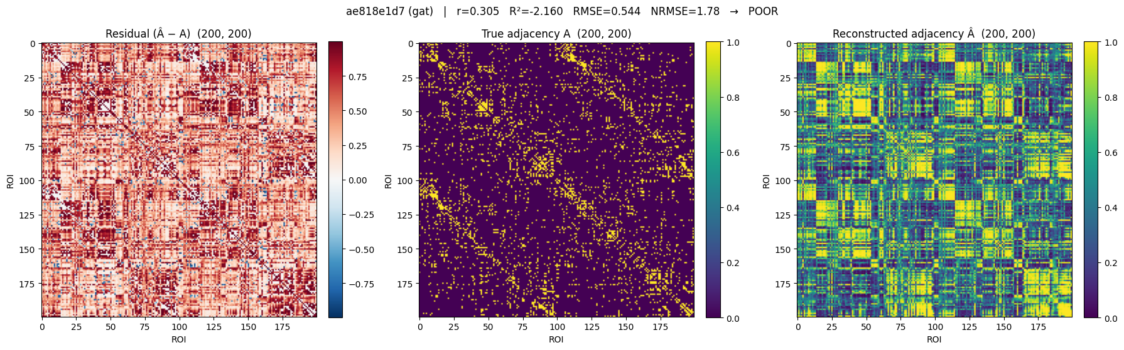
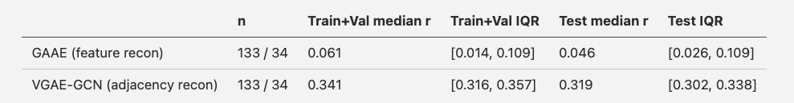
Most Recent Results
Moving to a VAE for the GAAE (Pretext model)
TODO 1: Check if the Pretext model even helps the classifier, so how the performance of the classifier looks like without it
Notes:
Go through the new models? - Rational behind the GRU (Longitudinal Data not too long) and the VGAE (64 latent vector dimensions were not enough to reconstruct the fmri)?
- Rationale behind using tangent space

Slide 10
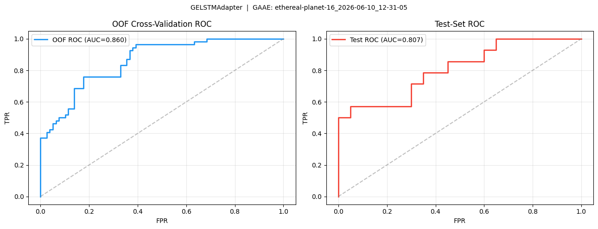
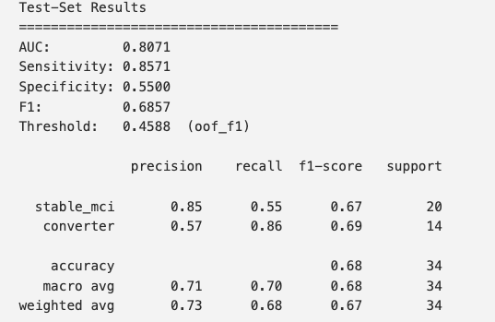
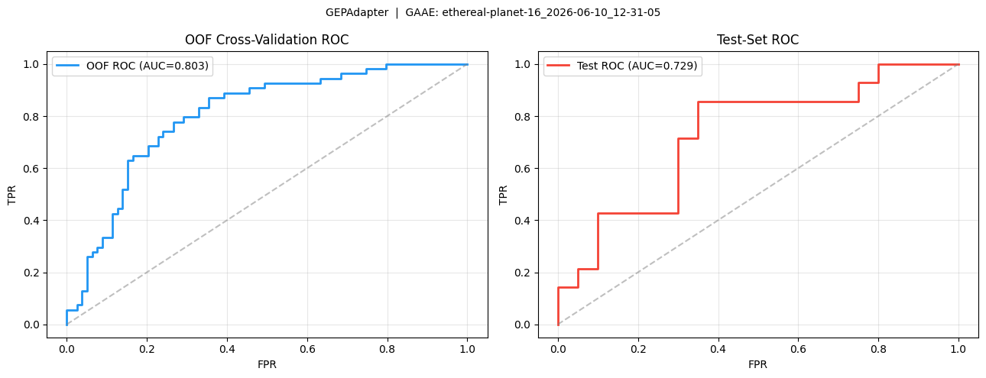
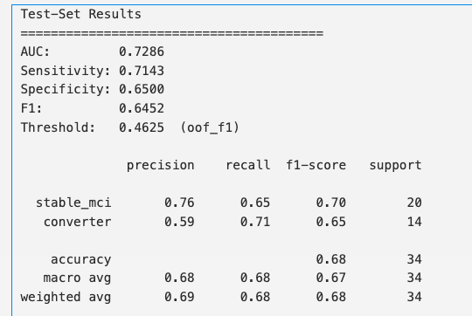
Most Recent Results
Notes:
Go through the new models? - Rational behind the GRU (Longitudinal Data not too long) and the VGAE (64 latent vector dimensions were not enough to reconstruct the fmri)?
- Rationale behind using tangent space

Slide 11
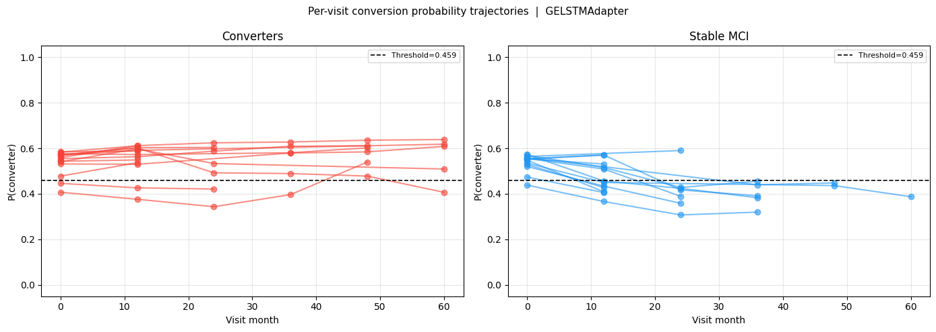
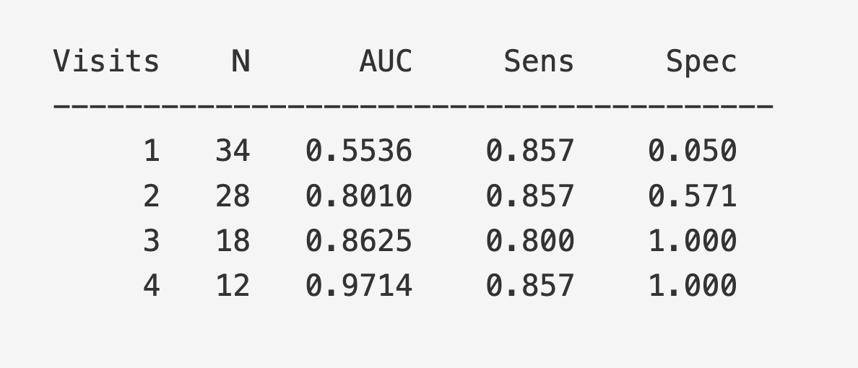
Most Recent Results
LSTM truncated visits and their AUCs
## Early-Detection Curve: AUC vs. Number of Visits Used
Shared `early_detection_table`: for each N it restricts every test subject with `T >= N` visits to their first N (via `truncate_to_n_visits`) and re-scores with `eval_split`.
TODO 3: Find out why LTSM’s AUC jumps from 0.55 to 0.80 when presented with two visits instead of just 1

Slide 12
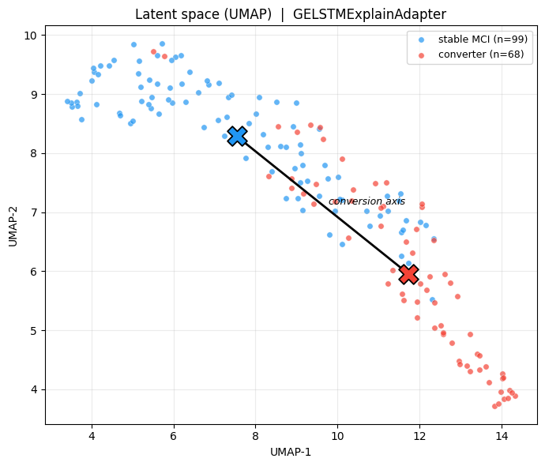
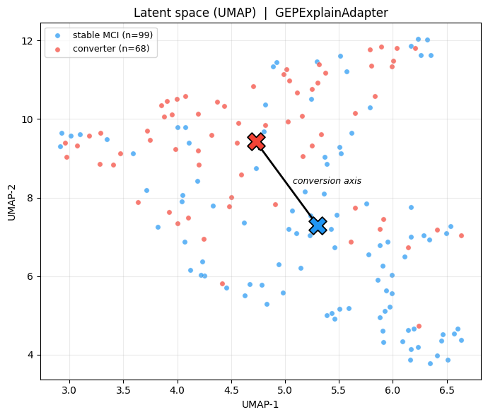
Most Recent Results
Notes:
Go through the new models? - Rational behind the GRU (Longitudinal Data not too long) and the VGAE (64 latent vector dimensions were not enough to reconstruct the fmri)?
- Rationale behind using tangent space

Slide 13
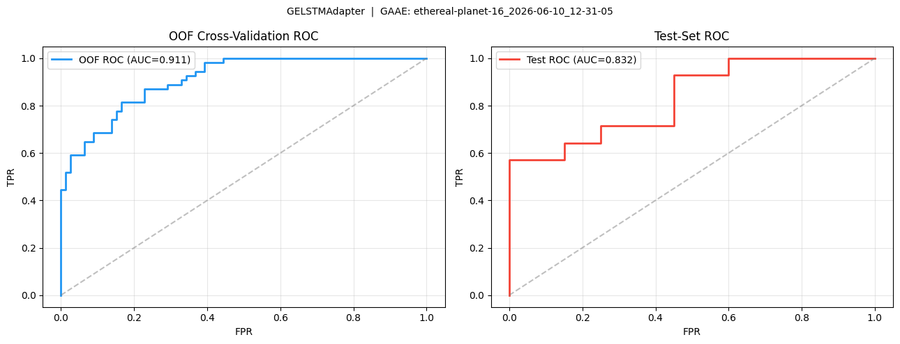
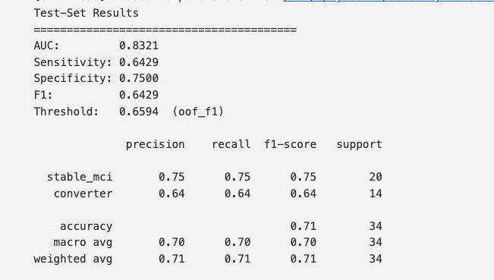
Most Recent Results
LSTM vs GRU
GRU perform in general better on shorter longitudinal than LSTMs data
Notes:
Go through the new models? - Rational behind the GRU (Longitudinal Data not too long) and the VGAE (64 latent vector dimensions were not enough to reconstruct the fmri)?
- Rationale behind using tangent space

