Slide 1

Longitudinal Data Results Fraj Yassine Lakhal TUM School of Computation, Information and Technology
Functional Neuroimaging, LMU
Supervisor: Dr. med. Stephan Wunderlich
Computer Aided Medical Procedures & Augmented Reality, TUM
Supervisor(s): M.Sc. Chantal Pellegrini, Dr. Shahrooz Faghihroohi
München, 24. March 2026

Slide 2
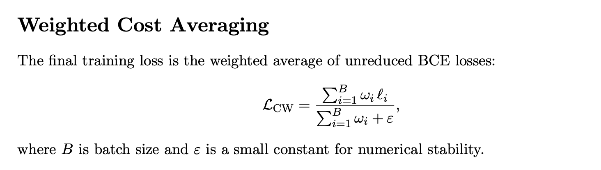
Recap
Significant imbalance between converters (Longitudinal 196 scans) vs non-converters or stable mci (Baseline only 99 Scans)
→ Workaround: Use Weighted Cost Averaging

Slide 3
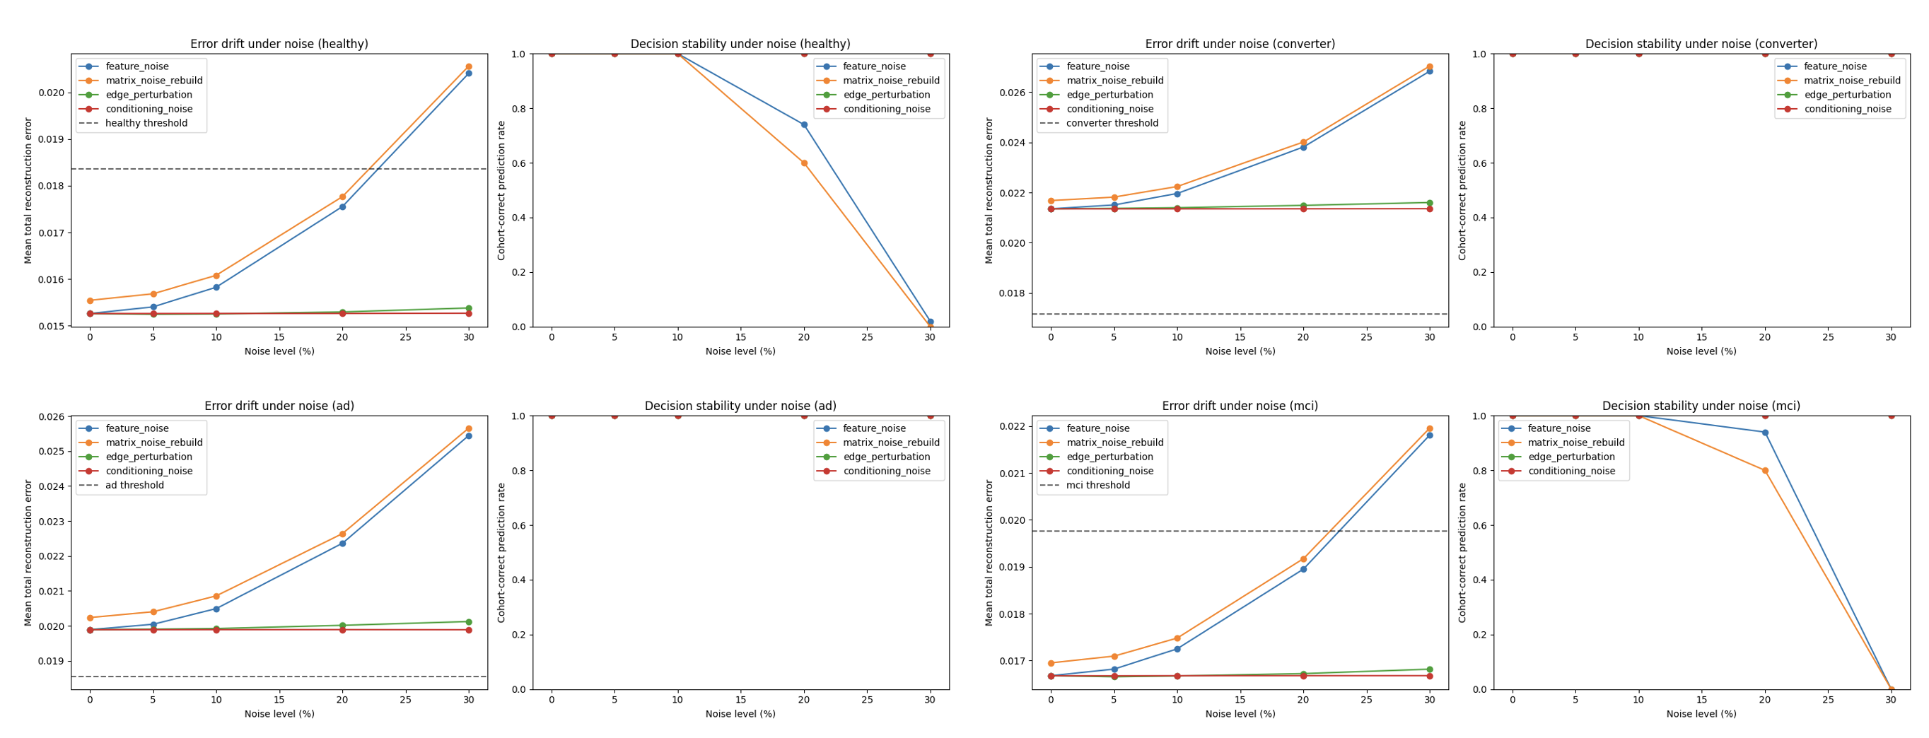
Recap
Significant imbalance between converters (Longitudinal 196 scans) vs non-converters or stable mci (Baseline only 99 Scans)
→ Workaround: Use Weighted Cost Averaging
Adding Gaussian Noise to the patient graphs and seeing the effect on the classification error to understand bad performance
→ Deprioritized: much better results
with new longitudinal stable mci data

Slide 4
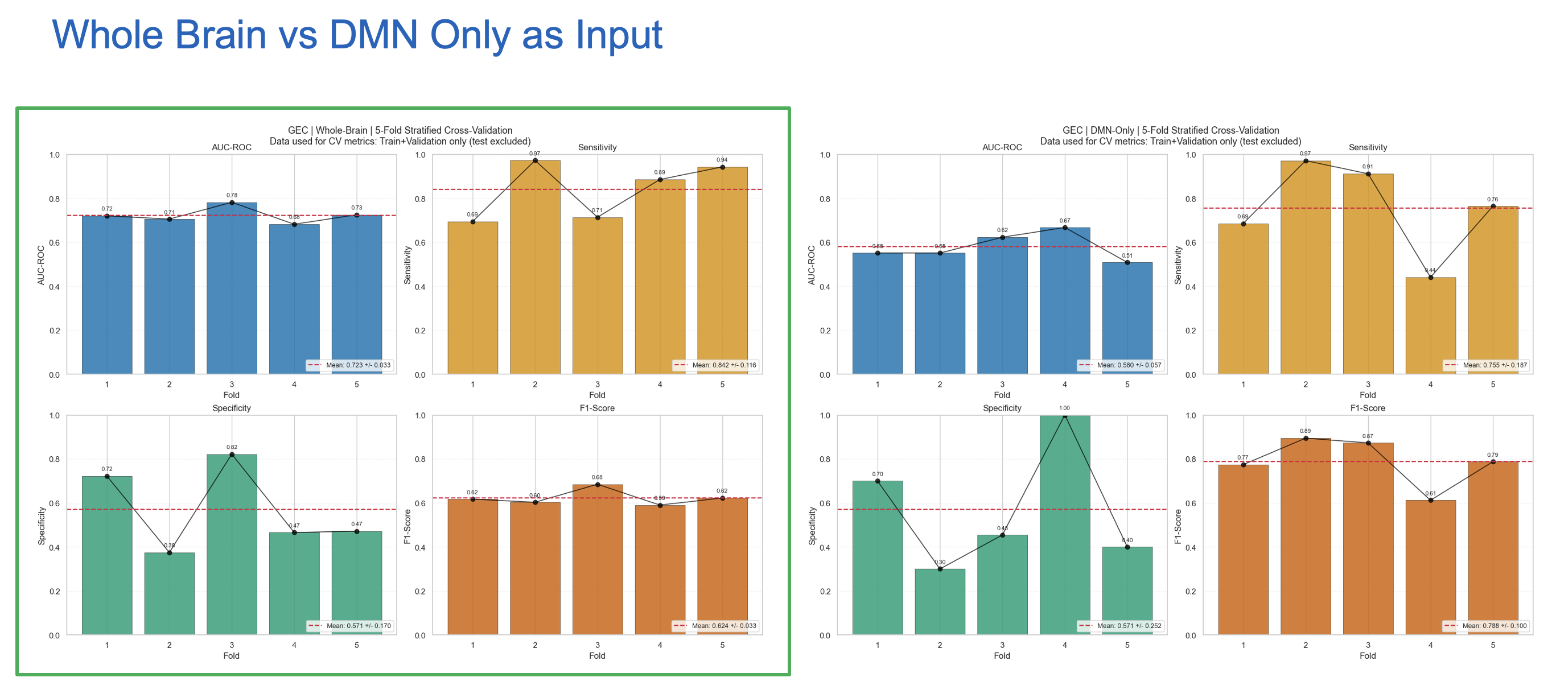
Recap
Limiting the input to the DMN and comparing to the whole brain
→ Replace Youden’s index (prioritizes Sens and Spec) with Better F1 to find optimal threshold

Slide 5

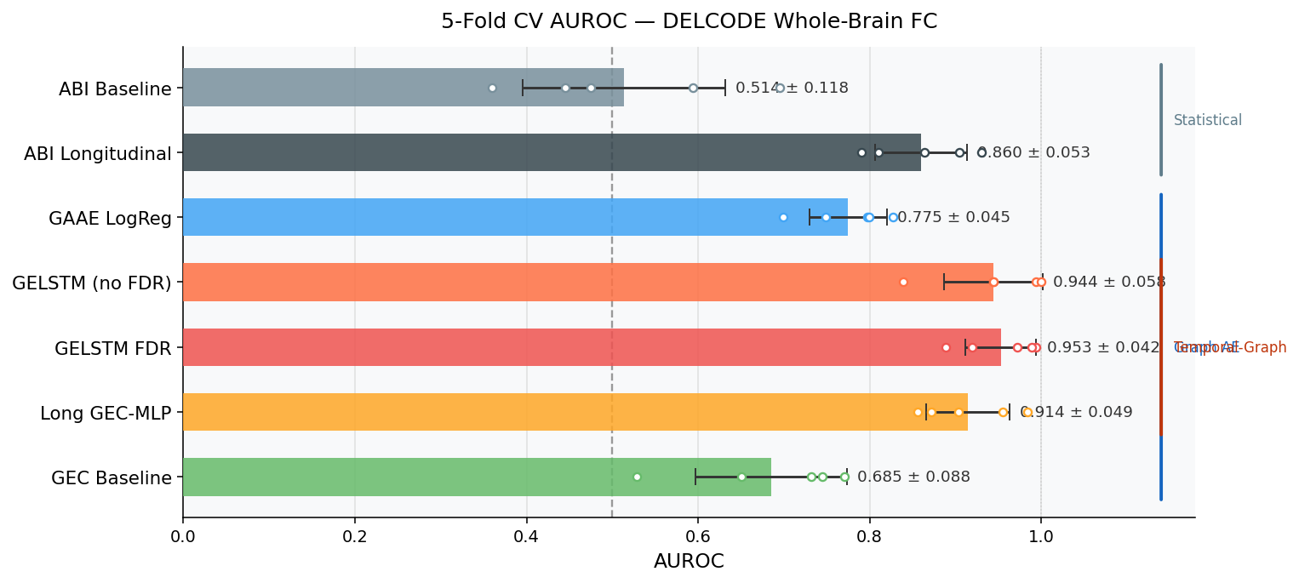
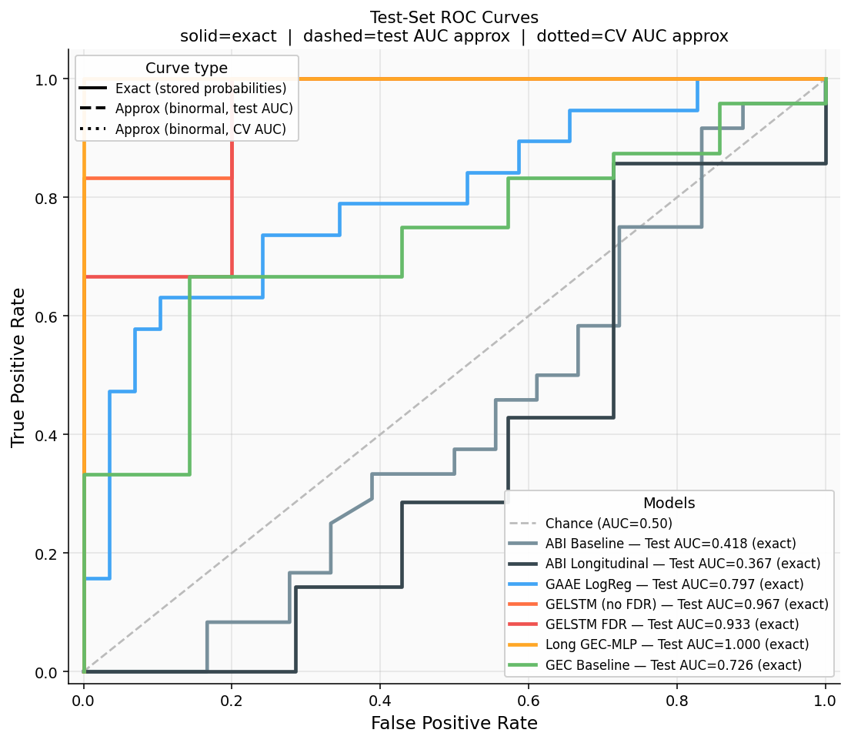
Model Comparisons
CV Results
Test Dataset Results
Issue: test data is small 14 Subjects – 78 Scans

Slide 6
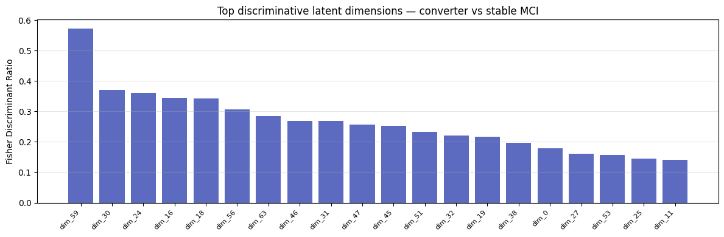
Evaluating the GAAE Latent Vector (Relevant Dimensions 64D Latent Vector)
FDR_j = |μ_conv_j - μ_mci_j|² / (σ²_conv_j + σ²_mci_j) for each dimension j

Slide 7
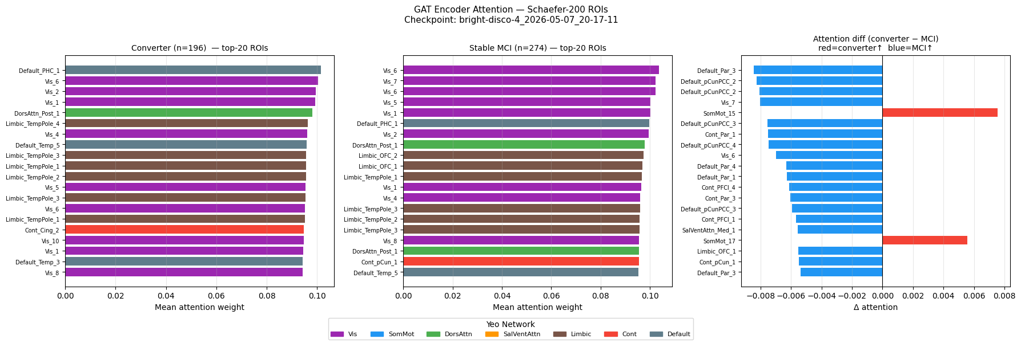
Evaluating the GAAE Latent Vector (Brain ROIs)
FDR_j = |μ_conv_j - μ_mci_j|² / (σ²_conv_j + σ²_mci_j) for each dimension j

Slide 8
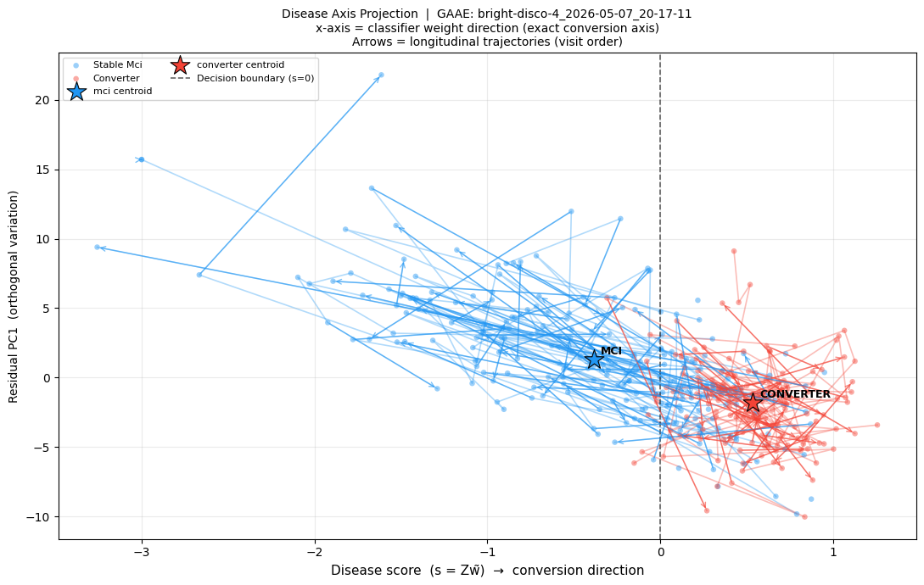
Evaluating the GAAE Latent Vector (Disease Progression)
Each fMRI connectivity matrix is encoded by the frozen GAAE into a 64-dimensional latent vector via mean-pooling over node embeddings
All latent vectors are z-standardised across the training set before any downstream analysis
A L2-regularised logistic regression is fitted on the standardised embeddings to classify MCI-stable vs. converter
→ the resulting weight vector w̃ ∈ ℝ⁶⁴ defines the disease axis: the linear direction in latent space most predictive of conversion
Every scan is projected onto this unit-normalised axis to yield a scalar disease score s = z · ŵ, where positive values indicate proximity to the converter class and negative values to stable MCI

Slide 9
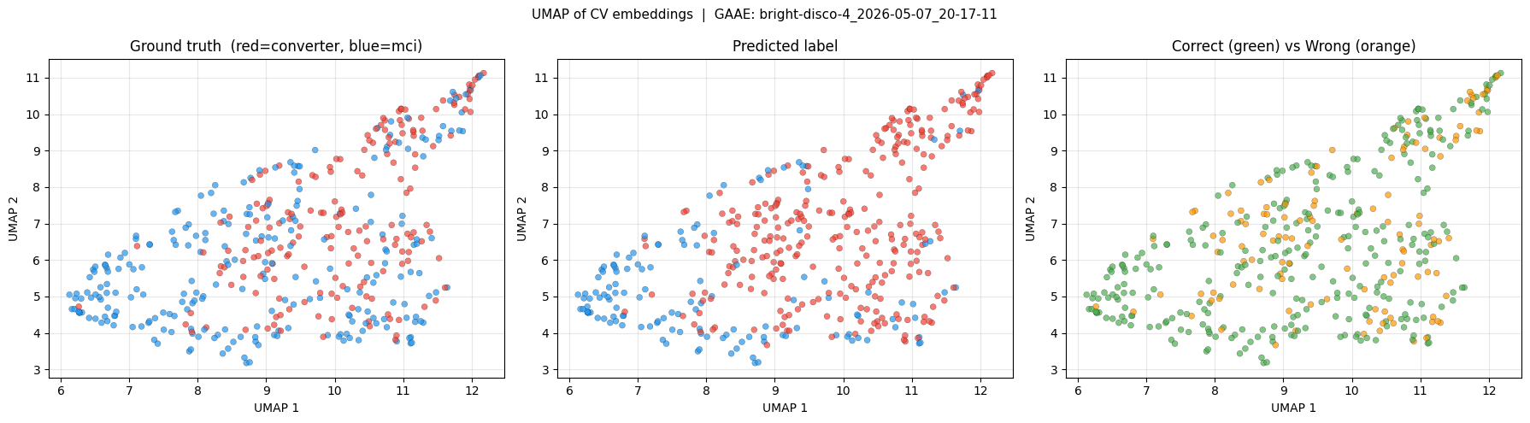
Evaluating the GAAE Latent Vector (Predictions in UMAP)
Using Logistic Regression

Slide 10
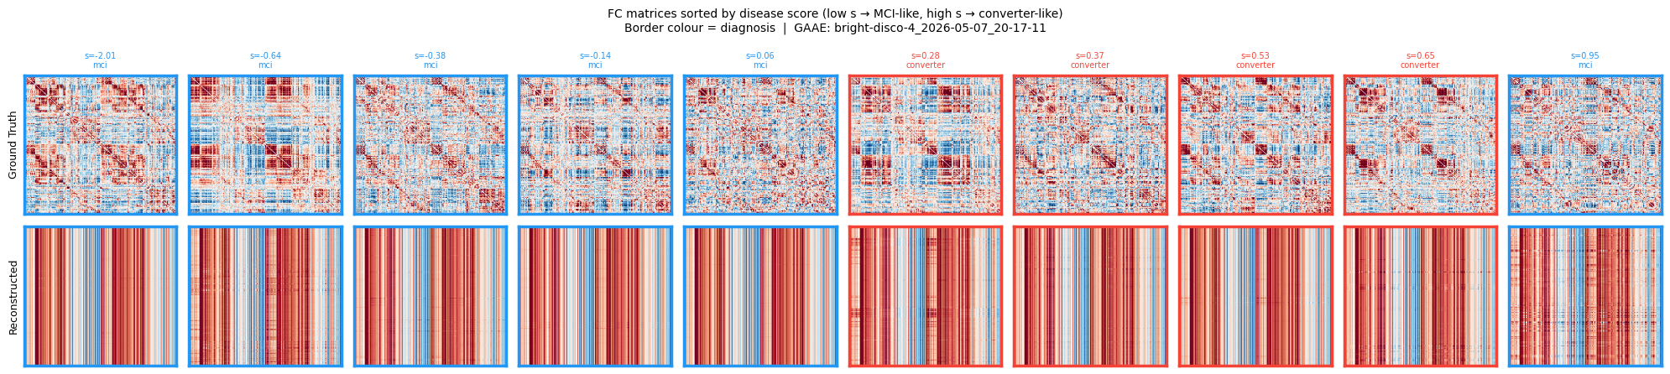
FC Matrix MCI vs Converter

