Slide 1

Pretraining: Model Architecture Fraj Yassine Lakhal TUM School of Computation, Information and Technology
Functional Neuroimaging, LMU
Supervisor: Dr. med. Stephan Wunderlich
Computer Aided Medical Procedures & Augmented Reality, TUM
Supervisor(s): M.Sc. Chantal Pellegrini, Dr. Shahrooz Faghihroohi
München, 13. Januar 2026

Slide 2
Outline
DELCODE Dataset
Statistical Tests
Pretrained Model Architecture: Supervised vs Unsupervised Learning

Slide 3
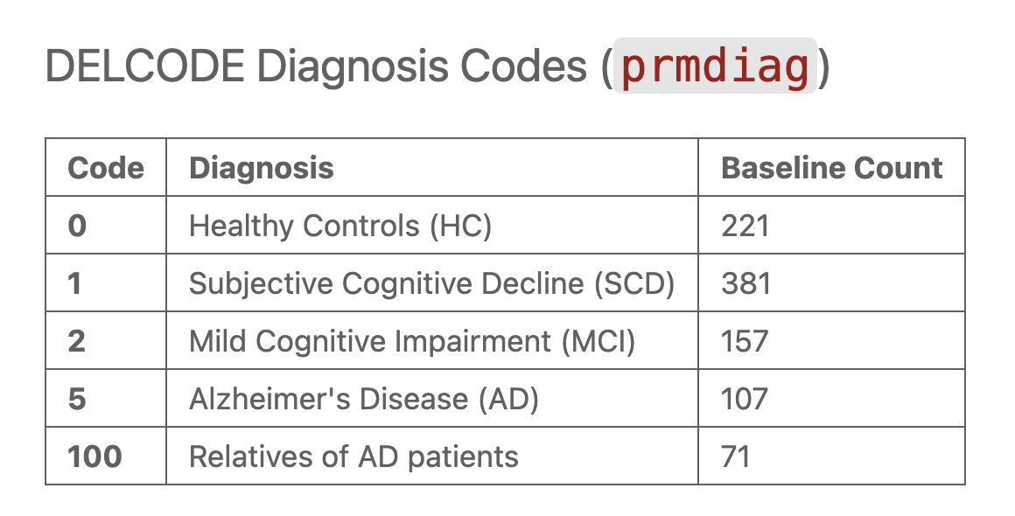
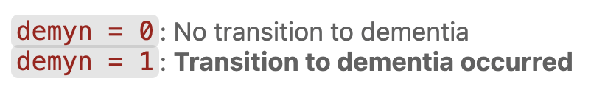
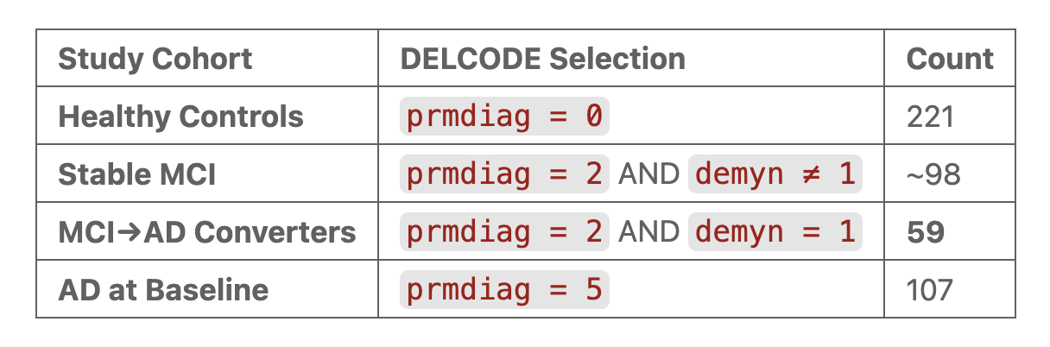
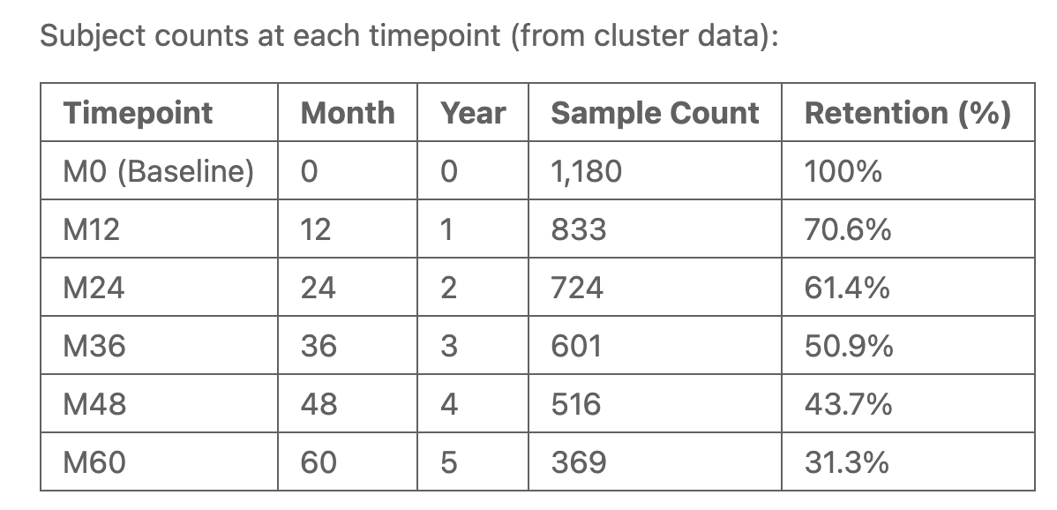
DELCODE Dataset
Cohorts
⚠️ Counts only baseline fMRIs ⚠️

Slide 4
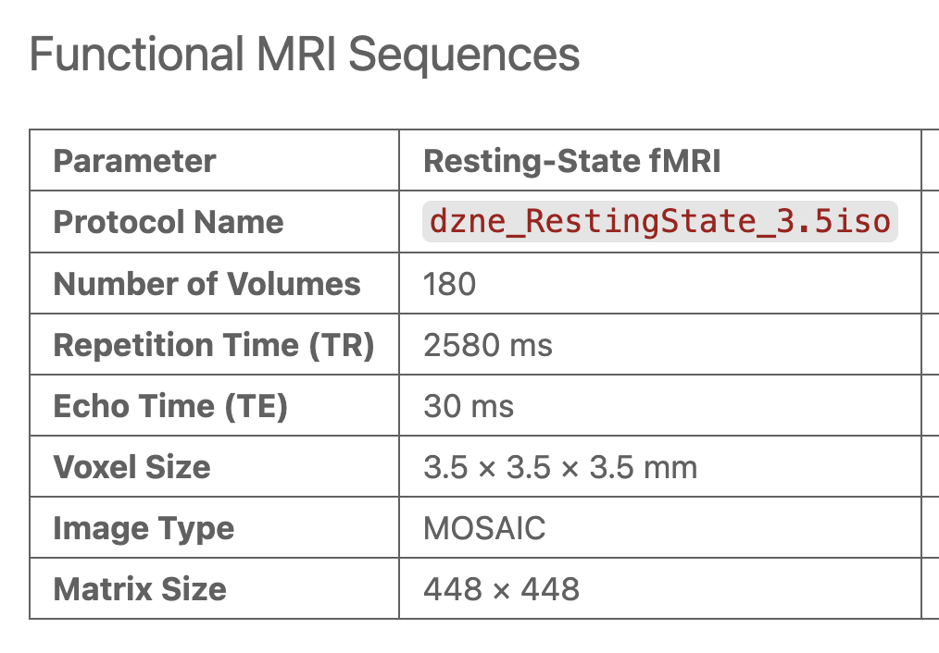
DELCODE Dataset
Scanning Procedure

Slide 5
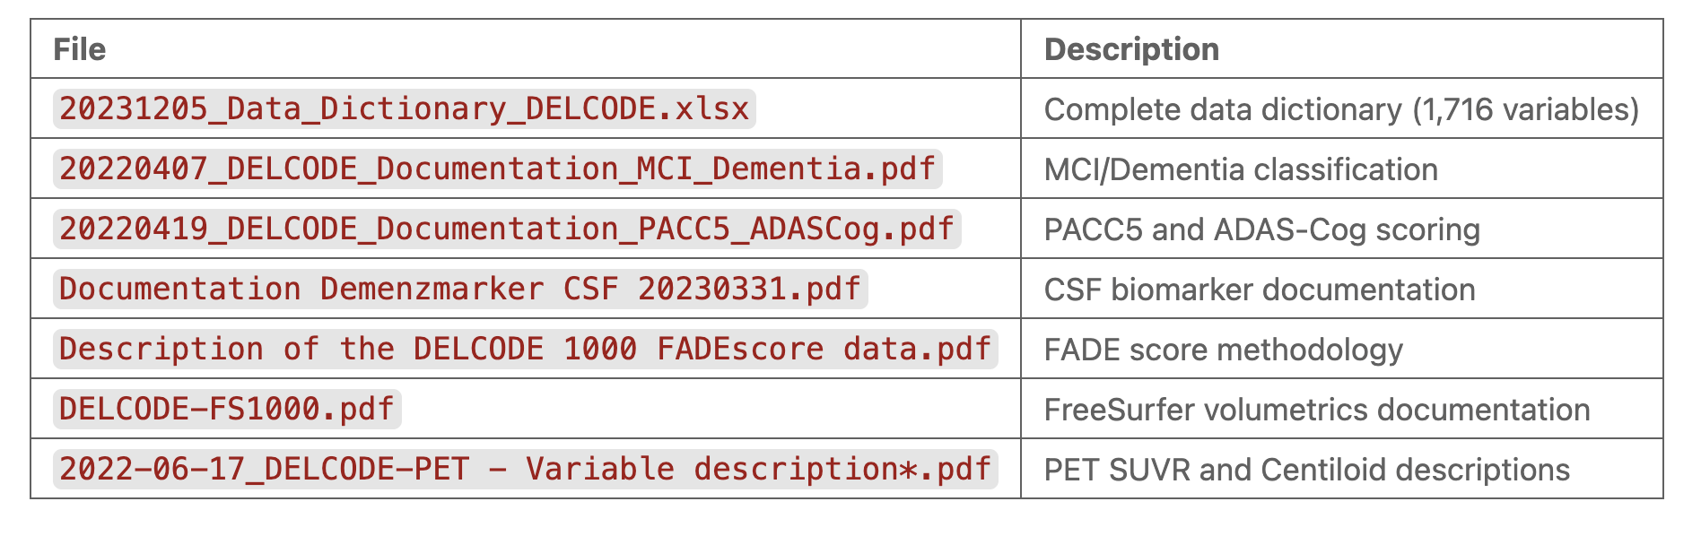
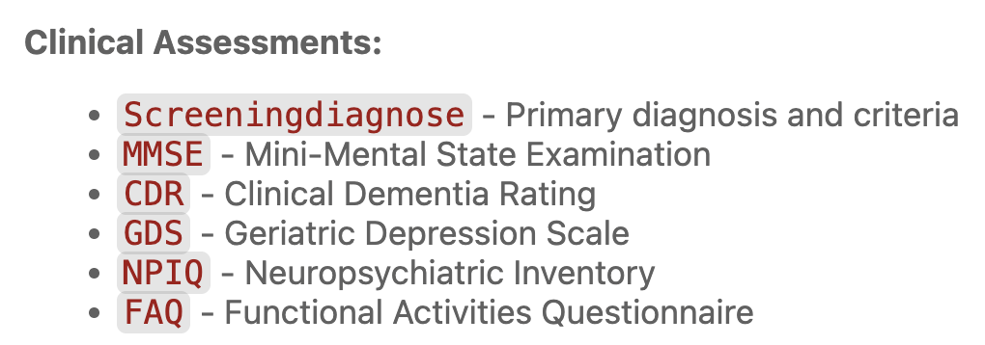
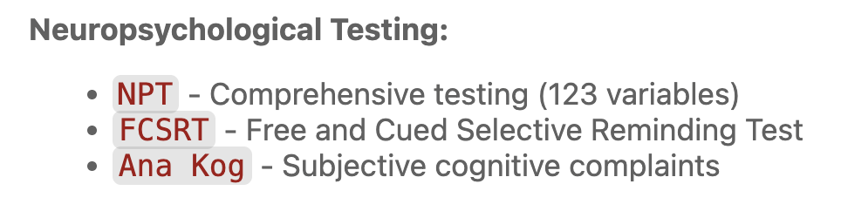
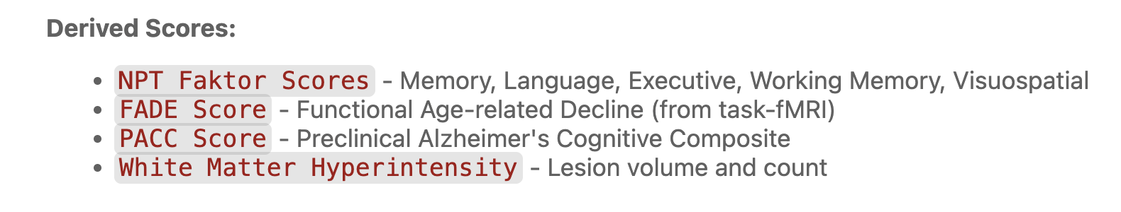
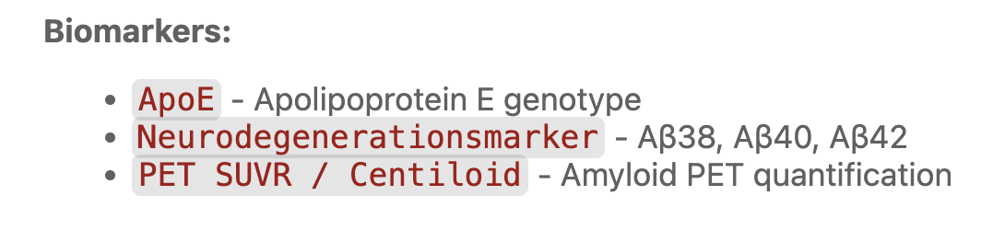
DELCODE Dataset
Clinical Biomarkers

Slide 6
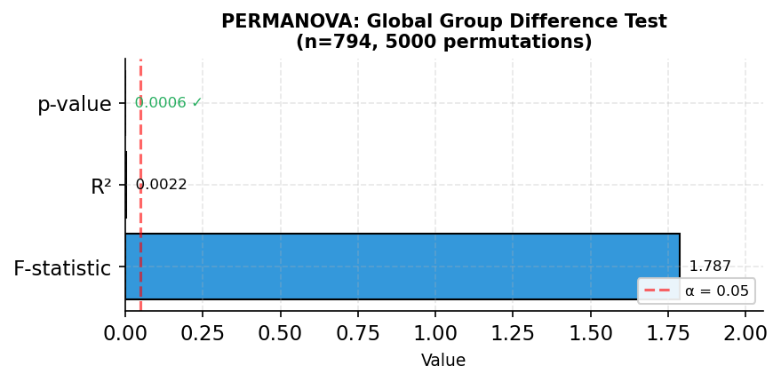
Statistical Tests (Converters vs non-Converters)
PERMANOVA Test
Rasero, J., Amoroso, N., La Rocca, M., Tangaro, S., Bellotti, R., & Stramaglia, S. (2017). Multivariate regression analysis of structural MRI connectivity matrices in Alzheimer's disease. PLOS ONE, 12(11), e0187281. https://doi.org/10.1371/journal.pone.0187281
Notes:
PERMANOVA tests whether the overall connectivity patterns differ between converters and non-converters.
A significant p-value (< 0.05) indicates that the groups have different multivariate distributions. The R² value shows how much variance is explained by group membership.
F < 1: Within-group variation is larger than between-group differences
α = 0.05 means you're willing to accept a 5% chance of a false positive (Type I error)

Slide 7
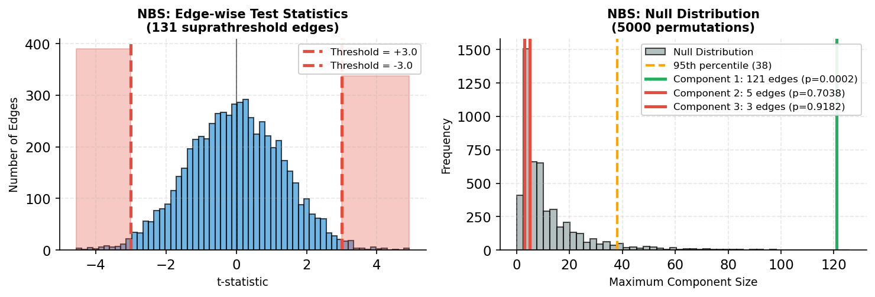
Statistical Tests (Converters vs non-Converters)
NBS Tests
Zalesky, A., Fornito, A., & Bullmore, E. (2010). Network-based statistic: Identifying differences in brain networks. NeuroImage, 53(4), 1197-1207. https://doi.org/10.1016/j.neuroimage.2010.06.041
Notes:
Network-Based Statistic (NBS) identifies connected components of edges that show group differences.
The left plot shows the distribution of t-statistics for all edges, with red areas indicating suprathreshold edges.
The right plot compares observed component sizes to the null distribution. Only components larger than expected by chance (above the orange line) are significant. → NBS identified 1 significant network component(s), suggesting localized connectivity differences.

Slide 8
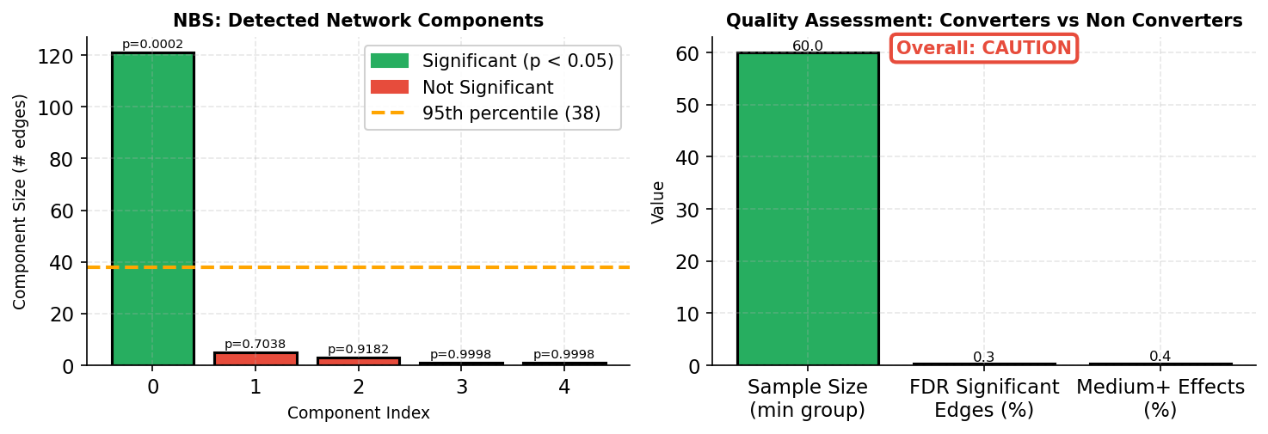
Statistical Tests (Converters vs non-Converters)
NBS Tests
Zalesky, A., Fornito, A., & Bullmore, E. (2010). Network-based statistic: Identifying differences in brain networks. NeuroImage, 53(4), 1197-1207. https://doi.org/10.1016/j.neuroimage.2010.06.041
Notes:
Left: Individual network components detected by NBS, with significance indicated by color (green = significant, red = not significant).
Right: Quality metrics for the analysis. Small sample sizes or low signal can affect reliability and increase caution.

Slide 9
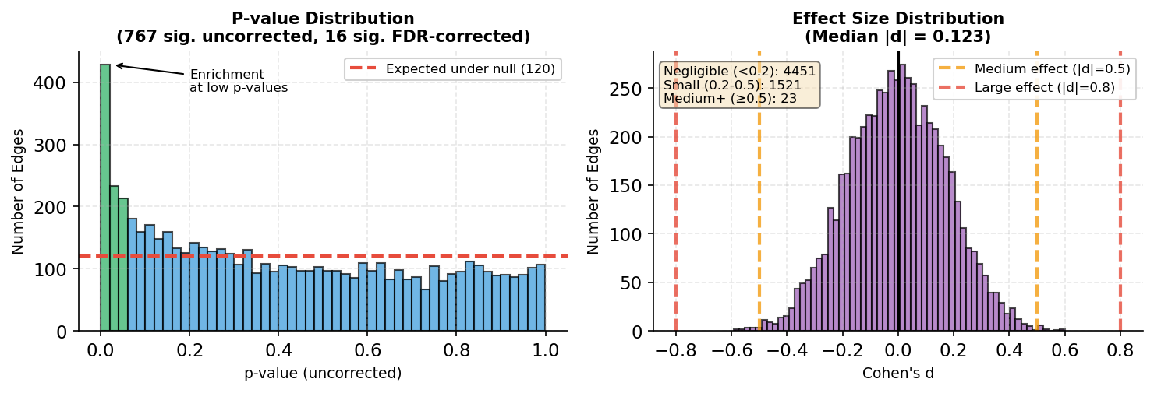
Statistical Tests (Converters vs non-Converters)
FDR, Cohen’s d
Rechberger S, Li Y, Kopetzky SJ, Butz-Ostendorf M; for the Alzheimer's Disease Neuroimaging Initiative. (2022). Automated High-Definition MRI Processing Routine Robustly Detects Longitudinal Morphometry Changes in Alzheimer's Disease Patients. Frontiers in Aging Neuroscience, 14:832828. doi: 10.3389/fnagi.2022.832828
Miao D, Zhou X, Wu X, Chen C, Tian L. (2022). Distinct profiles of functional connectivity density aberrance in Alzheimer's disease and mild cognitive impairment. Frontiers in Psychiatry, 13:1079149. doi: 10.3389/fpsyt.2022.1079149
Notes:
Left: P-value distribution shows enrichment at low values (green bars), indicating true effects beyond chance. A uniform distribution would suggest no real differences.
Right: Effect sizes (Cohen's d) show the magnitude of differences. Most effects are small (d < 0.3), which is typical for brain connectivity studies.

Slide 10
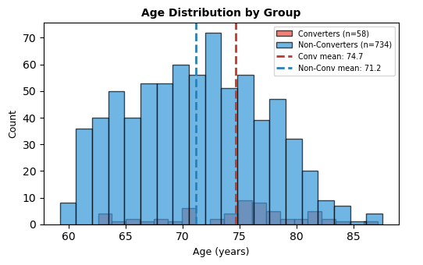
Statistical Tests (Converters vs non-Converters)
Age Effect: Age distribution

Slide 11
Statistical Tests (Converters vs non-Converters)
Age Effect: Regressing out the age
1) Connectivity = β₀ + β₁ × Age + ε
We fit a linear regression model
2) Cᵢⱼᶜᵒʳʳᵉᶜᵗᵉᵈ = Cᵢⱼ - β₁ × Ageᵢ + β₁ × Age_mean
For each subject, we predict their connectivity based solely on their age using this model, then subtract this age-driven prediction from their actual connectivity values.
We add back the mean connectivity so the corrected values stay in a meaningful range

Slide 12
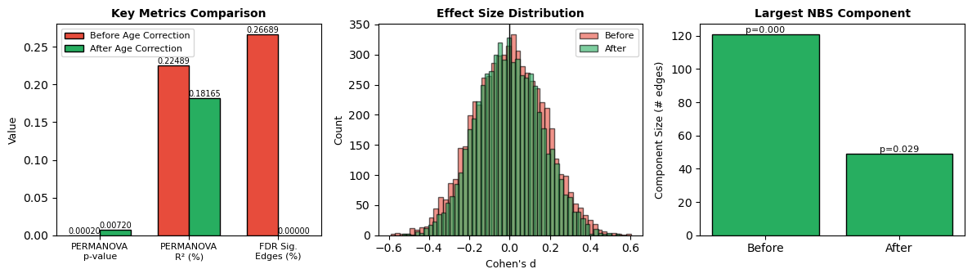
Statistical Tests (Converters vs non-Converters)
Age Effect: Before and after regressing out the age

Slide 13
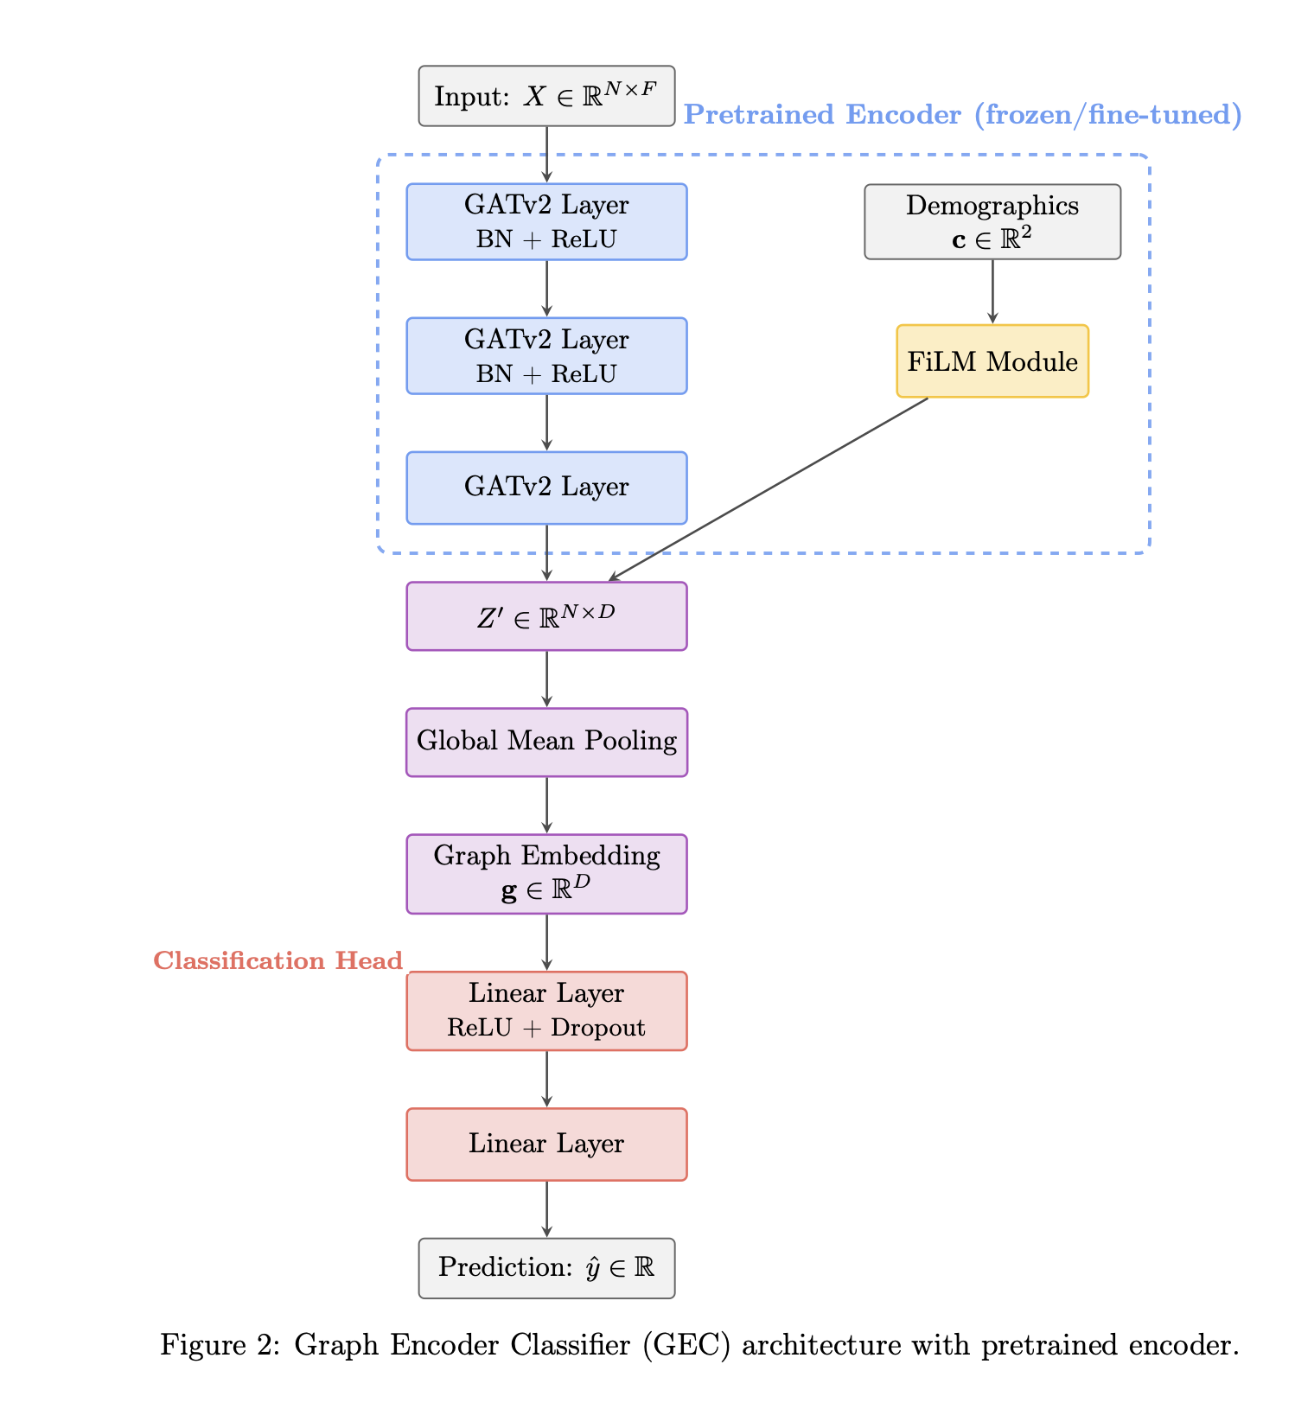
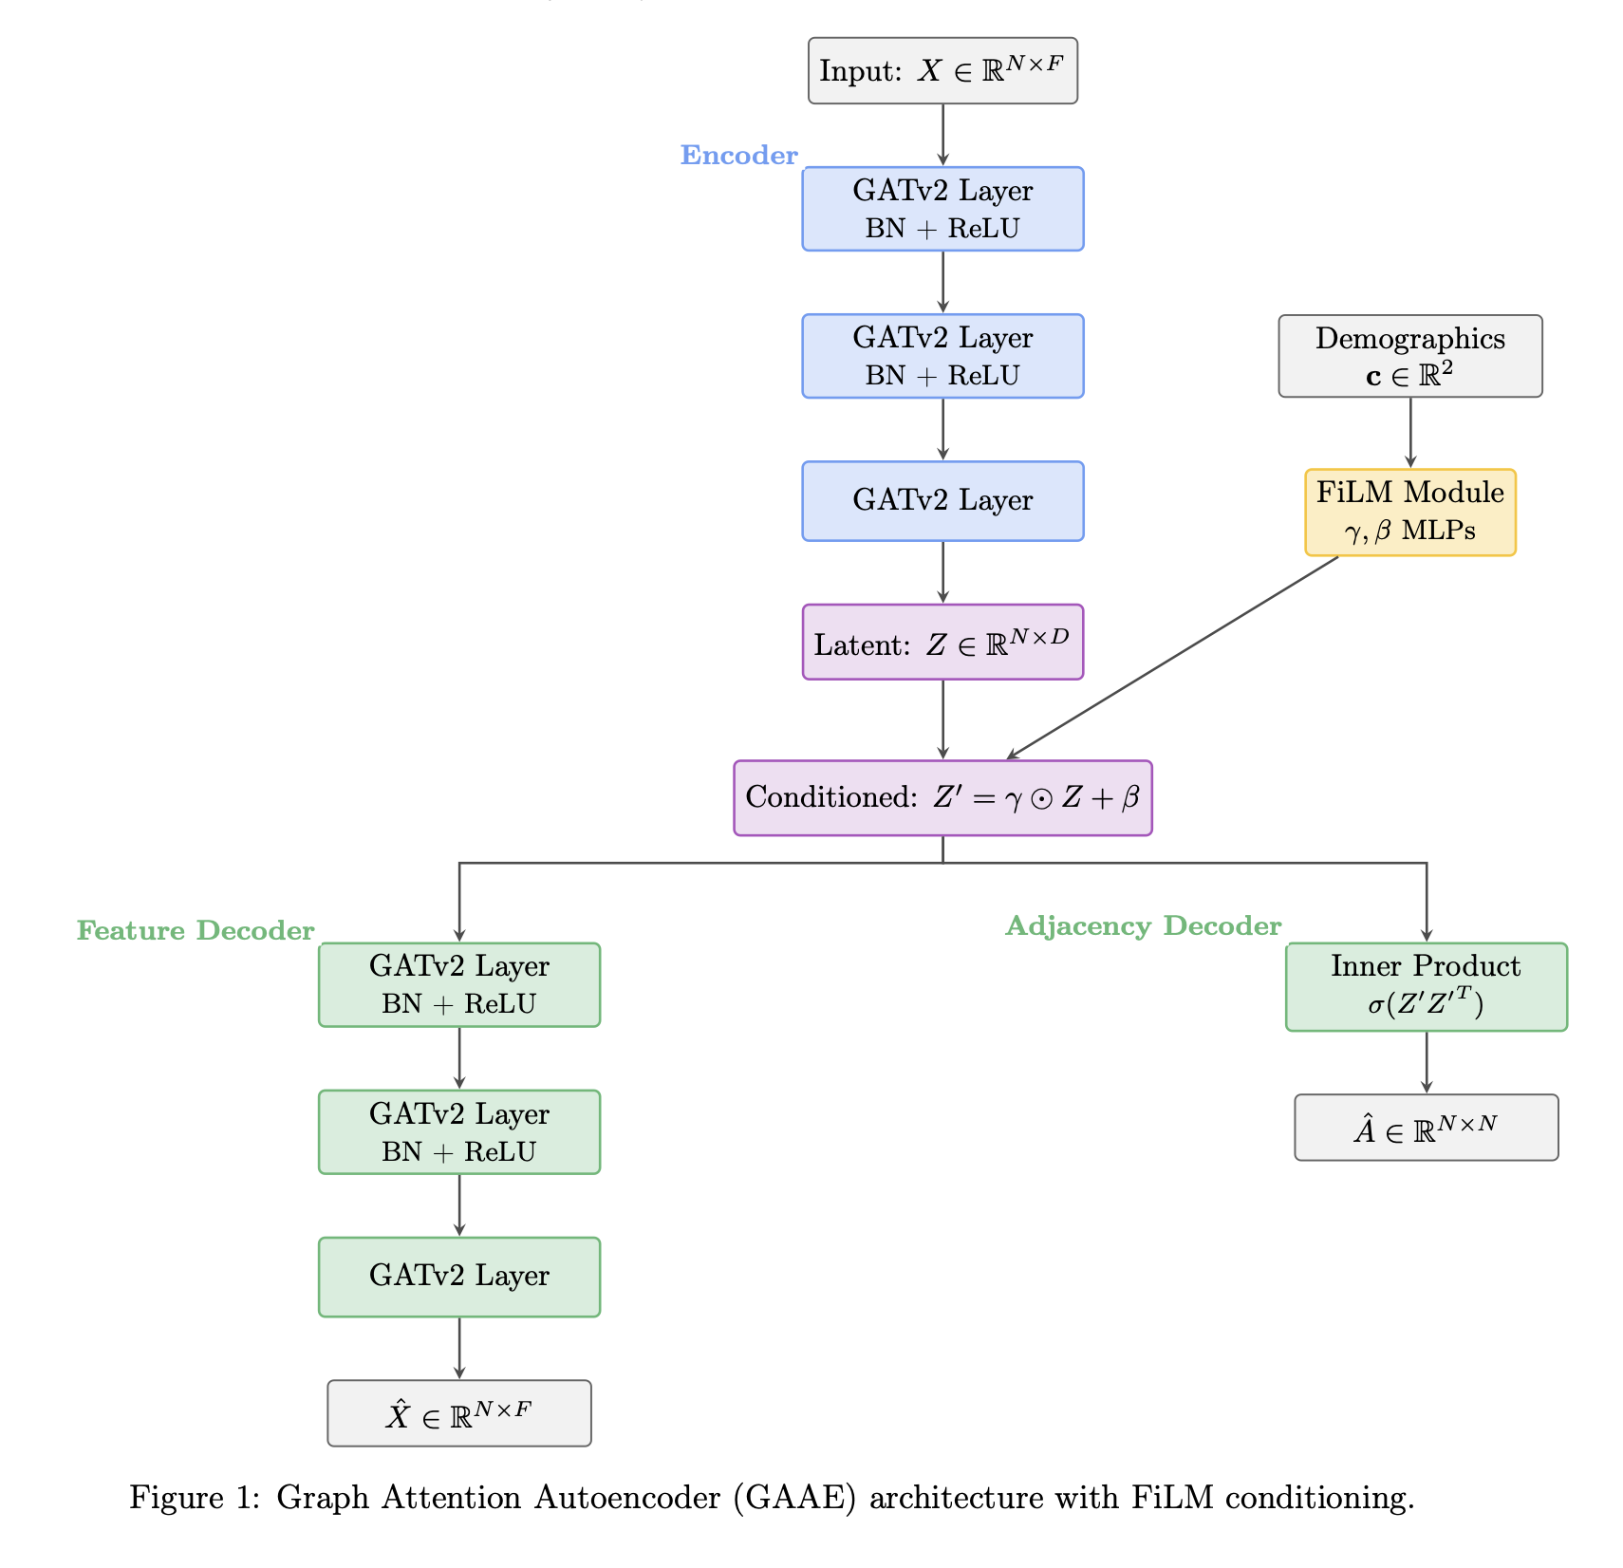
Pretrained Model Architecture
GAAE vs GEC: Architectures

Slide 14
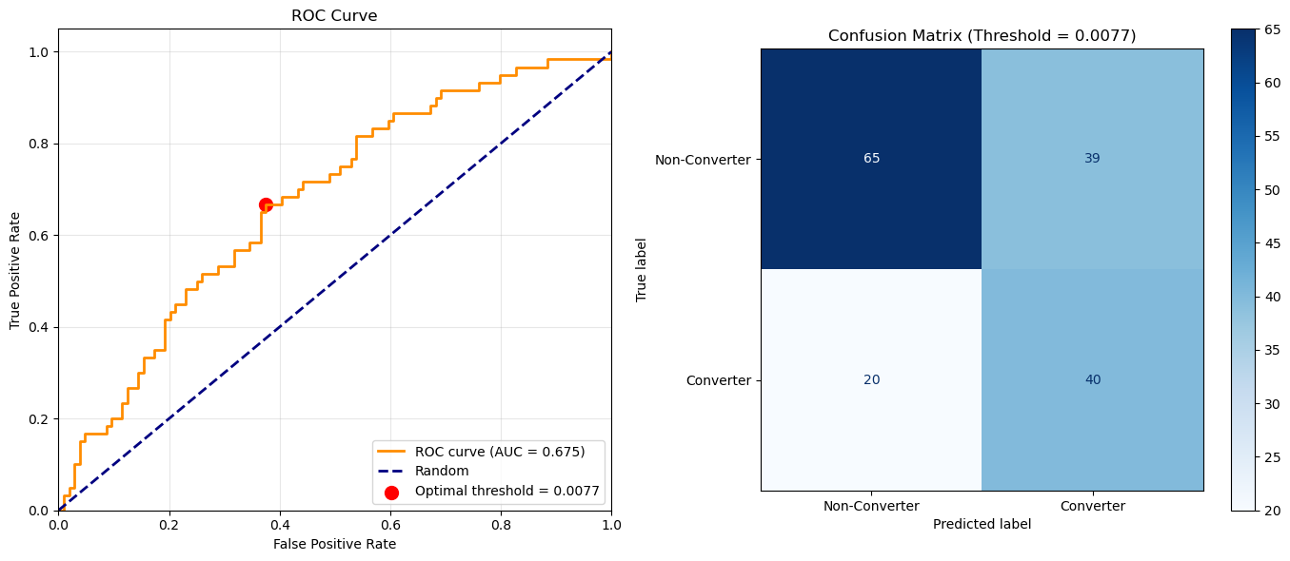
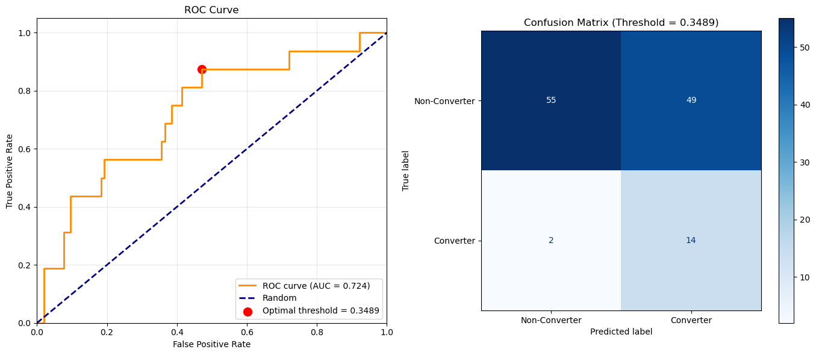
Pretrained Model Architecture
GAAE vs GEC: Evaluation on Classification
Graph Attention Auto-Encoder (GAAE)
Graph Encoder Classifier (GEC)

Slide 15
Pretrained Model Architecture
GAAE vs GEC: Evaluation on Classification
Discriminative Learning (Inter-Cohort Variability): The GEC uses supervised learning with labeled data, which forces the model to focus on the variability between cohorts (e.g., Converters vs. Non-Converters) rather than the variability within them.
→ The GEC allows the model to identify specific nodes and edges in the brain graph that are critical for differentiating the cohorts, rather than trying to model the global brain structure.
Noise Reduction: The reconstruction-based GAAE approach learned "noisy features" because the differences between patients within the same group were large.

