Slide 1
Light Chase
An Android 1v1 stealth duel built with Java
SEARCH WITH LIGHT.
ESCAPE WITH A PLAN.
One police officer tracks. One thief moves three parcels.
Walls, limited vision and timing turn a small map into a tactical duel.
Research and proposed design • 7 October 2026
Draft: team details, repository and teaching week still need confirmation.
LIGHT CHASE / PROJECT OUTLINE
01
Notes:
Course sources: documents 00-04 supplied by the user and pasted Moodle Outline instructions. Working title, not a checked registered brand. English is a drafting assumption. Team members, repository URL, teaching week and final submission language are not yet supplied.
Status: proposed course project; no implemented-game or measured-performance claims. Sources checked 7 October 2026.

Slide 2
A focused game that can be evaluated
Target users: friends seeking a short tactical match on the same local network.
1 vs 1
3 deliveries
180 seconds
Two different roles
Choose routes and task order
A starting balance hypothesis
Baseline
One fixed map; two tools; tutorial, settings and local match history.
Two physical phones are part of acceptance, not an optional demonstration.
Deferred: public matchmaking, accounts, 3D, extra teams, ranked play and full replays.
LIGHT CHASE / PROJECT OUTLINE
02
Notes:
The entertainment benefit is a design hypothesis, not validated demand. Baseline requires two Android phones plus a laptop Java server. Scope and parameters are provisional. Course 00 recommends a narrow task and genuine learning.
Status: proposed course project; no implemented-game or measured-performance claims. Sources checked 7 October 2026.

Slide 3
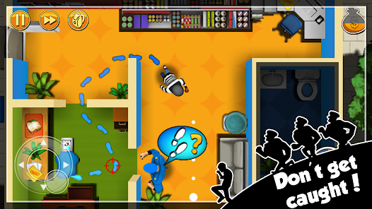

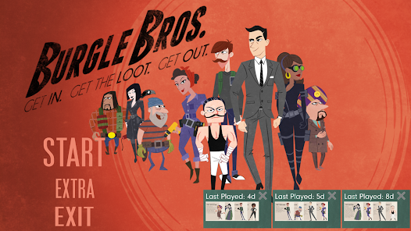
Three Android references
Publisher-listed features and official store imagery; no hands-on competitor tests.
Robbery Bob
Identity V
Burgle Bros
Single-player stealth puzzles.
Collect loot and evade guards.
Reference: routes and touch play.
1v4 asymmetric pursuit.
Survivors decode and escape.
Reference: opposing objectives.
Heist planning and guard evasion.
Tools, powers and multiple floors.
Reference: route/tool decisions.
Image credits: DECA Games / NetEase Games / Fowers Games, via official Google Play listings.
LIGHT CHASE / PROJECT OUTLINE
03
Notes:
Robbery Bob: https://play.google.com/store/apps/details?id=com.chillingo.robberybobfree.android.row&hl=en
Identity V: https://play.google.com/store/apps/details?id=com.netease.idv.googleplay&hl=en
Burgle Bros: https://play.google.com/store/apps/details?id=net.fowers.BurgleBros&hl=en
Images are official Google Play promotional assets, including promotional artwork and menu/game screens. Copyright remains with the respective rights holders. These are comparison evidence, not licensed game assets for Light Chase. Do not infer undocumented internal architecture from screenshots.
Status: proposed course project; no implemented-game or measured-performance claims. Sources checked 7 October 2026.

Slide 4
Differentiate the combination, not the genre
Stealth, asymmetry, smoke and invisibility already have precedents.
Reference | Established design | Light Chase proposal
Robbery Bob | Solo stealth and loot collection | Human-controlled search and cargo delivery routes
Identity V | Asymmetric chase and escape objectives | Compact 1v1; capture through sustained directional light
Burgle Bros | Heist routes, guards and tools | Real-time adversarial route and visibility decisions
Invisigun Reloaded | Invisible multiplayer; environmental clues | Opposed search/delivery roles; post-mark escape window
Claim: an original course-project integration, not a worldwide first.
LIGHT CHASE / PROJECT OUTLINE
04
Notes:
Sources: https://play.google.com/store/apps/details?id=com.chillingo.robberybobfree.android.row&hl=en
https://play.google.com/store/apps/details?id=com.netease.idv.googleplay&hl=en
https://play.google.com/store/apps/details?id=net.fowers.BurgleBros&hl=en
https://store.steampowered.com/app/375750/Invisigun_Reloaded/
The official Invisigun listing describes invisible multiplayer characters and environmental tells. It limits any novelty claim. Differences are proposed design comparisons; no exhaustive market search or global novelty claim.
Status: proposed course project; no implemented-game or measured-performance claims. Sources checked 7 October 2026.

Slide 5
A repeated search-and-delivery loop
Each role acts on a different, explicitly limited set of information.
THIEF
POLICE
Pick up one parcel
Choose a route and avoid light
Deliver at its paired station
After 3 deliveries, reach an exit
Aim and inspect possible routes
Maintain unobstructed illumination
React to delivery-zone clues
Earn 3 marks or run down the clock
Interactions need 1 stationary second; movement or a mark cancels them.
LIGHT CHASE / PROJECT OUTLINE
05
Notes:
Original proposed rules. Static walls and station locations are public. Police does not receive hidden inventory, current task or precise remote pickup changes. Delivery emits a coarse zone and total. Smoke location is an intentionally public last-area cue. Server priorities: timeout, third mark, successful escape. Characters do not body-block.
Status: proposed course project; no implemented-game or measured-performance claims. Sources checked 7 October 2026.

Slide 6
Rules that support counterplay
All values are proposed starting points; playtesting may change them.
Mechanic | Player-facing rule | Technical implementation
Detection | 0.8 s continuous light gives one mark | Range + angle + wall/smoke raycast; server timer
Escape window | First two marks grant temporary invisibility | Explicit cloak/protection states; hide body and cargo
Wide beam | Search a wider but shorter area | Server-owned duration, angle, range and cooldown
Smoke | Trade a public area clue for cover | Opaque region affects both roles; expires on server
Win and tie rules | 3 marks or timeout; otherwise deliver and escape | One authoritative result; deterministic priority
LIGHT CHASE / PROJECT OUTLINE
06
Notes:
Original design. Default beam 60 degrees / 6 tiles. Wider beam 90 degrees / 4 tiles, 3 s duration, 15 s cooldown. Smoke radius about 1.5 tiles, duration 3 s, cooldown 20 s; it blocks both roles' vision, its area is public. After marks 1 and 2: 1.5 s true invisibility then 1 s marking protection; body may be visible in the second phase. Cloak blocks interactions. Third mark ends immediately. Illumination interruption resets progress.
Status: proposed course project; no implemented-game or measured-performance claims. Sources checked 7 October 2026.

Slide 7
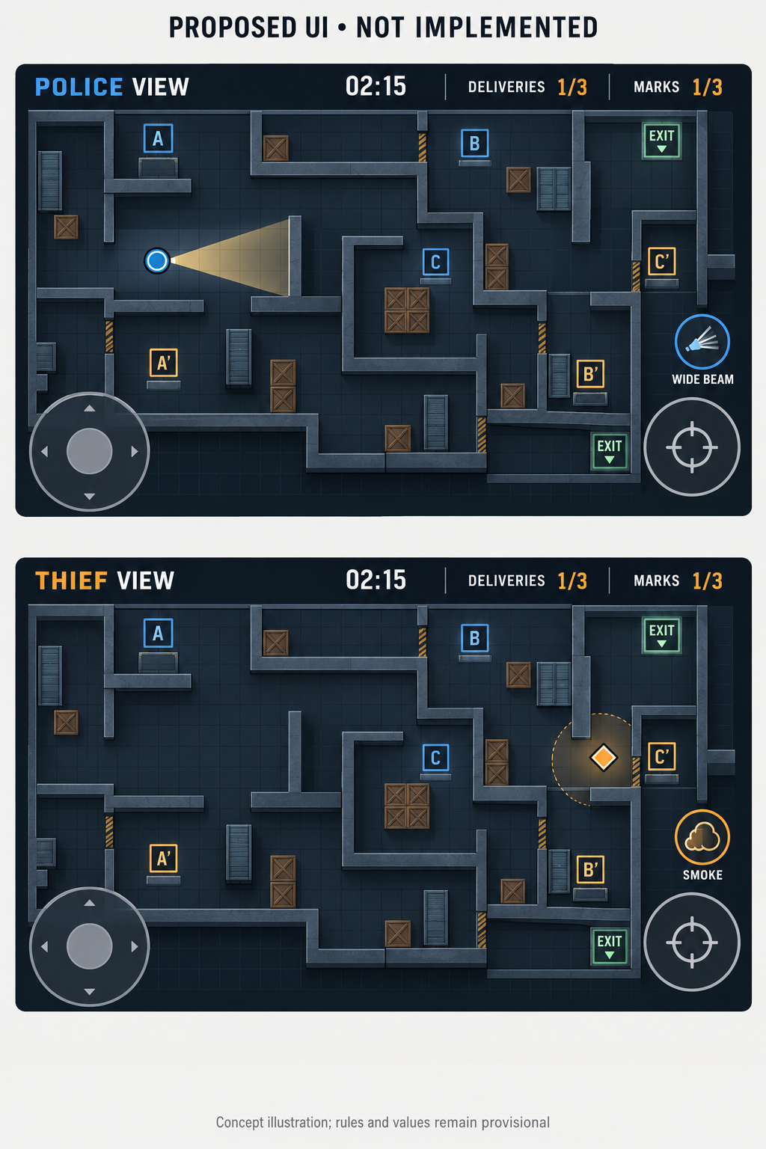
Proposed gameplay interface
Concept illustration only; the final collision map and touch layout still need testing.
Police view
Static map is known. A wall hides the thief.
Move with the left pad; aim with the right.
Watch illumination progress and marks.
Thief view
Track your cargo and paired destination.
See nearby threats within line of sight.
Use interaction and smoke controls.
Full-resolution concept image is supplied separately.
LIGHT CHASE / PROJECT OUTLINE
07
Notes:
AI-generated proposed UI produced with the built-in image generation tool on 7 October 2026. Full prompt is in the accompanying concept disclosure file. This board is not a screenshot from a running game. Do not infer exact geometry, awareness distance or path connectivity from the illustration. Formal rules in the summary govern implementation.
Status: proposed course project; no implemented-game or measured-performance claims. Sources checked 7 October 2026.

Slide 8
Design the whole flow, including failures
Role names, shapes and text supplement colour; sound is never the only cue.
Screen | Main actions and content | Required feedback
Home / tutorial | Join; learn roles; open history/settings | Rules and history remain available offline
Connect / lobby | Address, room code, role, ready | Invalid address, timeout, occupied role, full room
Gameplay | Move, aim/interact, ability, progress | Mark/cloak/cooldown states; connection status
Results / history | Outcome reason, events, role filter, rematch | Interrupted match; empty history; delete confirmation
Settings | Control size, sensitivity, audio, vibration | Saved state and clear reset behaviour
LIGHT CHASE / PROJECT OUTLINE
08
Notes:
Proposed screen inventory. The gameplay concept is visualized on slide 7; other screens are specified here but not yet clickable mockups. Native Android menu conventions, scalable controls and readable HUD are design goals, not completed accessibility tests. First release aborts disconnected/backgrounded matches as interrupted, with no normal win/loss.
Status: proposed course project; no implemented-game or measured-performance claims. Sources checked 7 October 2026.

Slide 9
Reuse infrastructure and own the game logic
Chosen base: a new Java game built with libGDX, not a fork of a commercial competitor.
Source | What we reuse | What we build
libGDX | Apache-2.0 | Rendering, input, camera, screens, tile-map APIs | Rules, controls, levels, visibility and game UI
Java-WebSocket | MIT | Java transport and connection callbacks | Rooms, validated inputs, filtered state and recovery policy
Room 2.x | AndroidX | SQLite abstraction; Java annotationProcessor | Results/events, history queries, deletion and deduplication
gdx-ai | optional | Pathfinding / state-machine support | Fair bot perception and behaviour, only if time permits
Track source URL, version/commit, licence, copied code, changes and owner.
LIGHT CHASE / PROJECT OUTLINE
09
Notes:
Sources: https://github.com/libgdx/libgdx
Apache-2.0: https://github.com/libgdx/libgdx/blob/master/LICENSE
https://github.com/TooTallNate/Java-WebSocket (MIT)
Example: https://github.com/TooTallNate/Java-WebSocket/blob/master/src/main/example/ChatServer.java
https://developer.android.com/jetpack/androidx/releases/room
Optional https://github.com/libgdx/gdx-ai (Apache-2.0)
Pin versions after the build/network spike; no integration has been tested yet. Preserve applicable licence notices and record sources/changes. Commercial game screenshots are not proposed shipped assets.
Status: proposed course project; no implemented-game or measured-performance claims. Sources checked 7 October 2026.

Slide 10
The server owns truth; each player gets a view
Initial demonstration: two Android phones plus one Java server on a laptop.
Android clients
Java server
Local persistence
Move + aim + action
Sequenced requests
Render permitted observations
Clear hidden-entity caches
Validate inputs
Simulate at fixed steps
Resolve vision and objectives
Filter each role’s snapshot
Completed match results
Key event timeline
Settings and history filters
No per-frame database writes
First gate: prove two real phones can join and receive different views.
Complete this before committing to extra maps, bots or additional tools.
LIGHT CHASE / PROJECT OUTLINE
10
Notes:
Architecture is proposed. Sources: https://github.com/TooTallNate/Java-WebSocket; https://libgdx.com/wiki/app/threading; https://developer.android.com/privacy-and-security/local-network-permission. Begin with manual server address and room code. Room code is not authentication. Verify local-network permissions and routing for the selected SDK and actual classroom network. No public Internet security/deployment claim. 30 Hz simulation and 10-15 Hz snapshots are hypotheses, not benchmark results.
Status: proposed course project; no implemented-game or measured-performance claims. Sources checked 7 October 2026.

Slide 11
Meet all four development aspects
Do not add sensors or an AI API without a useful role in the game.
Aspect | Planned implementation | Evidence to show
Input | 20% | Multi-touch, room details, settings, network inputs | Validation; touch cancellation; role-specific controls
Processing | 25% | Collision, light, states, objectives and filtering | Boundary tests and inspectable server events
Storage | 20% | Room results/events; active server state in memory | Restart, query, filter, deduplicate and delete
Output / UI | 25% | Different views, progress, sound/haptics, history | Readable feedback and explicit error/empty states
Integration | 10% | Input to authoritative result to stored history | A complete two-phone match and individual explanation
LIGHT CHASE / PROJECT OUTLINE
11
Notes:
Course source: document 01 Four main components/aspects and its Assessment Rubric. Weights: input 20, processing 25, storage 20, output/UI 25, integration 10. These are separate from the Outline rubric weights in document 04. Room guidance: https://developer.android.com/jetpack/androidx/releases/room.
Status: proposed course project; no implemented-game or measured-performance claims. Sources checked 7 October 2026.

Slide 12
Conditional work plan to teaching week 15
Assumes a week 6 start. The actual current week and team capacity still need confirmation.
Week | Work and acceptance evidence
6 | Rules and scope; Java/Android build; two-phone LAN spike; record device/network setup
7 | Movement, collision, aiming and wall occlusion; corner/cone-boundary checks
8 | Mark/cloak states, delivery and exit, timer and tie rules; local playable loop
9 | Authoritative LAN integration and filtered views; Alpha target and learning log
10 | Wide beam and smoke; cooldown validation; early role-swapped playtests
11 | Room history/events; tutorial/settings; background, exit and disconnect states
12 | Beta target: feature-complete baseline; device checks; freeze additional features
13 | 20-30 exploratory role-swapped rounds; analyse causes, tune and retest
14 | Regression fixes; APK, source archive, MP4 demo, report and slide updates
15 | Final two-phone acceptance; actual course submission; individual technical explanation
LIGHT CHASE / PROJECT OUTLINE
12
Notes:
Course 00 page 16 suggests Alpha about week 8-9, Beta 11-12 and Final 15-16. The pasted Outline request specifies week 15; this plan targets week 15, subject to actual Moodle dates. Workstreams are simulation/network, Android/UI/storage and QA/documentation; these are not assigned people. Estimated 160-220 person-hours, not actual effort. If start is later, re-estimate rather than relabel the same plan.
Status: proposed course project; no implemented-game or measured-performance claims. Sources checked 7 October 2026.

Slide 13
Test the failure modes that could break the idea
Planned acceptance checks; no results or measured performance are claimed yet.
Risk | Concrete acceptance check
Vision and cloak | No marks through walls or true cloak; the beam agrees with the rules
Hidden-data leakage | Omit hidden positions and inventory; clear hidden render caches
State mismatch | Both phones show one winner; repeated requests cannot duplicate delivery
Lifecycle / network | Backgrounding clears input; disconnect interrupts the match without crashing
Storage reliability | Results survive restart; queries/deletion work; match ID prevents duplicates
Balance / performance | Log role-swapped outcomes; measure frame time and latency on named devices
LIGHT CHASE / PROJECT OUTLINE
13
Notes:
Original validation plan. Explore balance with several participants swapping roles across 20-30 rounds; this is not statistical proof of fairness. Record named devices, OS, network and frame/latency measurements. Acceptance tests have not been executed for an implemented game.
Status: proposed course project; no implemented-game or measured-performance claims. Sources checked 7 October 2026.

Slide 14
Original contribution and learning outcomes
A small complete system with evidence is more useful than a large untested feature list.
Our contribution
Learning to demonstrate
Detection and escape state machine
Cargo routes and map decisions
Per-role information filtering
Android controls, persistence and feedback
Tests and evidence-led balancing
Java modules and fixed-step simulation
Android lifecycle and multithreading
Local storage and reliable data flow
Network validation and debugging
Attribution and explainable code
Before submission
Confirm the teaching week, team details, repository and language; remap the schedule.
The accompanying Summary is four pages. Sources and reuse boundaries are documented.
LIGHT CHASE / PROJECT OUTLINE
14
Notes:
Course sources: documents 00-04 and pasted Outline instructions. Evidence should be genuine: commits, issue logs, design changes, Alpha/Beta/Final reflections and ability to explain AI-assisted code. Sources for research and reuse are in notes on slides 3, 4, 9 and 10 and the linked reference list in the accompanying four-page Summary and Chinese report. Submission readiness remains conditional on the real teaching week, names, repository and required language.
Status: proposed course project; no implemented-game or measured-performance claims. Sources checked 7 October 2026.

