Slide 1
CI/CD环境搭建实践
第一次团队作业——PPT展示
蔡一凡 姜凡叙 周笑 李东起 同睿哲
上海交通大学 软件学院

Slide 2
Pipeline
Integration
Developer
Integration
Developer writes new modules and functions.
Then pushes their codes to the server.
The integration tool builds the changed project
Then returns the result to the developer.
Developer
Delivery
Deployment
Delivery
Life Cycle
The deployment tool packages the project and deploys it to the server.
The delivery tool updates the project to the newest edition if the project is built successfully
Deployment

Slide 3
Achievement
Travis CI
+
Node.js Project
+
Github
Travis CI : Friendly to Github
Github Page

Slide 4
Process
Choose the Repositories
Sign in with Github
Build Automatically
Add the .travis.yml File
Check the Result

Slide 5
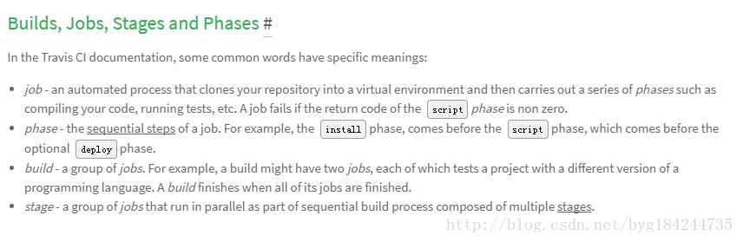
How Travis CI Build/How to Write the .travis.yml

Slide 6
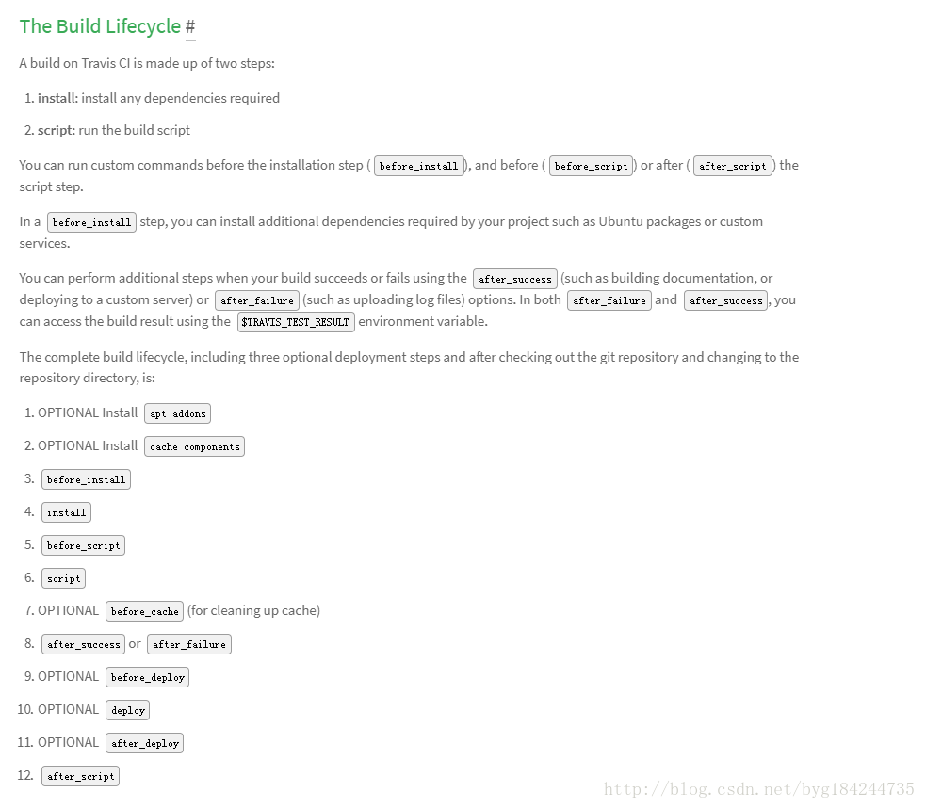

Slide 7
Travis + NPM
Install npm when Travis builds
Generate an HTML page
“npm run build”
Push it to Github Page

Slide 8
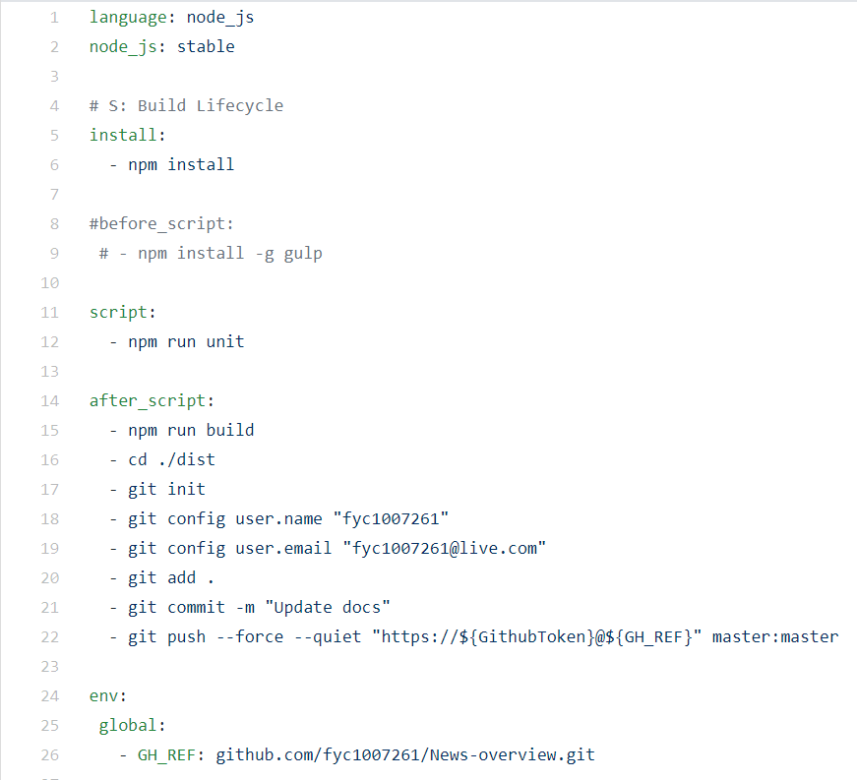
.travis.yml in our project
“npm install ……”：install npm and gulp before the project is integrated.
“npm run unit” : we used the Vue.js frame
“npm run build” : build the project
“git config ……” : the Email address is necessary so Travis can send Error Message to this Email account.
“git add/commit ……” : the git commands which can commit changes to Github remote server.
“git push ……” : push the HTML page to our Github Page

Slide 9

The Final Edition of Our Project : https://fyc1007261.github.io/News-overview/#/

Slide 10
Thanks.
蔡一凡 姜凡叙 周笑 李东起 同睿哲
上海交通大学 软件学院

