Slide 1
中国剩余定理在信息科学的应用
张真诚
台湾逢甲大学

Slide 2
1. Chinese Remainder Theorem (中国剩余定理)
2. Ordered Minimal Perfect Hashing Functions (OMPHF)
3. Data Field Protection
4. Access Control
5. Conclusions

Slide 3




Chinese Remainder Theorem (中国剩余定理)
韩信点兵问题：「今有物不知其数，三三数之剩二，五五数之剩三，七七数之剩二，问物几何？」～(孙武 孙子算经)
亦即 求正整数 ，使得
两个疑问？
(1) 是否存在？
(2)如何求 ？

Slide 4







回答(1)：中国剩余定理
Let be integers.
an integer C . st.
If ,

Slide 5


EX：令 ,且令
s.t.

Slide 6
回答(2)：
「三人同行七十稀
五树梅花廿一枝
七子团圆正半月
除百零五便得知。」
～(程大位 算法统宗(1593))

Slide 7
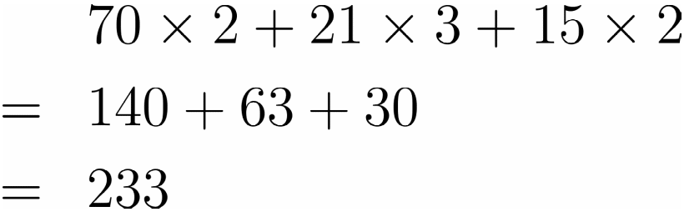


亦即
余

Slide 8
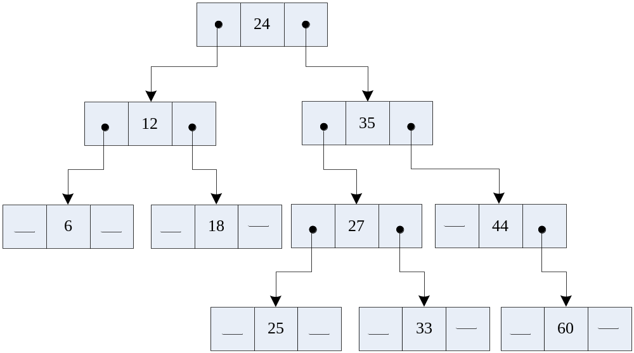
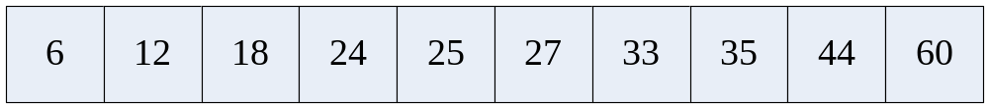
Ordered Minimal Perfect Hashing Functions
Non-linear Organization
  Ex: binary tree
  Linear Organization

Slide 9
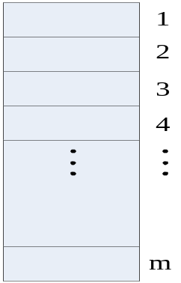
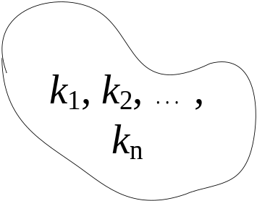


hashing
key to address transformation
  problem: collision
  particular cases
    (1) one-to-one mapping and
    | key space | ≤ | address space |
h
Perfect hashing

Slide 10

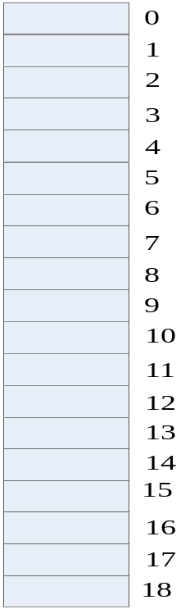


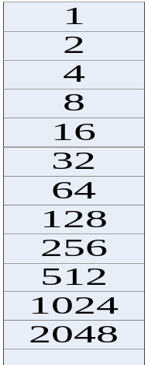
Hashing
(2)one-to-one mapping and
| key space | = | address space|
Minimal perfect hashing
Ex: key
is a perfect hashing

Slide 11


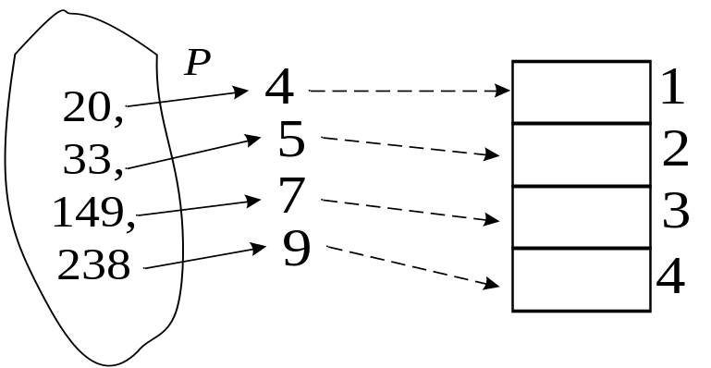




Minimal Perfect Hashing
since

Slide 12





Minimal Perfect Hashing (Cont.)
Some questions
(1) Why can be”1-1” and “onto”?
(2) Is there a method to convert
such that
(3) How to obtain C ?

Slide 13


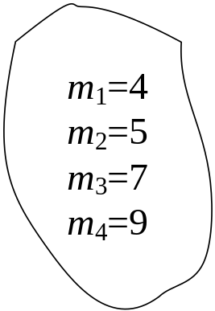
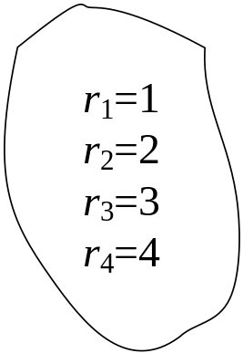



Minimal Perfect Hashing (Cont.)
Ans(1): Chinese Remainder Theorem
Let be an integers.
an integer c s.t.
If

Slide 14
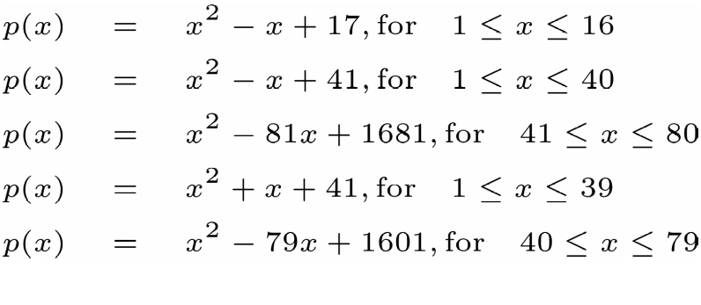
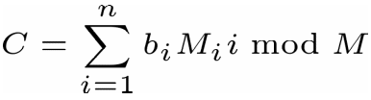
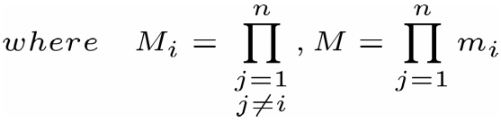
Minimal Perfect Hashing (Cont.)
Ans(2): Use Prime Number Functions
Ans(3):

Slide 15



THEOREM 22.10 Let be a set of n distinct positive integers with .if
is the set of
differences ,then ,where w is any positive integer, has the property that are pairwise
relatively prime.

Slide 16
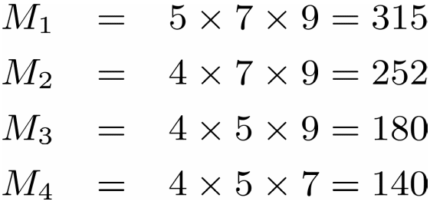
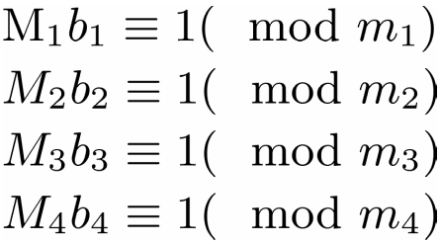
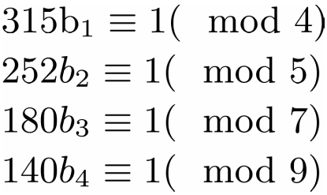
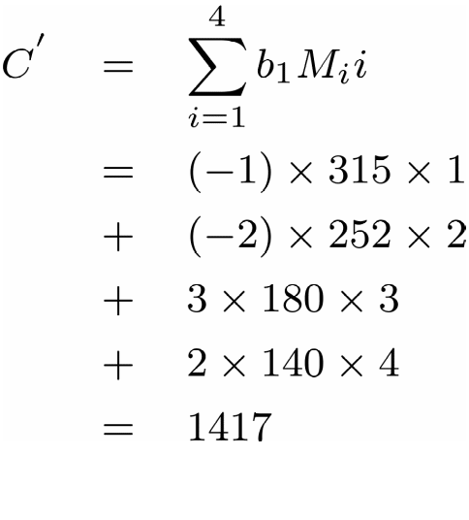
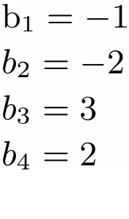
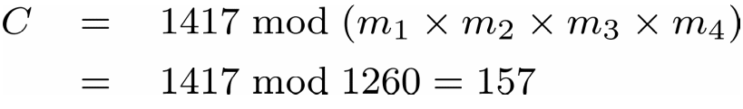
Minimal Perfect Hashing (Cont.)
Ex:
C'

Slide 17
Applications-12 months English identifiers
JANUARY
FEBRUARY
MARCH
APRIL
MAY
JUNE
JULY
AUGUST
SEPTEMBER
OCTOBER
NOVEMBER
DECEMBER

Slide 18
Applications-12 months English identifiers (Cont.)
Extract (The 2nd char., The 3rd char.)
(A, N)
(E, B)
(A, R)
(P, R)
(A, Y)
(U, N)
(U, L)
(U, G)
(E, P)
(C, T)
(O, V)
(E, C)

Slide 19
Applications-12 months English identifiers (Cont.)
Group | Location | Extraction pair | Original key
1 | 1 2 3 | (A, N) (A, R) (A, Y) | JANUARY MARCH MAY
2 | 4 | (C, T) | OCTOBOR
3 | 5 6 7 | (E, B) (E, C) (E, P) | FEBRUARY DECEMBER SEPTEMBER
4 | 8 | (O, V) | NOVEMBER
5 | 9 | (P, R) | APRIL
6 | 10 11 12 | (U, G) (U, L) (U, N) | AUGUST JULY JUNE

Slide 20
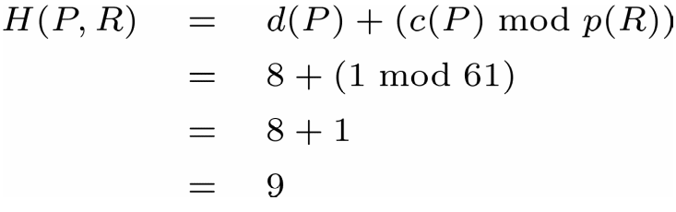
Applications-12 months English identifiers (Cont.)
x | d(x) | c(x) | p(x)
A B C D E F G H I J K L M | 0 3 4 | 161896 1 427 | 2 3 5 7 11 13 17 19 23 29 31 37 41
x | d(x) | c(x) | p(x)
N O P Q R S T U V W X Y Z | 7 8 9 | 1 1 12989 | 43 47 53 59 61 67 71 73 79 83 89 97 101

Slide 21
36 Pascal Reserved Words
ARRAY, AND, BEGIN, CASE,
CONST, DOWNTO, DO, DIV, END,
ELSE, FUNCTION, FILE, FOR, GOTO,
IF, IN, LABEL, MOD, NIL, NOT,
OTHERWISE, OF, OR, PROCEDURE,
PROGRAM, PACKED, REPEAT, RECORD,
SET, TYPE, THEN, TO, UNTIL, VAR,
WITH, WHILE

Slide 22
AA, AD, BI, CE, CS, DN
DO, DV, ED, EE, FC, FE
GO, IF, IN, LE, MD, NL
NT, OE, OF, OR, PC, PG
PK, RE, RO, ST, TE, TN
TO, UI, VR, WH, WL

Slide 23
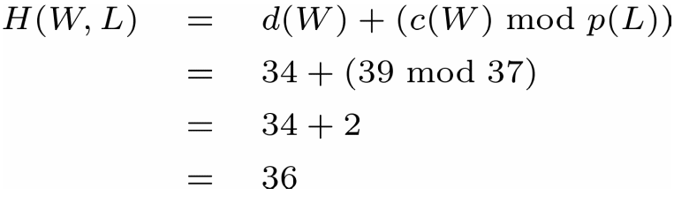
x | d(x) | c(x) | p(x)
A B C D E F G H I J K L M | 0 2 3 5 8 10 13 14 16 17 | 9 1 672 50010 57 3236 1 131 1 1 | 2 3 5 7 11 13 17 19 23 29 31 37 41
x | d(x) | c(x) | p(x)
N O P Q R S T U V W X Y Z | 18 20 23 26 28 29 32 33 34 | 1777 3785 726 331 1 15654 1 1 39 | 43 47 53 59 61 67 71 73 79 83 89 97 101
H(W, L) = d(W) + (c(W) mod p(L))
= 34 + (39 mod 37)
= 34 + 2
= 36

Slide 24
Data Field Protection
α₁
α₂
…
α_{j}
…
α_{m}
Record R
＊e₁
＊e₂
＊e_{j}
＊e_{m}
∑ mod D
Record R’s Ciphertext
C
C mod d_{j}
The Occurrence of the j-th field

Slide 25



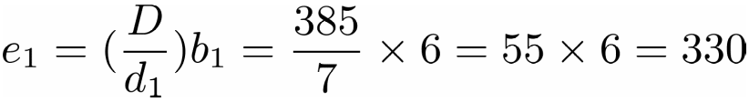
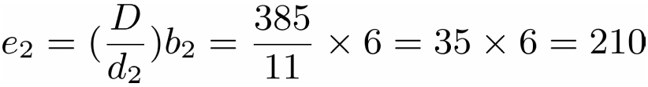
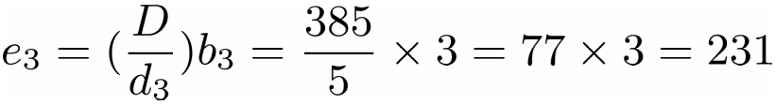
Data Field Protection (Cont.)
Example:
Let be a record. Take and to be R’s three deciphering keys. Then
The following are encryption keys

Slide 26


Data Field Protection (Cont.)
Because and , we have
. Thus R’s ciphertext is .
Then we have

Slide 27
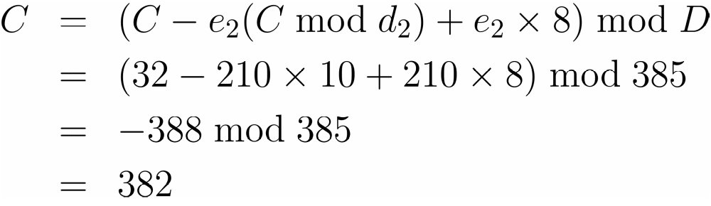
Data Field Protection (Cont.)
When α₂ is changed from 10 to 8, R’s ciphertext becomes

Slide 28
Access Control
M₁
M₂
M₃
M₄
R
W
E
Own
R
W
P1
R
W
E
Own
R
E
P2
Access Matrix

Slide 29
Access Control (Cont.)
File
Database
User
Program
File System
Table

Slide 30
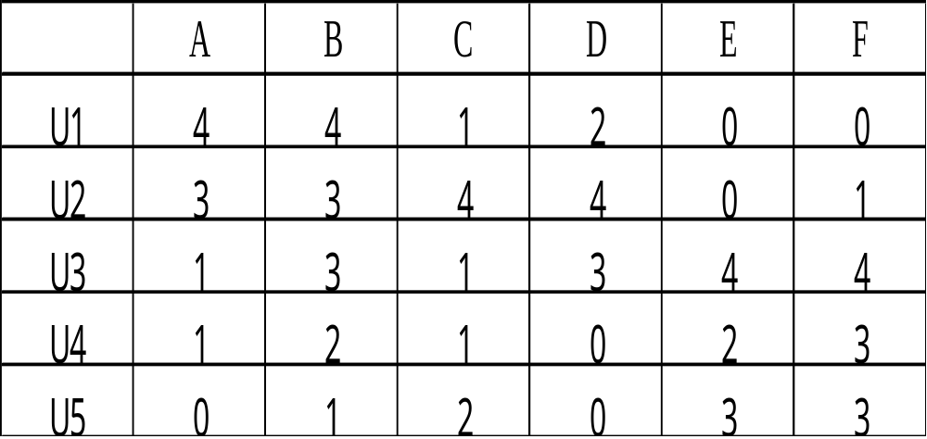
Access Control (Cont.)
File
0 : No access
1 : Execute
2 : Read
3 : Write
4 : Own
User

Slide 31

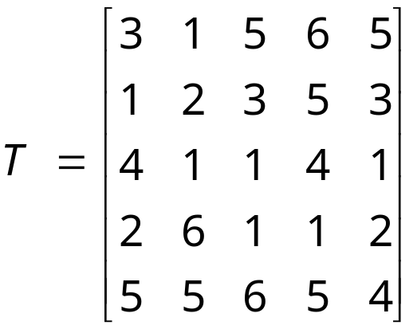
Key_Lock Pair
A. Wu and Hwang [1984]
(1) * ：inner product of Galois Field GF(p)
(2) p>a_{ij} and p is a prime number
Step1:Find a 5*5 Non_Singular Matrix

Slide 32






Key_Lock Pair (Cont.)
Step 2:
Step 3:

Slide 33

Key_Lock Pair (Cont.)
⇓
⇓

Slide 34
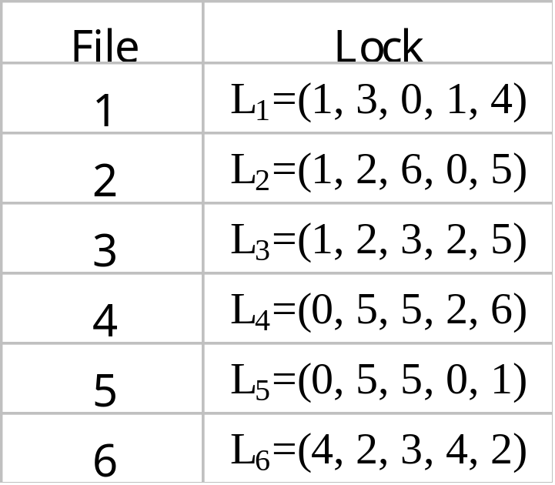
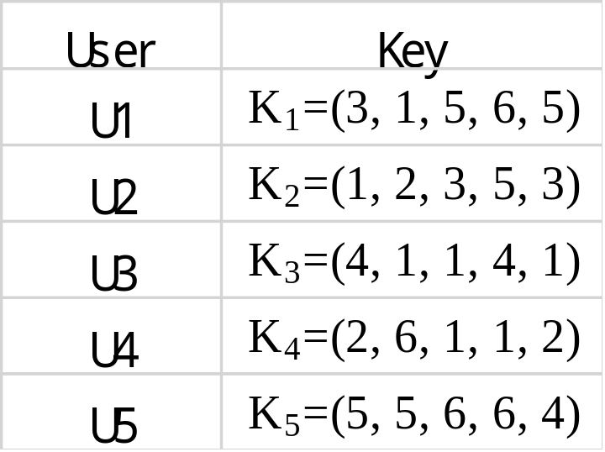
Key_Lock Pair (Cont.)

Slide 35


Key_Lock Pair (Cont.)
Example:
#
Disadvantage:
(1) Space: O(m²+mn) > O(mn)
(2) Time: 1. m multiplications
2. m-1 additions
3. 1 divisions
※ m users and n files.

Slide 36
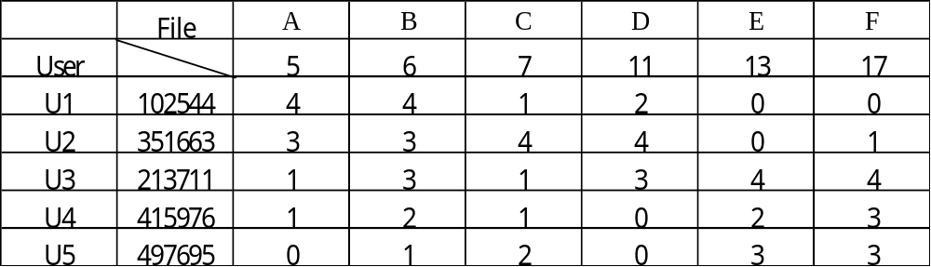
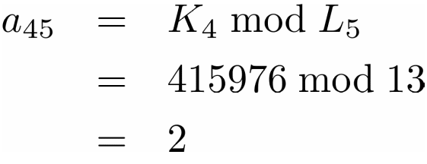
Key_Lock Pair (Cont.)
B. Chang [1985]
a_{ij}=K_{i} mod L_{j}
Lock
Key
Example:

Slide 37





Key_Lock Pair (Cont.)
Questions??
(1) Why ?
(2) How to find K_{i}’s and L_{j}’s ?
Answer (1)
Chinese Remainder Theorem
Let be integers ,
an integer K s.t.
If

Slide 38
Key_Lock Pair (Cont.)
Ex:
∃ K=102544
L₁=5
4
L₂=6
4
L₃=7
1
L₄=11
2
L₅=13
0
L₆=17
0
Answer(2):
Lock: L₁, L₂,…,L_{n}, coprimes

Slide 39
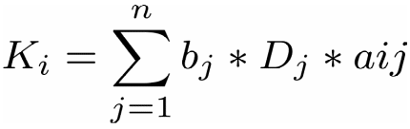
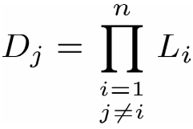

Key_Lock Pair (Cont.)
Key
(1)
(2)
Example

Slide 40


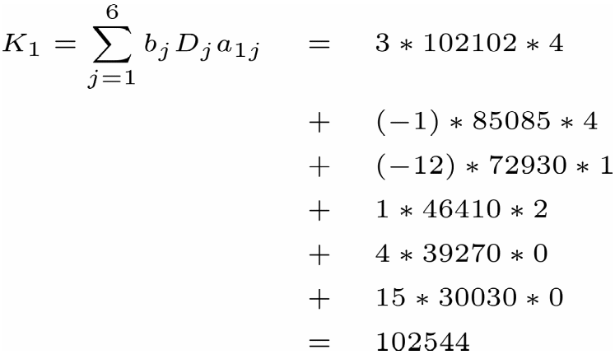




Key_Lock Pair (Cont.)
∵
∴
If , where , is there any efficient way to find b?
find
How to deal with large K_{i} ?

Slide 41
Conclusions
Design a perfect hashing function to allow insertion and deletion of keys
How to speed up the calculation of C?
Multi-key hashing
How to deal with large K_{i} problem?
Apply Data Field Protection to Secure Broadcasting
More applications?

