Slide 1
Used Car Price Analysis in India
Yuhan Wang & Siming Yan

Slide 2

Road Map
Data Describe
Predictions
Casual Inference

Slide 3
Introduction

Slide 4
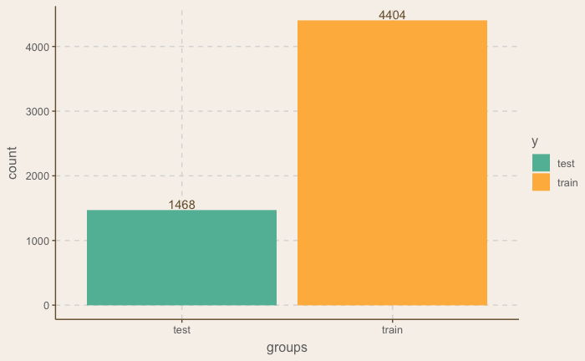
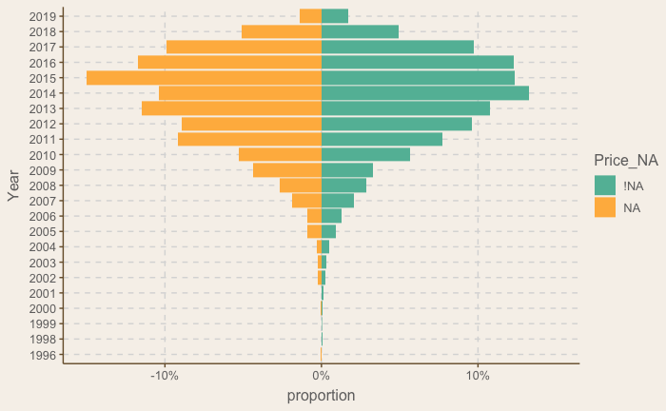
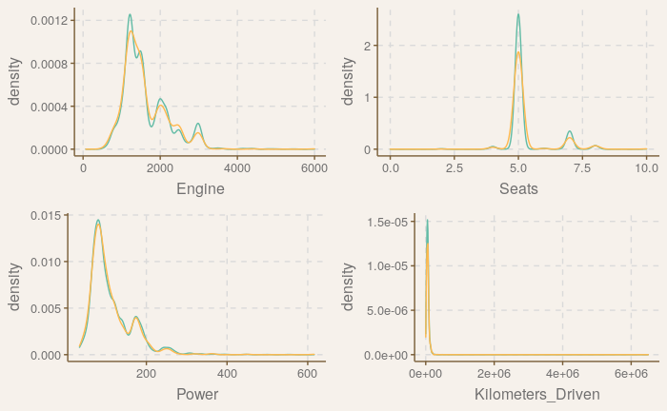
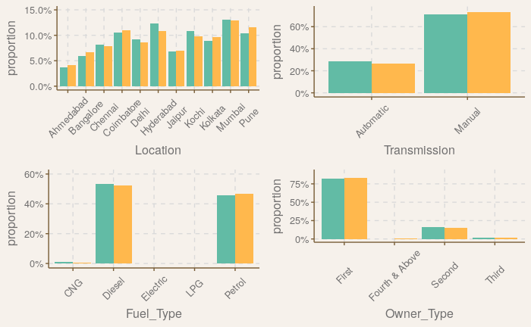
Data Describe
Number of observations after data cleaning
Output variable: Price: the price of the used car in INR Lakhs (Indian currency).
Input Variables:
dim(Used_car_data)
5872 | 46
Notes:
Removed Index, Names of cars, new_price(86% NA).
Removed all rows have a value of NA in price.
Take log transform for Kilometers_Driven. Some of the variables we make them Dummy: Location(Ahmedabad), year(1996), fuel_type(ele), transmissions(auto), owner type (first), mileage type
1. #: index
2. Name: the brand and model of the car
3. Location: the location in which the car is being sold or is available for purchase
4. Year: the year or edition of the model.
5. Kilometers_Driven: the total kilometres driven in the car by the previous owner(s) in KM.
6. Fuel_Type: The type of the fuel used by the car (petrol/diesel/electric/CNG/LPG).
7. Transmission: the type of transmission used by the car (automatic/manual).
8. Owner_Type: whether the ownership is Firsthand, Second hand or other.
9. Mileage: the standard mileage offered by the car company in kmpl or km/kg.
10. Engine: the displacement volume of the engine in cc.
11. Power: the maximum power of the engine in bhp.
12. Seats: the number of seats in the car.
13. New_Prices: the price of a new car of the same model.

Slide 5
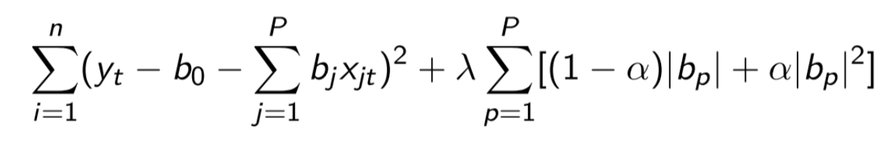

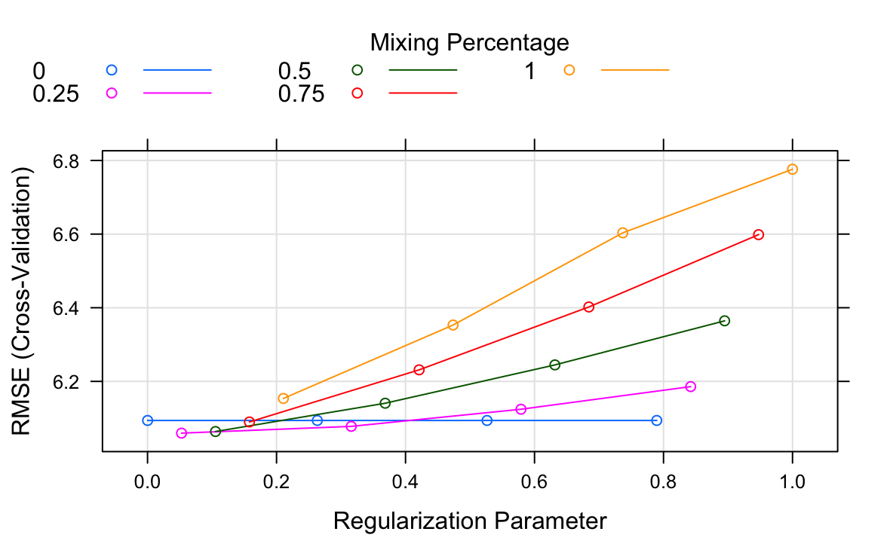
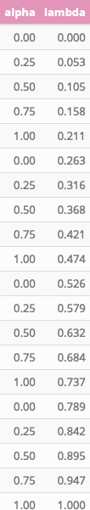
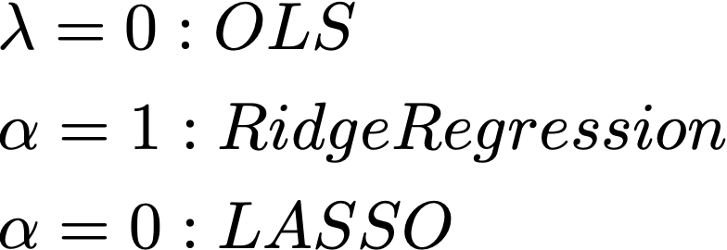

Prediction: Method 1: Linear Regression with Ridge & LASSO penalty
Notes:
Mixed up the two major shrinkage methods, select variables.

Slide 6
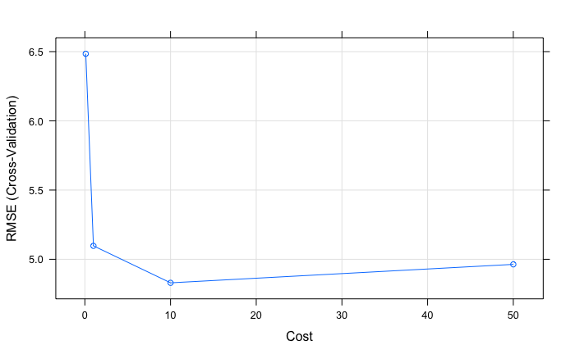
Prediction: Method 2: Support Vector Machines with Radial Basis Function Kernel
Cost: c(0.1,1,10,50)

Slide 7
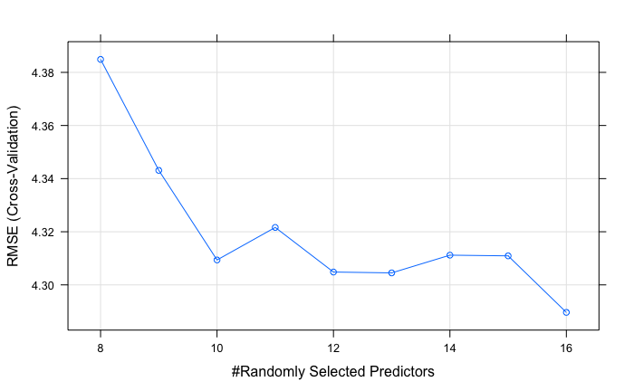
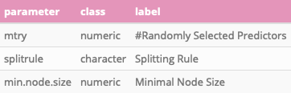
Prediction: Method 3: Random Forest
mtry: c(8:16)
Notes:
Tuning parameter 'splitrule' was held constant at a value of variance
Tuning parameter 'min.node.size' was held constant at a value of 5
RMSE was used to select the optimal model using the smallest value.
The final values used for the model were mtry = 16, splitrule = variance and min.node.size = 5.

Slide 8
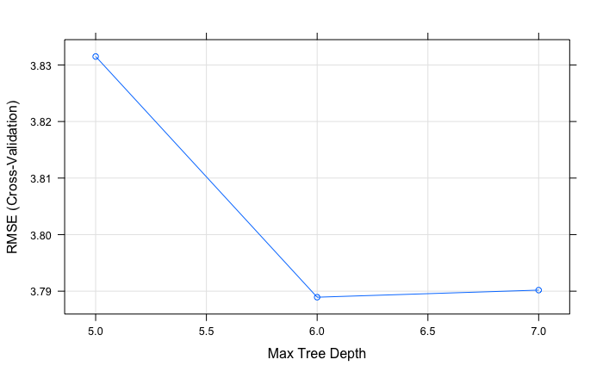
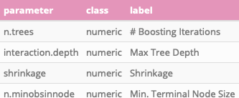

Prediction: Method 4: Stochastic Gradient Boosting Machine.
Notes:
.n.trees = 10000,
.interaction.depth = c(5,6,7),
.shrinkage = 0.01,
.n.minobsinnode = 5

Slide 9
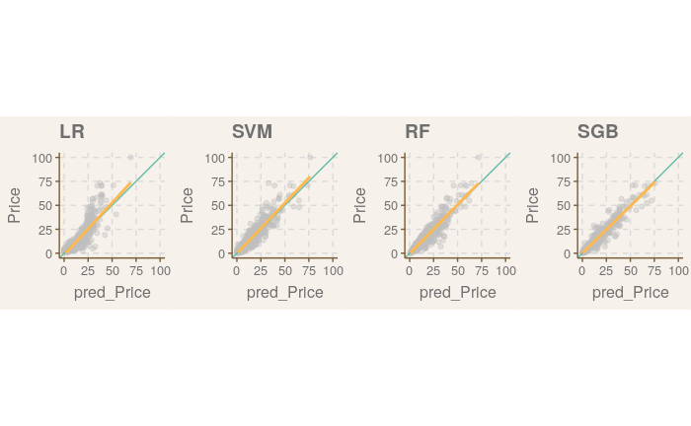
Prediction:
RMSE

Slide 10
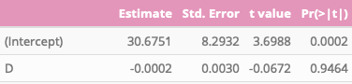
Casual Inference: Engine on the Car Price. Method 1: OLS
dim(Used_car_data)
5872 | 1858
Price ~ Engine + .
“Engine” is not significant
Notes:
Names included.

Slide 11

Casual Inference: Engine on the Car Price. Method 2: Orthogonal Machine Learning
Folds = 5
“Engine” is significant

Slide 12
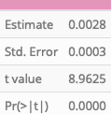
Casual Inference: Engine on the Car Price. Method 3: High-dimensional confounder adjustment
dim(Used_car_data)
5872 | 10
glm(Price ~ Engine + (Location + .^2)*(Year+Year^2))
“Engine” is significant
Notes:
Exclude name variable.

Slide 13
Casual Inference: Study Whether Engine Has Positive Effect on the Car Price. Method 4: naive lasso regression
glm(Price ~ Engine + (Location + .^2)*(Year+Year^2))
“Engine” is significant
Notes:
Exclude name variable.

Slide 14
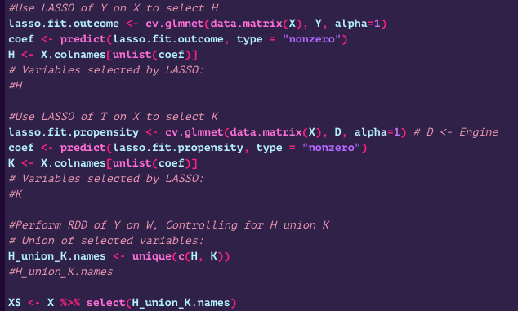
Casual Inference: Engine on the Car Price. Method 6: Double Selection of Engine
1858 -> 1337

Slide 15
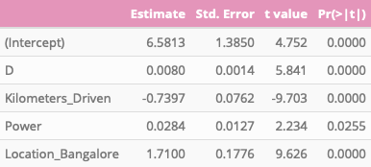
Casual Inference: Engine on the Car Price. Method 6: Double Selection of Engine
“Engine” is significant
Notes:
Exclude name variable.

Slide 16
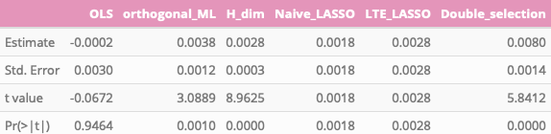
Conclusion: Casual Inference Comparation
Notes:
OLS
Orthogonal Machine Learning
High-dimensional confounder adjustment
LASSO naïve & LTE.
Double Selection of Engine

Slide 17
Link

Slide 18

Copy right:
Yuhan Wang
Siming Yan

Slide 22


Slide 23
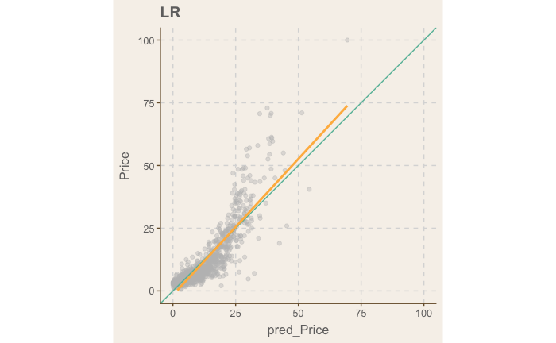
RMSE = 5.332

Slide 24
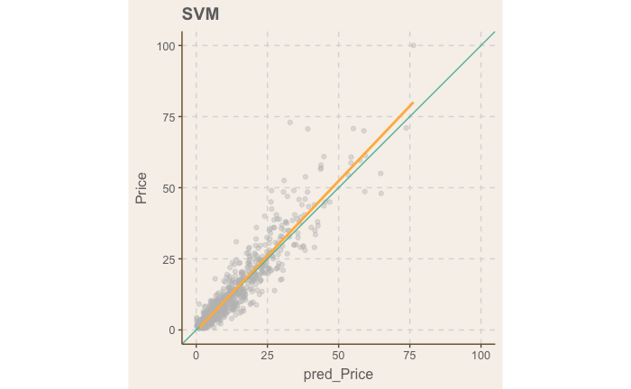
Cost = 10
RMSE = 3.6070

Slide 25
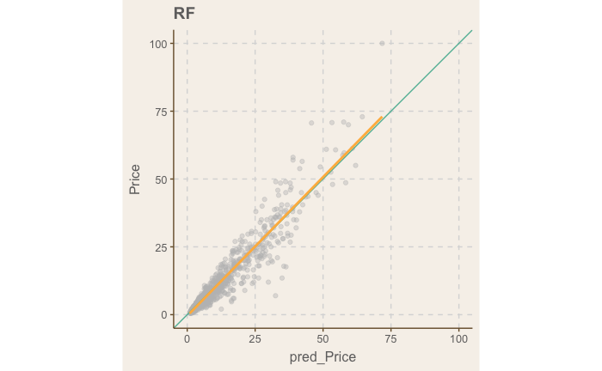
Mtry = 16
RMSE = 3.2211

Slide 26
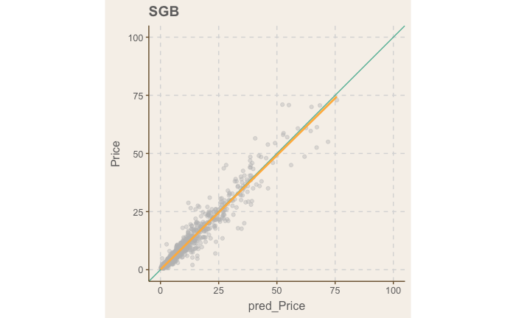
2.64
RMSE = 2.643808

