Slide 1

TSC BMS 分析
2021-XXXX

Slide 2
整体趋势是否健康？YES
4月有不少新业务上线：
SFELCSHMHS
HUAWEDGLSS
INFINWXWHS
OTISXSHIHS

Slide 3
分布：2021活跃OU数：121
OU | Sum of bms_bill_amount_exclude_tax
ERICSNJJLS | 49,623,795 | top10：45% | top20：63%
HUAWEDHW4S | 38,022,951
HPPXXSHMGS | 30,395,533
HONORDGWSS | 25,444,582
ONSEMSHFTS | 21,038,049
NEXPEDGWHS | 18,139,103
MLBKDSHWHS | 14,814,800
HPPXXWHWDS | 14,083,156
ASMLXSHZCS | 13,259,848
H3CUHBJXWS | 11,470,088
SFELCSHMHS | 10,648,067 | 10-20： 18%
KLATESHZCS | 10,420,977
DIODESHFTS | 10,396,757
HWSXXNSNXS | 10,049,287
DELLSSHY2S | 9,647,808
HONORDGHMS | 9,114,096
HUAWEDGLSS | 7,540,299
ASMLXBJKCS | 7,087,542
TYCOTSDXXS | 7,009,501
HUAWEDHW1S | 6,532,834

Slide 4
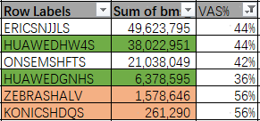
分布：按OU类型
操作型：54 / 121
存储型：23 / 121
VAS型：2 / 121
平衡型：42 / 121
HONORDGWSS | 25,444,582
MOLEXSHBSS | 5,752,714
HUAWEDHWMS | 4,693,772
NSBSHSHYXS | 1,746,093
CEXARSHBSS | 1,237,588
H3CNHBJXWS | 1,237,156
HPIPSBJXWS | 1,036,497
CHANESHKQS | 656,120
SKFSHDLSMS | 478,055
SOLVASHMFS | 448,566
ZEBRASHALV | 1,578,646
KONICSHDQS | 261,290
ERICSNJJLS | 49,623,795
HPPXXSHMGS | 30,395,533
ONSEMSHFTS | 21,038,049
HPPXXWHWDS | 14,083,156
ASMLXSHZCS | 13,259,848
H3CUHBJXWS | 11,470,088
KLATESHZCS | 10,420,977
HWSXXNSNXS | 10,049,287
ASMLXBJKCS | 7,087,542
ASMLXXAEPS | 6,232,442
有关务业务的OU： 36个

Slide 5
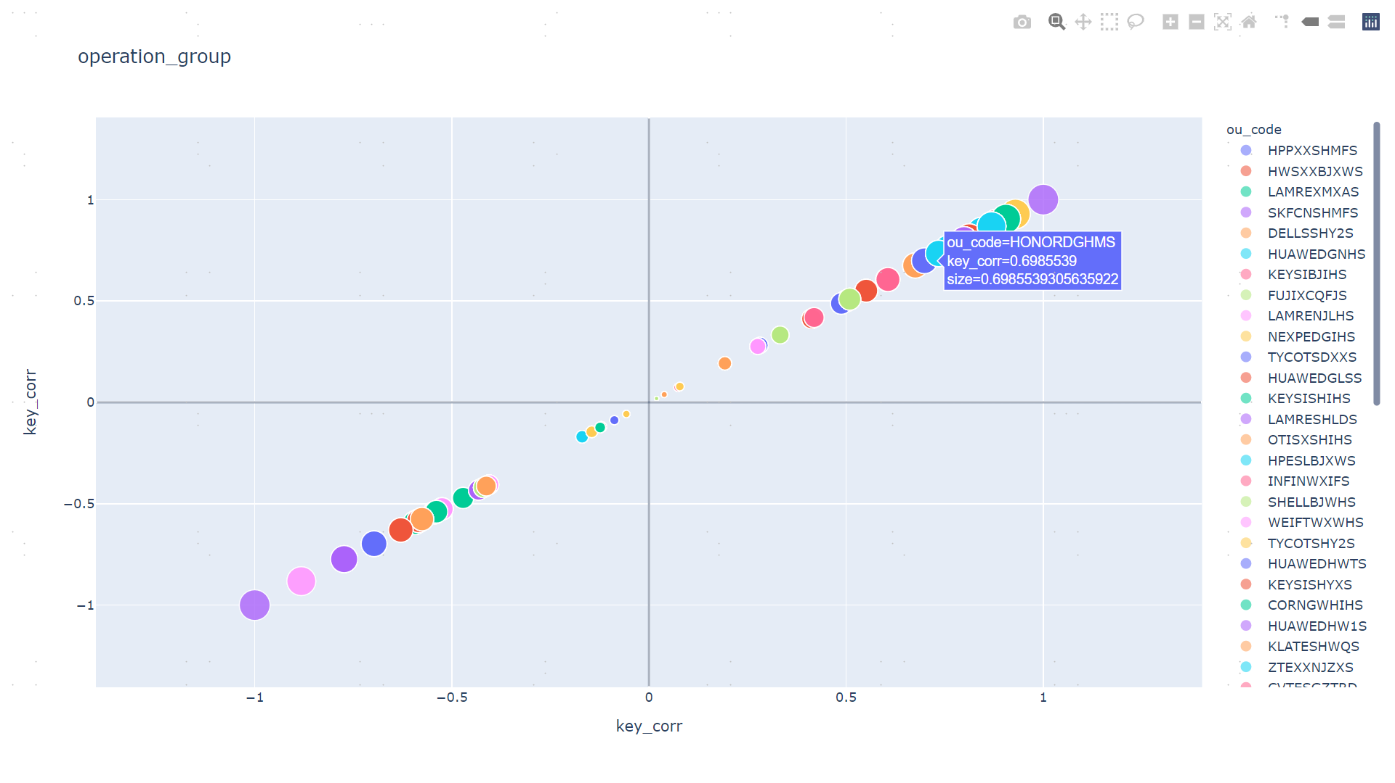
健康度四象限分析
关键指标和时间成现的相关性: (操作费用主导型ou)

Slide 6
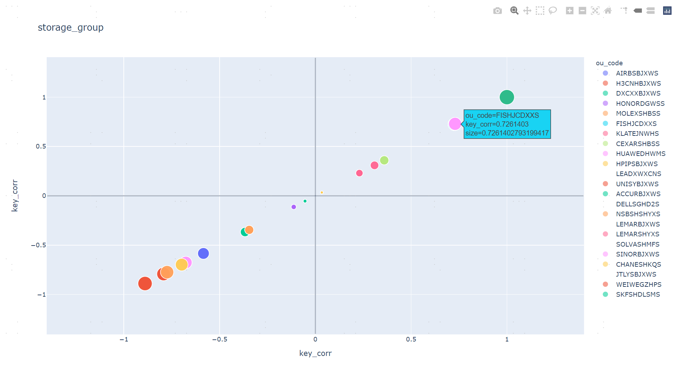
健康度四象限分析

Slide 7
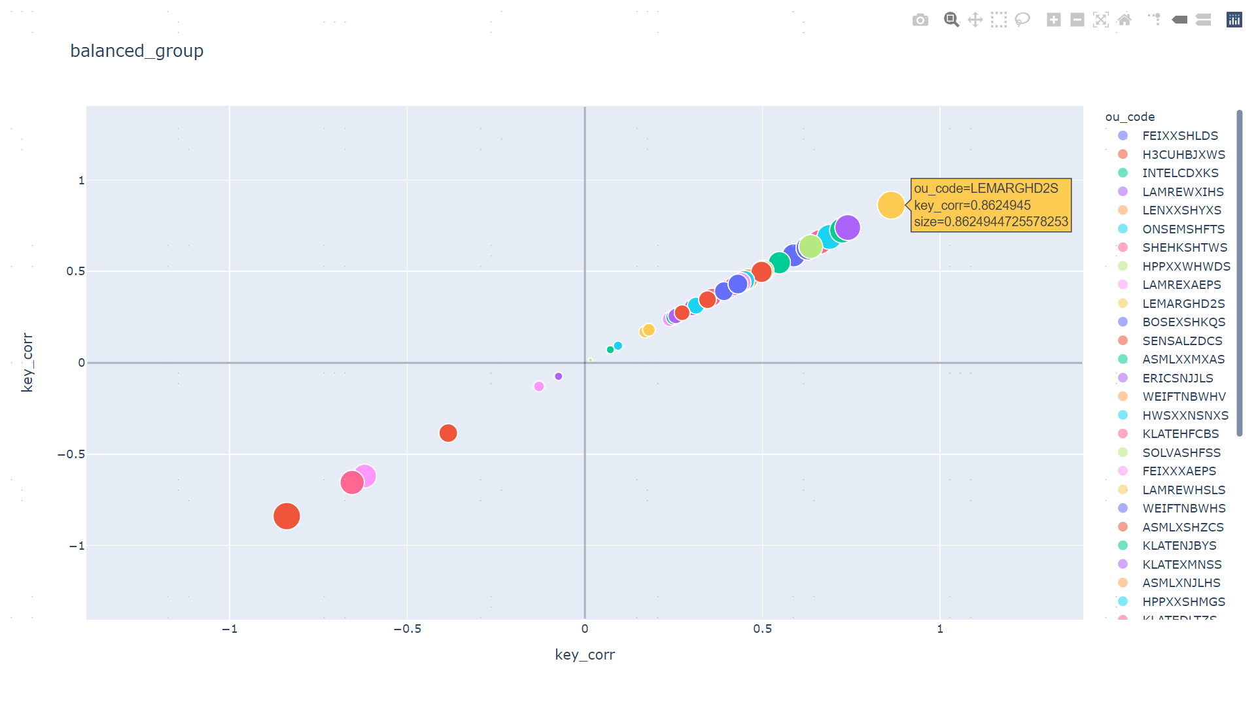
健康度四象限分析

Slide 8
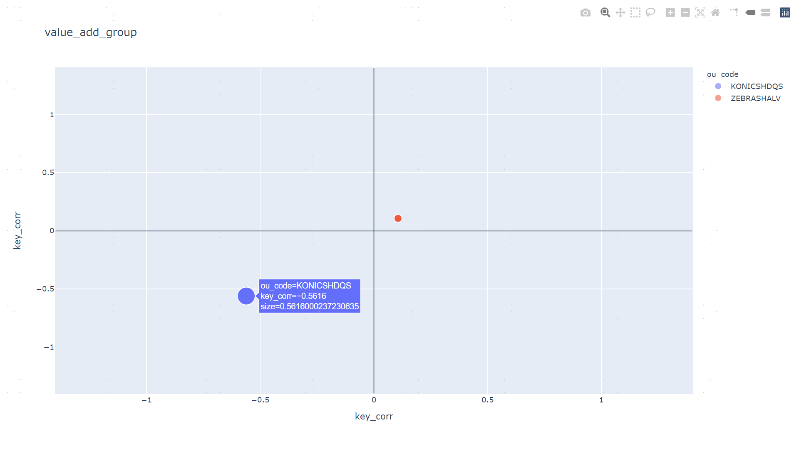
健康度四象限分析

Slide 9
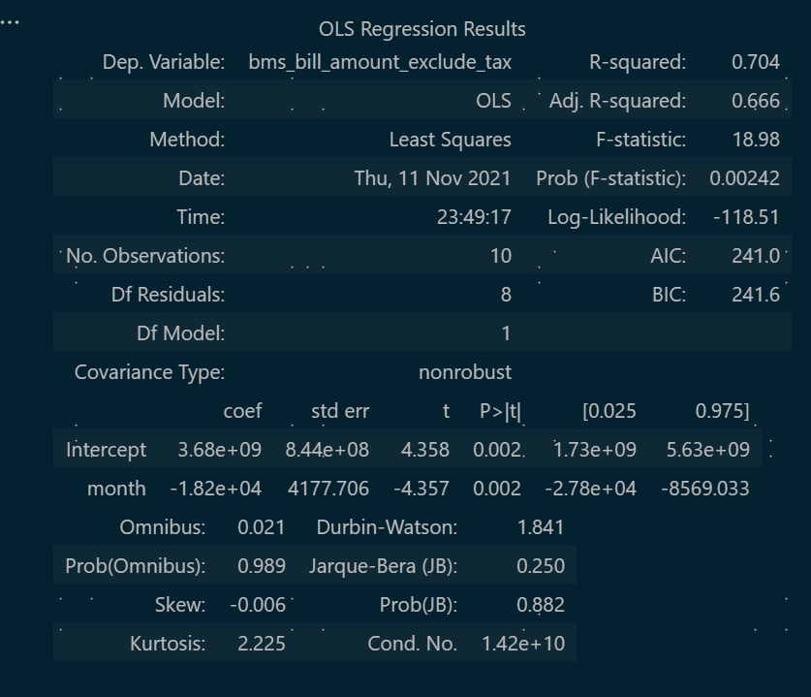
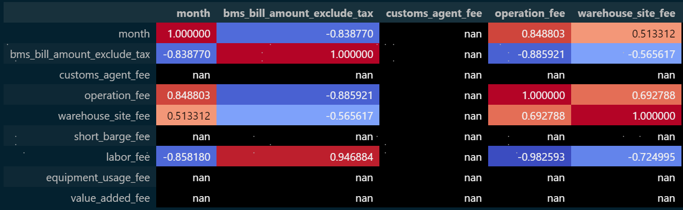
健康度四象限分析
bms_bill_amount_exclude_tax ~ month
相关性 vs 线性回归

