Slide 1

Germinal Center Dark/Light Zone Migrations for B Cell Affinity Maturation
Peter Fyffe

Slide 2
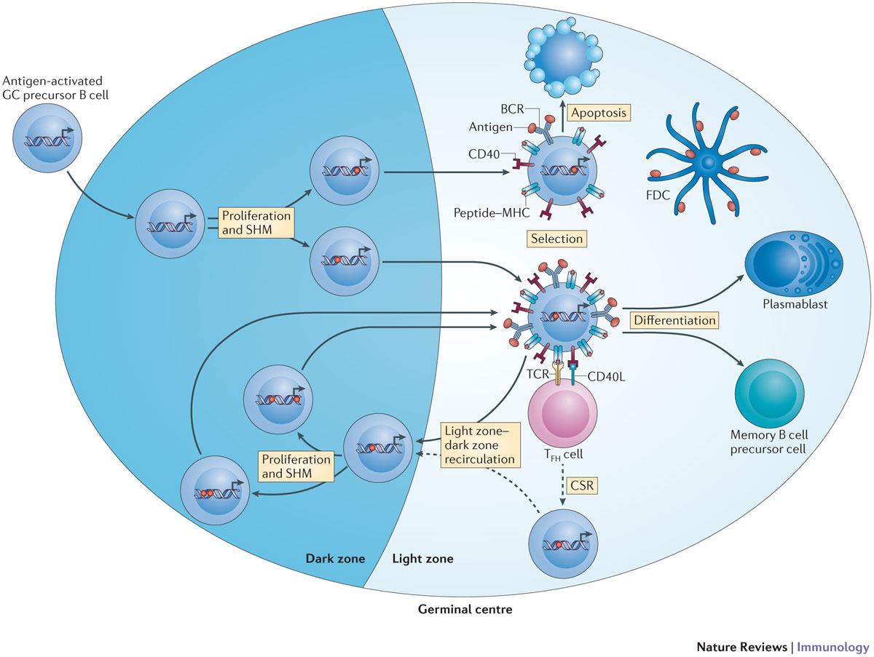
De Silva 2015 https://doi.org/10.1038/nri3804

Slide 3
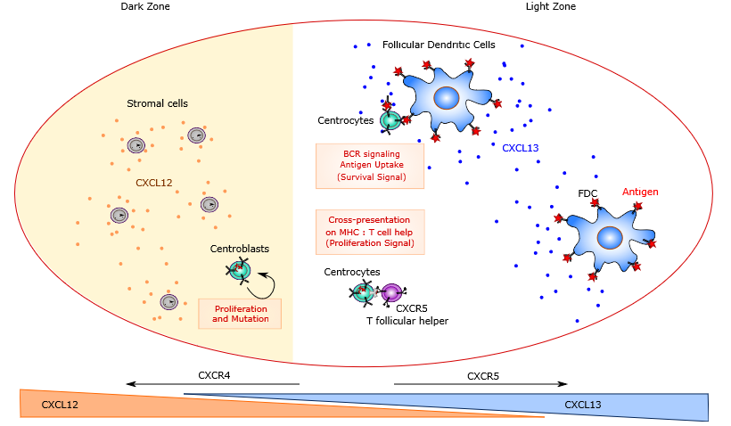
Robert 2017 https://doi.org/10.1007/978-1-4939-7095-7_22

Slide 4
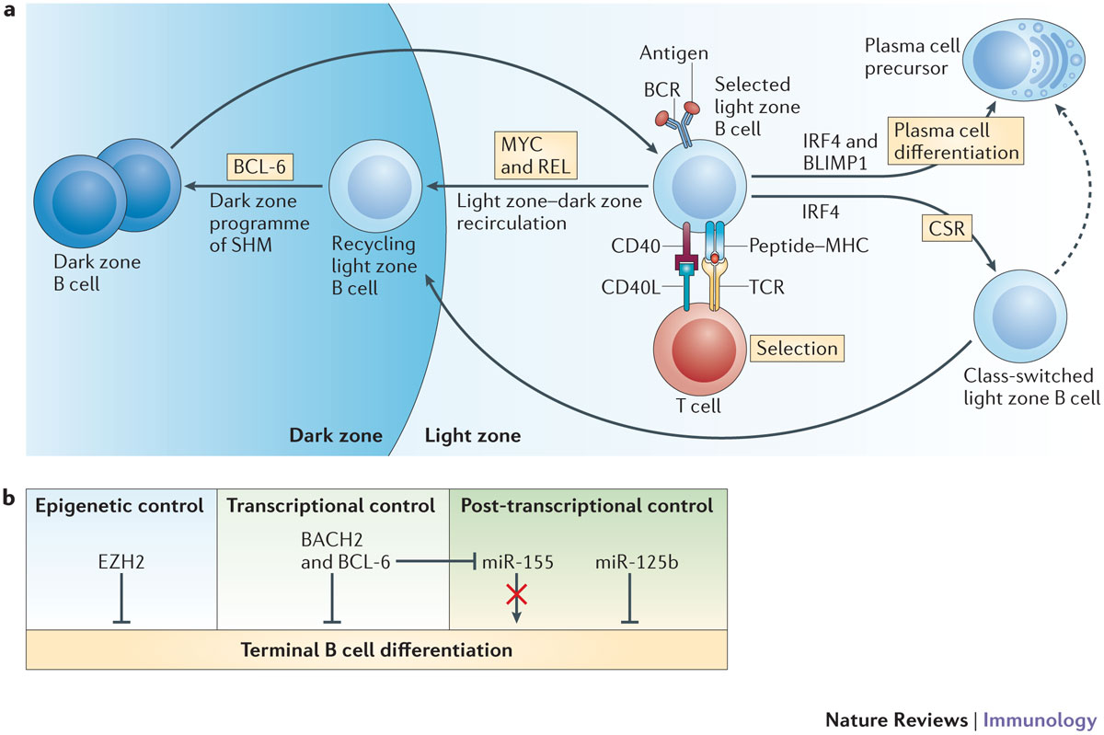
De Silva 2015 https://doi.org/10.1038/nri3804

Slide 5
Affinity Algorithm
$Affinity\left(TCR,BCR\right)=exp⁡(−\frac{Hamming{\left(TCR,BCR\right)}^{η}}{Γ^{η}}$)
Robert 2017 https://doi.org/10.1007/978-1-4939-7095-7_22

Slide 6
Hypothesis
It is well-known that T_{FH} cell help determines the B cell’s affinity
At the same time, the amount of antigen a B cell collects from an FDC is determined by its antibody affinity
Thus, for a high-affinity B cell, the number of antigen copies its daughter cells have is higher
B cells with no antigen remaining (due to asymmetric division) die via apoptosis, which culls the low-affinity cells

Slide 7
Modeling Goals
1. How many plasma cells are output?
2. Is the apoptosis rate directly correlated with the overall time needed to get a plasma cell?
3. Can I match the growth of average affinity to existing models?
Spatial modeling allows for competing for T_{FH} cell help
Only a few B cells can interact with a T_{FH} cell at a time

Slide 8


Two of the B Cell Types
Centroblast:
Divide 2-6 times
Asymmetric division: lose some antigen each time
Become a centrocyte when division limit is reached
Dark zone
Centrocyte:
Non-dividing
Wait for T_{FH} survival signals to be recycled as centroblast
Light zone

Slide 9
WORKS Cited
Primary Reference:
Robert, P.A., Rastogi, A., Binder, S.C., Meyer-Hermann, M. (2017). How to Simulate a Germinal Center. In: Calado, D. (eds) Germinal Centers. Methods in Molecular Biology, vol 1623. Humana Press, New York, NY. https://doi.org/10.1007/978-1-4939-7095-7_22
LEDA Theory:
Meyer-Hermann M, Mohr E, Pelletier N, Zhang Y, Victora GD, Toellner KM. A theory of germinal center B cell selection, division, and exit. Cell Rep. 2012 Jul 26;2(1):162-74. doi: 10.1016/j.celrep.2012.05.010. Epub 2012 Jun 28. PMID: 22840406.

Slide 10
Works Cited
Biological Background:
De Silva NS, Klein U. Dynamics of B cells in germinal centres. Nat Rev Immunol. 2015 Mar;15(3):137-48. doi: 10.1038/nri3804. Epub 2015 Feb 6. PMID: 25656706; PMCID: PMC4399774.
Merino Tejero E, Lashgari D, García-Valiente R, Gao X, Crauste F, Robert PA, Meyer-Hermann M, Martínez MR, van Ham SM, Guikema JEJ, Hoefsloot H, van Kampen AHC. Multiscale Modeling of Germinal Center Recapitulates the Temporal Transition From Memory B Cells to Plasma Cells Differentiation as Regulated by Antigen Affinity-Based Tfh Cell Help. Front Immunol. 2021 Feb 5;11:620716. doi: 10.3389/fimmu.2020.620716. PMID: 33613551; PMCID: PMC7892951.

