Slide 1

Germinal Center Dark/Light Zone Migrations for B Cell Affinity Maturation
Peter Fyffe

Slide 2
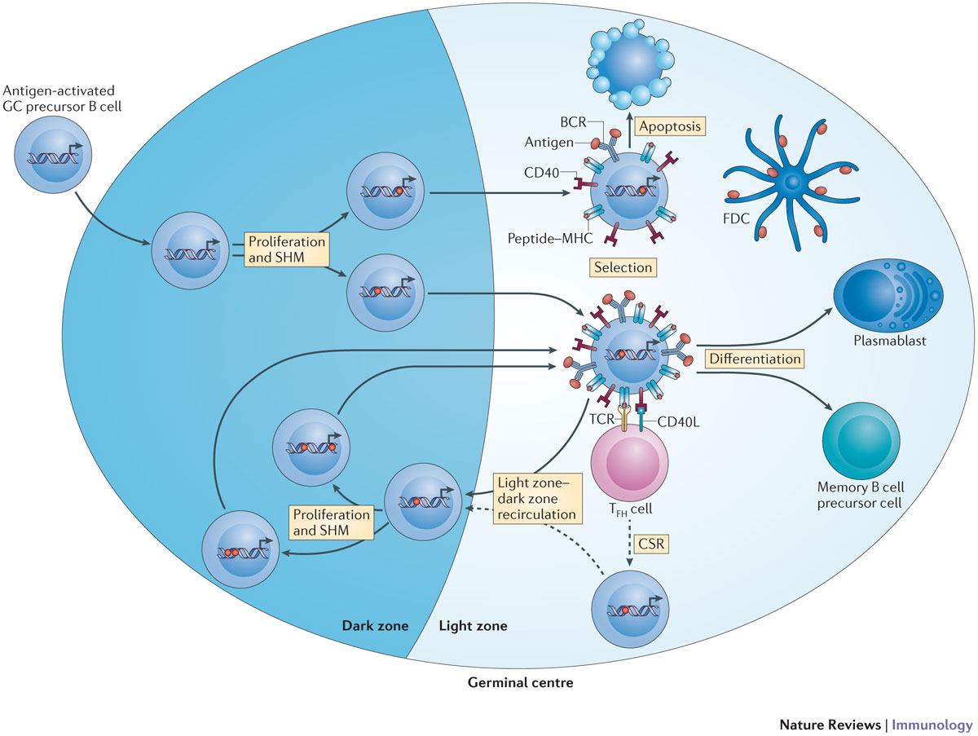
De Silva 2015 https://doi.org/10.1038/nri3804

Slide 3
Parameters: Number of Cells
Robert 2017 https://doi.org/10.1007/978-1-4939-7095-7_22
 | My Value | Literature Value
Initial no. Centroblasts | 55 | 100
Initial no. Dendritic | 26 | 200
Initial no. TFH | 66 | 250
Initial no. Stromal | 0 | 300

Slide 4
Hypothesis
It is well-known that T_{FH} cell help determines the B cell’s affinity
At the same time, the amount of antigen a B cell collects from an FDC is determined by its antibody affinity
Thus, for a high-affinity B cell, the number of antigen copies its daughter cells have is higher
B cells with no antigen remaining (due to asymmetric division) die via apoptosis, which culls the low-affinity cells

Slide 5
Affinity-Dependent Antigen Collection
An FDC should give out a limited number of antigen at a time to a centrocyte’s MHC II receptor
Each dendrite should reach out to give centrocytes in its vicinity more antigen.
Future work: Compute distance between CC and dendritic cell so that contact is not needed
Antigen collected cannot exceed 3000 (amount held by FDC)
B cell collects 1600 * Affinity% per MCSFuture work: Compute distance between CC and dendritic cell so that contact is not needed

Slide 6
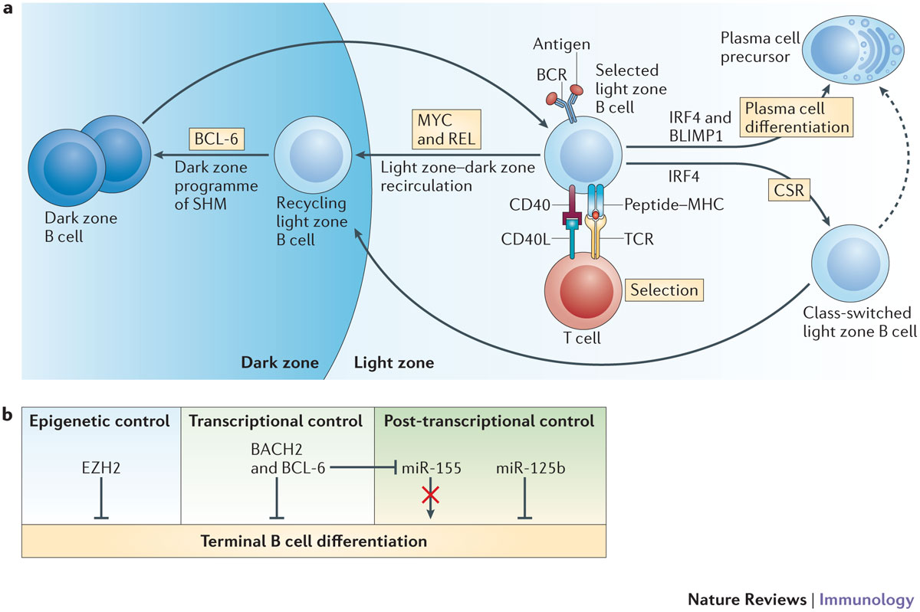
T Follicular Helper Cell Interaction Phase
As soon as a B cell touches a TFH cell,
the clock starts ticking
For every neighbor B cell (centrocyte):
If affinity == 100%, become a plasma cell
Give a “reward point” (survival signal) to the highest affinity B cells
For every neighbor B cell (centrocyte):
If survival signal is sufficient, become centroblast and return to dark zone
If insufficient, apoptosis
Reality: a B cell can undergo apoptosis if it fails to reach the FDC or TFH at all
De Silva 2015 https://doi.org/10.1038/nri3804

Slide 7
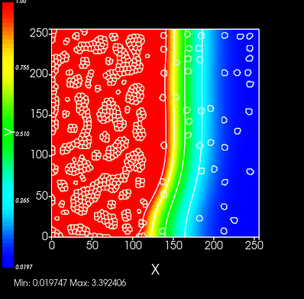
PERFORMANCE PRIORITY
Stromal Cells – secrete CXCL12
FDCs – secrete CXCL13
REMOVED

Slide 8
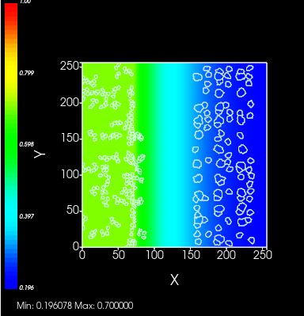
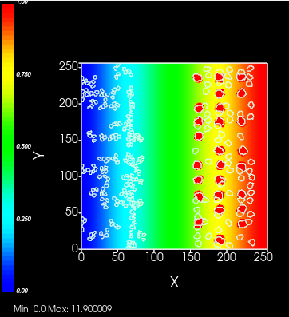
Step 1: Faster Gradients
CXCL12
CXCL13

Slide 9
Affinity Algorithm
$Affinity\left(TCR,BCR\right)=exp⁡(−\frac{Hamming{\left(TCR,BCR\right)}^{η}}{Γ^{η}}$)
Robert 2017 https://doi.org/10.1007/978-1-4939-7095-7_22

Slide 10
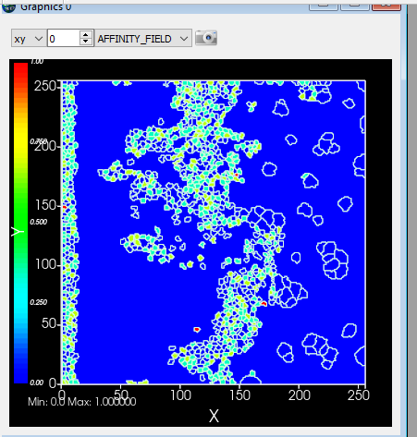
STEP 2: Affinity Field
Day 1, 2:21pm

Slide 11
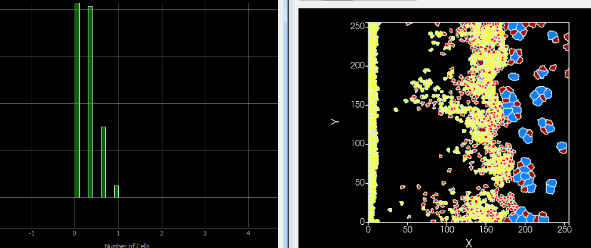
Affinity HISTOGRAM
Day 1, 3:32pm

Slide 12
Affinity HISTOGRAM
Day 1, 3:32pm

Slide 13
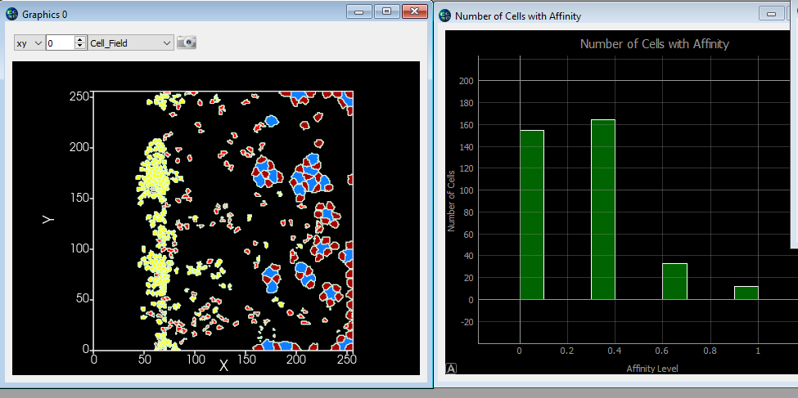
AFTer 11,000 MCS
Day 1, 8:58pm

Slide 14
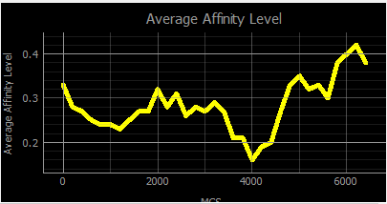
Average Affinity over time
Day 2, 3:36pm

Slide 15
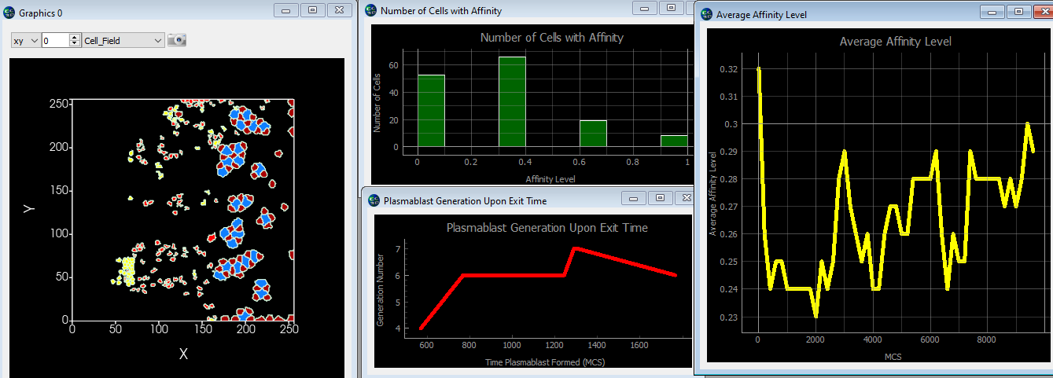
Average Affinity over time
Day 2, 4:55pm

Slide 16
Parameters: GENERAL
Robert 2017 https://doi.org/10.1007/978-1-4939-7095-7_22
 | My Value | Literature Value
B cell division time | 0.07h | 0.6h
Max B cell divisions | Dependent on antigen held; max ~6 | 2-6
T cell max interaction time | 0.6h | 0.6h
T cell min survival signal | 0.5h | 0.5h
B cell persistence time | ? | 0.08h
B cell motility speed | ? | 0.18 μM/h

Slide 17
Parameters: ANTIGEN
 | My Value | Literature Value
Max antigen retained upon division | 0.88% | 0.88%
Chance to divide asymmetrically | 0.72% | 0.72%
FDC Antigen Held | 3000…ish | 3000
FDC Collection Period | 0.075h to 0.225h | 0.7h [2]
[1] Robert 2017 https://doi.org/10.1007/978-1-4939-7095-7_22
[2] Merino Tejero 2021 https://www.ncbi.nlm.nih.gov/pmc/articles/PMC7892951/

Slide 18
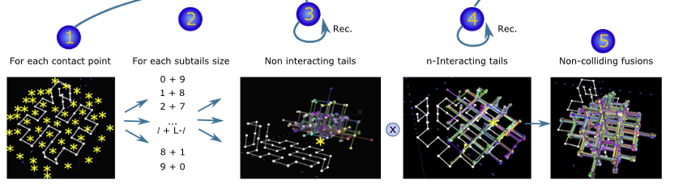
Future Work

Slide 20
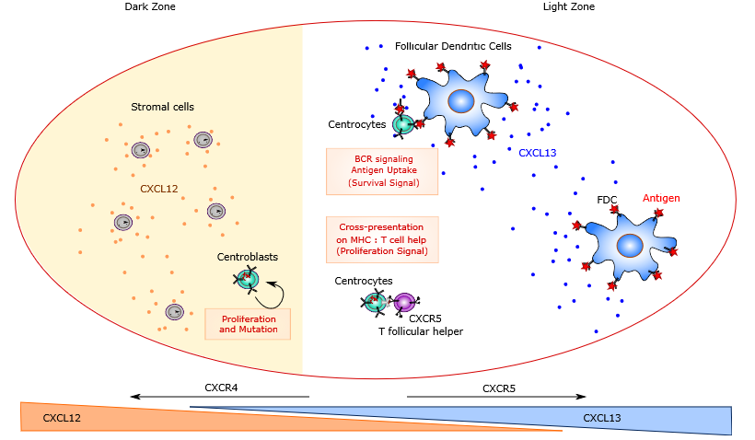
Robert 2017 https://doi.org/10.1007/978-1-4939-7095-7_22

Slide 21
De Silva 2015 https://doi.org/10.1038/nri3804

Slide 22
Modeling Goals
1. How many plasma cells are output?
2. Is the apoptosis rate directly correlated with the overall time needed to get a plasma cell?
3. Can I match the growth of average affinity to existing models?
Spatial modeling allows for competing for T_{FH} cell help
Only a few B cells can interact with a T_{FH} cell at a time

Slide 23


Two of the B Cell Types
Centroblast:
Divide 2-6 times
Asymmetric division: lose some antigen each time
Become a centrocyte when division limit is reached
Dark zone
Centrocyte:
Non-dividing
Wait for T_{FH} survival signals to be recycled as centroblast
Light zone

Slide 24
WORKS Cited
Get the source code:
https://github.com/fyffep/cc3d-antigen-migration/tree/main
Primary Reference:
Robert, P.A., Rastogi, A., Binder, S.C., Meyer-Hermann, M. (2017). How to Simulate a Germinal Center. In: Calado, D. (eds) Germinal Centers. Methods in Molecular Biology, vol 1623. Humana Press, New York, NY. https://doi.org/10.1007/978-1-4939-7095-7_22
LEDA Theory:
Meyer-Hermann M, Mohr E, Pelletier N, Zhang Y, Victora GD, Toellner KM. A theory of germinal center B cell selection, division, and exit. Cell Rep. 2012 Jul 26;2(1):162-74. doi: 10.1016/j.celrep.2012.05.010. Epub 2012 Jun 28. PMID: 22840406.

Slide 25
Works Cited
Get the source code:
https://github.com/fyffep/cc3d-antigen-migration/tree/main
Biological Background:
De Silva NS, Klein U. Dynamics of B cells in germinal centres. Nat Rev Immunol. 2015 Mar;15(3):137-48. doi: 10.1038/nri3804. Epub 2015 Feb 6. PMID: 25656706; PMCID: PMC4399774.
Merino Tejero E, Lashgari D, García-Valiente R, Gao X, Crauste F, Robert PA, Meyer-Hermann M, Martínez MR, van Ham SM, Guikema JEJ, Hoefsloot H, van Kampen AHC. Multiscale Modeling of Germinal Center Recapitulates the Temporal Transition From Memory B Cells to Plasma Cells Differentiation as Regulated by Antigen Affinity-Based Tfh Cell Help. Front Immunol. 2021 Feb 5;11:620716. doi: 10.3389/fimmu.2020.620716. PMID: 33613551; PMCID: PMC7892951.

