Slide 1
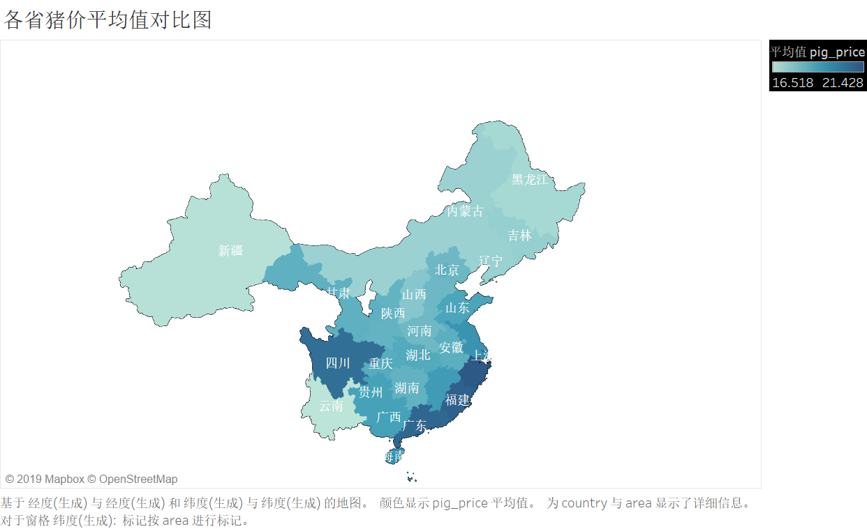

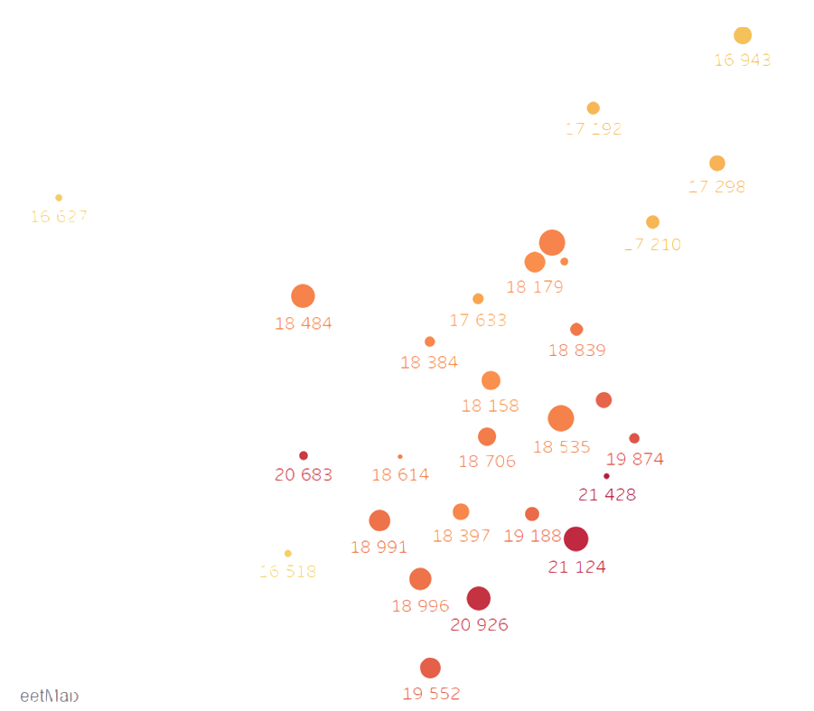
17.9
18.7
18.0
18.0
18.0
18.8
宁夏
18.2
18.2
18.8
18.6
18.8
18.7
20.6
19.7
19.0
20.2
21.1
19.3
浙江
江西
20.2
20.5
20.2
22.1
17.1
22.1
19.6
21.2
18.7

Slide 2
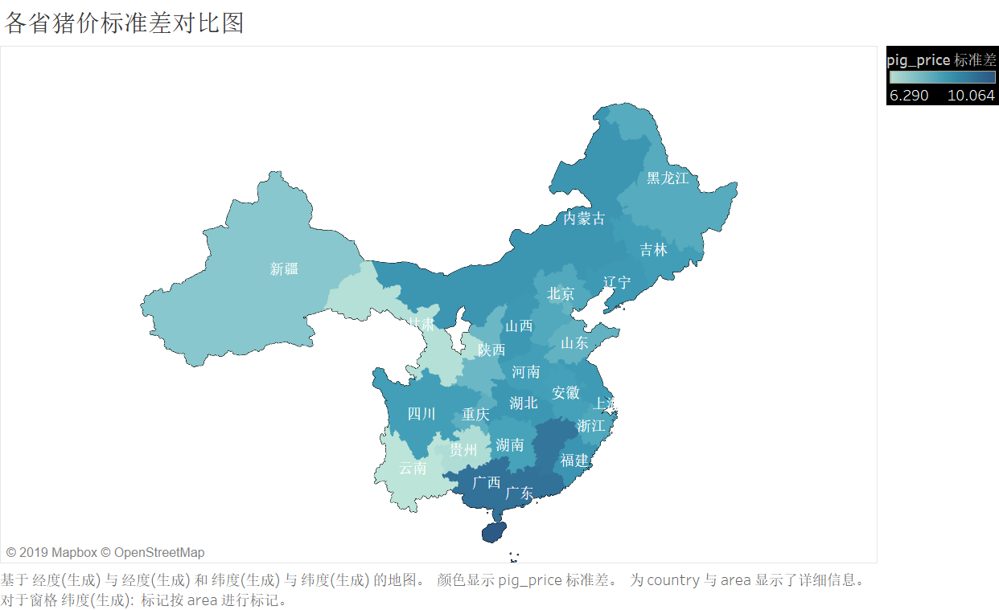
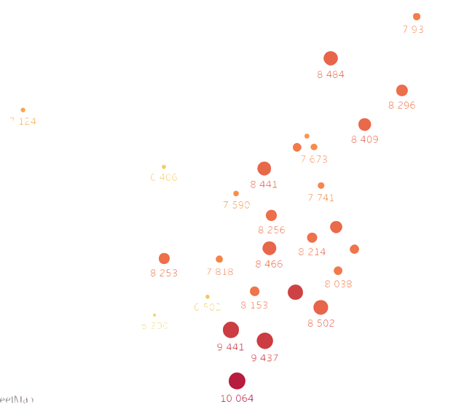

7.124

