Slide 1
What is missing in visual field progression analysis?

Slide 2

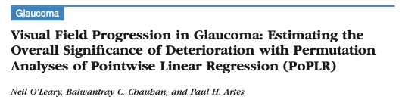
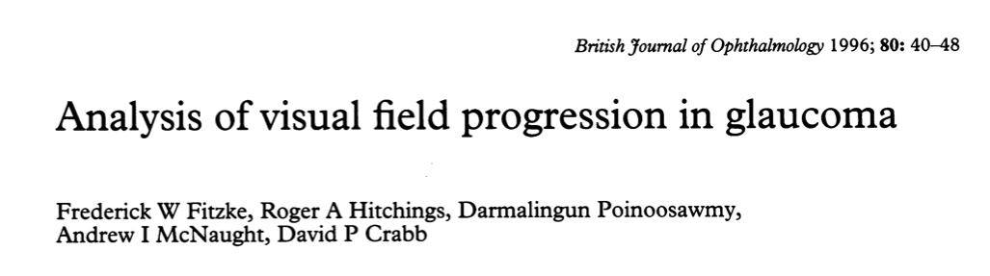
i
o
s
n
n
o
s
e
n
e
i
s
o
n
o
s
e
n
o
i
i
n
o
n
o
n
o
i
o
i
o
o
s
i
s
o
i
e
i
n
o
s
s
i
s
e
i
i
n
n
o
s
e
o
s
s
i
s
o
e
i
e
s
n
e
s
i
i
s
s
o
i
e
e
o
n
o
i
s
i
s
s
e
i
o
i
e
o
i
n
s
n
n
s
e
s
o
n
n
e
o
o
o
i
o
i
o
e
n
s
e
o
n
o
n
s
i
i
o
i
o
o
o
e
e
i
i
s
s
n
o
s
i
o
i
e
s
s
i
s
n
i
e
i
i
o
s
e
i
n
o
s
n
n
e
e
n
e
o
s
Trend based
s
Event based
s
e
o
n
i
s
o
s
i
o
i
n
o
s
o
s
i
i
n
i
o
i
o
s
i
s
o
i
n
o
s
e
o
s
i
i
i
i
s
e
e
s
o
n
e
o
s
o
s
o
n
n
o
n
e
e
i
i
n
i
s
n
i
o
e
i
n
o
s
i
n
e
o
o
s
i
s
n
s
e
s
s
s
o
n
o
s
e
n
o
i
e
o
i
o
s
i
e
i
o
e
s
i
n
o
s
o
e
n
s
s
s
s
s
e
o
i
o
o
i
e
s
o
e
i
e
o
s
n
i
i
n
i
n
i
e
s
s
e
s
o
o
e
s
o
s
i
i
n
i
i
i
e
n
o
n
n
e
s
i
o
s
e
s
o
s
e
o
o
n
i
i
n
i
i
o
e
e
i
n
o
s
s
o
n
n
n
n
o
i
e
o
n
s
e
o
s
s
e
s
o
i
s
o
i
o
n
e
o
n
s
i
n
s
i
i
o
i
o
i
o
i
o
o
e
o
o
e
s
o
i
i
i
o
n
o
s
e
o
o
n
i
n
o
s
i
e
n
s
n
o
s
i
i
s
o
n
o
s
s
n
e
s
i
s
i
e
o
i
i
o
s
e
o
i
e
n
e
n
i
e
s
n
o
s
o
n
o
s
i
i
e
e
s
i
o
s
n
e
s
o
e
e
n
s
i
e
o
i
s
o
n
i
o
n
o
s
s
o
s
n
i
s
o
e
s
i
e
o
s
e
e
s
i
o
n
e
s
n
s
i
i
i
o
i
i
i
s
i
i
i
o
i
o
o
s
i
o
i
i
s
s
i
n
i
i
s
s
i
s
i
s
n
s
e
s
o
n
o
o
i
e
e
i
e
o
s
n
o
s
s
o
s
i
i
n
i
s
o
e
i
i
e
o
s
o
s
s
o
o
o
n
n
s
e
e
n
s
o
n
o
e
i
i
s
s
o
i
n
n
o
n
e
i
s
n
e
e
e
e
o
s
e
e
i
n
n
o
e
i
i
s
s
e
s
n
s
s
o
n
e
s
e
s
s
s
o
o
o
o
e
o
n
e
n
i
s
o
n
i
s
i
s
e
n
i
e
o
i
i
s
n
i
n
o
n
o
i
s
s
s
i
o
n
e
e
o
o
i
i
e
e
n
i
s
e
o
n
s
e
i
i
n
i
e
e
o
e
o
s
o
s
n
n
i
o
n
s
s
o
o
o
i
o
n
o
o
s
i
o
s
o
n
i
s
i
s
i
i
i
i
o
o
o
e
o
e
s
e
i
s
i
e
i
n
i
o
o
s
n
o
o
i
s
s
s
e
s
i
e
o
s
i
i
n
o
e
s
n
i
s
i
e
s
i
e
s
e
o
e
s
o
n
o
o
s
n
n
n
o
s
s
n
e
o
e
i
o
s
e
i
i
s
e
i
i
e
i
i
e
n
s
e
o
s
i
o
i
n
i
n
n
s
s
s
o
e
n
o
s
e
s
o
e
i
s
e
i
s
o
n
o
s
s
o
s
i
o
i
o
s
i
i
s
o
i
e
i
o
i
s
i
e
i
o
s
i
e
o
n
s
e
i
i
i
s
o
s
i
o
n
o
e
s
o
n
n
s
n
e
e
e
s
o
n
i
i
i
s
o
n
i
o
o
s
i
s
e
e
s
o
n
e
e
o
s
s
e
i
s
o
n
o
s
s
e
s
i
o
o
i
e
s
o
s
i
n
o
n
s
i
i
i
e
e
n
o
i
e
e
o
i
e
i
o
e
e
o
s
i
n
s
o
s
i
i
i
s
o
n
e
n
o
s
s
i
e
n
n
n
e
n
e
i
s
e
o
s
o
i
e
o
e
n
o
n
s
s
s
e
s
o
o
o
s
i
s
e
i
i
o
s
i
i
n
o
o
s
i
n
i
o
i
i
e
s
e
s
o
s
i
i
n
o
i
o
i
i
n
i
e
n
e
o
s
s
o
o
s
e
o
i
s
n
s
o
e
n
s
s
o
e
s
e
i
s
o
n
n
i
s
i
s
o
i
o
s
i
e
n
e
o
i
n
e
e
o
s
e
o
i
e
s
o
n
i
e
s
i

Slide 3
Signal or noise?
Progression analysis
Positive
Negative
Power: detectability of a given amount of change
Specificity: likelihood of this being a false positive

Slide 4
Why measure Power?

Slide 5
Low variability (high power)
Stable
Time
Progressing
-3 dB/y

Slide 6
High variability (low power)
Stable
Time
Progressing
-3 dB/y

Slide 7


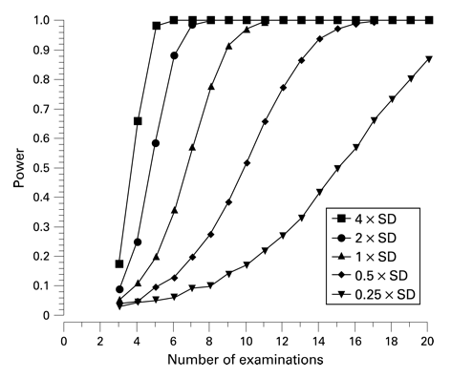
How do we measure power?
Monte Carlo simulation!

Slide 8

Methods
Azure Cloud Computing
Virtual Machine
Dataset
Artes et al. (2014): 30 stable glaucoma patients (Halifax, Canada)
12 visual fields per patient measured across 12 consecutive weeks using Humphrey Field Analyzer
Median (IQR) MD: -2.5 (-4.4 to -1.3) dB

Slide 9
(2) Select 5 locations randomly
(3) Inject (-) linear trend
1 patient
(1) Reorder VF series randomly
(4) Permutation of Pointwise Linear Regression (PoPLR)
X100 p-values
Power proportion of p < 0.05
1 p-value
Test intervals: 0.5y
2 p-values
(5) Original VF series (clean slate)
Methods

Slide 10
Example...
PoPLR
Location 14
Overall progression (MD) = -0.002 dB/y
Year 0
- 0
- 0.02
- 0.03
- 0.04
- 0.05
- 0.06
31
- 0.01
31
33
31
33
32
34
1st P-value
Year 5.5
31
- 0.08
- 0.09
- 0.1
- 0.11
- 0.07
32
31
31
32

Slide 11
Example...
PoPLR
Location 14
Overall progression (MD) = -0.002 dB/y
Year 0
- 0.02
- 0.03
- 0.04
- 0.05
- 0.06
31
31
33
31
33
32
- 0
34
- 0.01
2nd P-value
Year 5.5
31
- 0.08
- 0.1
- 0.11
32
31
31
32
- 0.07
- 0.09

Slide 12
Example...
X100 PoPLR
dB values at location 14
Overall progression (MD) = -0.002 dB/y
Year 0
- 0.02
- 0.03
- 0.04
- 0.05
- 0.06
31
31
33
31
33
32
- 0
34
- 0.01
X100 P-values
Year 5.5
31
- 0.08
- 0.1
- 0.11
32
31
31
32
Power
- 0.07
- 0.09
-0.002
MD Progression rate (dB/y)

Slide 13
Example...
X100 PoPLR
dB values at location 14
Overall progression (MD) = -0.004 dB/y
Year 0
- 0.04
- 0.06
- 0.08
- 0.1
- 0.12
31
31
33
31
33
32
- 0
34
- 0.02
X100 P-values
Year 5.5
31
- 0.16
- 0.2
- 0.22
32
31
31
32
Power
- 0.14
- 0.18
-0.004
MD Progression rate (dB/y)

Slide 14
Example...
PoPLR
dB values at location 14
Overall progression (MD) = -0.002 to -4 dB/y
Year 0
31
34
31
33
31
33
32
100 P-values
Year 5.5
Power
31
32
31
31
32
MD Progression rate (dB/y)

Slide 15
Example...
PoPLR
dB values at location 14
Overall progression (MD) = -0.002 to -4 dB/y
Year 0
31
34
31
33
31
33
32
100 P-values
Year 5.5
Power
31
32
31
31
32
MD Progression rate (dB/y)

Slide 16
Example...
PoPLR
dB values at location 14
Overall progression (MD) = -0.002 to -4 dB/y
Year 0
31
34
31
33
31
33
32
100 P-values
Year 5.5
Power
31
32
31
31
32
MD Progression rate (dB/y)

Slide 17
Results

Slide 18
Higher power!

Slide 19
Px 3
Px 25

Slide 21
Thank you!

Slide 22
Current model of progression
5 (arbitrary) random locations excluding blind spots & locations with very poor sensitivity
Progression = negative linear trend (simplicity)
Next steps?
Develop a more sophisticated model, e.g. account for increased variability with increased VF damage
Compare if different models give rise to very different results

