Slide 1
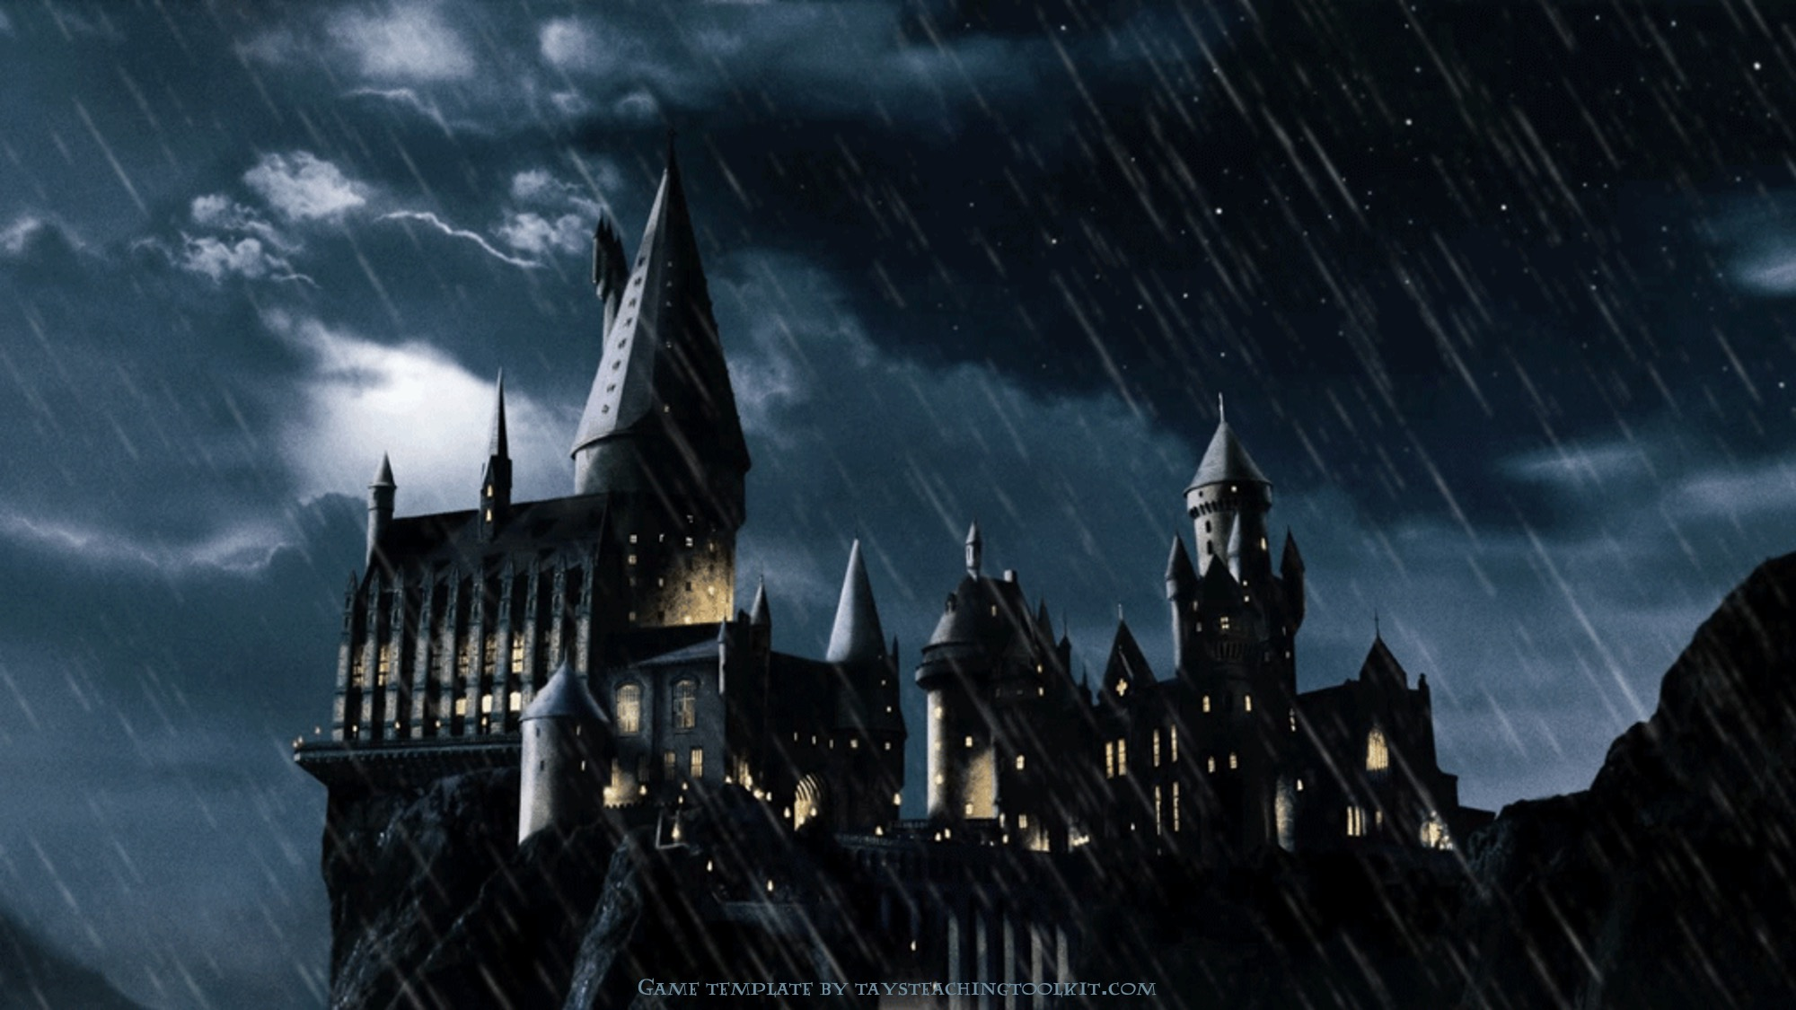

and
the
GAME
of
KNOVLEDGE
Notes:
This template is for educational, non-commercial purposes only. For more free game templates like this one, visit https://www.taysteachingtoolkit.com

Slide 2

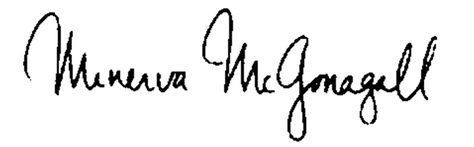
Dear Students of SILK ROAD,
We are pleased to inform you that you have been accepted at Hogwarts School of Witchcraft and Wizardry. Your knowledge journey begins now. We await to see which of you will become the top of your class by the end of this game.
Sincerely,
Notes:
Feel free to change the name of the school in the opening line as needed ☺

Slide 3
Rule
Team Division: The class will be divided into 2 teams (Team A and Team B).
Turn-taking: The two teams will take turns choosing a letter displayed on the screen.
Answering: Each chosen letter corresponds to a vocabulary question. The active team must discuss and provide the correct answer.
Scoring & Mystery Rewards:
If the team answers correctly, they will unlock a mystery reward.
The reward points are completely random, so be careful with your choice.
Winning Condition: The team with the highest score at the end of the game wins!
Sincerely,
Notes:
Feel free to change the name of the school in the opening line as needed ☺

Slide 4

1
2
5
6
3
4
7
8
9
10
13
14
11
12
15
16
Notes:
Click a letter to go to a question.

Slide 5





Question 1
Question 1: Which word matches the definition "referring to the ancient past, especially the period before the Middle Ages"?
A. Medieval
B. Antiquity
C. Quasi-
D. Underbelly
B. Antiquity
Notes:
Click the spacebar to make the ANSWER appear.
The blank space in the middle is for any extra text/images you need.
Click the green seal to go to the reward slide.
Click the red seal to go back to the question-choosing slide.

Slide 6
Question 2
Question 2: “Many quasi-legendary katana were created by the hand of many famous Japanese swordsmith”. What does the prefix/word "Quasi-" mean?
A. Related to the
Middle Ages
B. Used to show that something is almost, but not completely, the thing described
C. A wise saying
D. The weakest or most unpleasant part of something
B. Used to show that something is almost, but not completely, the thing described
Notes:
Click the spacebar to make the ANSWER appear.
The blank space in the middle is for any extra text/images you need.
Click the green seal to go to the reward slide.
Click the red seal to go back to the question-choosing slide.

Slide 7
Question 3
Question 3: Which term defines "the weakest or most unpleasant part of something"?
A. Underbelly
B. Filament
C. Almanac
D. Caravanserai
A. Underbelly
Notes:
Click the spacebar to make the ANSWER appear.
The blank space in the middle is for any extra text/images you need.
Click the green seal to go to the reward slide.
Click the red seal to go back to the question-choosing slide.

Slide 8
Question 4
Question 4: Which word corresponds to "related to the Middle Ages (= the period in European history from about AD 600 to AD 1500)"?
A. Antiquity
B. Enamored
C. Medieval
D. Quasi-
C. Medieval
Notes:
Click the spacebar to make the ANSWER appear.
The blank space in the middle is for any extra text/images you need.
Click the green seal to go to the reward slide.
Click the red seal to go back to the question-choosing slide.

Slide 9
Question 5
Question 5: “The adage ‘Time is money’ teaches us to value our time.” What is the exact meaning of the word "Adage"?
A. A thin thread or fibre of natural or artificial material
B. A wise saying
C. An annual publication providing various information
D. Marked by a great liking or admiration
B. A wise saying
Notes:
Click the spacebar to make the ANSWER appear.
The blank space in the middle is for any extra text/images you need.
Click the green seal to go to the reward slide.
Click the red seal to go back to the question-choosing slide.

Slide 10
Question A
Question 6: Which term describes someone or something "marked by a great liking or admiration for something"?
A. Enamored
B. Filament
C. Medieval
D. Antiquity
A. Enamored
Notes:
Click the spacebar to make the ANSWER appear.
The blank space in the middle is for any extra text/images you need.
Click the green seal to go to the reward slide.
Click the red seal to go back to the question-choosing slide.

Slide 11
Question A
Question 7: Which publication is defined as "an annual publication that provides a variety of information, typically related to weather forecasts, astronomical data, holidays, notable events..."?
A. Caravanserai
B. Adage
C. Almanac
D. Filament
C. Almanac
Notes:
Click the spacebar to make the ANSWER appear.
The blank space in the middle is for any extra text/images you need.
Click the green seal to go to the reward slide.
Click the red seal to go back to the question-choosing slide.

Slide 12
Question J
Question 8: “The filament inside the old light bulb burned out, leaving the room in darkness.” What does the word "Filament" mean?
A. The weakest or most unpleasant part of something
B. A thin thread or fibre of natural or artificial material
C. An inn with a central courtyard in the desert
D. A wise saying
B. A thin thread or fibre of natural or artificial material
Notes:
Click the spacebar to make the ANSWER appear.
The blank space in the middle is for any extra text/images you need.
Click the green seal to go to the reward slide.
Click the red seal to go back to the question-choosing slide.

Slide 13
Question K
Question 9: Which of the following words means "to suppose that something is true without having evidence to confirm it" ?
A. Deduce
B. Surmise
C. Assert
D. Verify
B. Surmise
Notes:
Click the spacebar to make the ANSWER appear.
The blank space in the middle is for any extra text/images you need.
Click the green seal to go to the reward slide.
Click the red seal to go back to the question-choosing slide.

Slide 14
Question L
Question 10: When you want to describe a status that is "almost, but not completely official", what prefix should you use?
Quasi-
Notes:
Click the spacebar to make the ANSWER appear.
The blank space in the middle is for any extra text/images you need.
Click the green seal to go to the reward slide.
Click the red seal to go back to the question-choosing slide.

Slide 15
Question M
Question 11: Which word matches the definition "wealthy or prosperous"?
A. Asphalt
B. Affluent
C. Apocryphal
D. Genocide
B. Affluent
Notes:
Click the spacebar to make the ANSWER appear.
The blank space in the middle is for any extra text/images you need.
Click the green seal to go to the reward slide.
Click the red seal to go back to the question-choosing slide.

Slide 16
Question N
Question 12: “The workers are laying a new layer of asphalt on the playground.” .What does the word "Asphalt" mean?
A. A dark, sticky substance, often mixed with small stones or sand, that forms a strong surface when hard
B. A place where different cultures, ideas or traditions are mixed together
C. The crime of intentionally destroying part or all of a national or ethnic group
D. A journey or travel of a religious nature to a sacred destination
A. A dark, sticky substance, often mixed with small stones or sand, that forms a strong surface when hard
Notes:
Click the spacebar to make the ANSWER appear.
The blank space in the middle is for any extra text/images you need.
Click the green seal to go to the reward slide.
Click the red seal to go back to the question-choosing slide.

Slide 17
Question O
Question 13: Which term defines "of doubtful authenticity, although widely circulated as being true"?
A. Pilgrimage
B. Melting pot
C. Apocryphal
D. Affluent
C. Apocryphal
Notes:
Click the spacebar to make the ANSWER appear.
The blank space in the middle is for any extra text/images you need.
Click the green seal to go to the reward slide.
Click the red seal to go back to the question-choosing slide.

Slide 18
Question P
Question 14: Which word refers to "the crime of intentionally destroying part or all of a national, ethnic, racial, or religious group"?
A. Genocide
B. Asphalt
C. Apocryphal
D. Melting pot
A. Genocide
Notes:
Click the spacebar to make the ANSWER appear.
The blank space in the middle is for any extra text/images you need.
Click the green seal to go to the reward slide.
Click the red seal to go back to the question-choosing slide.

Slide 19
Question Q
Question 15: Which term describes "a place where different cultures, ideas or traditions are mixed together"?
A. Pilgrimage
B. Melting pot
C. Affluent
D. Asphalt
B. Melting pot
Notes:
Click the spacebar to make the ANSWER appear.
The blank space in the middle is for any extra text/images you need.
Click the green seal to go to the reward slide.
Click the red seal to go back to the question-choosing slide.

Slide 20

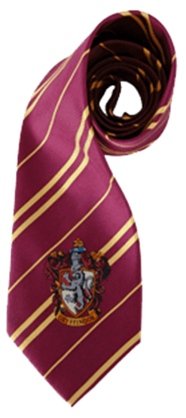


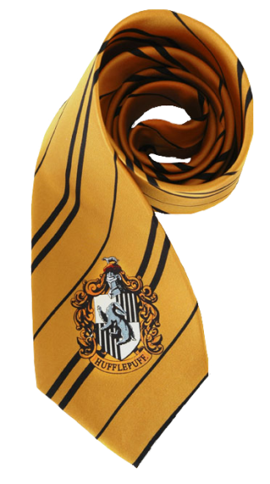

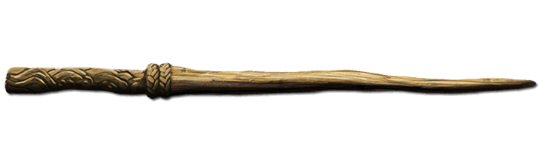




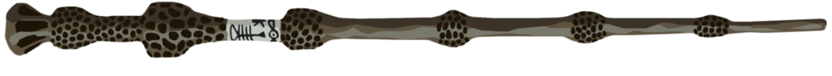
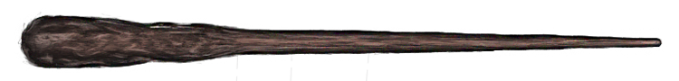
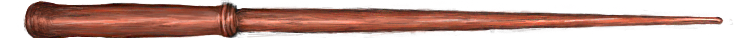
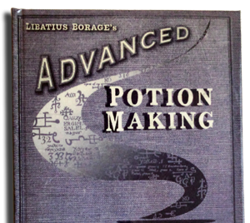
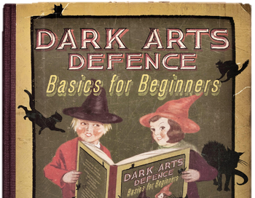
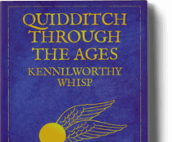
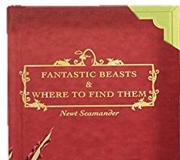



Reward C
Buy some school supplies (1 of each)…
Notes:
Click an item to make a reward/penalty appear.
Students have to choose one of each item (3 items total).
If they find a bomb (the Death Eater icon), they lose the points they earned and cannot continue choosing items.
If there’s nothing behind an object, that means 0 points/no points added the total. A number is the number of points.
Click the Hogwarts icon to go back the question-choosing slide.

Slide 21
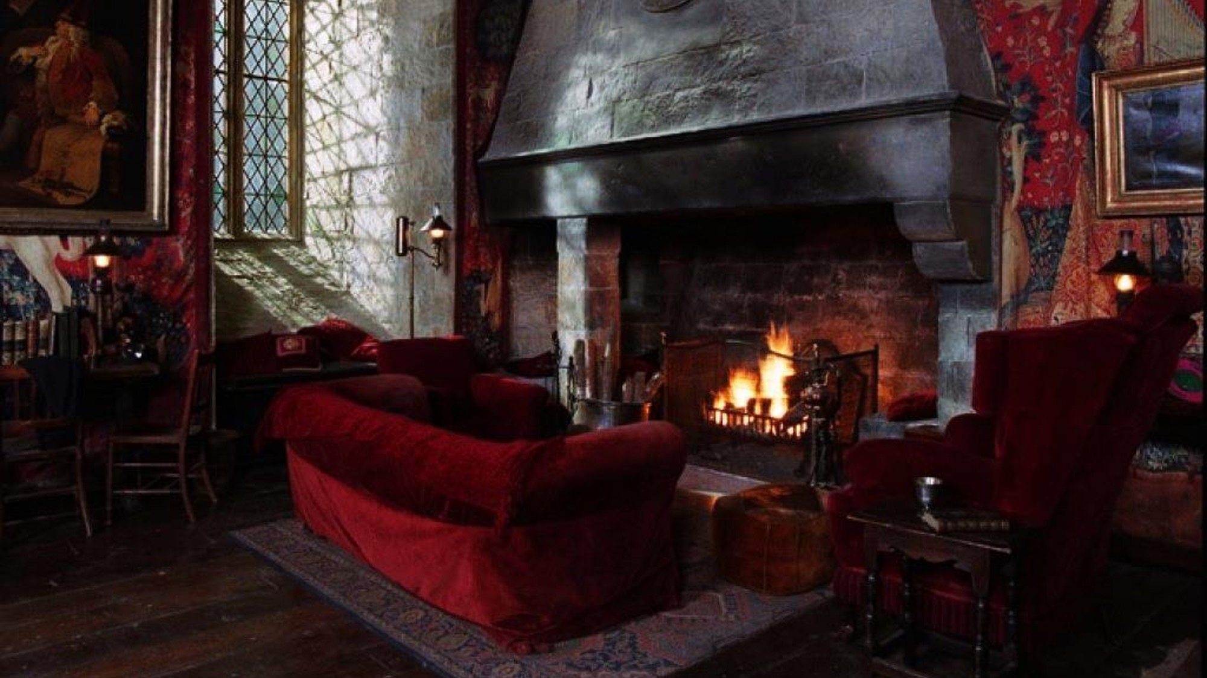
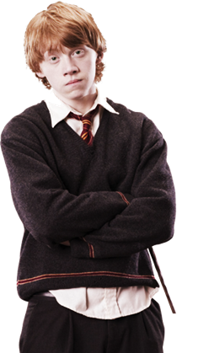

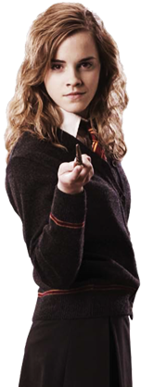



Reward D
Choose your best friend…
Notes:
Click a character to reveal a reward/penalty.
Click the Hogwarts icon to go back the question-choosing slide.

Slide 22
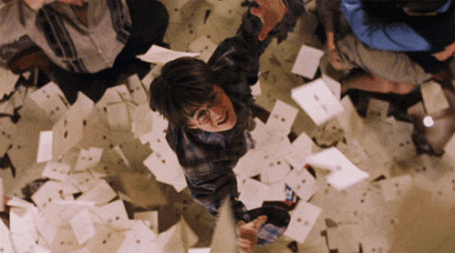


Reward F Question
You finally get your
letter from Hogwarts!
Notes:
Click “A” or “B” to reveal a reward/penalty.

Slide 23
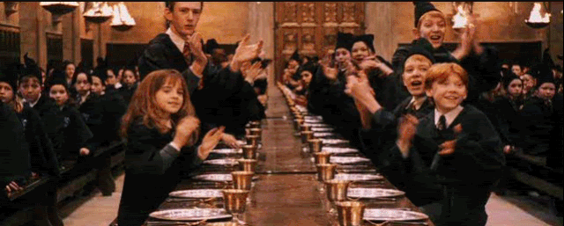

Reward F - A
Welcome to Hogwarts!
Notes:
Click the Hogwarts icon to go back the question-choosing slide.

Slide 24
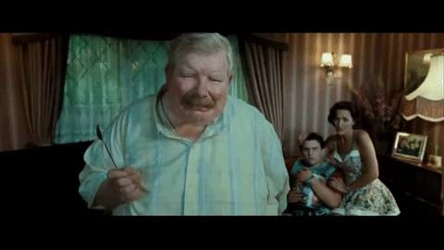
Reward F - B
You were caught
by the Dursleys!
Notes:
Click the Hogwarts icon to go back the question-choosing slide.

Slide 25

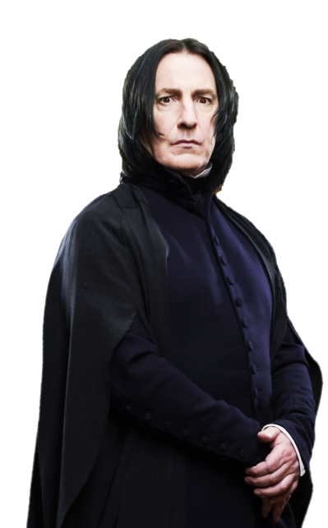

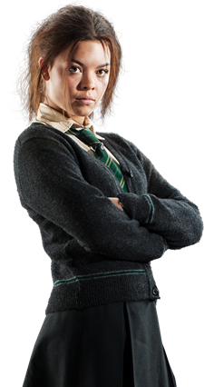

Reward H
Choose someone to duel…
Notes:
Click a character to reveal a reward/penalty.
Click the Hogwarts icon to go back the question-choosing slide.

Slide 26

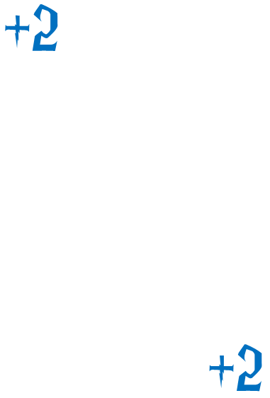
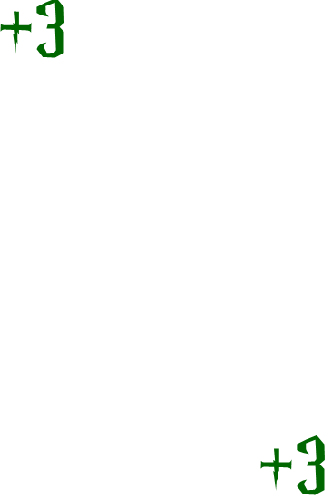





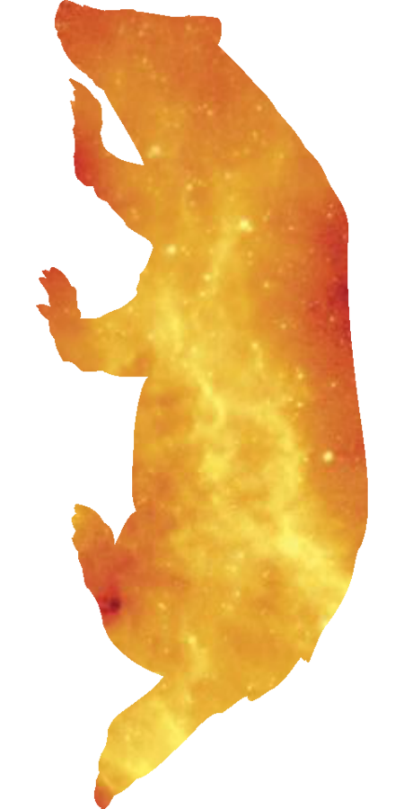

Reward I
Test your luck!
Keep the card you have or draw more for more points. But beware! If you find a bomb the game is over and you lose all your points.
Notes:
Click the cards to make a reward appear.
Ask the students if they want to keep the reward or click again to add more points, but at the risk of finding a bomb.
Repeat that process until they either decide to keep their points, or reach the BOMB! card.
Click the Hogwarts icon to go back the question-choosing slide.

Slide 27

Reward J Question
Your rival challenges
you to a duel.
Notes:
Click “A” or “B” to reveal a reward/penalty.

Slide 28
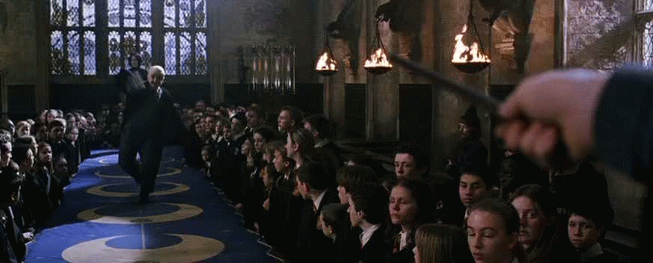

Reward J - B
You lost!
Notes:
Click the Hogwarts icon to go back the question-choosing slide.

Slide 29
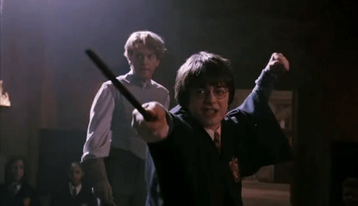
Reward J - A
You won!
Notes:
Click the Hogwarts icon to go back the question-choosing slide.

Slide 30
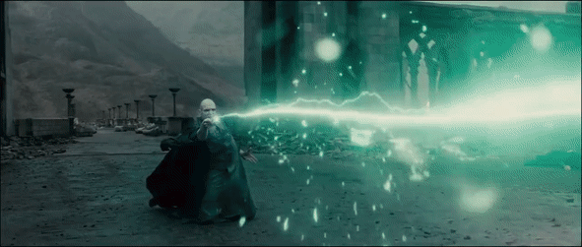
Reward M Question
Voldemort attacks!
Notes:
Click “A” or “B” to reveal a reward/penalty.

Slide 31
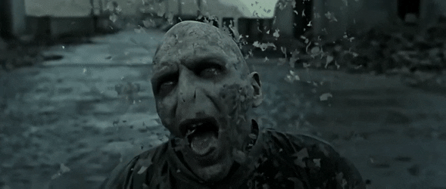
Reward M - B
You won!
Notes:
Click the Hogwarts icon to go back the question-choosing slide.

Slide 32
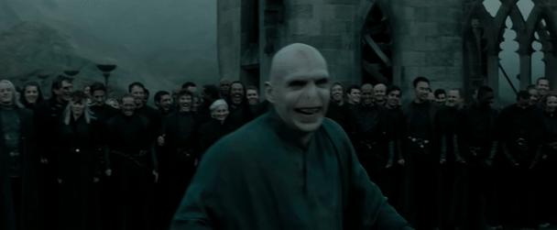
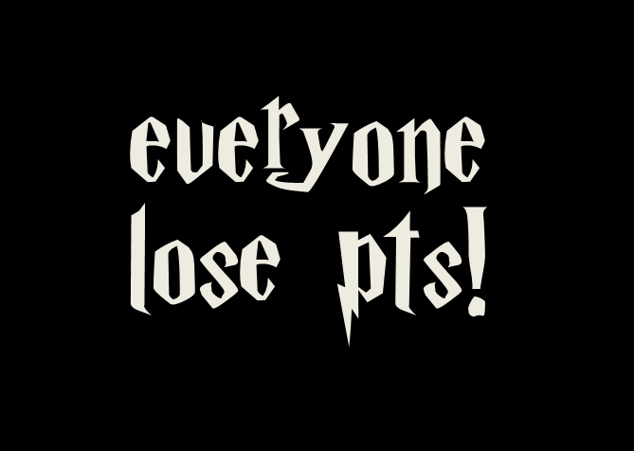
Reward M - A
You lost!
Notes:
Click the Hogwarts icon to go back the question-choosing slide.

Slide 33







Reward N
Choose 3 classes to take…
Muggle Studies
History of Magic
Potions
Divination
Astronomy
Defense
Against
Dark Arts
Magical Theory
Care of
Magical Creatures
Charms
Herbology
Notes:
Click a book to reveal a reward/penalty.
Students choose 3 books.
If they find a bomb (the Death Eater icon), they lose the points they earned and cannot continue choosing books.
If there’s nothing behind a book, that means 0 points/no points added the total. A number is the number of points.
Click the Hogwarts icon to go back the question-choosing slide.

Slide 34
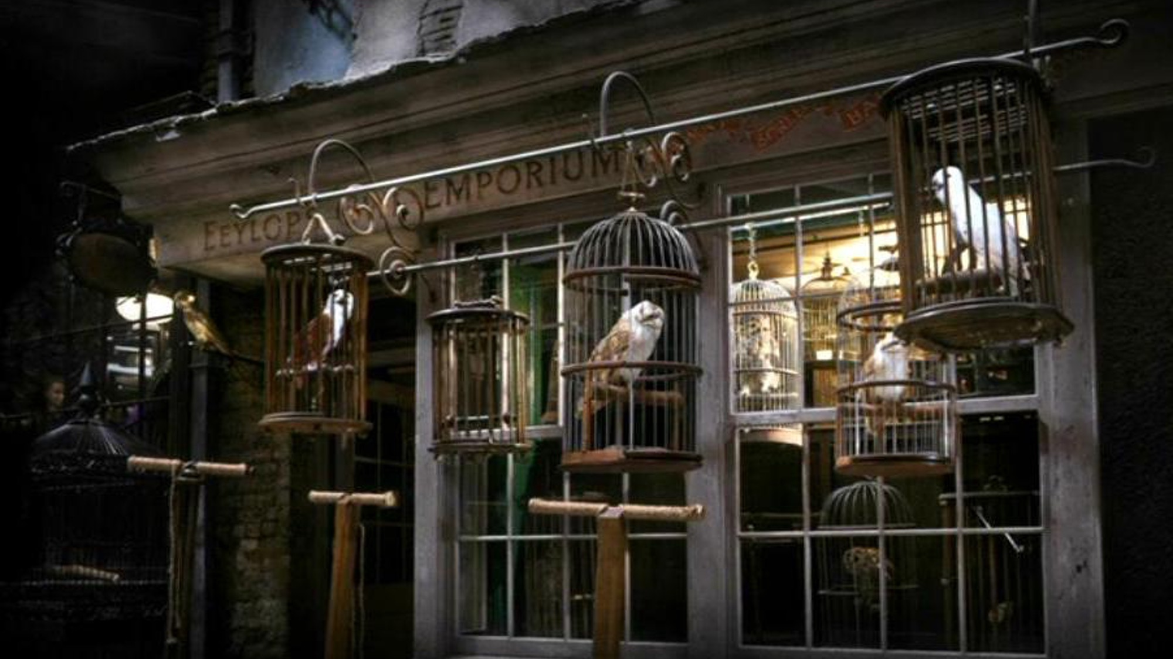
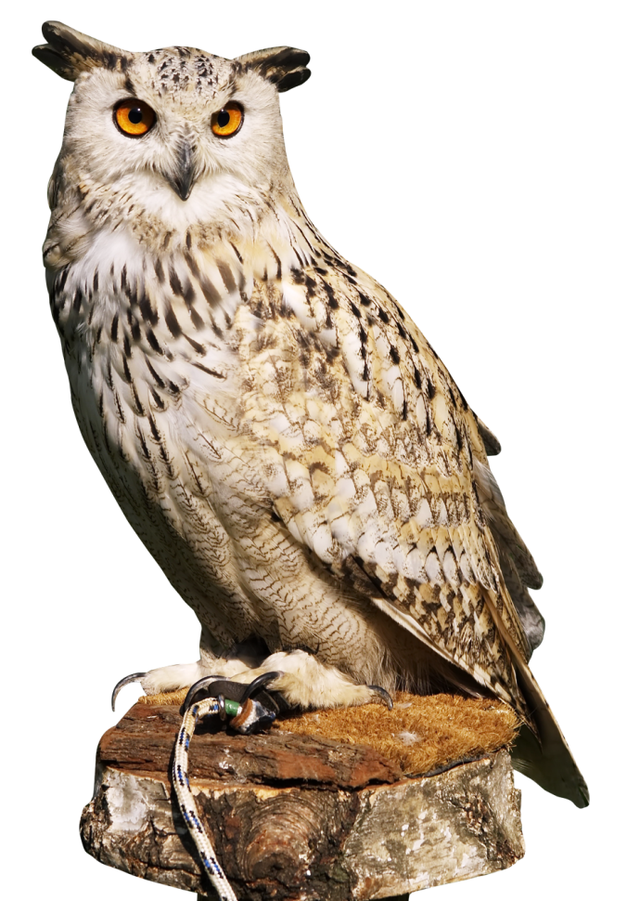
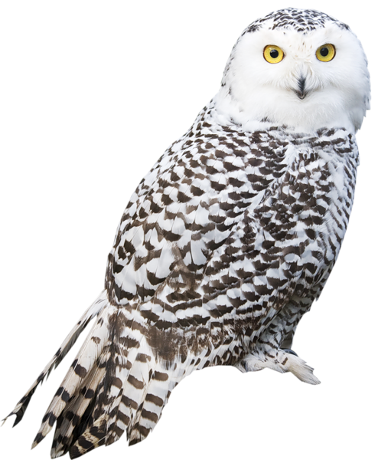

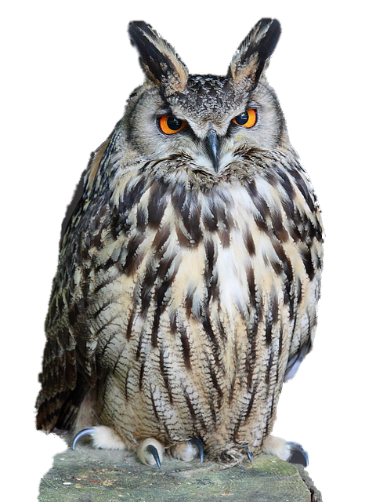
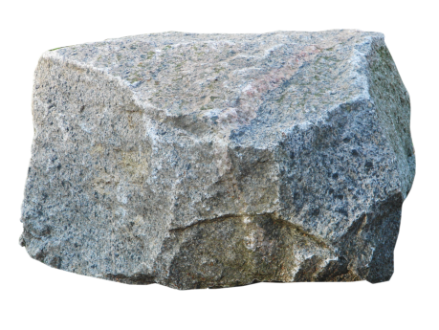
Reward P
Choose your pet owl…
Notes:
Click an owl to reveal a reward/penalty.
Click the Hogwarts icon to go back the question-choosing slide.

Slide 35

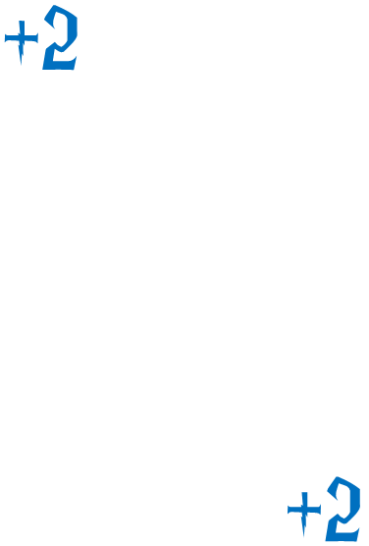

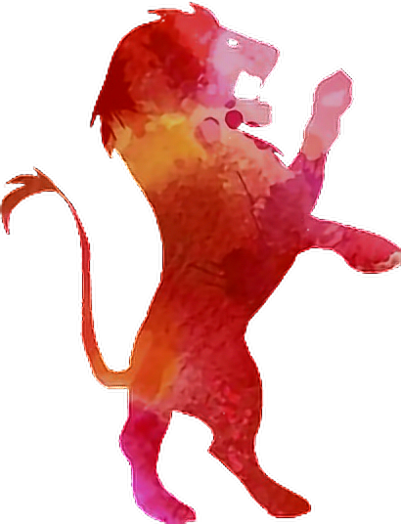

Reward T
Test your luck!
Keep the card you have or draw more for more points. But beware! If you find a bomb the game is over and you lose all your points.
Notes:
Click the cards to make a reward appear.
Ask the students if they want to keep the reward or click again to add more points, but at the risk of finding a bomb.
Repeat that process until they either decide to keep their points, or reach the BOMB! card.
Click the Hogwarts icon to go back the question-choosing slide.

Slide 36
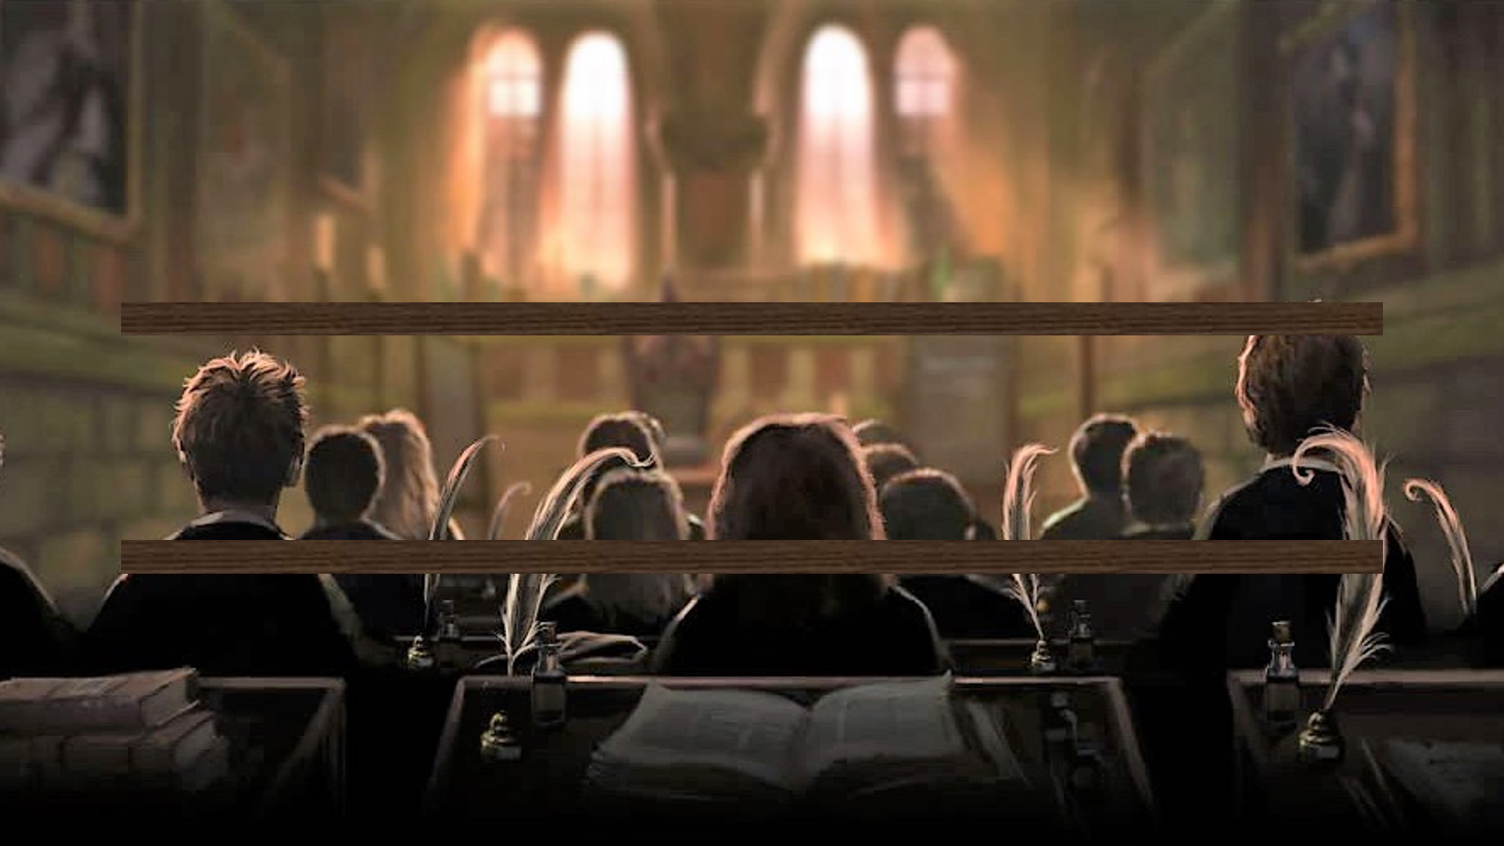
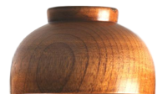


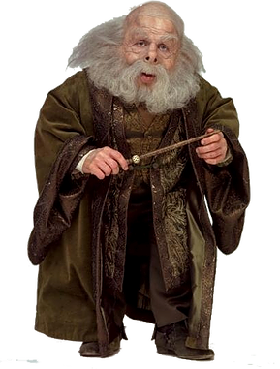

Reward U
Cast Wingardium Leviosa on 3 bowls to reveal your points…
1
2
3
4
5
6
7
8
9
10
11
12
Notes:
Click a bowl to make a reward/penalty appear.
Students choose 3 bowls.
If they find a bomb (the Death Eater icon), they lose the points they earned and cannot continue choosing bowls.
If there’s nothing under a bowl, that means 0 points/no points added the total. A number is the number of points.
Click the Hogwarts icon to go back the question-choosing slide.

Slide 37
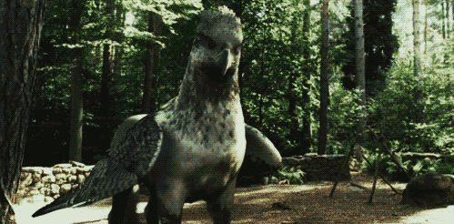
Reward W Question
You find a hippogriff
in the forest.
Notes:
Click “A” or “B” to reveal a reward/penalty.

Slide 38
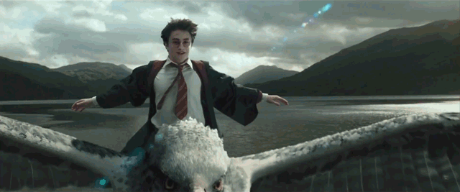
Reward W - A
It sees you
as a friend!
Notes:
Click the Hogwarts icon to go back the question-choosing slide.

Slide 39
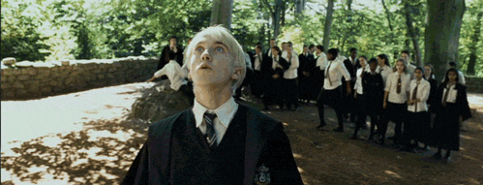
Reward W - B
It sees you
as an enemy!
Notes:
Click the Hogwarts icon to go back the question-choosing slide.

Slide 40
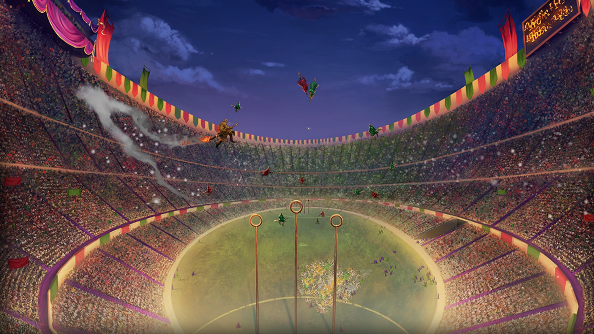

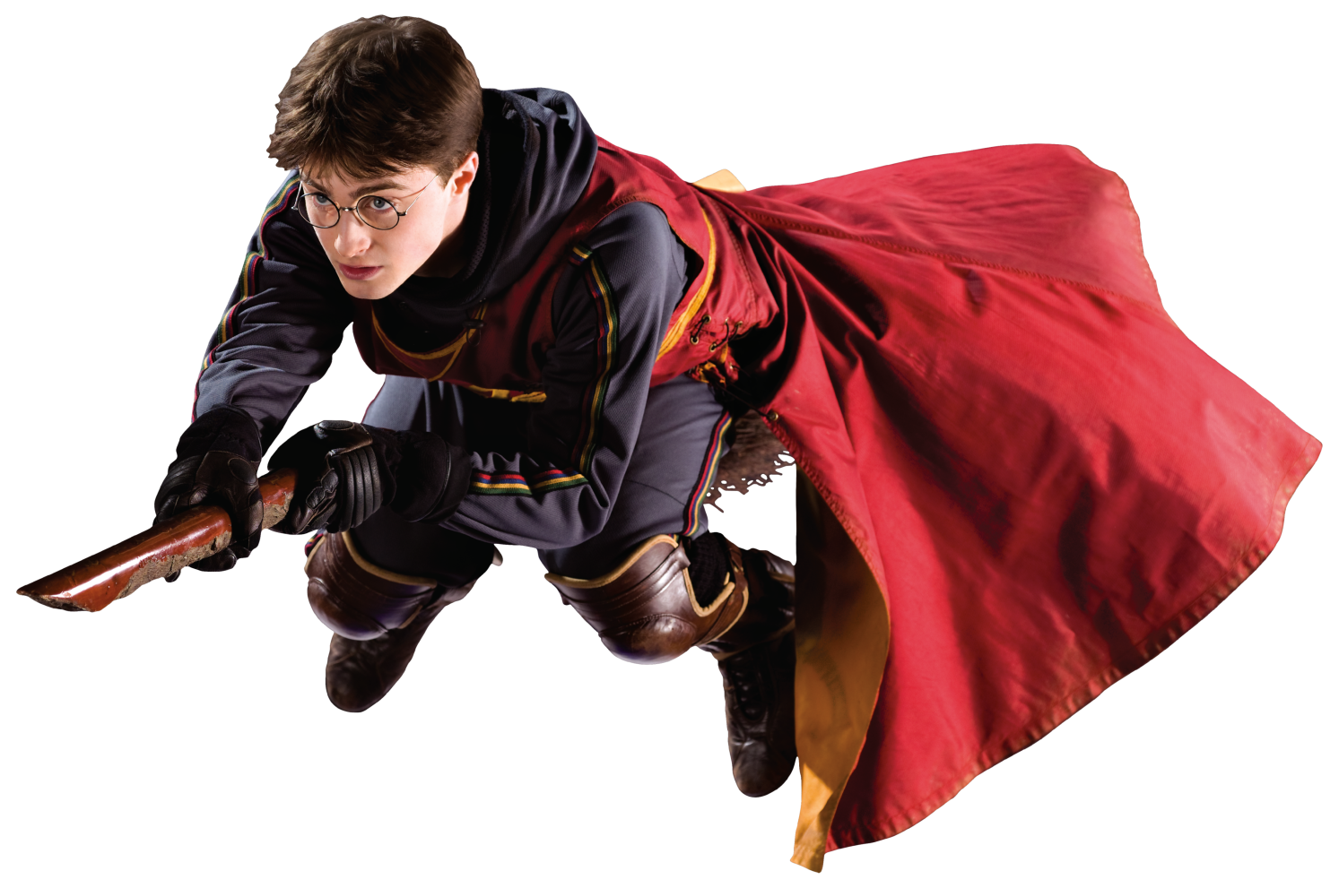
Reward B, K, Q, V
Catch the golden snitch for 10pts!
Notes:
Click the wheel to spin it.
The golden snitch is worth 10pts and the Death Eater icon is worth 0pts.
Click the Hogwarts icon to go back the question-choosing slide.

Slide 41



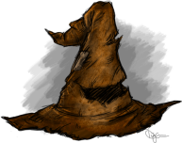







Reward X
Notes:
Click a sorting hat to reveal a reward/penalty.
Students choose 4 sorting hats.
If they find a bomb (the Death Eater icon), they lose the points they earned and cannot continue choosing hats.
Point values are indicated on the right.
Click the Hogwarts icon to go back the question-choosing slide.

Slide 42

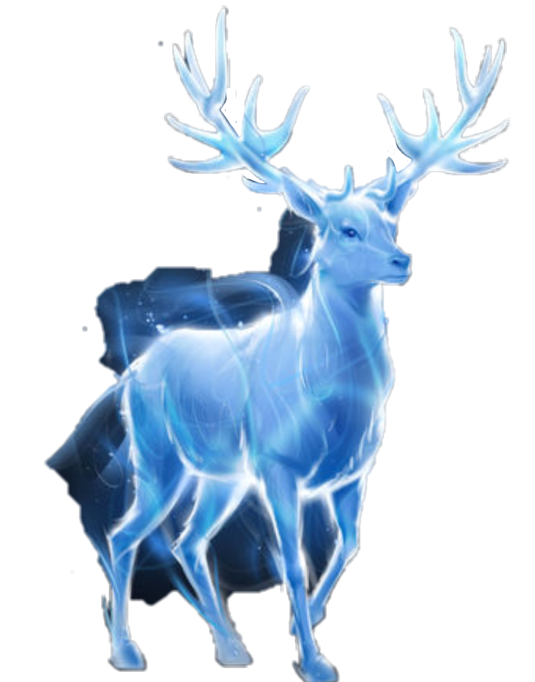

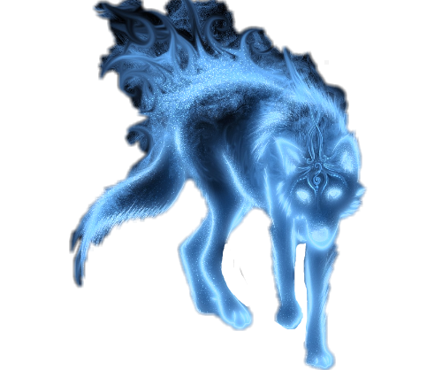
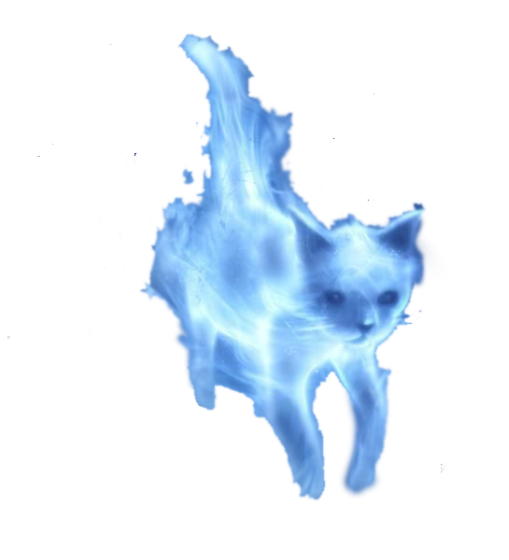
Reward S
Choose your Patronus…
Notes:
Click a Patronus to reveal a reward/penalty.
Click the Hogwarts icon to go back the question-choosing slide.

