Slide 1

Nats UI With Fyne
https://github.com/devalexandre/broker-ui
https://www.linkedin.com/in/devevantelista/

Slide 2
Who I’m
Hi! I’m Alexandre Evangelista de Souza — Brazilian coder, dad of 3 amazing girls, and proud survivor of the wild web era.
I’ve been coding since 2006 — yes, before TikTok, before cloud-native, even before “Go” was cool.
Today? Go is my home. My passion? Distributed systems — because losing a message in production is basically a crime against humanity.
And yes — I have three daughters. They’re my greatest joy… and my toughest QA team. When they ask, “Daddy, tell me a story?”
I say:
“Once upon a time, there was a NATS broker… and it dropped a message.” They don’t laugh. But they still hug me. ❤️

Slide 3
Why Fyne? (Why Not React? Or Electron?)
🚫 “I didn’t want to bundle 200MB of Chrome just to show a button.”
✅ One Binary. Zero Dependencies. go build → instant native app. No Node. No npm. No bloat.
✅ Native Look & Feel. Looks like macOS on Mac. Like Windows on Windows. Fyne handles it all.
✅ Go Code = UI Code. button := widget.NewButton("Send", func() { publish(msg) })
No JSX. No virtual DOM. Just Go.
✅ Built-in Themes & Icons. Dark/Light toggle? One line. PNG icons embedded? Done. No CSS wars. Ever.
✅ Responsive by Default. Resize the window? Widgets adapt. No media queries needed.
✅ 10–25 MB. Not 500 MB.

Slide 4
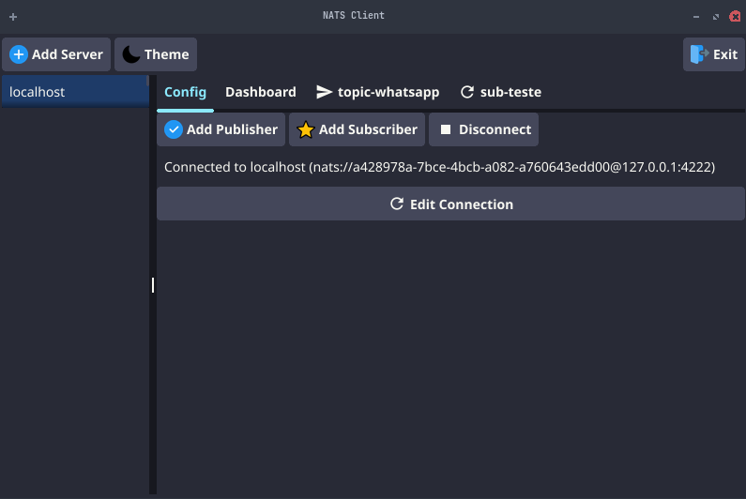
The Interface? So Simple, Even Your Dad Could Use It.
🧠 “No Training Needed. Just Click. Send. See.”

Slide 5
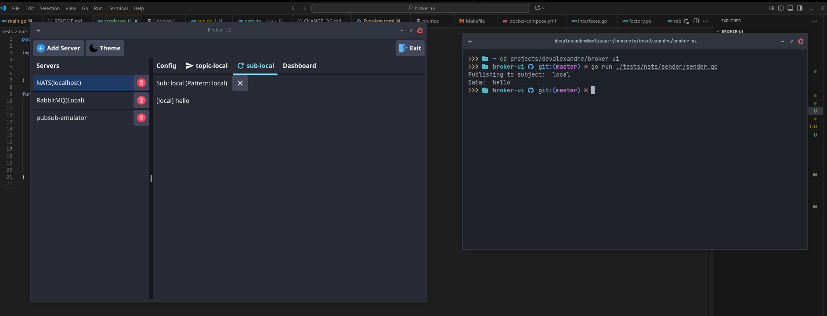
The Goal is all brokers

Slide 6
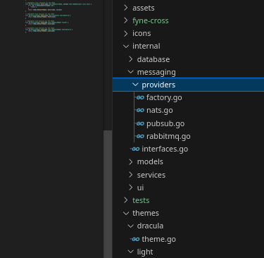
The Goal is all brokers (Providers)

Slide 7
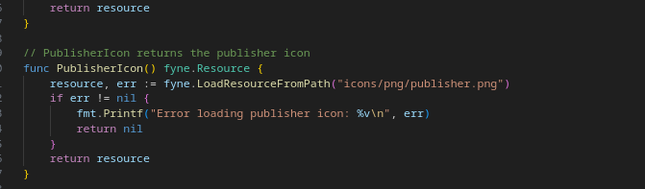
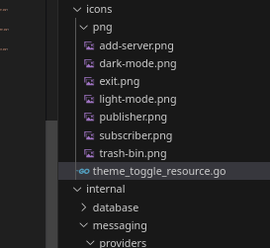
easy to use custom icons

Slide 8
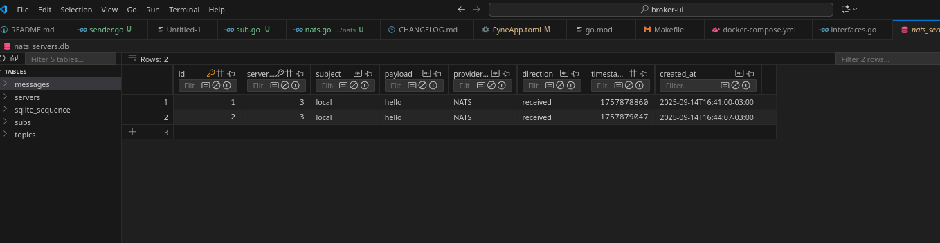
Audit messages

