Slide 1

Fyne Vision
To be the best toolkit
for developing beautiful,
native graphical applications
across all platforms.

Slide 2

Why?
Building cross platform graphical applications can be complicated, slow and difficult to test.
We will redefine GUI development, making it easy to learn, intuitive and simple to achieve high test coverage.
Fyne user interfaces can be deployed to any graphical devices with a single code base.

Slide 3
In 3 years
To become the new standard for native graphical application development.
With IDE plugins, WYSIWYG editors and supporting services apps developed will work seamlessly
across all popular devices.

Slide 4
6 months
Release APIs for desktop and mobile app delivery on a single codebase
App configuration and data to be syncronised across all devices
Delivery of applications through
a cross platform app store

Slide 5
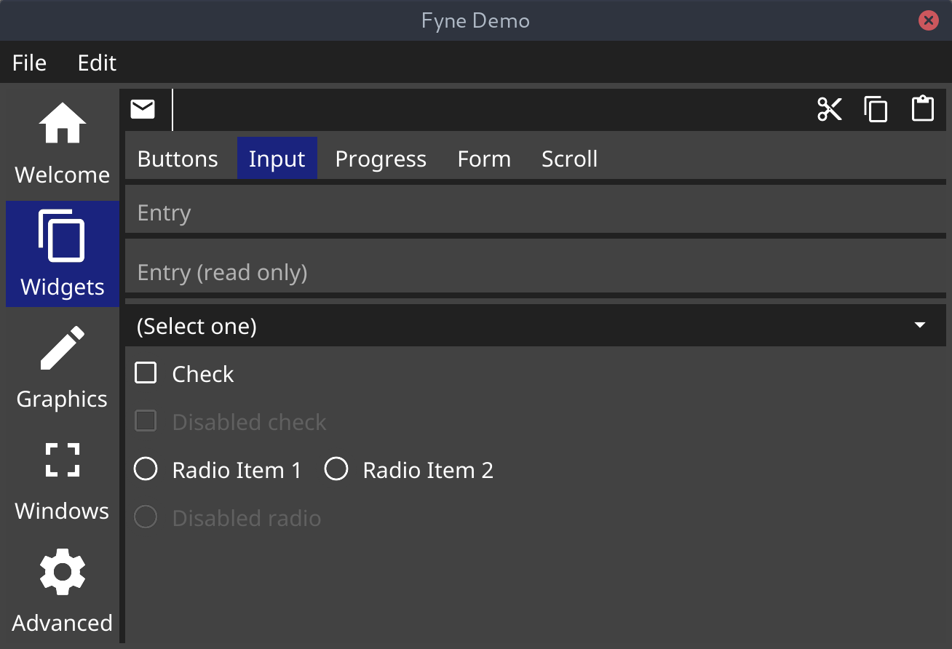
Widgets

Slide 6
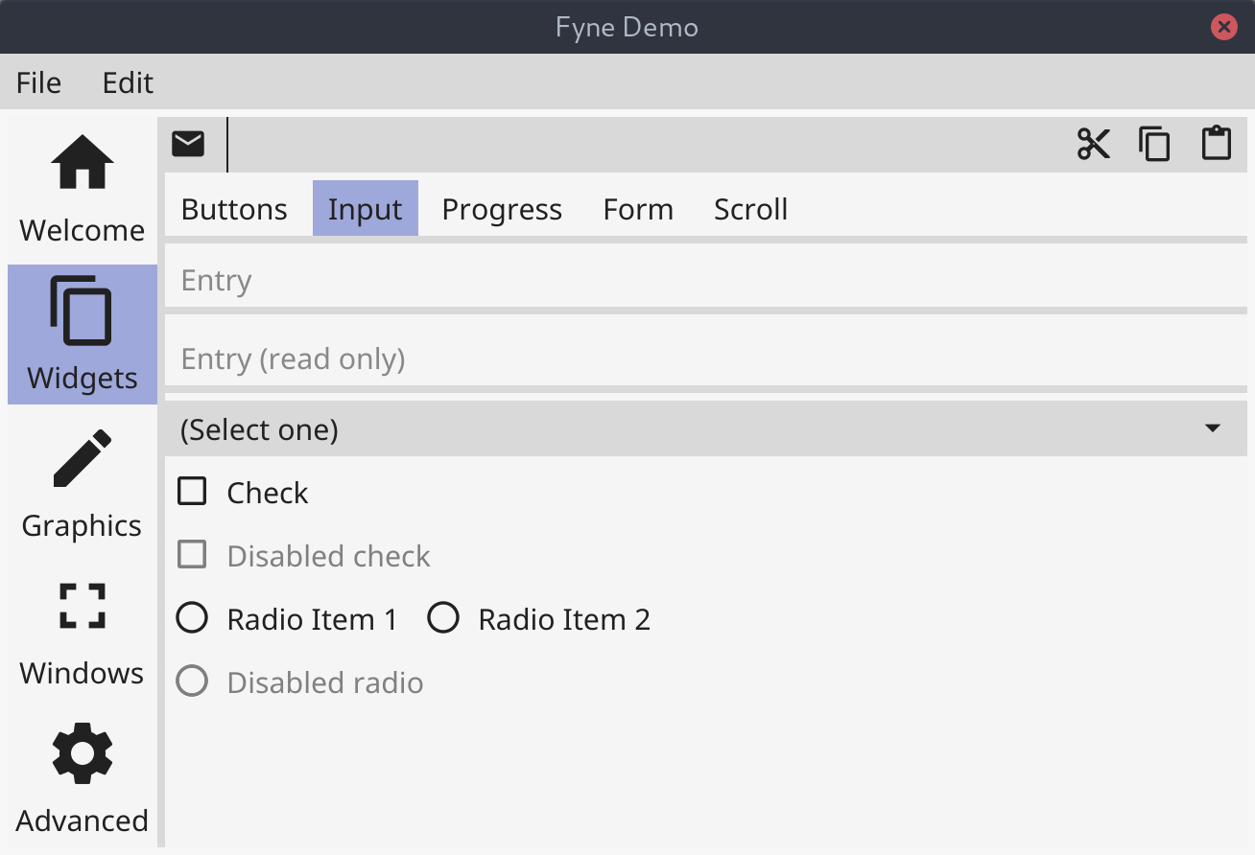
Widgets (light)

