Slide 1

Attributes

Slide 2
What is an attribute?
By themselves, attributes don’t actually do anything. However, they are certainly useful.
Informs compiler how to proceed with particular code
Attributes can be applied to large code elements: assemblies, modules, classes, types, methods, properties, etc.
Base purpose is to assign metadata to code that has been written

Slide 3
Attributes
Inherit from base type attribute lets compiler know class is an attribute
class SampleAttribute : Attribute
C# will drop the attribute part that is appended to a name, but you can leave the full name.
[Sample]

Slide 4
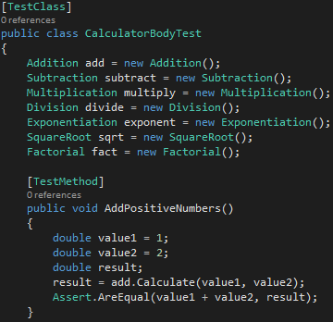
Attributes
[TestClass]
[TestMethod]
Tests specific method

Slide 5
Attributes
[HttpGet]
Get request is when a user views a page
[HttpPost]
Post request is when a user submits a form
[ValidateAntiForgeryToken]
Prevents cross-site forgeries

Slide 6
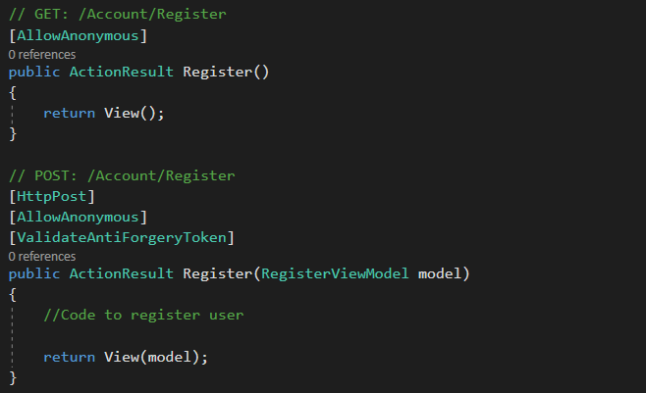
Example

Slide 7
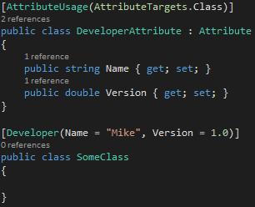
Attributes
Predefined
200-plus attributes in .NET library
Custom

