Slide 1
Simulating Schwarzschild and Kerr Black Hole Geodesics
Fynn Hufler
MSc Physics
Dec 3rd 2025, Austin

Slide 2
Table of Contents
Introduction
Schwarzschild Black Holes
Theory and Computational Implementation
Results and Visualization
Kerr Black Holes
Theory and Computational Implementation
Results and Visualization
Conclusion

Slide 3

Introduction
Problem – Solve geodesic equations in curved spacetime for timelike and null trajectories
Geodesic Equation:
$\frac{d^{2}x^{μ}}{dλ^{2}}+Γ_{αβ}^{μ}\frac{dx^{α}}{dλ}\frac{dx^{β}}{dλ}=0$
Christoffel Symbols:
$Γ_{αβ}^{μ}=\frac{1}{2}g^{μν}\left(∂_{α}g_{νβ}+∂_{β}g_{να}−∂_{ν}g_{αβ}\right)$
$\text{Metrics} \text{Considered}\text{:}$
Schwarzschild (a = 0): Spherical Symmetry
Kerr (a $≠\text{ 0): }\text{Axial} \text{Symmetry}$
Numerical Method:
DOP853 (8th order RK)

Slide 4

Schwarzschild – Theory and Implementation
Schwarzschild Metric (Boyer-Lindquist, $θ= π/2):$
$ds^{2}=−f\left(r\right) dt^{2}+f{\left(r\right)}^{−1}dr^{2}+r^{2}dφ^{2}, where f\left(r\right)=1−\frac{r_{s}}{r}=1−\frac{2M}{r}$
Killing Vectors & Conserved Quantities:
Time translation: $E=−p_{t}=f\left(r\right) u^{t}$
Axial rotation: $L=p_{φ}=r^{2}u^{φ}$
Geodesic Equations from Christoffel Symbols (equatorial, $θ=π/2$):
$\frac{d^{2}t}{dτ^{2}}=({2M}/{r^{2}f)u^{t}u^{r}}$
$\frac{d^{2}r}{dτ^{2}}=-({Mf}/{r^{2})u^{t}u^{t}+(M/{r^{2}f)u^{r}u^{r}+(r-2M)u^{Φ}u^{Φ}}}$
$\frac{d^{2}φ}{dτ^{2}}=−\frac{2}{r}u^{r}u^{φ}$
Normalization:
$g_{μν}u^{μ}u^{ν}=−1$ (timelike) | $g_{μν}u^{μ}u^{ν}=0$ (null)

Slide 5

Schwarzschild – Theory and Implementation
Implementation Details:
State Vector:
$y=\left[ t, r, φ, u^{t}, u^{r}, u^{φ} \right]$
Initial Conditions (from conserved quantities):
Given: $r_{0},φ_{0},E,L\left(orb=L/E\right)$
$u_{t}=E/{f(r_{0})}$
$u^{φ}=L/{r_{0}^{2}}$
from normalization constraints:
Null: ${\left(u^{r}\right)}^{2}=E^{2}−f\left(r_{0}\right)\frac{L^{2}}{r_{0}^{2}}$
Timelike: ${\left(u^{r}\right)}^{2}=E^{2}−\left(1+\frac{L^{2}}{r_{0}^{2}}\right)f\left(r_{0}\right)$

Slide 6
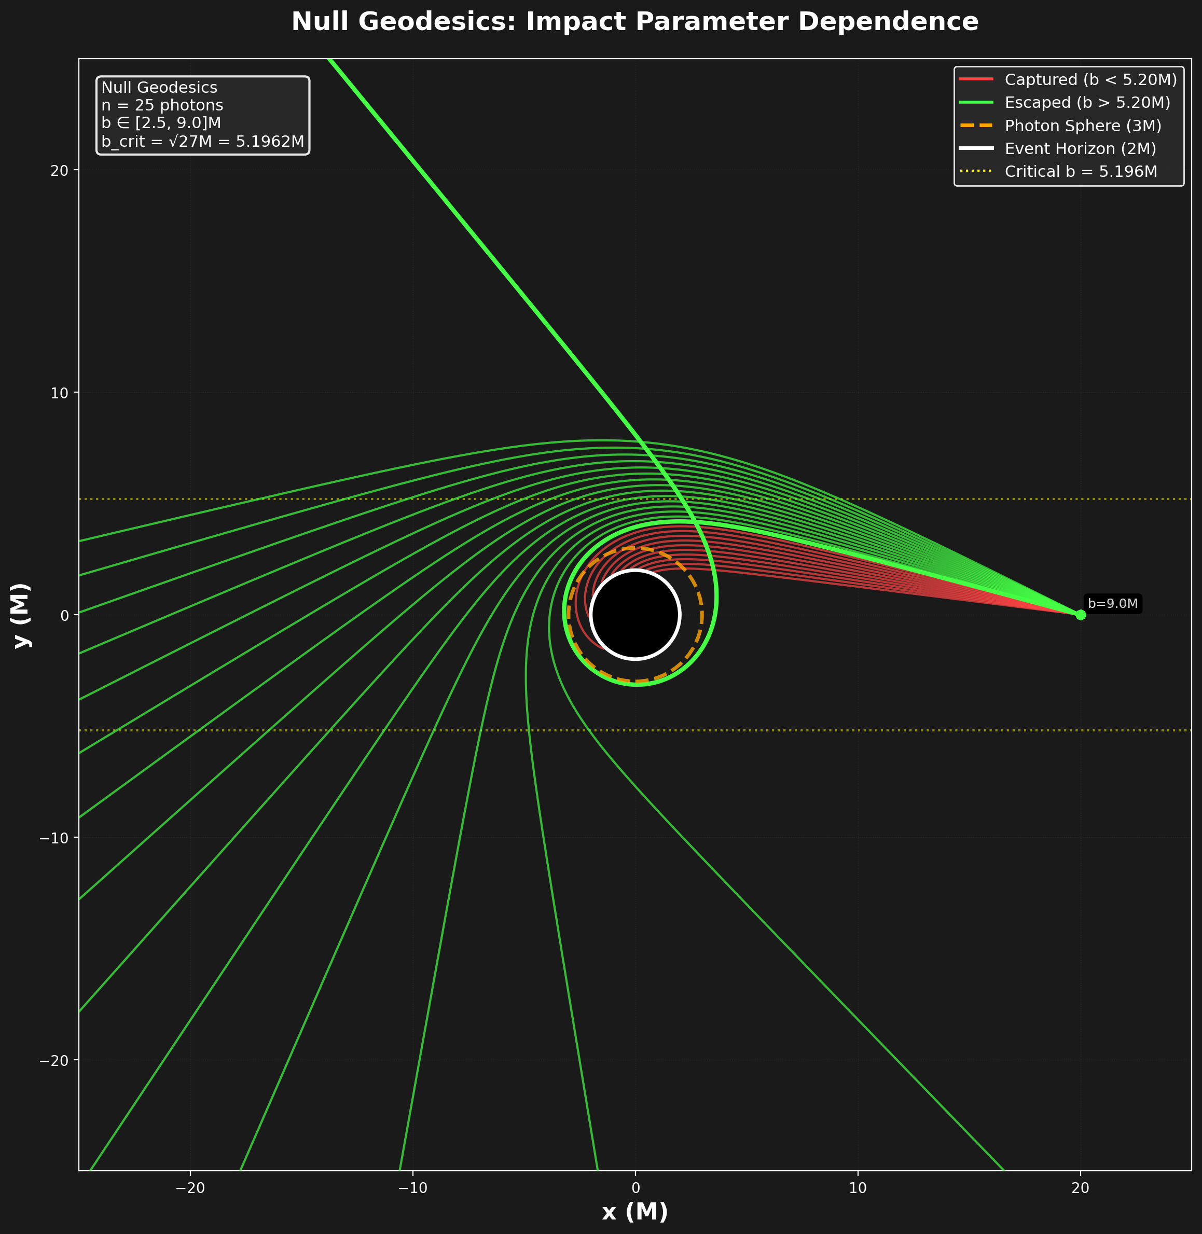

Schwarzschild – Results: Null Geodesics
Results:
$b < b_{crit} → captured, eventually crosses horizon$
$b > b_{crit} →scattered, returns to r →∞$
$b≈b_{crit}→unstable circular orbit, sensitive to initial cond.$
Clear bifurication at critical impact parameter
Constraint Violations (over full trajectory):
Energy: $\left|\frac{ΔE}{E}\right|<{10}^{−15}$
Angular Momentum: $\left|\frac{ΔL}{L}\right|<{10}^{−15}$
Null constraint: $\left|g_{μν}u^{μ}u^{ν}\right|<{10}^{−14}$

Slide 7
Schwarzschild – Results: Null Geodesics
Results:
$b < b_{crit} → captured, eventually crosses horizon$
$b > b_{crit} →scattered, returns to r →∞$
$b≈b_{crit}→unstable circular orbit, sensitive to initial cond.$
Clear bifurication at critical impact parameter
Constraint Violations (over full trajectory):
Energy: $\left|\frac{ΔE}{E}\right|<{10}^{−15}$
Angular Momentum: $\left|\frac{ΔL}{L}\right|<{10}^{−15}$
Null constraint: $\left|g_{μν}u^{μ}u^{ν}\right|<{10}^{−14}$

Slide 8
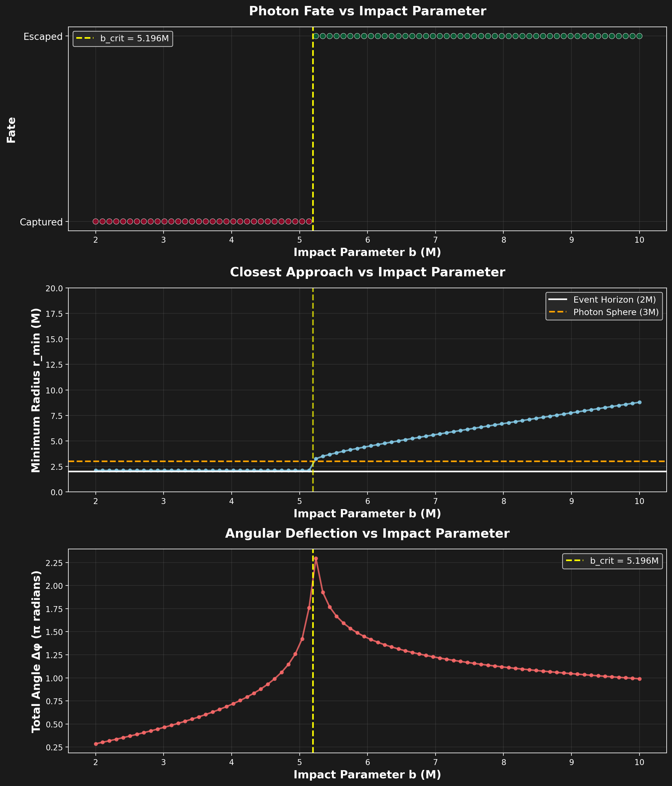
Schwarzschild – Scattering Experiment

Slide 9
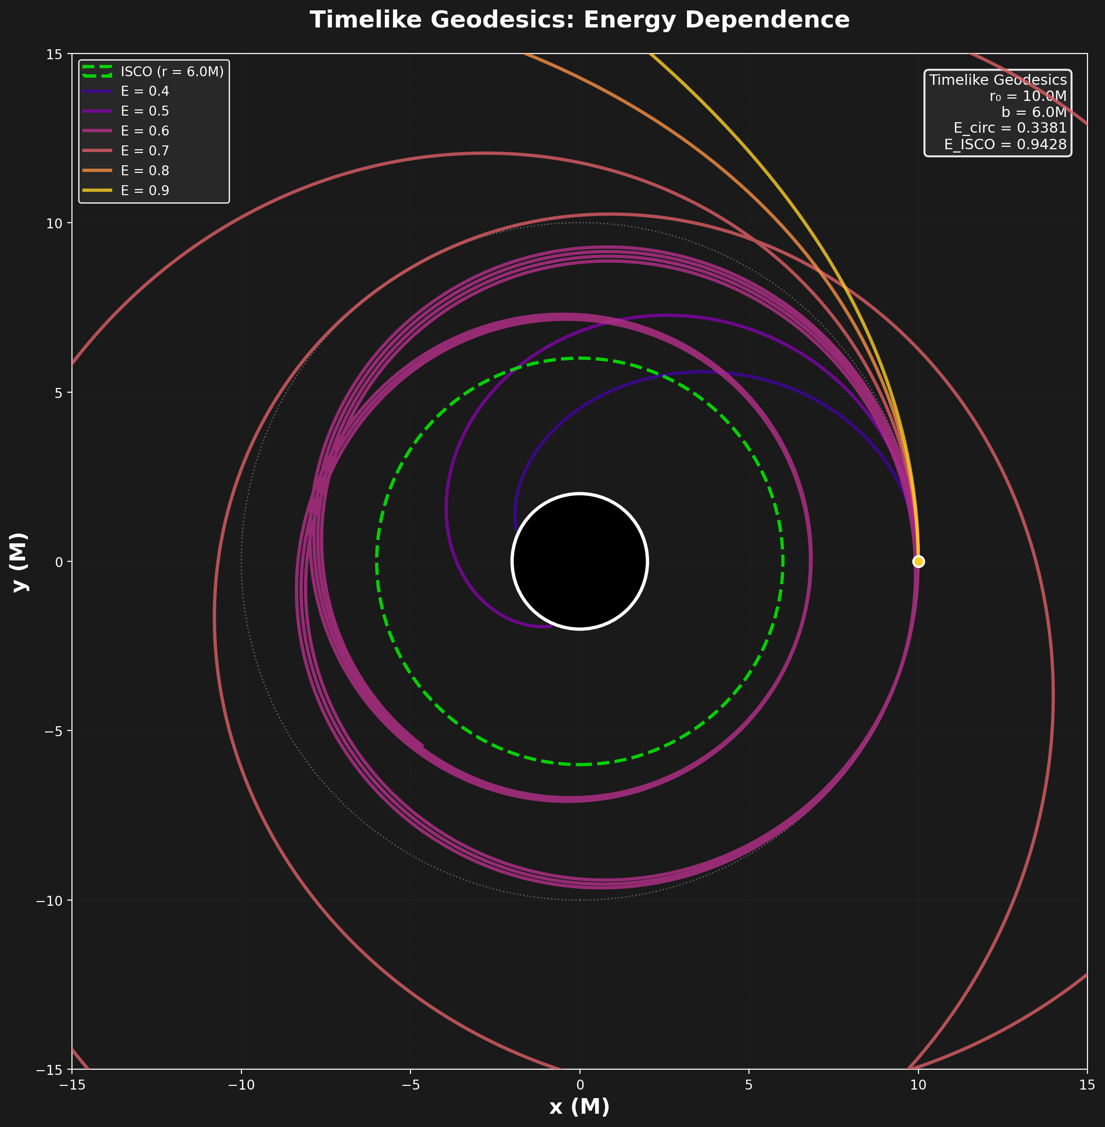

Schwarzschild – Results: Timelike Geodesics
Energy Constraint Analysis:
Effective Potential:
$$V_{eff}^{massive}= (1 + {L^{2}}/{r^{2})(1 – {2M}/r)}$$
Radial turning points satisfy:
$$E^{2}=V_{eff}(r_{crit})$$
For circular orbits at r:
$$E_{circ}(r)=\sqrt{{(r−2M)}/{(r−3M)}}/\sqrt{r}$$
$$L_{circ}(r)=M\sqrt{r/{(r−3M)}}$$
ISCO (innermost stable circular orbit) Analysis (r=6M):
$$E_{ISCO}≈0.943$$
$$L_{ISCO}≈3.464M$$
$$E < E_{circ}(r) →Bound orbits$$

Slide 10

Schwarzschild – Results: Timelike Geodesics
Energy Constraint Analysis:
Effective Potential:
$$V_{eff}^{massive}= (1 + {L^{2}}/{r^{2})(1 – {2M}/r)}$$
Radial turning points satisfy:
$$E^{2}=V_{eff}(r_{crit})$$
For circular orbits at r:
$$E_{circ}(r)=\sqrt{{(r−2M)}/{(r−3M)}}/\sqrt{r}$$
$$L_{circ}(r)=M\sqrt{r/{(r−3M)}}$$
ISCO (innermost stable circular orbit) Analysis (r=6M):
$$E_{ISCO}≈0.943$$
$$L_{ISCO}≈3.464M$$
$$E < E_{circ}(r) →Bound orbits$$

Slide 11
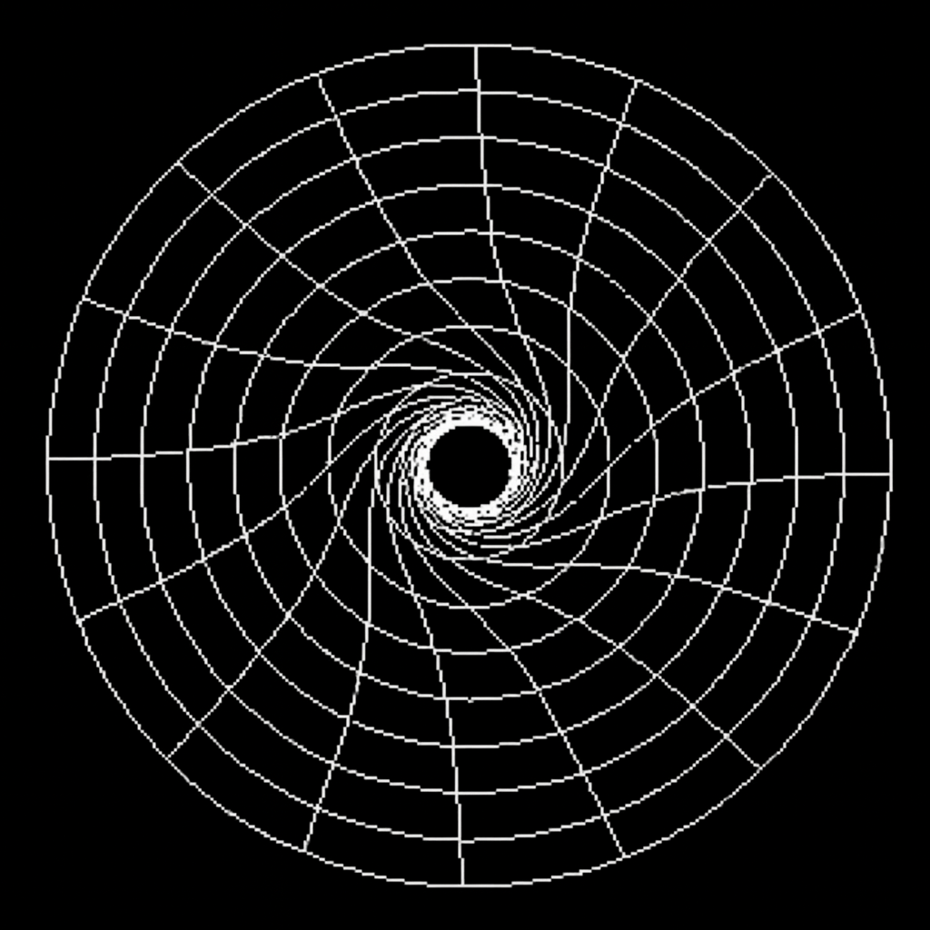

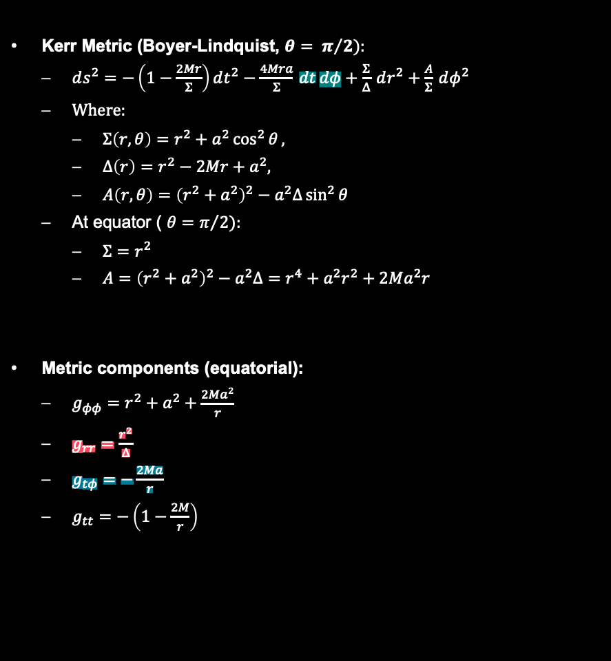
Kerr – Theory and Implementation
Kerr Metric (Boyer-Lindquist, $θ= π/2):$
$ds^{2}=−\left(1−\frac{2Mr}{Σ}\right)dt^{2}−\frac{4Mra}{Σ} dt dφ+\frac{Σ}{Δ} dr^{2}+\frac{A}{Σ} dφ^{2}$
Where:
$Σ\left(r,θ\right)=r^{2}+a^{2}\cos^{2}{θ},$
$Δ\left(r\right)=r^{2}−2Mr+a^{2},$
$A\left(r,θ\right)={\left(r^{2}+a^{2}\right)}^{2}−a^{2}Δ\sin^{2}{θ}$
At equator ( $θ=π/2):$
$Σ=r^{2}$
$A={\left(r^{2}+a^{2}\right)}^{2}−a^{2}Δ=r^{4}+a^{2}r^{2}+2Ma^{2}r$
$\text{Metric} \text{components}\text{ (}\text{equatorial}\text{):}$
$g_{φφ}=r^{2}+a^{2}+\frac{2Ma^{2}}{r}$
$g_{rr}=\frac{r^{2}}{Δ}$
$g_{tφ}=−\frac{2Ma}{r}$
$g_{tt}=−\left(1−\frac{2M}{r}\right)$
Event Horizons ($∆=0):$
$r_{±}=M±\sqrt{M^{2}−a^{2}}$
Outer horizon: $r_{+}$
$\text{Inner} \text{horizon}\text{: }r_{−},$
$$\text{Extremal} \text{limit}\text{: }a=M⇒r_{±}=M$$
Ergosphere ($g_{tt}=0):$
$r_{ergo} = 2M$
$r_{+}< r <r_{ergo}$
$Frame Dragging (angular velocity of ZAMO1$):
$ω_{H}=\frac{a}{,r_{+}^{2}+a^{2},} at horizon$
$ω=−\frac{g_{tφ}}{g_{φφ}}=\frac{2Mra}{A}$
Visualization of Frame Dragging
Stationary limit surface

Slide 12


Kerr – Theory and Implementation
Non-zero Christoffel Symbols (equatorial):
$$\text{Limit} a→0: \text{Schwarzschild}$$
$$Γ_{tr}^{φ}=−\frac{Ma}{Σ^{2}Δ},$$
$$Γ_{rφ}^{φ}=\frac{1}{r},$$
$$Γ_{tφ}^{r}=\frac{2aM^{2}r}{Σ^{3}},$$
$$Γ_{φφ}^{r}=−\frac{Δr}{Σ},$$
$$Γ_{rr}^{r}=\frac{Mr^{2}−Ma^{2}−rΔ}{ΣΔ},$$
$$Γ_{tt}^{r}=\frac{MΔ\left(r^{2}−a^{2}\right)}{Σ^{3}},$$
$$Γ_{rφ}^{t}=\frac{Ma\left(r^{2}−2Mr+a^{2}\right)}{Σ^{2}Δ},$$
$$Γ_{tr}^{t}=\frac{Mr}{Σ^{2}Δ},$$
Geodesic Equations¹⁾ (equatorial):
$$\frac{d^{2}φ}{dτ^{2}}=−2,Γ_{rφ}^{φ},u^{r}u^{φ}−2,Γ_{tr}^{φ},u^{t}u^{r},$$
$$\frac{d^{2}r}{dτ^{2}}=−Γ_{tt}^{r}{\left(u^{t}\right)}^{2}−Γ_{rr}^{r}{\left(u^{r}\right)}^{2}−Γ_{φφ}^{r}{\left(u^{φ}\right)}^{2}−2,Γ_{tφ}^{r},u^{t}u^{φ},$$
$$\frac{d^{2}t}{dτ^{2}}=−2,Γ_{tr}^{t},u^{t}u^{r}−2,Γ_{rφ}^{t},u^{r}u^{φ},$$
Conservation (from Killing vectors):
$$L=p_{φ}=g_{tφ}u^{t}+g_{φφ}u^{φ}$$
$$E=−p_{t}=−\left(g_{tt}u^{t}+g_{tφ}u^{φ}\right),$$

Slide 13
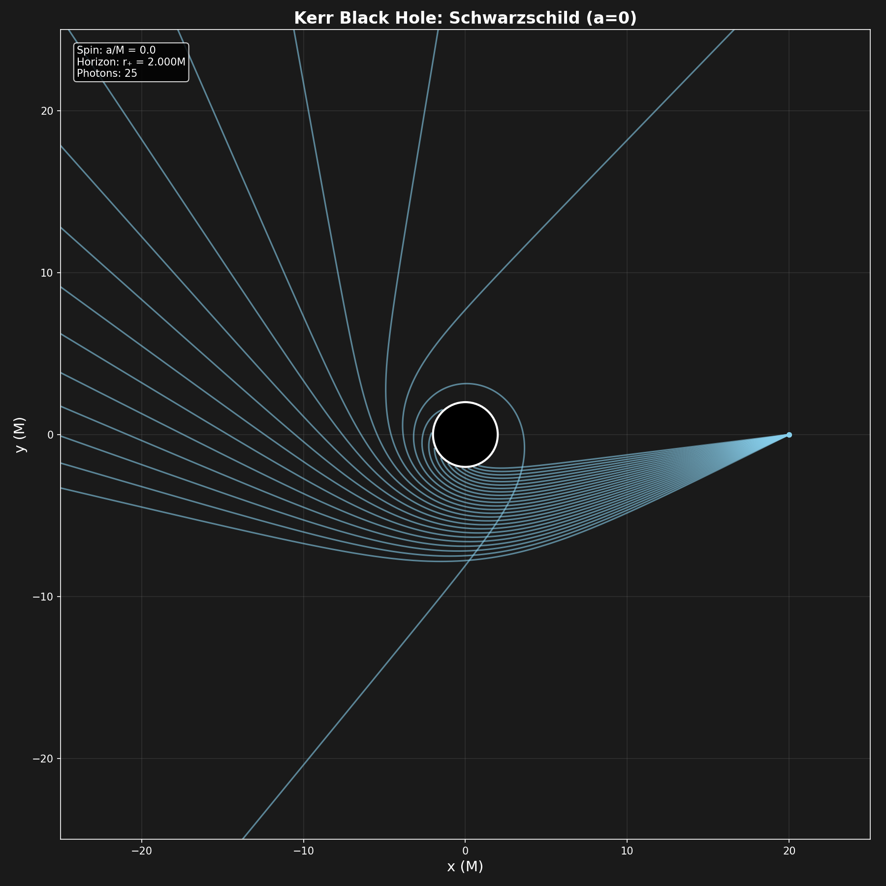
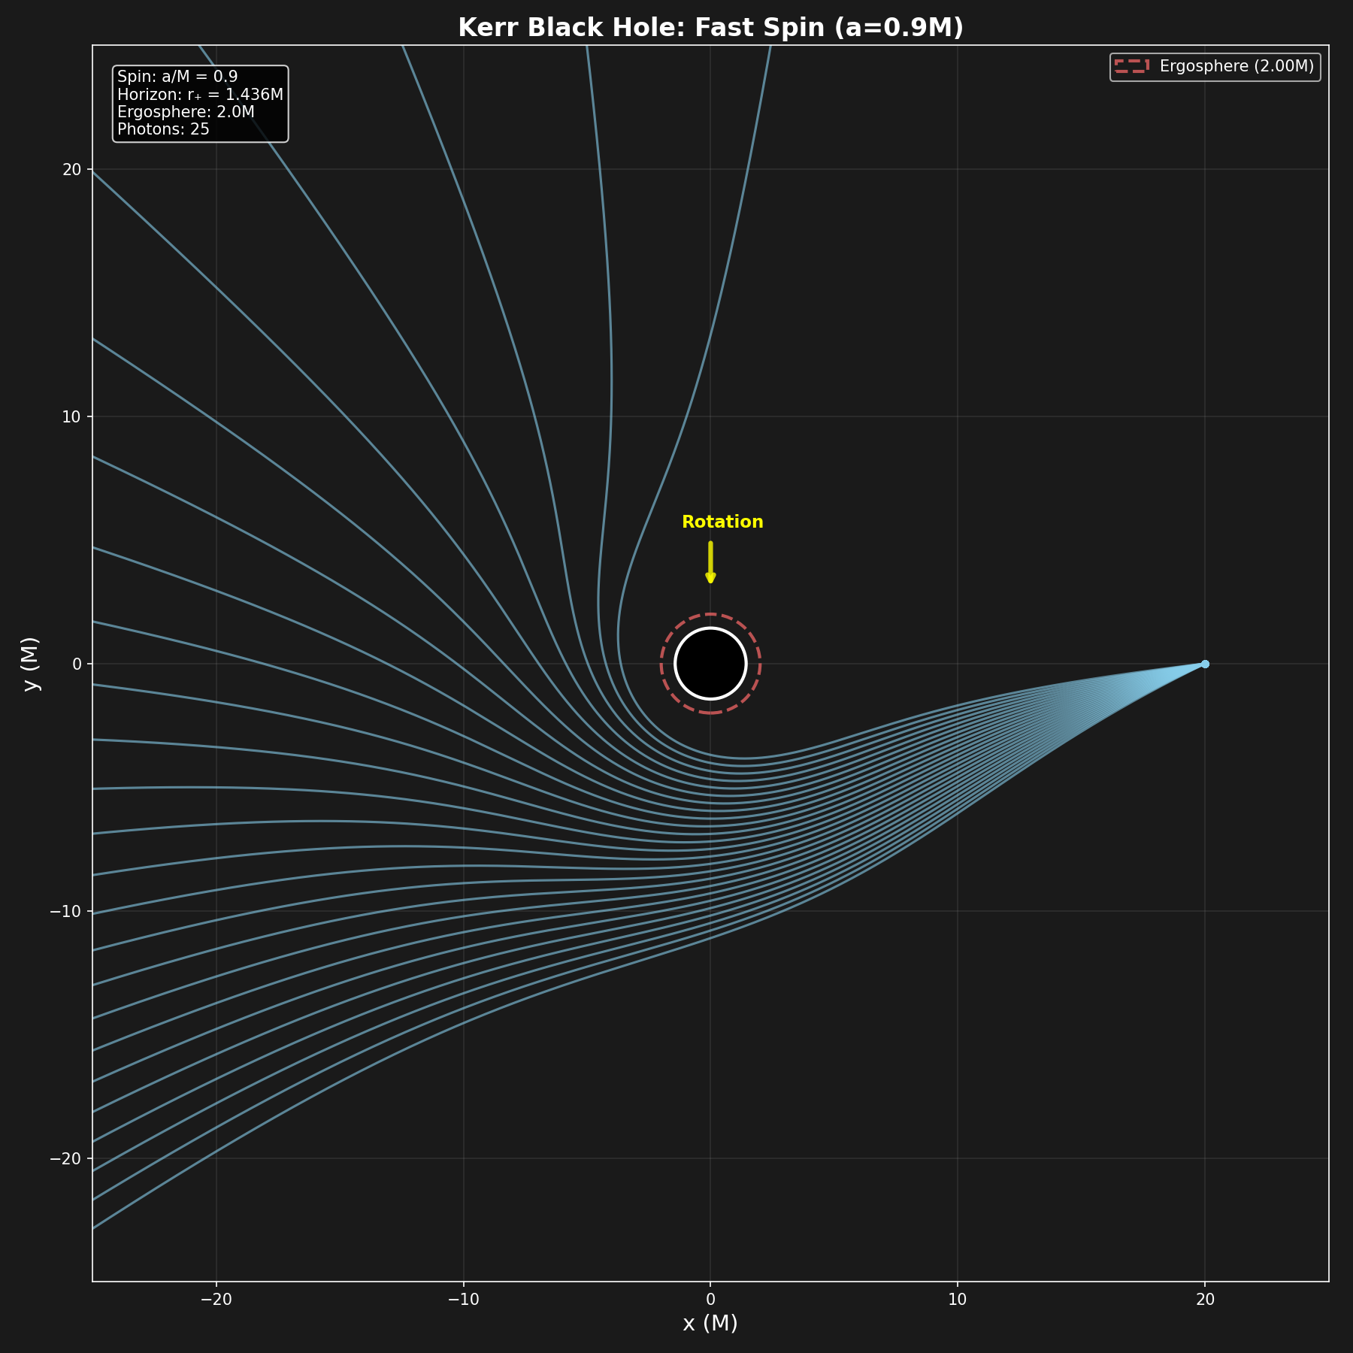
Kerr – Results: Null Geodesics
Constraint Violations (over full trajectory): Energy: $\left|\frac{ΔE}{E}\right|<{10}^{−14},$Angular Momentum: $\left|\frac{ΔL}{L}\right|<{10}^{−14},$Null constraint: $\left|g_{μν}u^{μ}u^{ν}\right|<{10}^{−13}$

Slide 14
Kerr – Results: Null Geodesics
Constraint Violations (over full trajectory): Energy: $\left|\frac{ΔE}{E}\right|<{10}^{−14},$Angular Momentum: $\left|\frac{ΔL}{L}\right|<{10}^{−14},$Null constraint: $\left|g_{μν}u^{μ}u^{ν}\right|<{10}^{−13}$

Slide 15
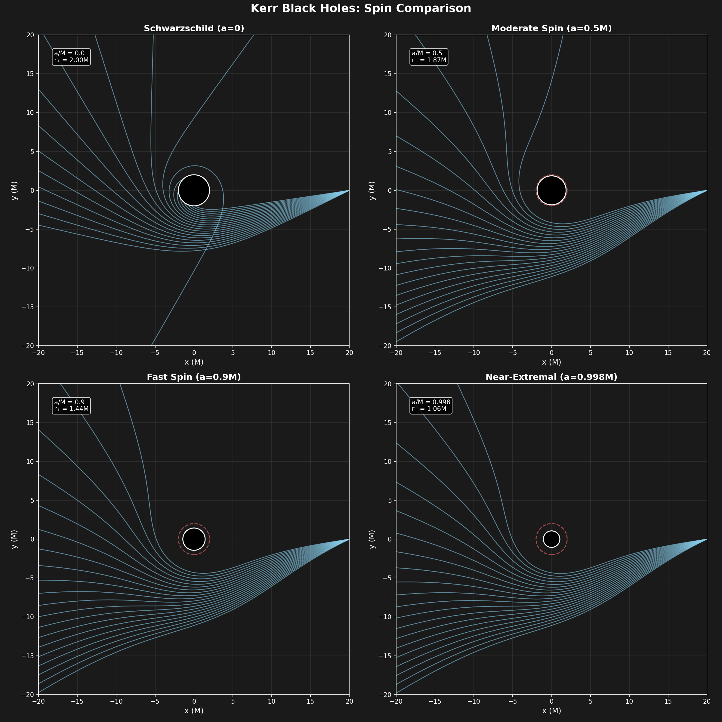
Kerr – Results: Null Geodesics

Slide 16
Kerr – Results: Null Geodesics

Slide 17

Conclusion
Developed a fully general geodesic simulator for Schwarzschild and Kerr black holes
Verified relativistic phenomena:
Photon Sphere, ISCO, impact parameters
Ergosphere behavior, frame dragging
~4000 loc
Source code, simulations Jupyter Notebook user demo and references can be found on GitHub:
https://github.com/fynnhufler/General-Relativity-Simulations
Fynn Hufler
MSc Physics
Dec 3rd 2025, Austin

