Slide 1

Loan Prediction
By Fynn Davis

Slide 2


Intro
Loans are everywhere
21 Million people
$162 billion of debt
Loans are stressful
We can help!
Notes:
Over the last decade, the number of people with a personal loan has nearly doubled from around 11 million in 2010 to around 21 million in 2020, and personal loan debt has nearly tripled from $55 billion to $162 billion
Americans with higher credit scores are more likely to have a personal loan. Personal loans were traditionally marketed toward subprime borrowers, but fintech changed that a few years ago.

Slide 3
Jupyter Labs
Python
Terminal
Data Visualization
Data
Random Forest
Train Test Split
Pipeline
Custom Functions
tmux session
Parameters
GridSearchCV
Flask API
AWS server
Gradient Boost
Pickle
Model
Logistic Regression

Slide 4


What does it do?
Feature | Value
Gender | Male
Married | No
Dependents | 0
Education | Graduate
Self_Employed | No
Loan_Amount | 150
Convert to JSON
POST
GET
http://ec2-3-99-131-102.ca-central-1.compute.amazonaws.com/loan_prediction?Gender=Male&Married=No&Dependents=0&Education=Graduate&Self_Employed=No&Loan_Amount=150

Slide 5
Next Step
http://ec2-3-99-131-102.ca-central-1.compute.amazonaws.com/loan_prediction
Loan Assessment Predictor
Fill out all the information you can, if you don’t know leave blank. The more information the more accurate!
Gender
Married
Dependents
Education
Self-Employed
Outcome
Rejection chance:
Acceptance chance:

Slide 6
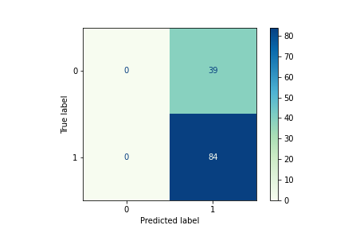
Limitations
Assumptions if there’s no input data
Most frequent
Small training set
Uneven classes
Loan rejections
Gender
Graduate
Self-Employment

Slide 7


Thank you
Thank You

Slide 8
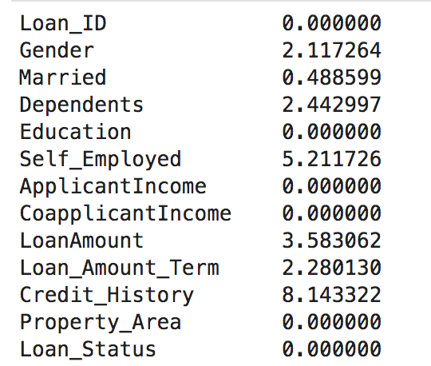
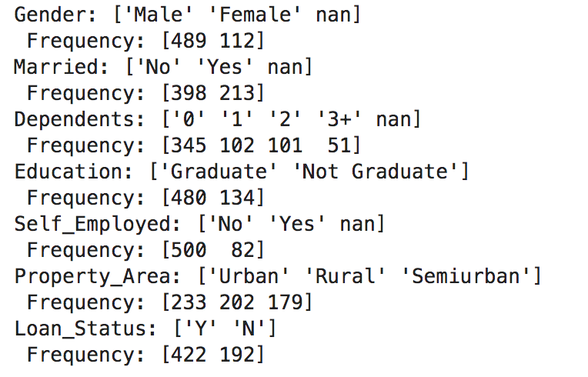
Appendix A
Fig 1. Null value percentage of each input feature
Fig 2. Counts of each feature class from input data

