Slide 1
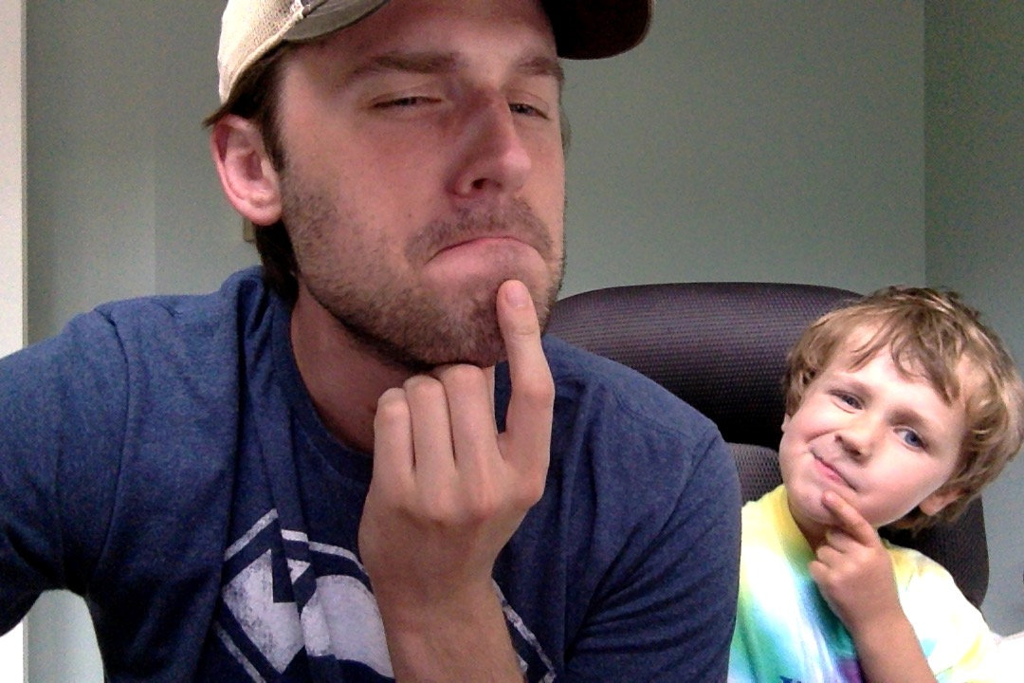
Asynchronous Programming in Javascript: State of the Union
Tony Lukasavage
Twitter: @tonylukasavage
Github: @tonylukasavage
Presentation Repo
https://github.com/tonylukasavage/async-in-js

Slide 2
