Slide 1
Combining Sketch and Tone for Pencil Drawing Production
Reporter : Fu Yuqian
Student ID : 2018302120169
Professor : Professor Bu.
Major : Electronic Engineering
Notes:
越界了 时间
封面对其==对齐

Slide 2
Outline
Background
Overall Framework
Line Drawing with Strokes
Tone Drawing
Color Pencil Drawing
Results
Notes:
预备条件；
方法；
总结与改进方案

Slide 3

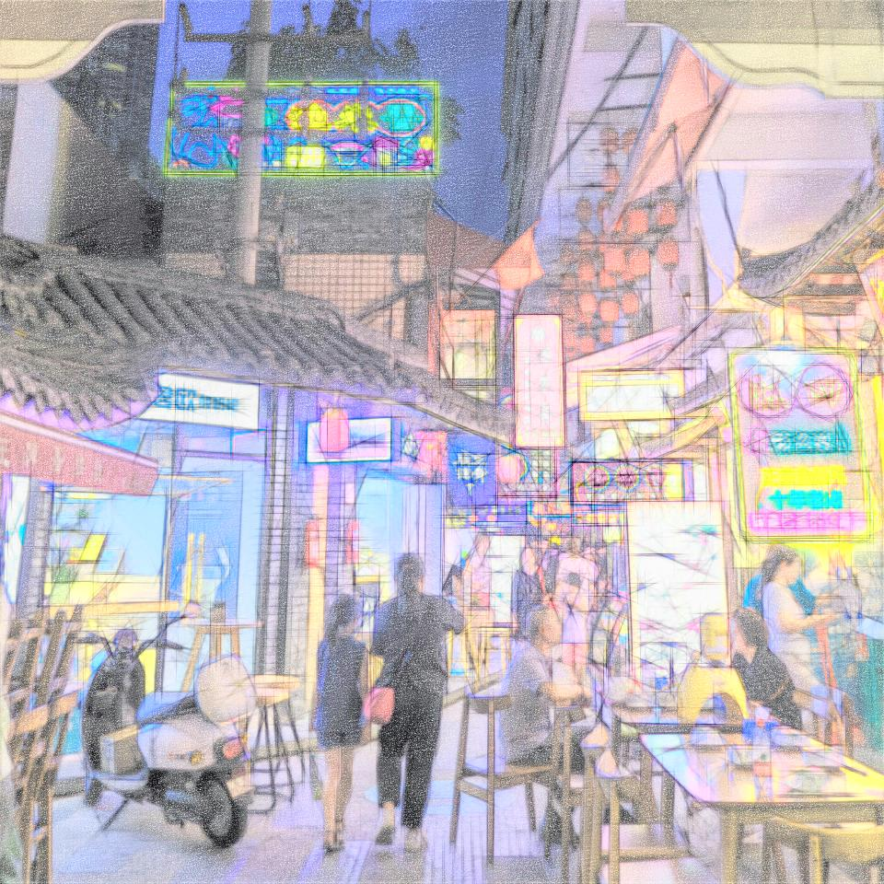
Background

Slide 4
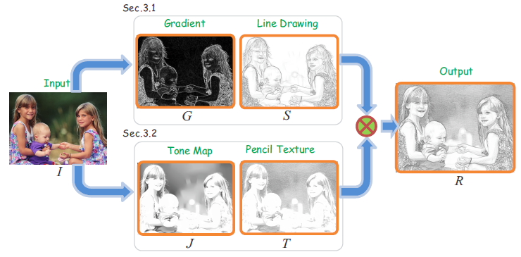

Overall Framework

Slide 5
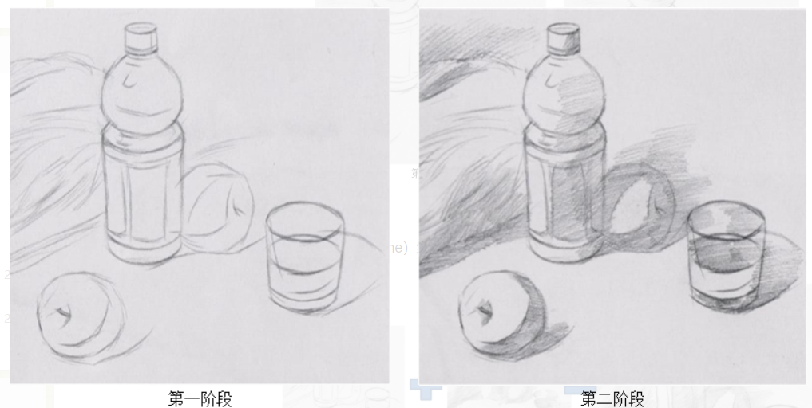
Line Drawing with Strokes
Purpose : expressing general structures of the scene
In the literature, pencil drawing can be classified into a few styles.Sketch typically refers to a quickly finished work without a lot of details. Artists often use sketches to depict the global shape and main contours. Hatching, on the other hand, is used to depict tone or shading by drawing dark and parallel strokes in different regions.

Slide 6
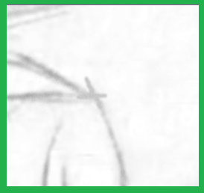
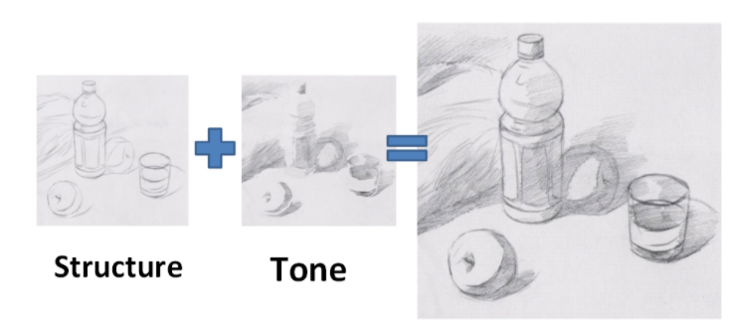

Slide 7

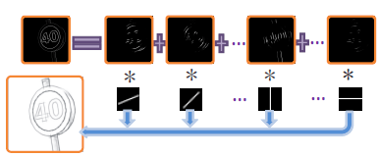
Classification
The gradient maps
typically noisy and do not contain continuous edges immediately ready for stroke generation
New step
Motion blur

Slide 8

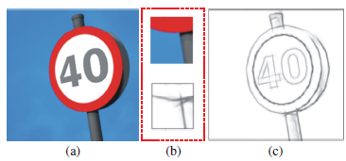
Line Shaping
S’->normalization->S

Slide 9
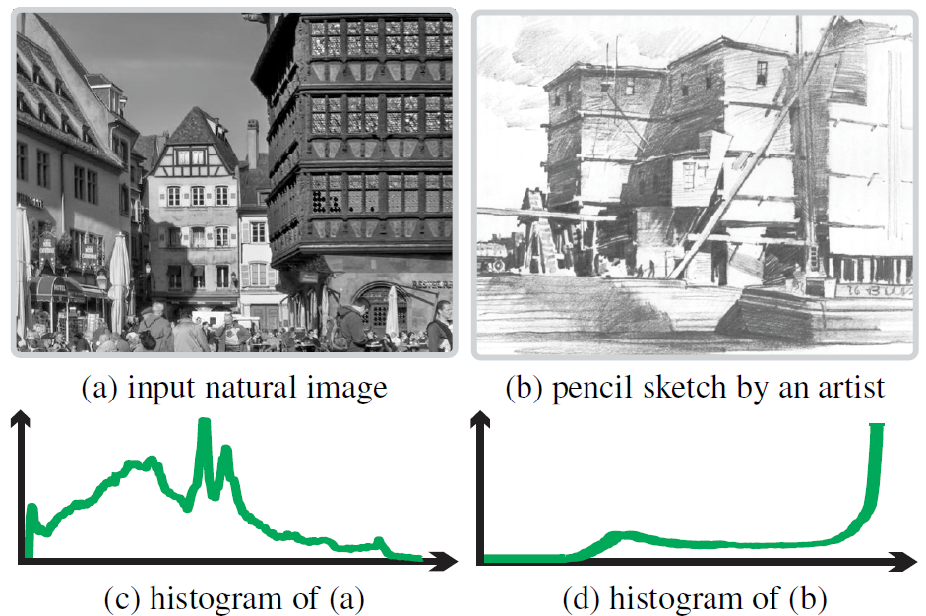
Tone Drawing
Purpose :focuses more on shapes, shadow, and shading than on the use of lines
Model-based Tone Transfer
For many cases, is not optimal because the tone distribution of a grayscale image generally differs significantly from that of pencil sketch.

Slide 10
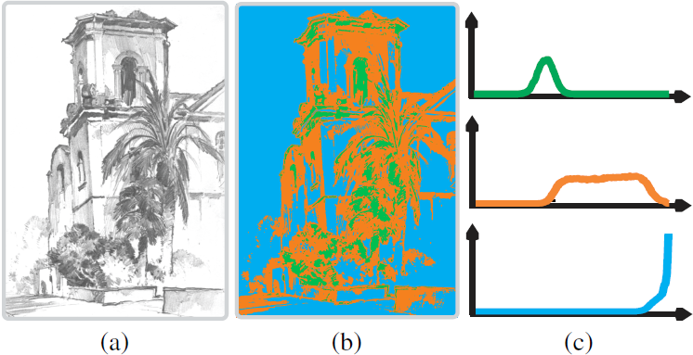

Given an artist-drawn pencil sketch shown in (a), we partition pixels into three layer, according to their values (details are given later when discussing parameter learning). They are highlighted in green, orange, and blue in (b). (c) gives the tone distributions of the three layers, in accordance with our observation.

Slide 11
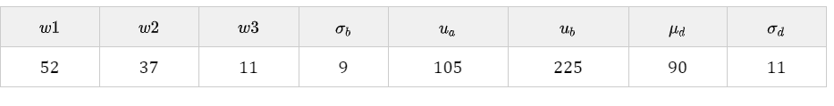
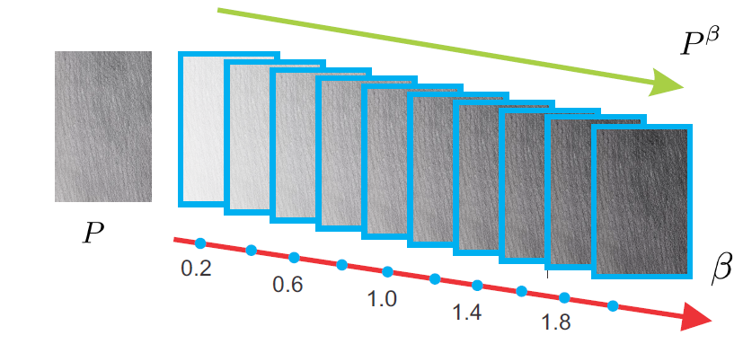
Parameter Learning
Pencil Texture Rendering
Generating suitable pencil textures for images is difficult. Tonal texture refers to pencil patterns without obvious direction, which reveal only the tone information.

Slide 12
Color Pencil Drawing
Take the generated grayscale pencil sketch R as the brightness layer, i.e., the Y channel in the YUV color space, and re-maping YUV back to the rgb space.

Slide 13

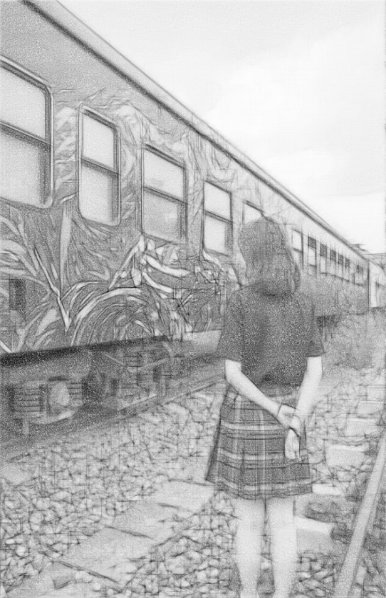
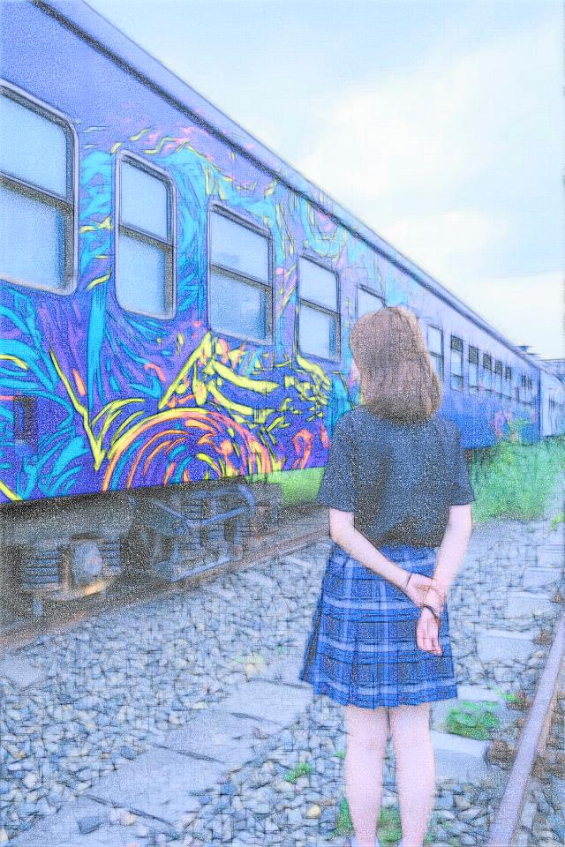

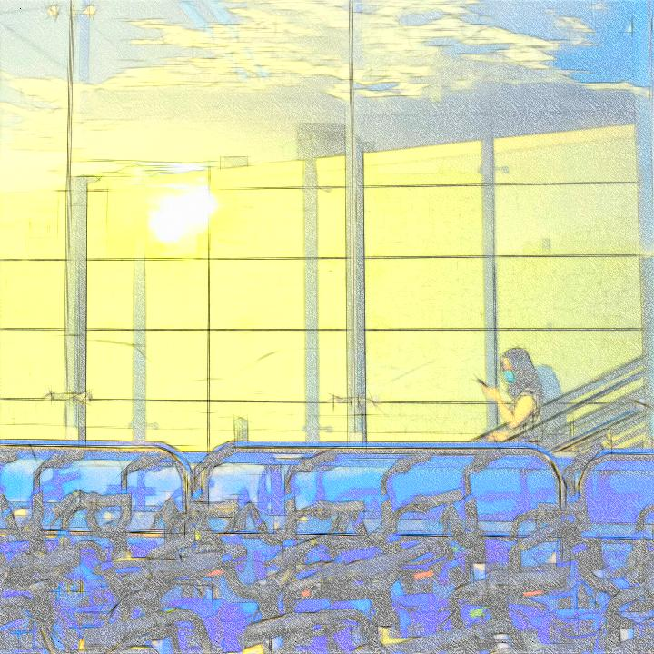
Results

Slide 14

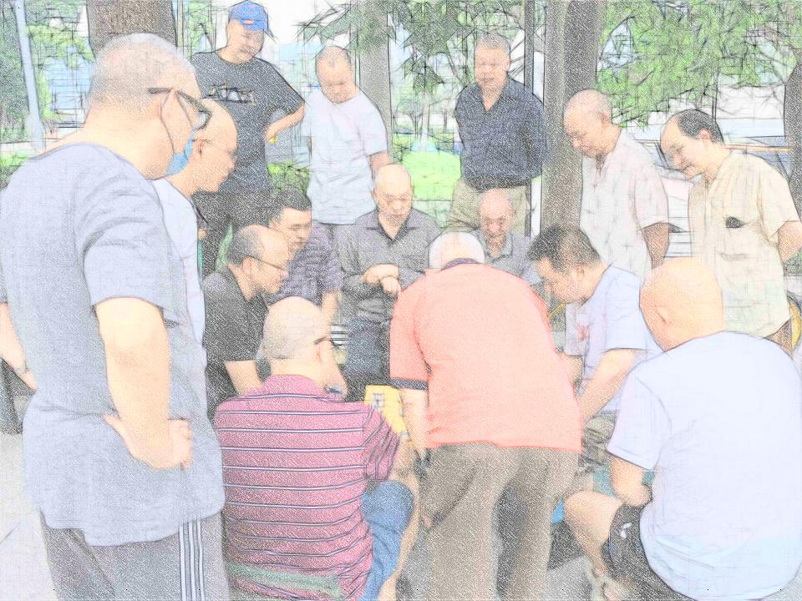
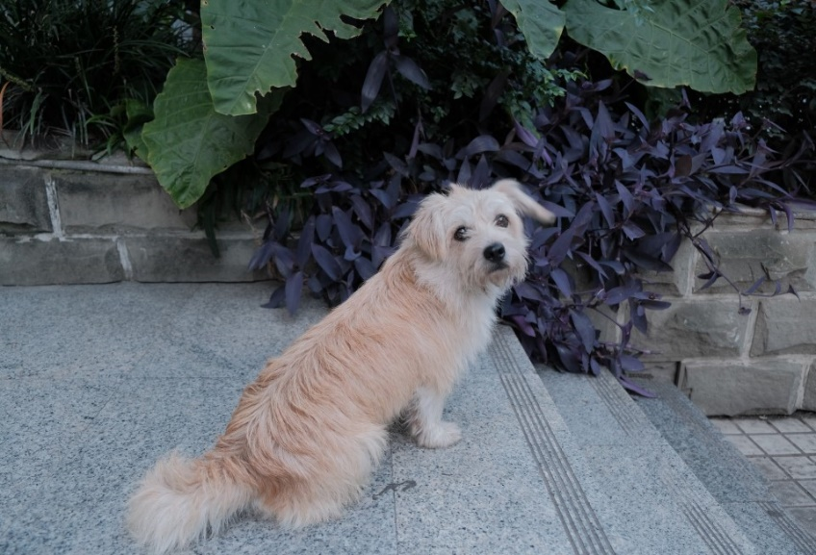
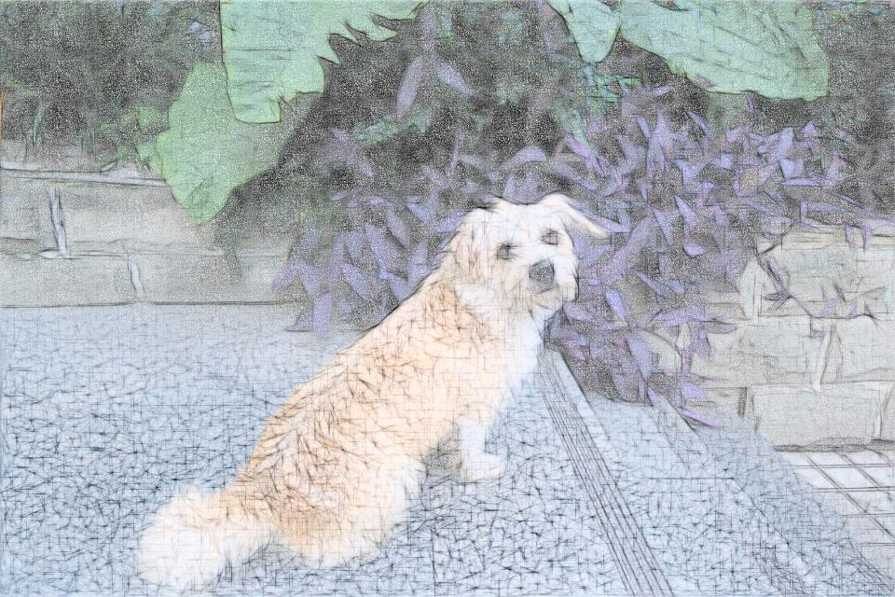

Slide 15
Thanks!
Reporter : Fu Yuqian
Student ID : 2018302120169
Professor : Professor Bu.
Major : Electronic Engineering
Notes:
总结与展望

