Slide 1
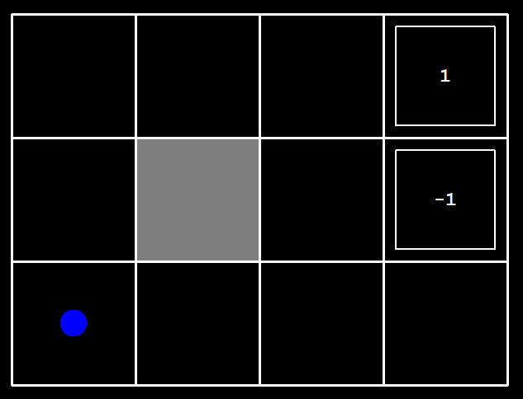
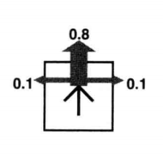
Gridworld
“行动不可靠”
noise = 0.2

Slide 2
Started in state: (3, 0)
Took action: north
Ended in state: (3, 1)
Got reward: 0.0
s:当前状态
a:行动
s:下一状态
R(s, a, s’):回报
在状态(2,2)采取任何行动，回报都是0，包括到达状态(3,2)。
在状态(3,2)只能采取行动“exit”，回报是+1。

Slide 3
问题的解：
任何固定的行动序列都无法解决这个问题。
For MDPs, we want an optimal
policy π*: S → A
A policy π gives an action for each state
An optimal policy is one that maximizes expected utility if followed

Slide 4
Agent的性能是通过对访问过的状态的回报求和来度量的，记作U_{h}([s₀,s₁,…,s_{n}])
折扣回报：U_{h}([s₀,s₁,…,s_{n}]) = R(s₀)+γ R(s₁)+ γ ²R(s₂)+…，γ ∈[0,1]
 |  |  | +1
discount = 0.9
(0,0)→(1,0)→(2,0)→(3,0)→TERMINAL_STATE
(0,0)→(0,1)→(0,2)→(1,2)→(2,2)→(3,2)→(3,1)→(3,0)→TERMINAL_STATE

Slide 5
Optimal Quantities
The value (utility) of a state s:
V*(s) = expected utility starting in s and acting optimally
The value (utility) of a q-state (s,a):
Q*(s,a) = expected utility starting out having taken action a from state s and (thereafter) acting optimally
The optimal policy:
π*(s) = optimal action from state s
s
s is a state
a
(s, a) is a q-state
s, a
s,a,s’
(s,a,s’) is a transition
s’
[Demo – gridworld values (L8D4)]

Slide 6
Values of States
Recursive definition of value:
s
a
s, a
s,a,s’
s’

Slide 7
Value Iteration

Slide 8
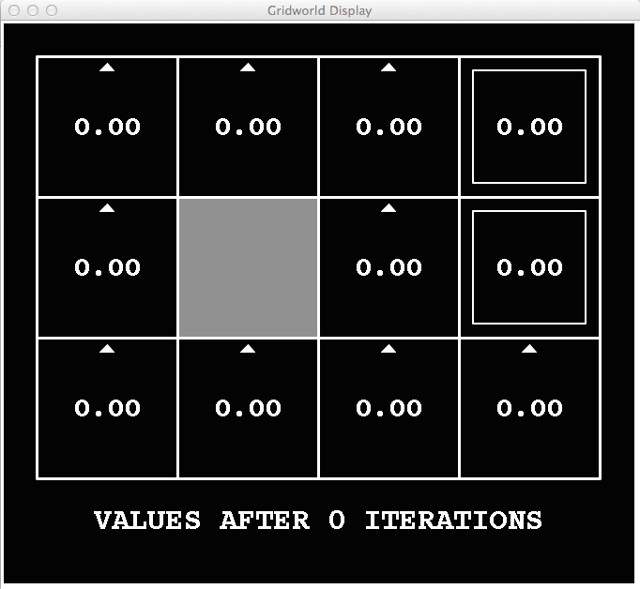
k=0
Noise = 0.2
Discount = 0.9
Living reward = 0

Slide 9
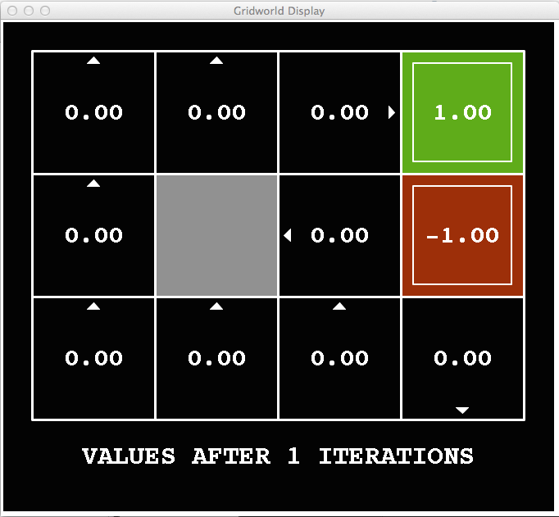
k=1
Noise = 0.2
Discount = 0.9
Living reward = 0

Slide 10
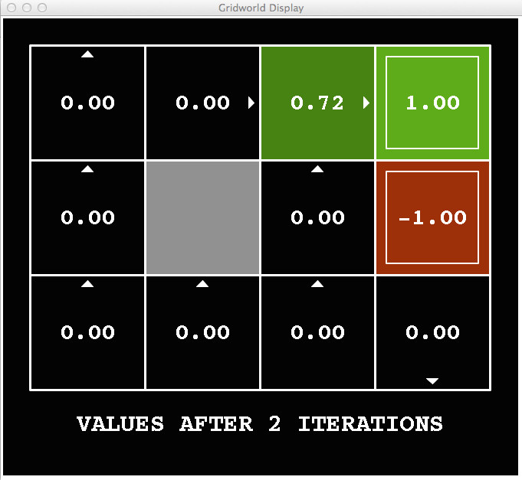
k=2
Noise = 0.2
Discount = 0.9
Living reward = 0

Slide 11
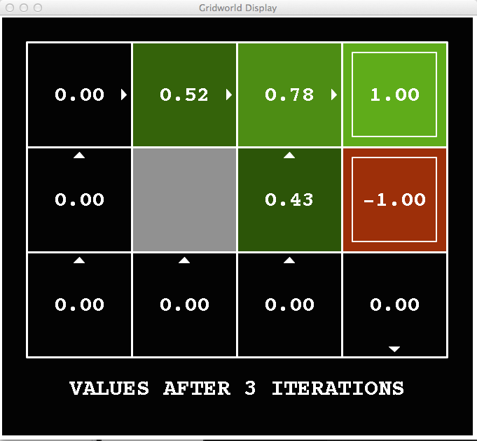
k=3
Noise = 0.2
Discount = 0.9
Living reward = 0

Slide 12
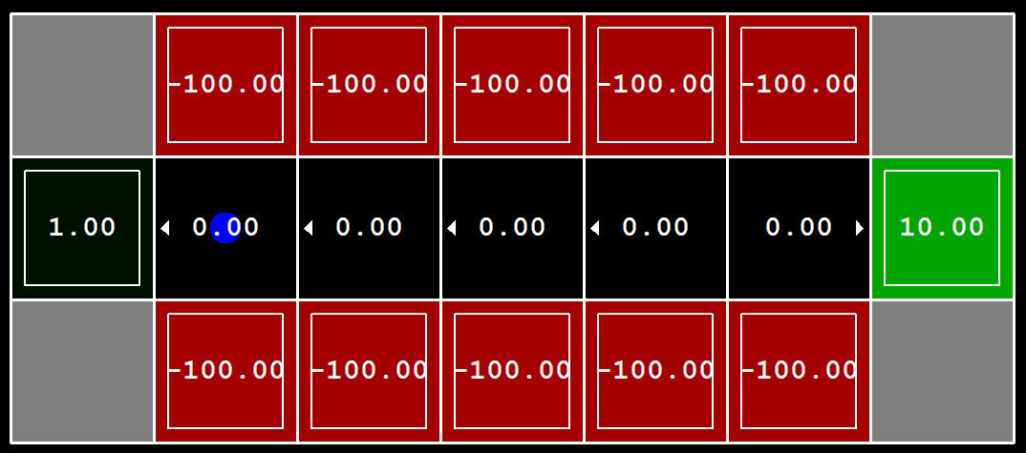

Slide 13
Reinforcement Learning
Still assume a Markov decision process (MDP):
A set of states s ∈ S
A set of actions (per state) A
A model T(s,a,s’)
A reward function R(s,a,s’)
Still looking for a policy π(s)
New twist: don’t know T or R
I.e. we don’t know which states are good or what the actions do
Must actually try actions and states out to learn

Slide 14
Input Policy π
Observed Episodes (Training)
Output Values
Episode 1
Episode 2
 | A
B | C | D
 | E
 | A
B | C | D
 | E
B, east, C, -1
C, east, D, -1
D, exit, x, +10
B, east, C, -1
C, east, D, -1
D, exit, x, +10
-10
+8
+4
+10
Episode 3
Episode 4
-2
E, north, C, -1
C, east, D, -1
D, exit, x, +10
E, north, C, -1
C, east, A, -1
A, exit, x, -10
Assume: γ = 1

Slide 15
Big idea: learn from every experience!
Update V(s) each time we experience a transition (s, a, s’, r)
Likely outcomes s’ will contribute updates more often
Temporal difference learning of values
Policy still fixed, still doing evaluation!
Move values toward value of whatever successor occurs: running average
s
π(s)
s, π(s)
s’
Sample of V(s):
Update to V(s):

Slide 16
States
Observed Transitions
B, east, C, -2
C, east, D, -2
 | A
B | C | D
 | E
 | 0
0 | 0 | 8
 | 0
 | 0
-1 | 0 | 8
 | 0
 | 0
-1 | 3 | 8
 | 0
Assume: γ = 1, α = 1/2

Slide 17
Submission
valueIterationAgents.py
qlearningAgents.py
analysis.py
提交至 xufangchn@foxmail.com
Deadline: 2020.11.08

