Slide 1

Notes:
Compatibility-rendered slide 1. Source deck: BioFlow Studio interview report v2.

Slide 2

Notes:
Compatibility-rendered slide 2. Source deck: BioFlow Studio interview report v2.

Slide 3

Notes:
Compatibility-rendered slide 3. Source deck: BioFlow Studio interview report v2.

Slide 4
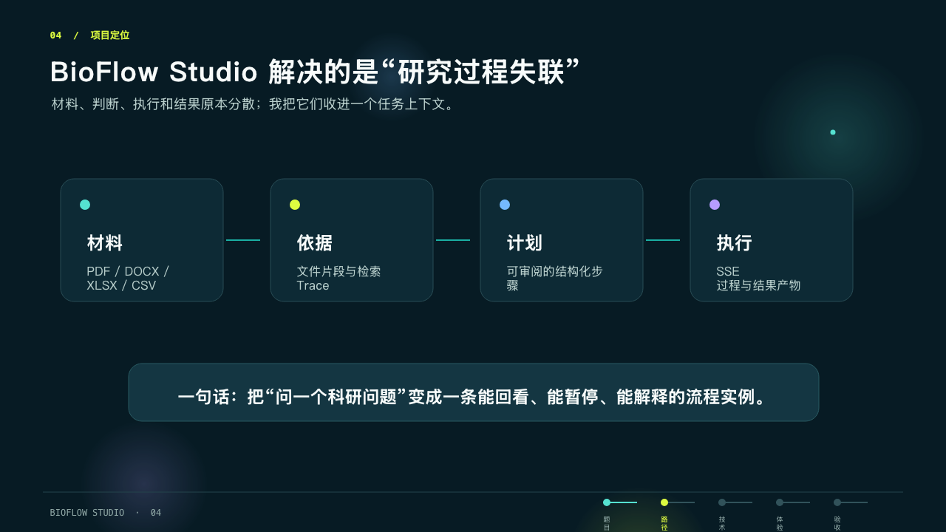
Notes:
Compatibility-rendered slide 4. Source deck: BioFlow Studio interview report v2.

Slide 5

Notes:
Compatibility-rendered slide 5. Source deck: BioFlow Studio interview report v2.

Slide 6
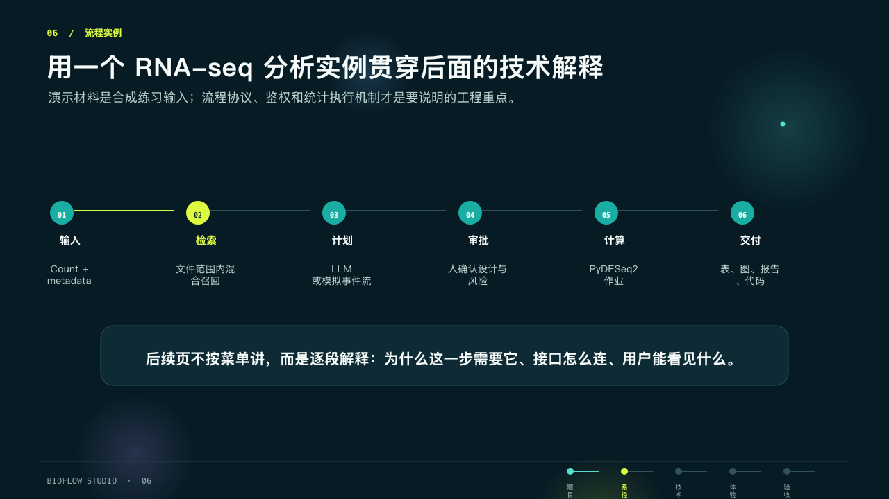
Notes:
Compatibility-rendered slide 6. Source deck: BioFlow Studio interview report v2.

Slide 7

Notes:
Compatibility-rendered slide 7. Source deck: BioFlow Studio interview report v2.

Slide 8
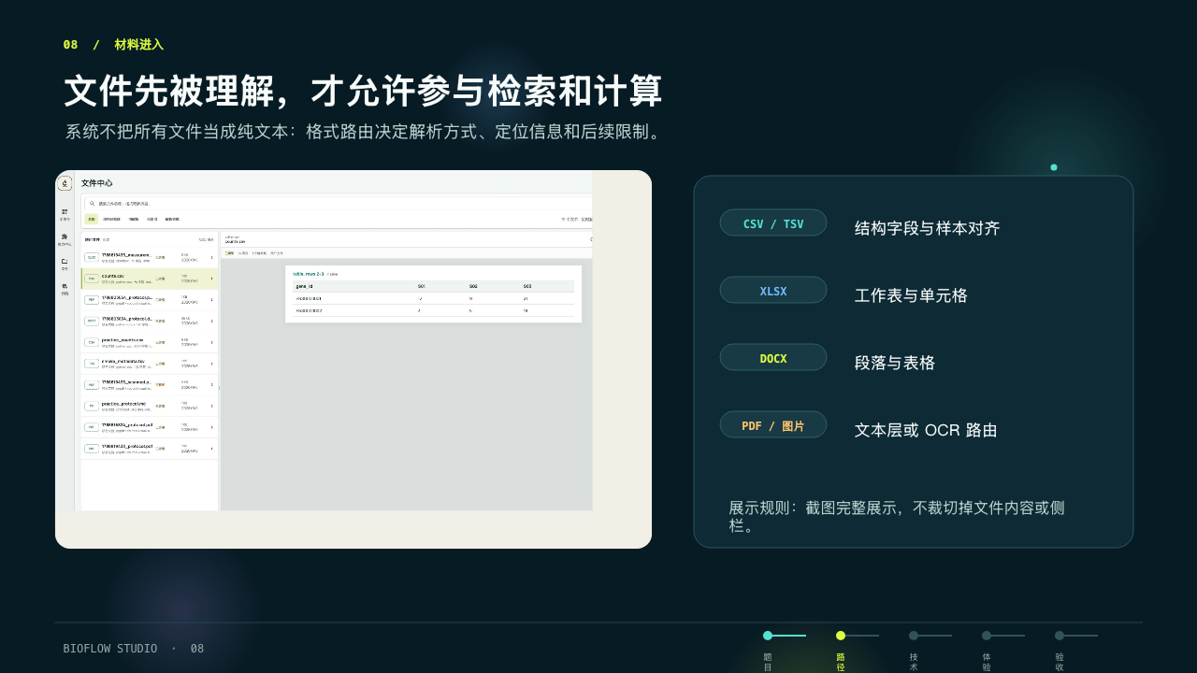
Notes:
Compatibility-rendered slide 8. Source deck: BioFlow Studio interview report v2.

Slide 9
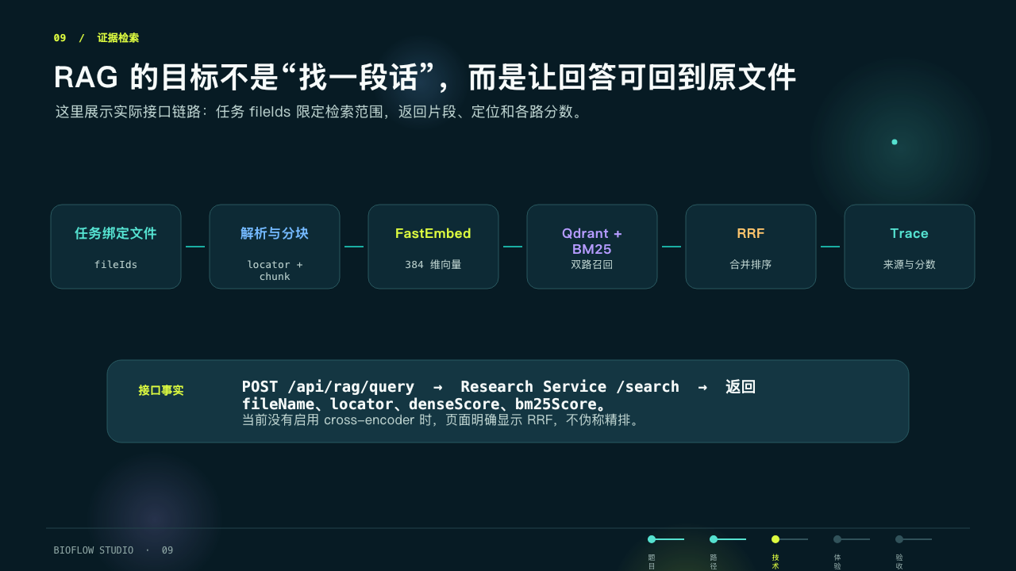
Notes:
Compatibility-rendered slide 9. Source deck: BioFlow Studio interview report v2.

Slide 10
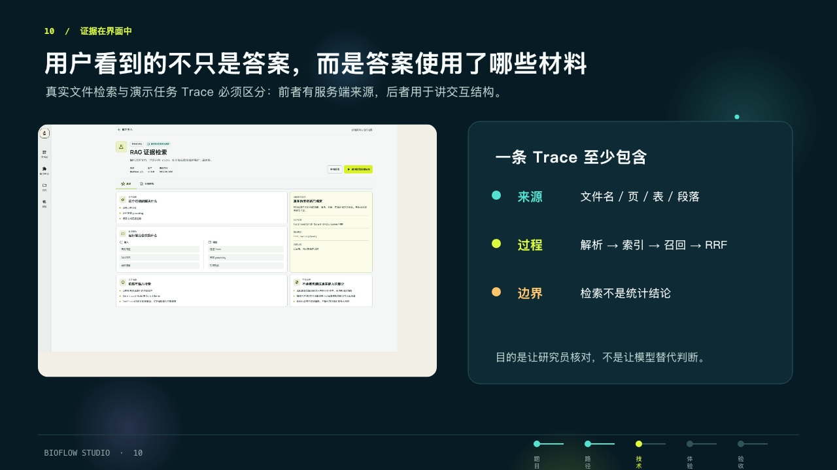
Notes:
Compatibility-rendered slide 10. Source deck: BioFlow Studio interview report v2.

Slide 11
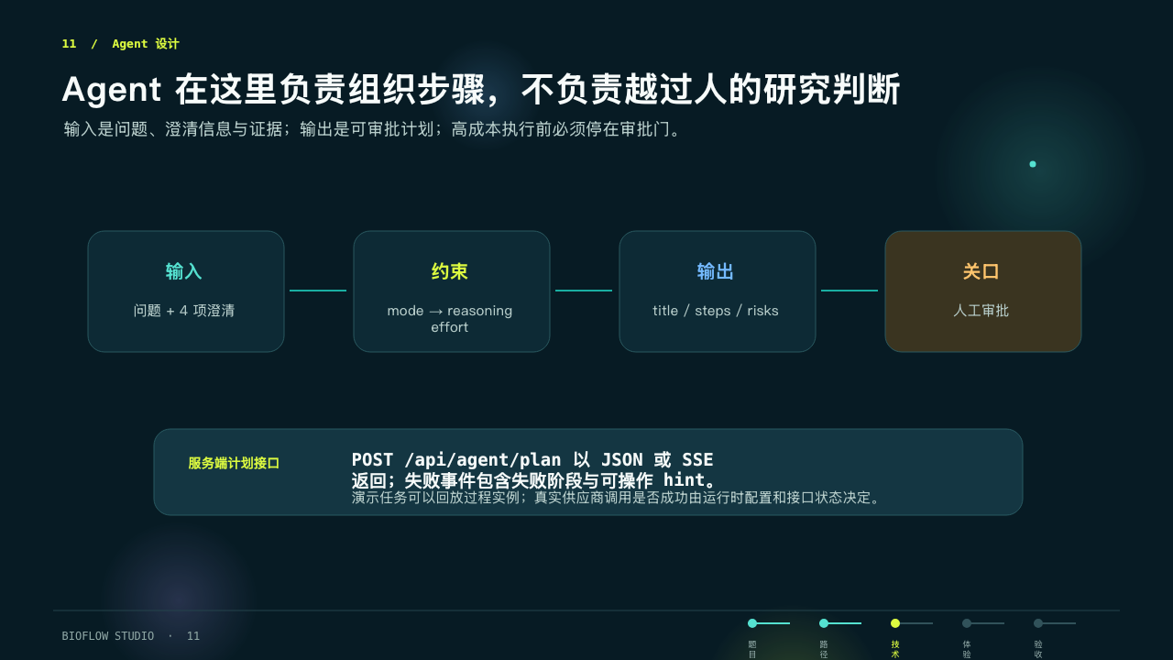
Notes:
Compatibility-rendered slide 11. Source deck: BioFlow Studio interview report v2.

Slide 12
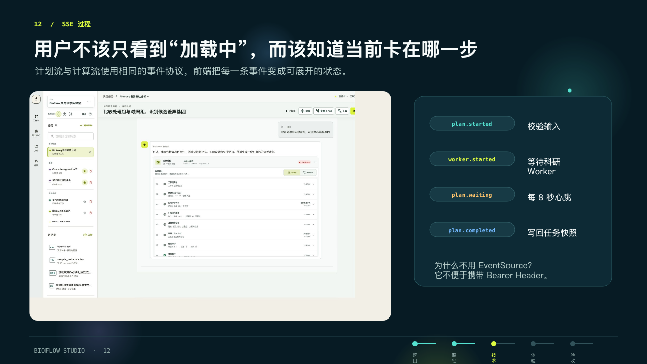
Notes:
Compatibility-rendered slide 12. Source deck: BioFlow Studio interview report v2.

Slide 13
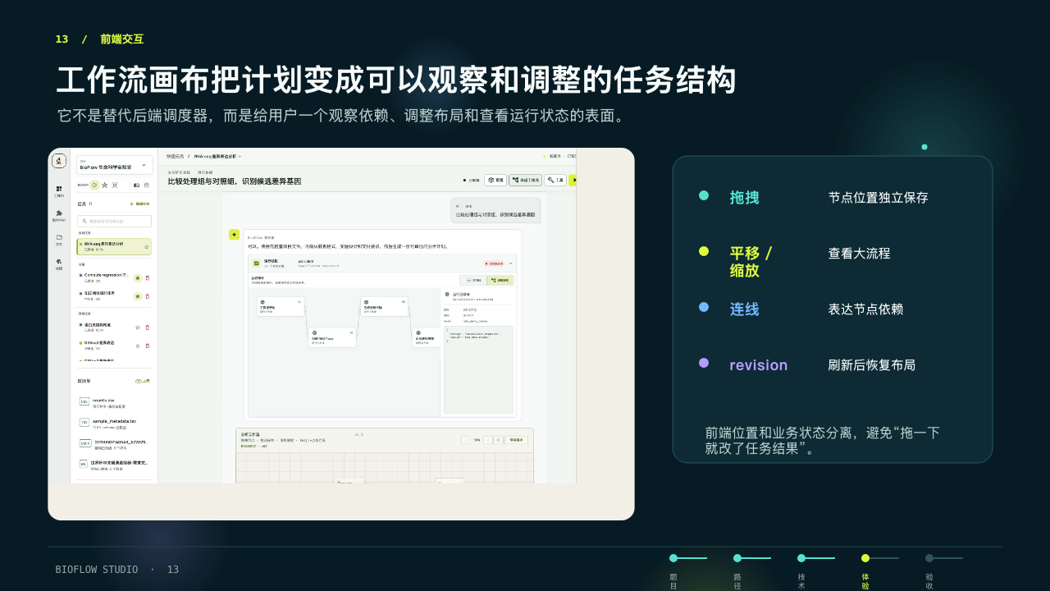
Notes:
Compatibility-rendered slide 13. Source deck: BioFlow Studio interview report v2.

Slide 14
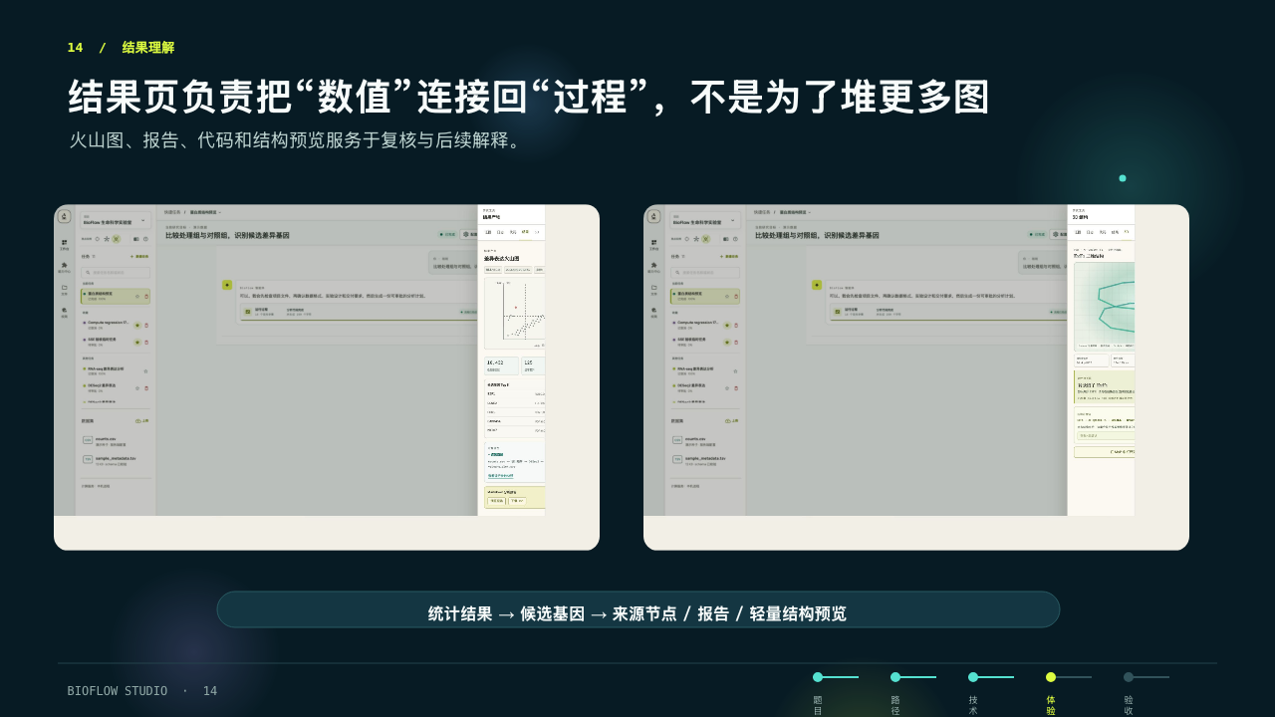
Notes:
Compatibility-rendered slide 14. Source deck: BioFlow Studio interview report v2.

Slide 15
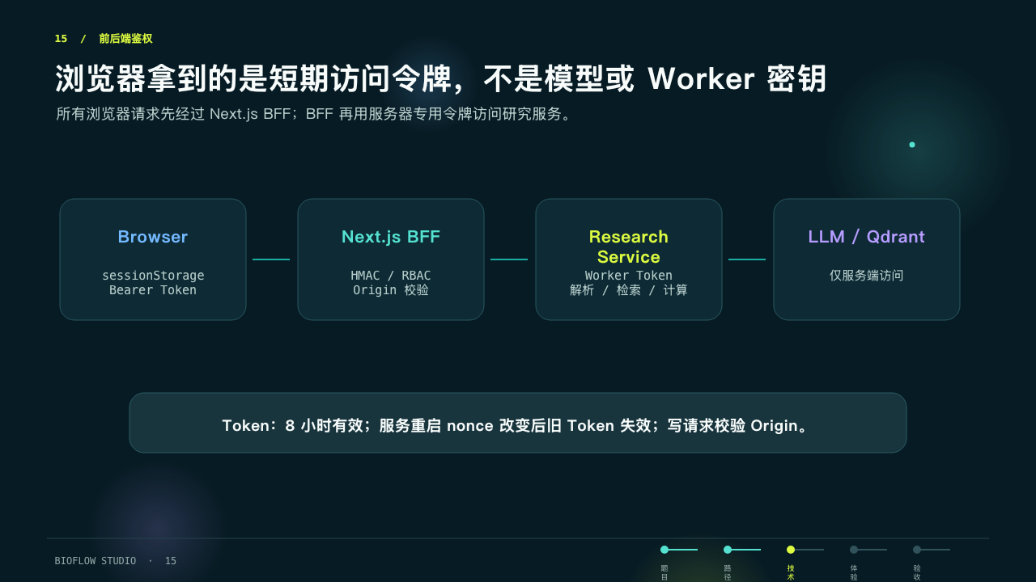
Notes:
Compatibility-rendered slide 15. Source deck: BioFlow Studio interview report v2.

Slide 16

Notes:
Compatibility-rendered slide 16. Source deck: BioFlow Studio interview report v2.

Slide 17
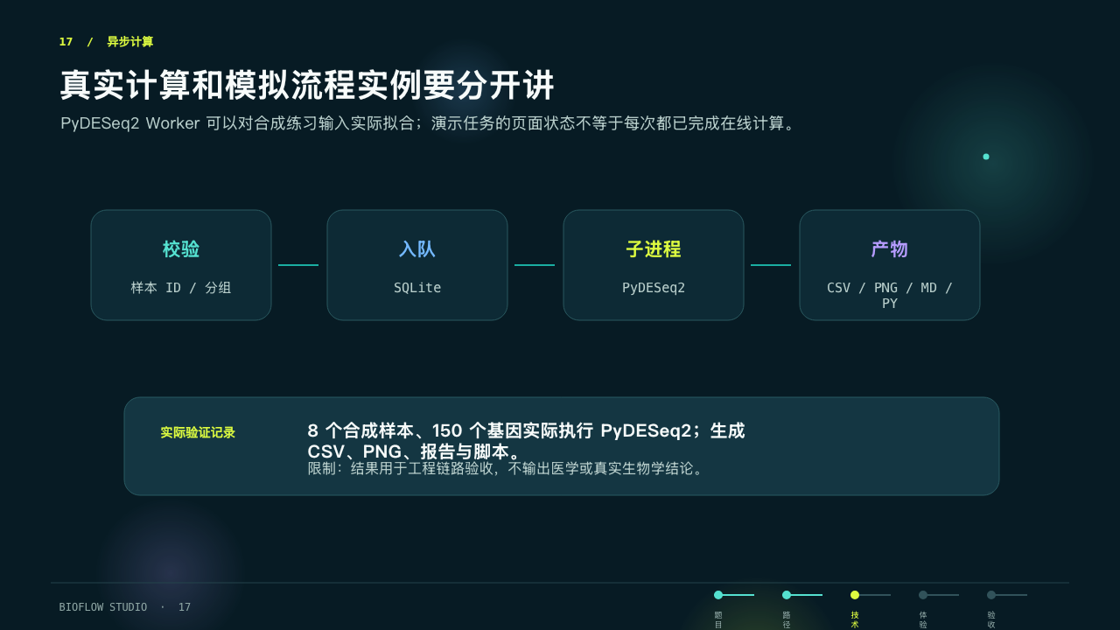
Notes:
Compatibility-rendered slide 17. Source deck: BioFlow Studio interview report v2.

Slide 18
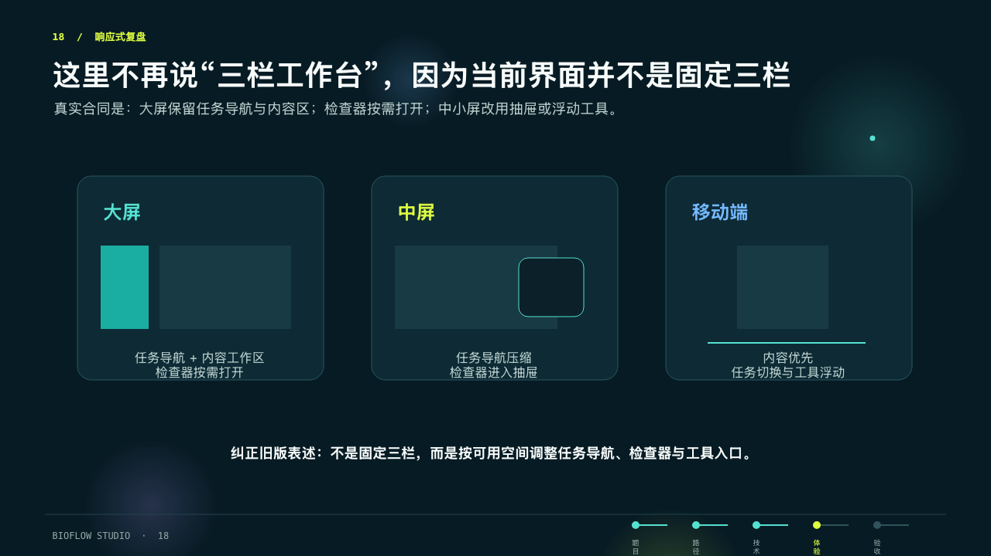
Notes:
Compatibility-rendered slide 18. Source deck: BioFlow Studio interview report v2.

Slide 19

Notes:
Compatibility-rendered slide 19. Source deck: BioFlow Studio interview report v2.

Slide 20

Notes:
Compatibility-rendered slide 20. Source deck: BioFlow Studio interview report v2.

Slide 21

Notes:
Compatibility-rendered slide 21. Source deck: BioFlow Studio interview report v2.

