Slide 1
System
Module A
Module B
Module D
Module C

Slide 2
4-bit full adder
4
4
A
SUM
4
B
COUT
CIN

Slide 3
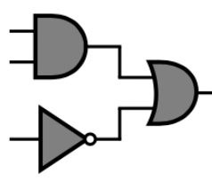
Timing path
FF1
FF2
D
Q
D
Q
clk
clk

Slide 4
Synchronization registers
R1
R2
Logic design
Data
D
Q
D
Q
D
Q
clk
clk
clk
Clock domain 1
Clock domain 2
clk1
clk2

Slide 5
Clock domain A
Clock domain B
Data external
Data A to B
clk1
clk2
If clk1 and clk2 are skewed/sliding with respect to each other (or of different frequency or unrelated), the data received in clock domain B may violate the setup and hold time of the input register in this domain

Slide 6
A
D
Q
A + B + C
D
Q
clk
clk
D
Q
A + B
D
Q
+ C
D
Q
clk
clk
clk

Slide 7
pulse
enable_n
D
Q
enable_i_n
clk

Slide 8
Synchronization registers
pulse
enable_n
D
Q
D
Q
D
Q
enable_i_n
clk
clk
clk
clk

Slide 9
Synchronization registers
pulse
enable_r1_n
enable_r2_n
enable_n
D
Q
D
Q
D
Q
enable_i_n
clk
clk
clk
clk

Slide 10
Synchronization registers
pulse
D
Q
enable_r1_n
enable_r2_n
clk
enable_n
D
Q
D
Q
D
Q
enable_i_n
clk
clk
clk
clk

Slide 11
4
A
4
4
+
SUM
D
Q
counter
4
1
B
clk
4-bit adder
ena
clk
enable

