Slide 1

Computer Components
Understanding the essential parts of a computer

Slide 2
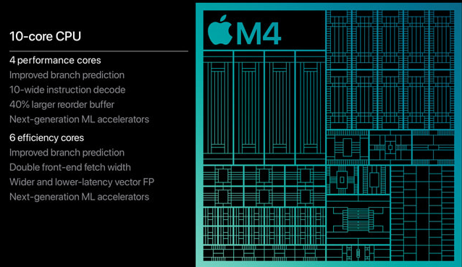
Central Processing Unit (CPU)
The CPU (Central Processing Unit) is responsible for processing instructions, performing calculations, and executing tasks.
Measured in GHz (gigahertz), which determines the clock speed.
Consists of multiple cores (Single-core, Dual-core, Quad-core, Octa-core, etc.) that allow multitasking.
Modern CPUs include features like hyper-threading and boost clock speeds for enhanced performance.

Slide 3
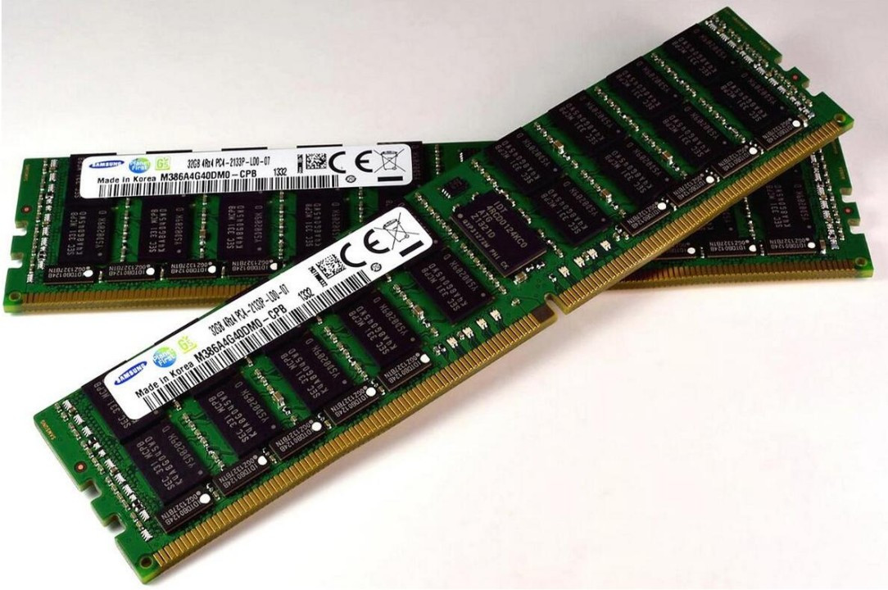
Memory and Storage
RAM (Random Access Memory):
Temporary memory used for actively running programs and processes.
More RAM allows for better multitasking and faster system performance.
Common types: DDR3, DDR4, DDR5.
Storage Types:
HDD (Hard Disk Drive): Slower but cheaper, used for bulk storage.
SSD (Solid State Drive): Faster, more reliable, and reduces system boot times significantly.
NVMe SSD: A newer type of SSD that offers even higher speeds than traditional SATA SSDs.
Computers often use a combination of SSD for the operating system and HDD for additional storage.

Slide 4
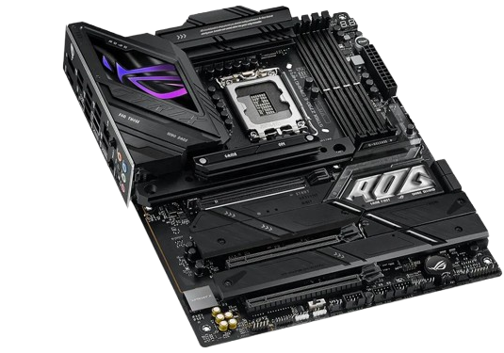
Motherboard & Power Supply
Motherboard:
The main circuit board that connects all components (CPU, RAM, storage, GPU, etc.).
Contains expansion slots (PCIe), USB ports, and integrated features like Wi-Fi and Bluetooth.
Different form factors: ATX (standard), Micro-ATX (smaller), Mini-ITX (compact).
Power Supply Unit (PSU):
Converts electricity from a wall socket into usable power for computer components.
Comes in different wattages and efficiency ratings (80+ Bronze, Silver, Gold, Platinum).
Modular vs. Non-Modular: Modular PSUs allow for better cable management.
Choosing the right PSU is crucial to ensure system stability and prevent power issues.

Slide 5
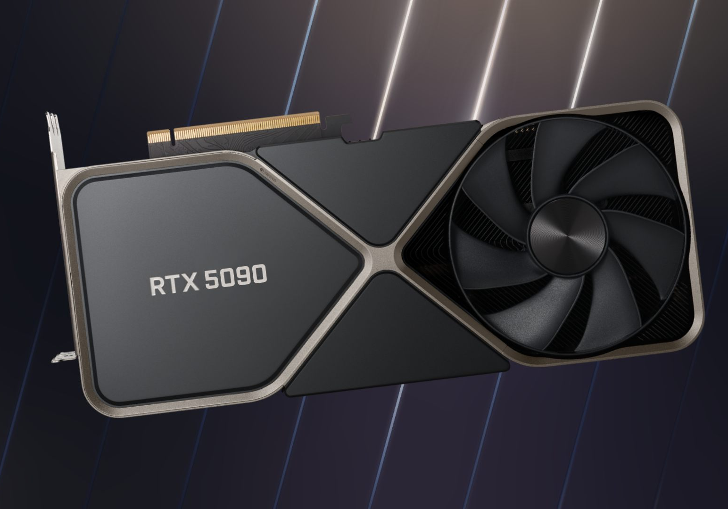
Graphics Card (GPU) & Peripherals
GPU (Graphics Processing Unit):
Handles rendering of graphics, crucial for gaming, video editing, and 3D modeling.
Can be integrated (built into the CPU) or dedicated (separate hardware, more powerful).
Popular GPUs: NVIDIA GeForce RTX series, AMD Radeon RX series.
Key specs: VRAM (video memory), CUDA cores (for NVIDIA), and Ray Tracing capabilities.
Peripherals & Input Devices:
Essential devices for interacting with a computer.
Examples: Keyboard (mechanical/membrane), Mouse (wired/wireless), Monitor (LCD/OLED), Headset, Printers, Scanners.
Gaming peripherals include mechanical keyboards, high-DPI mice, and high-refresh-rate monitors.
Connectivity:
Modern systems use USB-C, Thunderbolt, and DisplayPort for fast data transfer and display connections.

Slide 6


The End
I dont accept any questions, I already want to get this over with. Thank you.

