Slide 1
INFO 5001-Final Digital Marketing Design and Programming
002784869 Fang-Ying Tien

Slide 2
Summary
Define business – Amazon
Select suppliers – Warner music group/Sony
Define market – Teenager/ College Grad/ Millennial/ Z Generation/ Senior
Define submarket – Male/ Female
Define channel – TV/ Web
Define Market/Channel combination -TV for markets/ Web for markets

Slide 3
Summary
Define solution bundles – Customize bundles to meet the market preference within the different age groups of people
Select products for bundles – Pick the best-selling albums and electronic devices among certain age groups
Assign price for bundle/market, channel combination – ex. Consider teenagers shopping online more frequently, thus they get more discounts on web channel. Seniors, on the other hand, get more discounts on tv channel.

Slide 4
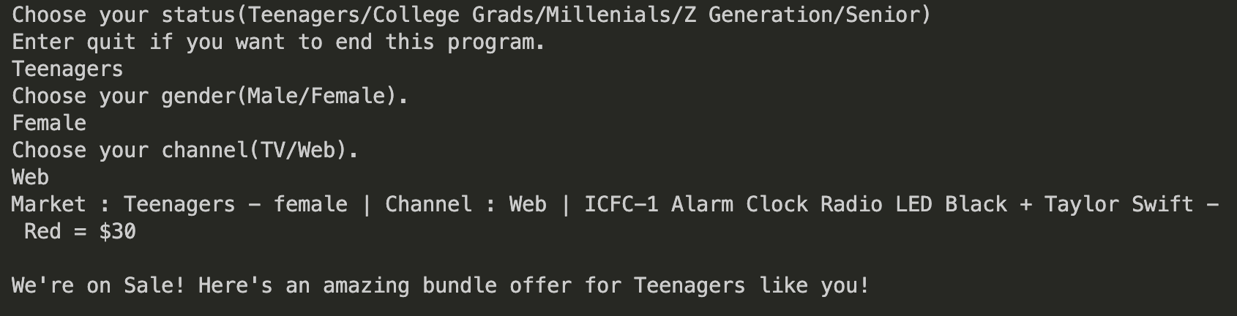
Output
Customers get the ad and customized bundled products that match their needs.

Slide 5
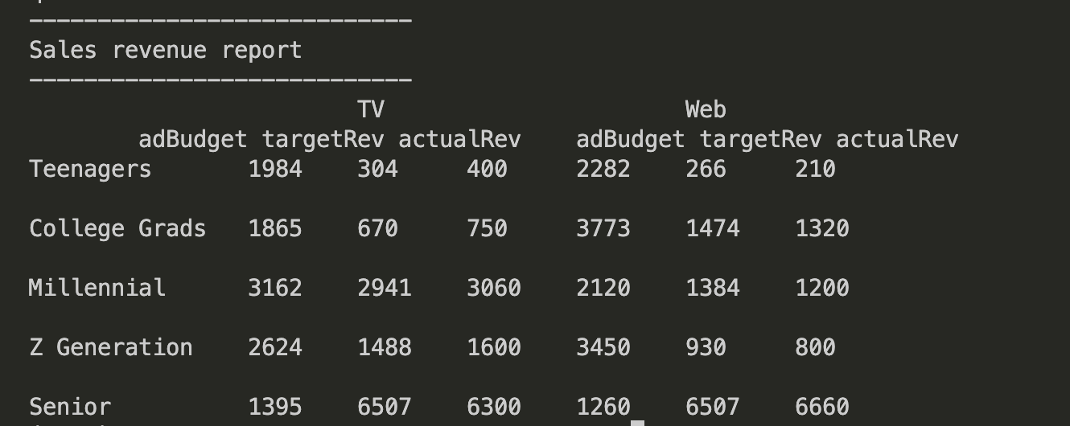
Output
After autogenerating sales orders, print the sales revenue report for the management team.

