Slide 1

Transportation Dataset Analysis 3rd July 2020 Barcelona

Slide 2




Our Team
Felipe Hayashi
Sanders Roos
Data Analyst Wannabe, data-driven and creative in the face of uncertainty.
Energy Engineer,
Want to contribute in the energy transition

Slide 3

Agenda
1 – Executive Summary
2 – Data sources
3 – Data Wrangling
4 – Main Insights
5 – Unanswered Questions & Challenges
6 – Main learnings

Slide 4





1 - Data Sources
Executive
Summary
2 - Data Wrangling
Our main goal is to practice a thorough Data-Analysis workflow, which involves:
3 - Insights
4 - Identifying Challenges/Next Steps
5 - Learn!

Slide 5
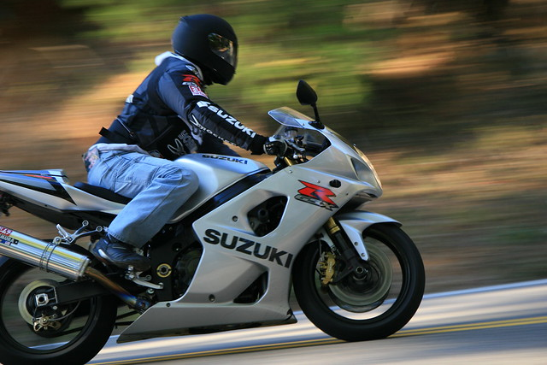
1 - Data Sources
Dataset: Transportation related accidents in Barcelona
Source: https://opendata-ajuntament.barcelona.cat/
Historical Data: 2016 and 2017
Numerical Data: Accidents, Victims, Light Injuries, Serious Injuries, Deaths
Categorical data: Neighborhood, District, Time of the day(ordinal)
Dataset: Motorbikes registered in Barcelona
Source: https://opendata-ajuntament.barcelona.cat/
Historical Data: 2016 and 2017
Numerical Data: Number of motorbikes registered
Categorical data: Neighborhood, District, displacement capacity(cc)

Slide 6
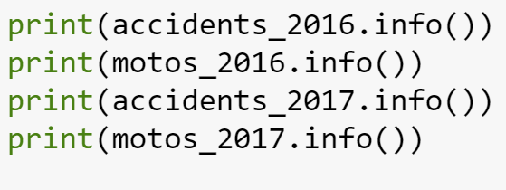
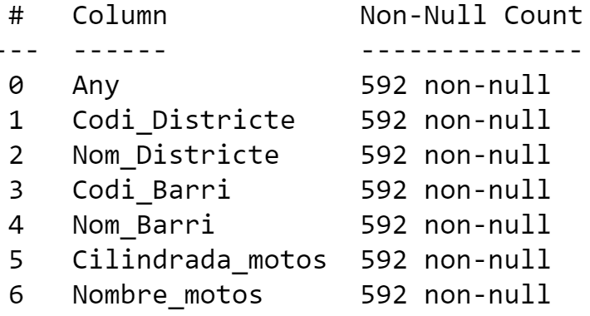
2 – Data Wrangling
DATA CLEANING:
Fortunately the data had no empty cells
On the other hand it was necessary to translate columns and values to English
GROUPING & AGGREGATION:
We used grouping for the Accidents Dataset by “District”, our objective was was to aggregate data to subgroups large sample size in order to remain representative
Alternatively for the Motorbikes we used the “pivot_table” function in order to “one-hot code” the bike potency(cc) category into numbers that could be aggregated by “District”

Slide 7
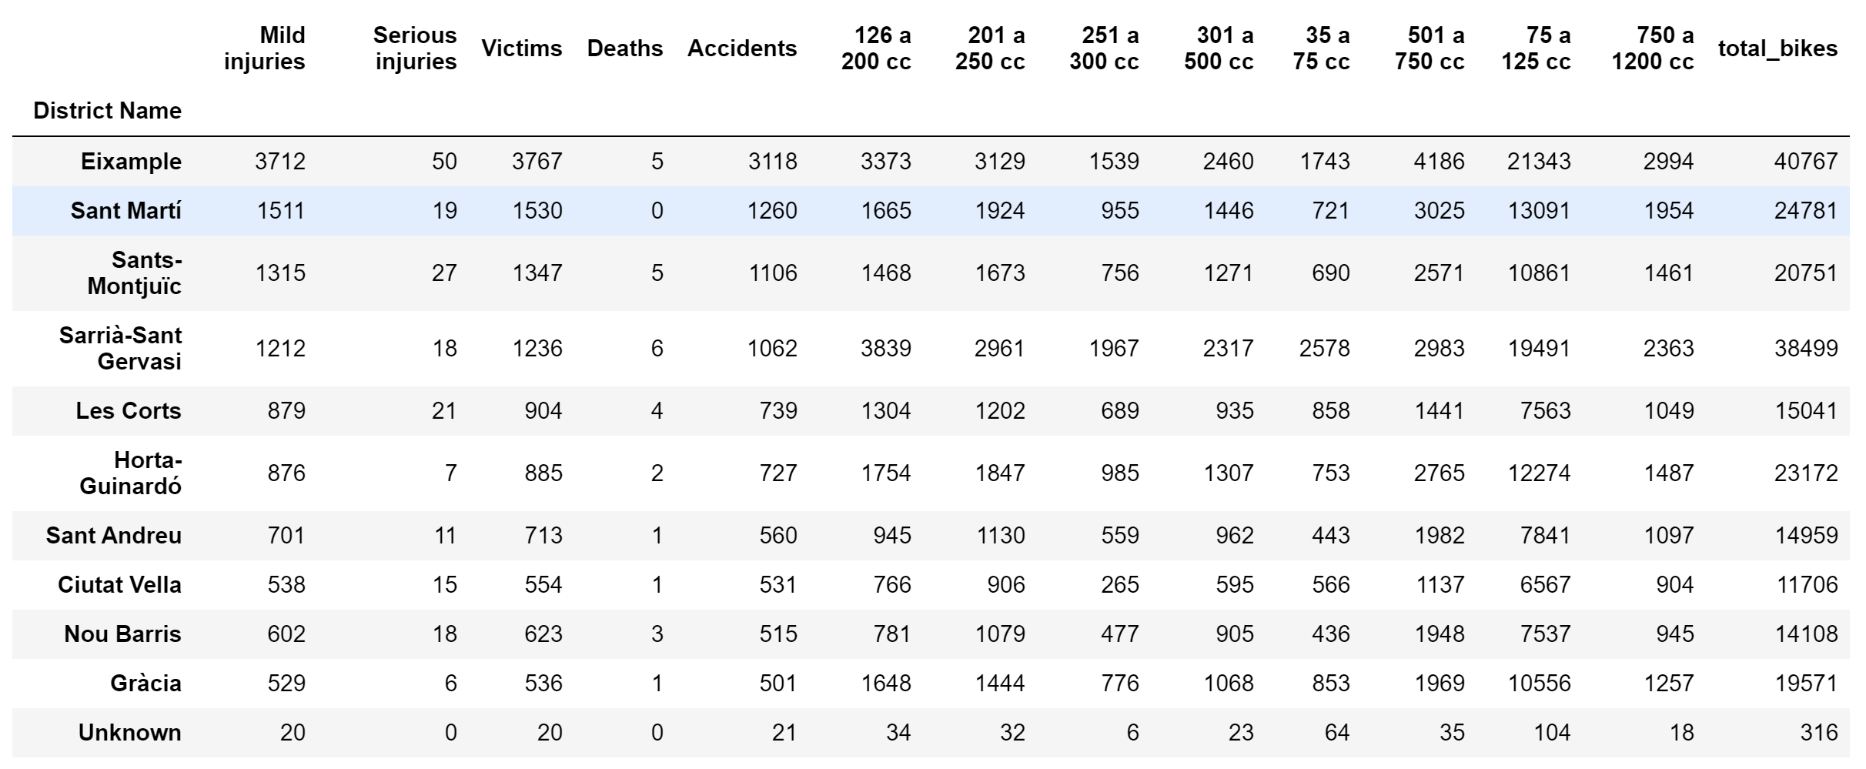
3 – Insights (1/3)
After merging the two datasets the Result was the Following Table*
Questions raised:
Do the total number of bikes has influence on the number of accidents?
Do they power/size of the bike correlates with accidents? What about deaths?
Hypothesis: We assumed for the purpose of the analysis that the Motorbikes registered to a district is representative of the number of bikes actively cruising in that area during any given day (No seasonality)
*2016 Dataset

Slide 8
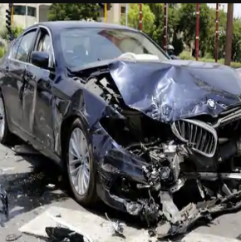

3 – Insights (2/3)
Using the correlation function we got to unexpected results:
Hypothesis
Correlation of Deaths/Accidents vs. Bike Category
Rankings
Accidents
Deaths
Deaths
Youths are less prudent so when they have an accident it is more likely to be serious/fatal
1st
750 – 1200 cc
35 - 75cc
2nd
501 – 750 cc
126 – 200 cc
Accidents
8th
301 – 500 cc
750 – 1200 cc
Big bikes are harder to control, more risky. Not necessarily fatal, riders are more experienced (A2 liscence) and more protected
9th
35 - 75cc
501 – 750 cc
Highest Correlation
88%
73%
Lowest Correlation
58%
53%
*2016 Dataset

Slide 9

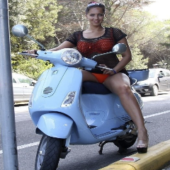
3 – Insights (3/3)
By subtracting 2017 dataset from 2016 we had another point of view based on yearly increase of bikes and accidents by neighborhood
Hypothesis
Accidents change 2016 - 2017
Correlation
Rankings
By District
By Motorbike
Why Ciutat Vella?
More vehicles
More tourists
Density of citizens
1st
Ciutat Vella
35 - 75cc
2nd
Sant Andreu
501 a 750 cc
Why < 75 cc
index[-2]
Les Corts
75 a 125 cc
Reckless youth (like Pol)
Most affordable type
index[-1]
Eixample
301 a 500 cc
Highest
13 %
52%
Lowest
-2.85%
25%

Slide 10
4&5 – Challenges Encountered & Key Learnings
Challenges | Caused by | Learnings
We could back test with historical data but we will never know if they will hold their truth “in the streets” | Are our insights/hypothesis true? How to reduce uncertainty? | When analysis involve offline phenomena's, at least some case-studies are necessary to validate hypothesis
Overthinking data frame manipulations | Doubts about representative analysis: sample size, value type(Percentual or absolute value? Comparing years or neighborhoods? How homogeneous is the area of each neighborhood) | Start by doing the basic, then build up complexity once you understand the nature of your data. Test representativeness with subsets once the initial work is done.
Losing overview (Jupyter Notebook) | 4 datasets, four different parts | Organize Notebook with Markdown
Repeat entire code because of mistake | Wrong expectation of meaningful result | More time to plan before code

