Slide 1

DigiPore Project Jobbox Application
Web development – Frontend and backend :HTML5,CSS3,JavaScript,Agular,Mysql,Restful

Slide 2
Project Jobbox - overview
Application for managing jobs.
for job seeker find a job which company published
User and Company
user can register profile and information.
show jobs list and job detail information.
user can apply job.
company can register profile and publish jobs.
company can get the user information who apply the job
administrator
manage user , company and job.

Slide 3
Project Jobbox - Technology
create users,companies and jobs three tables forming one to many relation in mySql database.
use Restful serivices implemented against the data.
implement as a SPA-applicaition
create adminstrator role to access control for managing the database.
use node-based web server and MySQL database.
use Angular as Frontend .

Slide 4
Step 1 : the data model
Company
id
company_id
name
email
password
location
Job
id
job_id
name
description
company_id
Application_id
Application
id
job_id
user_id
company_id
applicaition_id
User
id
user_id
name
email
phone
password

Slide 5
Step 2: Server application
Architecture(Server)
Client
angular index.html, styles,images
Server.js
UserAPI
UserDAO
MySQL
MySQL
Helper
CompanykAPI
CompanyDAO
JobAPI
PersonDAO
Node-Express web server
MySQL-Database, node-mysql extension

Slide 6
Step 2: Server application
Architecture(Server)
Client
angular index.html, styles,images
Server.js
User API
UserDAO
MySQL
MySQL
Helper
Company API
CompanyDAO
JobAPI - public
PersonDAO
Node-Express web server
MySQL-Database, node-mysql extension

Slide 7
Step 2
Architecture (Client, case Users)
Routing to select view
Services as proxy to data
UserList
HTTP
UserService
UserApi
UserDetail
Angular
Routing between views
Ajax
Self implemented responsiveness

Slide 8
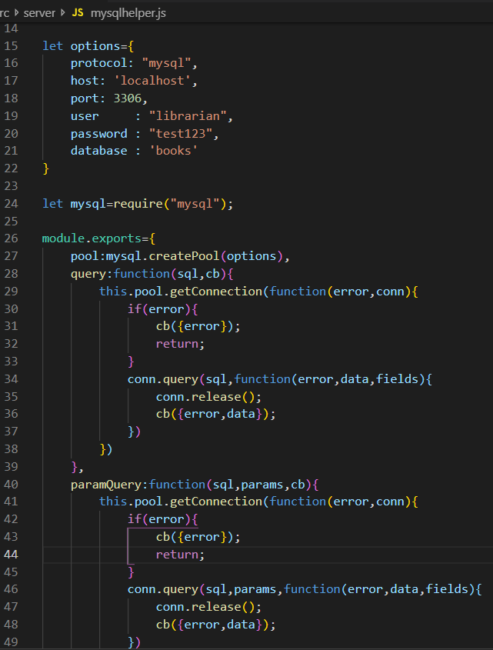
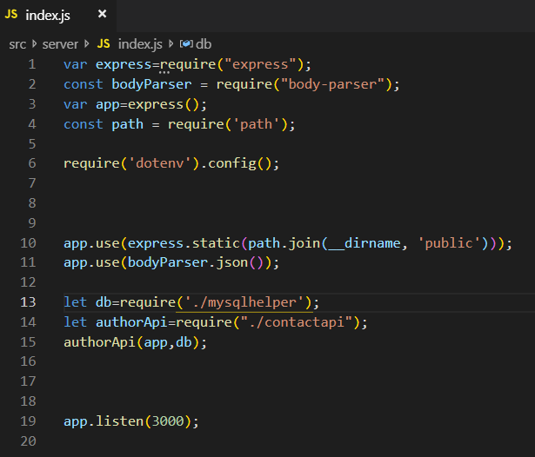
Step 3: RESTful interface

Slide 9
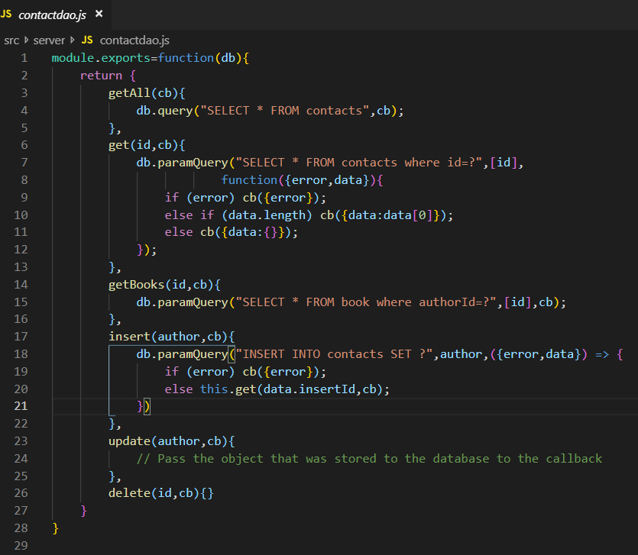
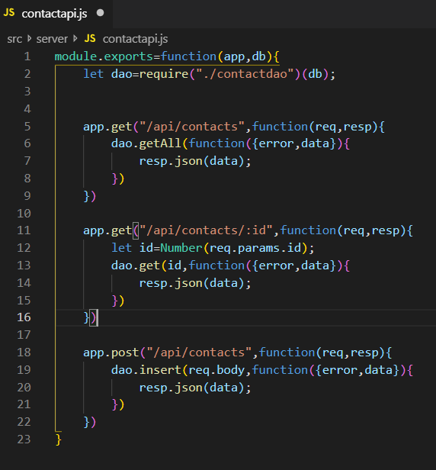
Step 3:

Slide 10
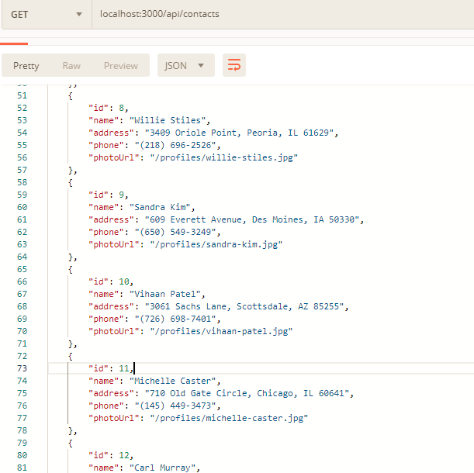
Step 3: get "/api/contacts"

Slide 11
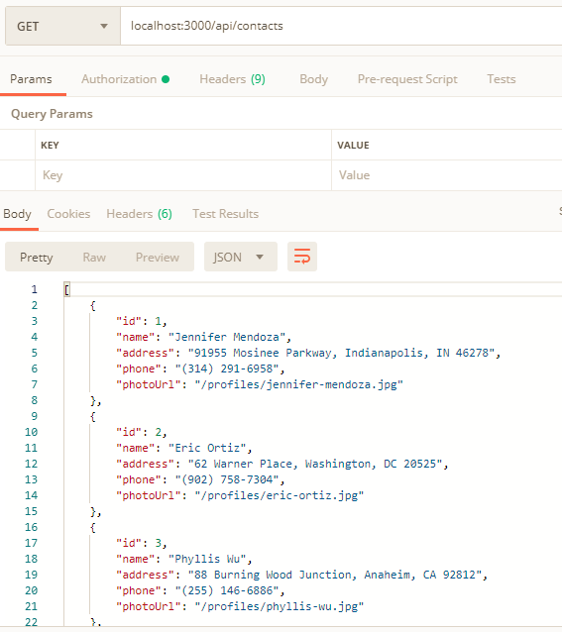
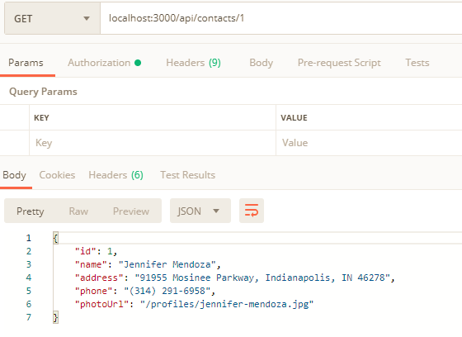
Step 3: get "/api/contacts/1"

Slide 12
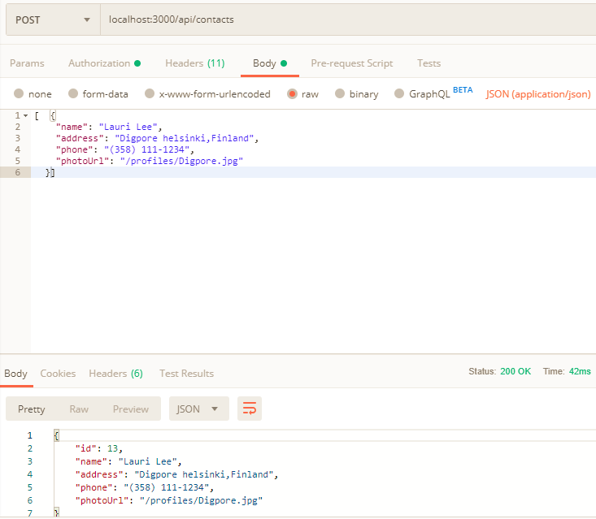
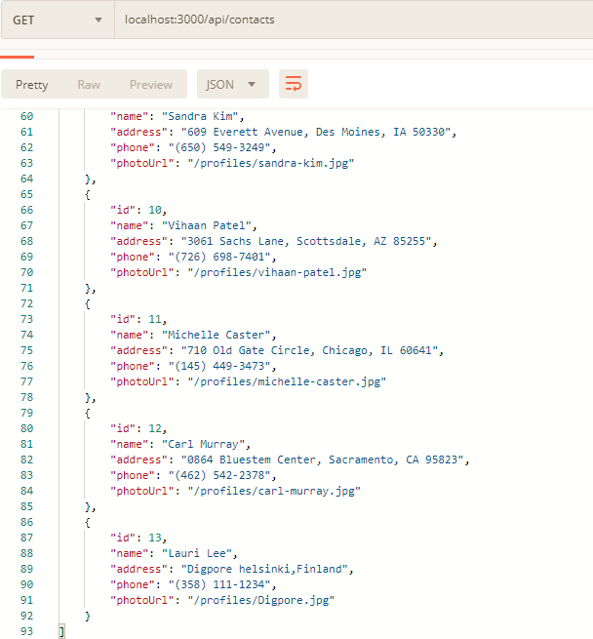
Step 3: post "/api/contacts"

Slide 13
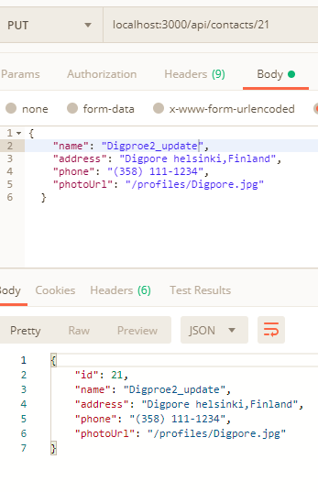
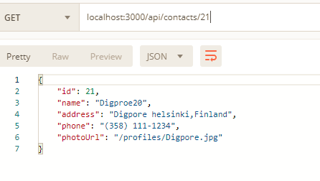
Step 3: put "/api/contacts/16"

Slide 14
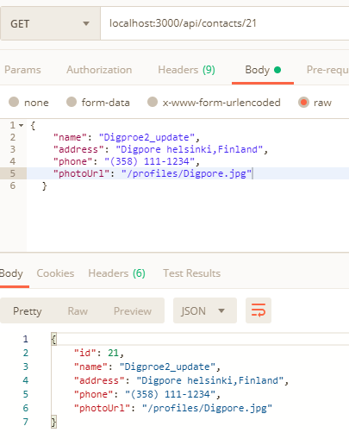
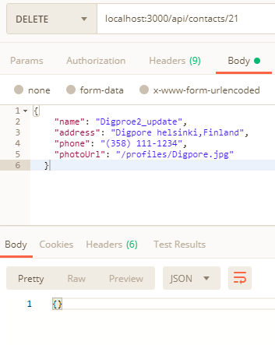
Step 3: delete "/api/contacts/16"

Slide 15
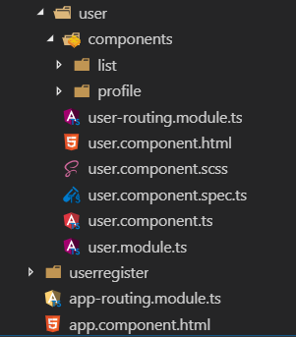
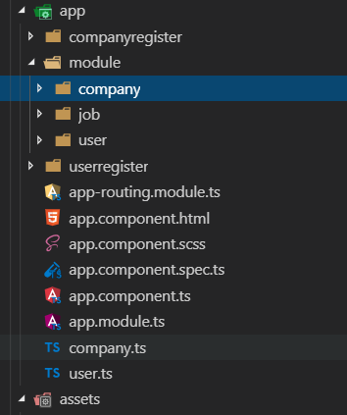
Step 4: UI
main page
jobs list
job detail
companies list
company detail
login page
users list
user detail
user registration
company registration

Slide 16
Step 4:
Option only available for administor
Companies
Jobs
Users
Lauri
Details
Edit
UserListComponent
List of UserComponents
CompanyComponent
Default (the essentials)
Details (the company list)
Edit (input fields for data)
TextInput
Display and Edit modes
lauri lauri@Hotmail.com
Hide Details
Edit
phone
password
Lauri
Lee
email
name
Save
Discard
Delete

Slide 17
Step 5:Security
Description of security implementation
Evaluate from different perspectives
All PUT, POST and DELETE calls are denied
Apart from Administrator
User may query books and authors
And own data
Separate service api/user
PUT, login
POST, add (register)
GET,

Slide 18

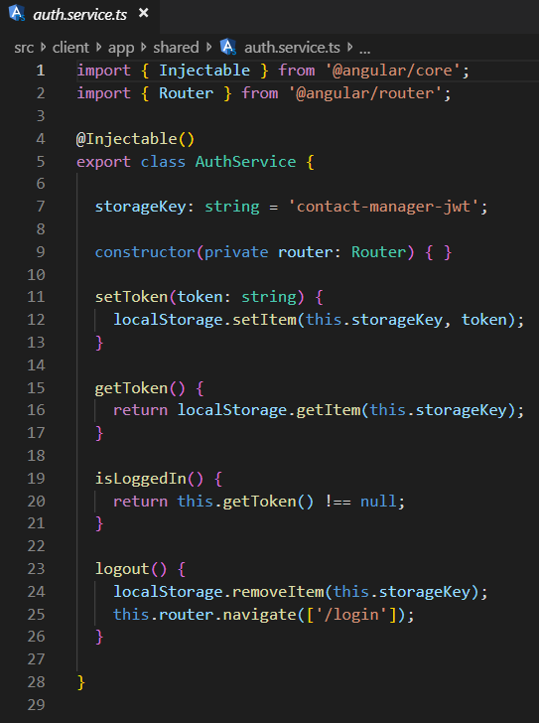
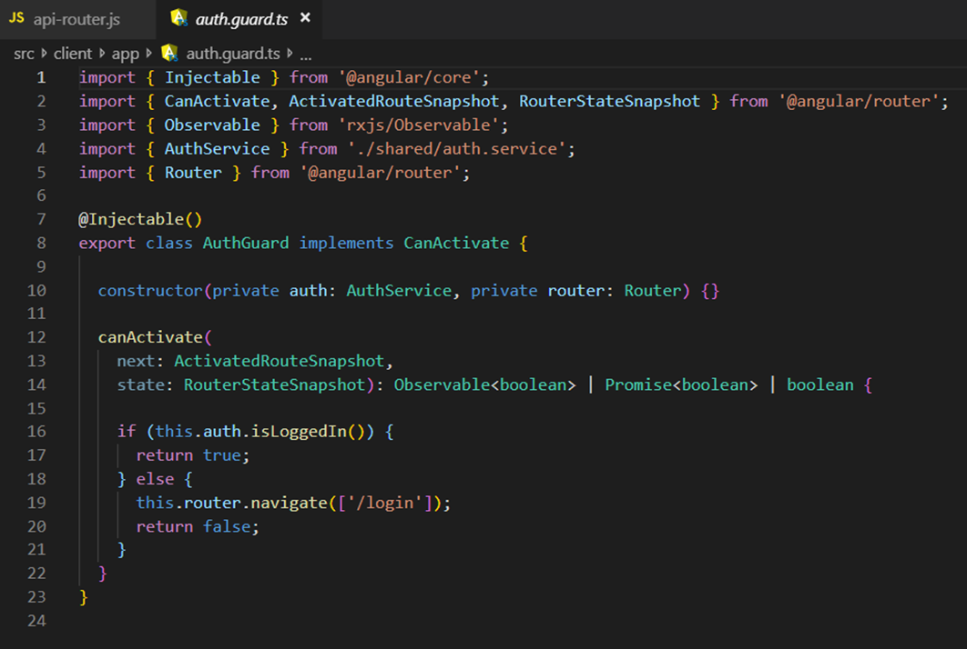
Step 5:

Slide 19
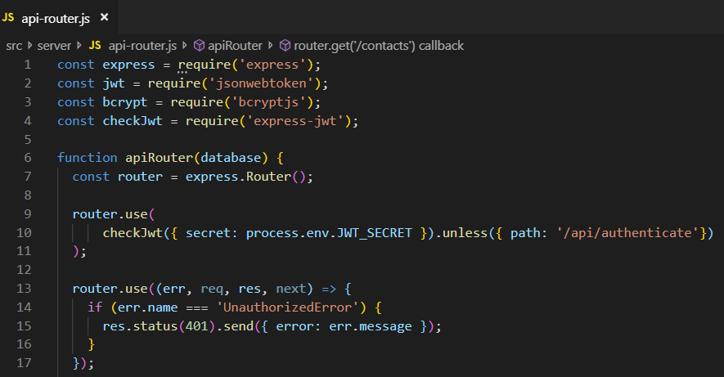
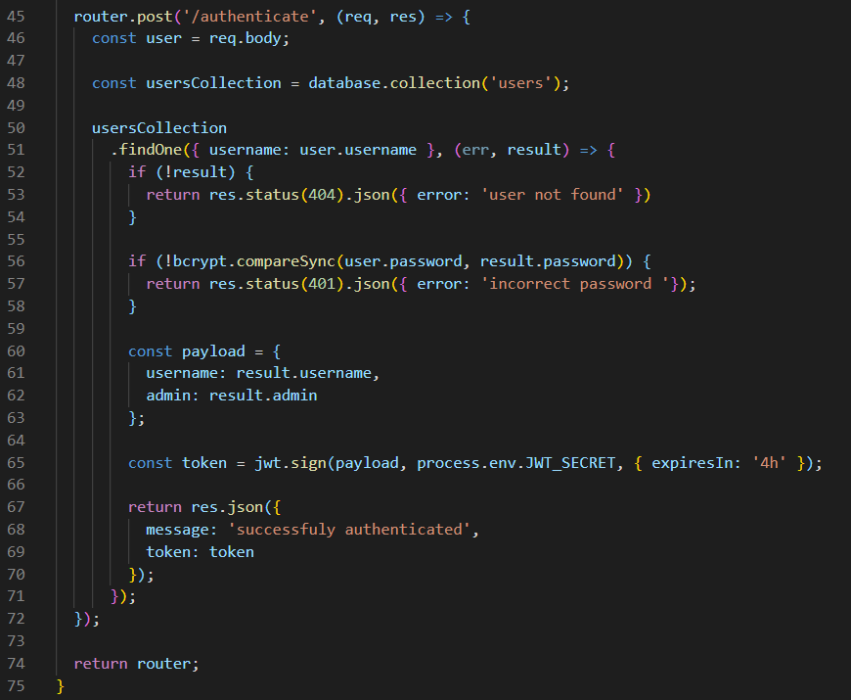
Step 5:

