Slide 1
A Cloud-Based Data Leakage Prevention System Using Rule-Based Content Inspection
TEAM MEMBERS :
SABARIRAJA. S ( 620822205090 )
RANJITH. P ( 620822205084 )
SHANTHOSH. M ( 620822205098 )
ROHITH. V ( 620822205088 )
GUIDE : Ms. JAYANTHI. R, AP/IT

Slide 2
Objective
Design a lightweight Cloud DLP gateway:
Inspect files before they are stored and block uploads that violate security policies.
Provide configurable DLP policies:
Regex‑based rules for emails, phone numbers, passwords, and sensitive patterns.
Encrypt and protect allowed content:
Encrypt allowed files at rest and store integrity hashes to detect tampering.
Offer full audit visibility:
Persist all upload attempts (ALLOWED / BLOCKED / ERROR) in an exportable audit log.
Expose a clean, user‑friendly web dashboard: Simple upload flow for users; clear stats, assets, and logs for admins.

Slide 3
Existing System
Manual or ad‑hoc checks: Security teams review data after upload (if at all). Reliant on user awareness.
Complex enterprise DLP suites: Heavyweight, complicated to configure and deploy. Overkill for smaller organizations or indiviuals.
Disadvantage
Limited transparency: Users and admins cannot easily see which uploads were blocked and why, or view currently stored assets.
Integrity monitoring gaps: Stored files can be updated or corrupted without straightforward integrity checks.
Result: Increased risk of accidental data leakage and difficulty demonstrating DLP behavior in PoC settings.

Slide 4
Proposed System :
Rule‑based upload gateway: FastAPI backend receives file uploads and applies regex‑based DLP policies before writing to storage.
Encrypted storage with integrity: Allowed files are encrypted (Fernet) and stored locally. SHA‑256 hashes of encrypted blobs are stored for verification.
Structured audit logging: Every attempt is logged in SQLite with reason and timestamp.
Advantage
Simple web dashboard: Users upload via a responsive UI; admins view stats, assets, and live audit logs.
Transparency & verifiability: Clear reasons for blocked uploads. Verify endpoint checks that stored files match recorded hashes.
Lightweight and extensible: Easy to plug in more policies, real cloud storage (e.g. S3/MinIO), and authentication later.

Slide 5
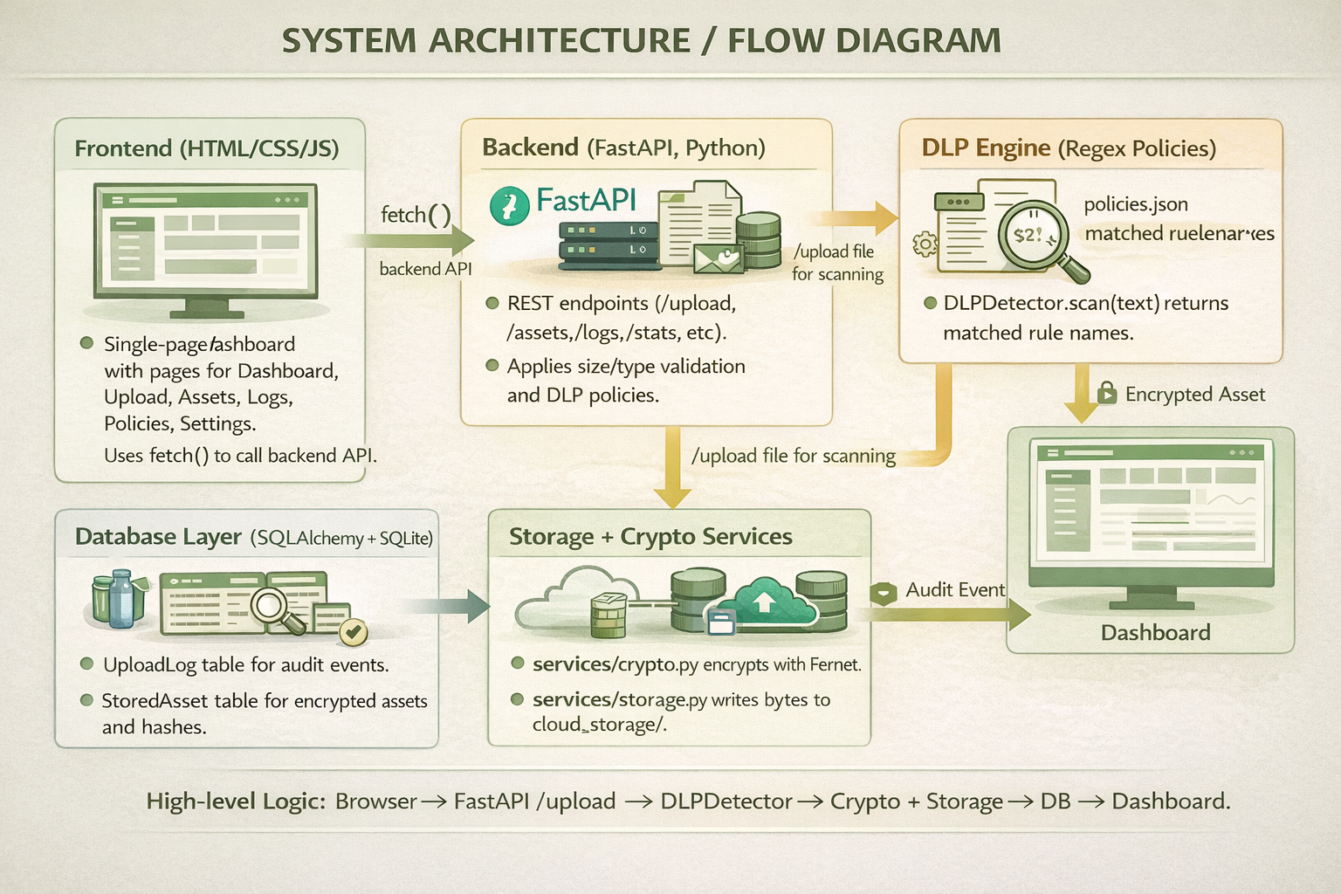
SYSTEM ARCHITECTURE/FLOW DIAGRAM

Slide 6
Modules :
Module 1: Rule-Based Content Inspection
Module 2: Cryptographic Hashing
Module 3: Secure Violation Logging
Module 4: User-Defined Security Policies
Module 5: Performance & Cloud Integration

Slide 7
Module 1: Rule‑Based Content Inspection
Purpose
Inspect file contents before upload to detect sensitive information (PII, credentials, etc.).
Core Idea
Use regex‑based rules on decoded text to flag patterns such as:
Email addresses, phone numbers, passwords / secrets, IDs.
Flow
Backend receives file → decodes bytes to text → calls DLPDetector.scan(text).
For each rule in policies.json, if regex matches, rule name is added to findings.
If findings is non‑empty, the upload is BLOCKED and never written to storage.
Benefits
Transparent and explainable: rules live in a simple JSON file.
Easy to extend with new patterns without changing core code.

Slide 8
Module 2: Cryptographic Hashing
Purpose
Ensure that stored (encrypted) files are not silently modified or corrupted.
Core Idea
Encrypt each allowed file and compute a SHA‑256 hash of the encrypted blob.
Why hash the encrypted data?
Integrity is verified on the exact bytes stored on disk.
Any change to the encrypted file (bit‑flip, truncation, replacement) changes the hash.
Where it fits
Runs only after a file passes DLP inspection.
Connects upload logic with the integrity verification endpoint.

Slide 9
Module 3: Secure Violation Logging
Purpose
Maintain a reliable audit trail for every upload attempt and its outcome.
Core Idea
Store structured log entries in SQLite with:
Filename, status (ALLOWED / BLOCKED / ERROR), reason, timestamp.
When it runs
On every /upload code path:
Size or type failure.
DLP violation.
Successful encrypted storage.
Internal errors (scan/storage issues).

Slide 10
Module 4: User-Defined Security Policies
Enables administrators to define and manage custom DLP detection rules.
Dynamic rule loading from policies.json without service restart.
Supports regex patterns for any sensitive data type: PAN, Aadhaar, custom IDs.
Each policy has: name, pattern (regex), severity level, and enabled flag.
Admin CRUD interface for adding, modifying, and disabling rules at runtime.
Hot-reload endpoint triggers immediate policy refresh in DLP engine.
Per-user policy overrides stored in database for personalized DLP profiles.
Policy audit log tracks all changes with timestamp and admin identity.

Slide 11
Module 4: Implementation Details
Policy Configuration (policies.json):
Each entry: { "name": "email", "pattern": "regex", "severity": "high", "enabled": true }
Loaded at startup and on POST /admin/policies/reload.
Backend API Endpoints:
GET /admin/policies — list all active rules with metadata.
POST /admin/policies — add a new rule (name, pattern, severity).
PUT /admin/policies/{name} — update existing rule pattern or toggle enable.
DELETE /admin/policies/{name} — remove a rule from active policy set.
DLPDetector Integration:
DLPDetector.reload() re-reads policies.json and recompiles regex patterns.
LRU cache on compiled patterns ensures no redundant re-compilation.
Invalid regex patterns rejected with descriptive error at creation time.

Slide 12
Module 5: Performance & Cloud Integration
Optimizes DLP inspection pipeline for large and concurrent file uploads.
Async upload handling using background task queue reduces response latency.
Streaming file processing with chunked reading reduces peak memory usage.
Integration with cloud storage backends: S3, MinIO, and Azure Blob adapter.
LRU cache for compiled regex patterns avoids redundant re-compilation.
Connection pooling for SQLite/PostgreSQL database operations.
Horizontal scaling support: DLP engine stateless; storage backend swappable.
Performance dashboard: throughput, average scan time, block rate metrics.

Slide 13
Module 5: Implementation Details
Async Processing:
FastAPI Background Tasks used for non-blocking upload logging.
Large files processed as streams: read in 64KB chunks to DLP scanner.
Regex matching applied per-chunk to avoid full file load into memory.
Cloud Storage Adapter:
Adapter pattern: Storage Backend interface with LocalDisk, S3, MinIO implementations.
S3 integration via boto3: upload_fileobj() streams encrypted bytes directly.
MinIO used for self-hosted S3-compatible storage in development.
Optimization Techniques:
functools.lru_cache wraps compiled regex objects — cache hit avoids re-compile.
SQL Alchemy connection pool (pool_size=10) handles concurrent log writes.
Prometheus metrics endpoint: /metrics exposes scan latency histograms.

Slide 14
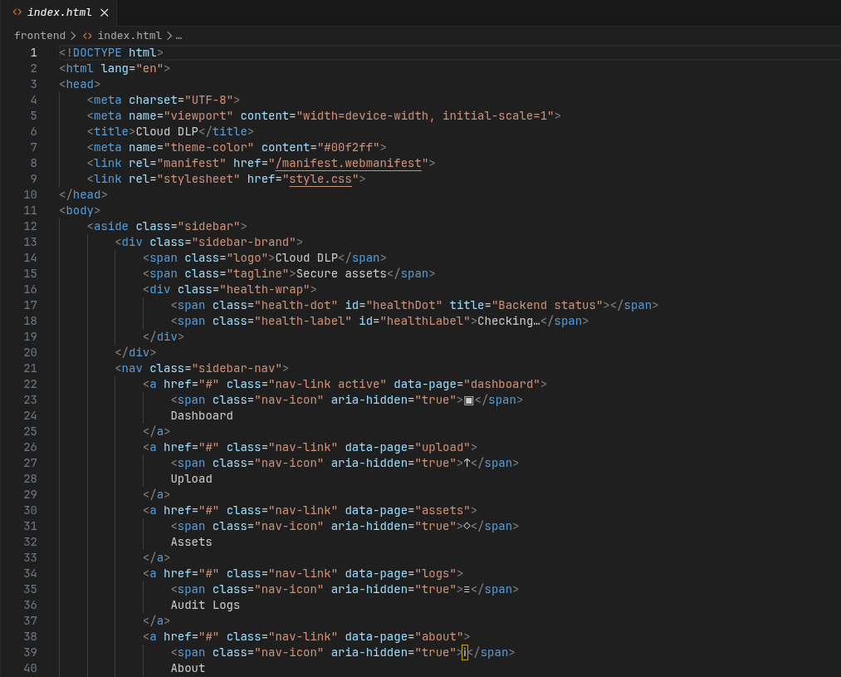
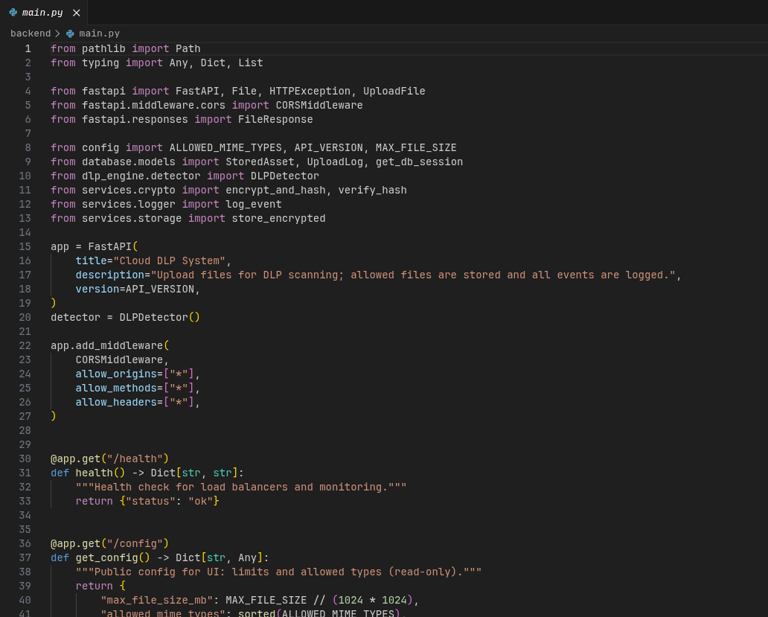
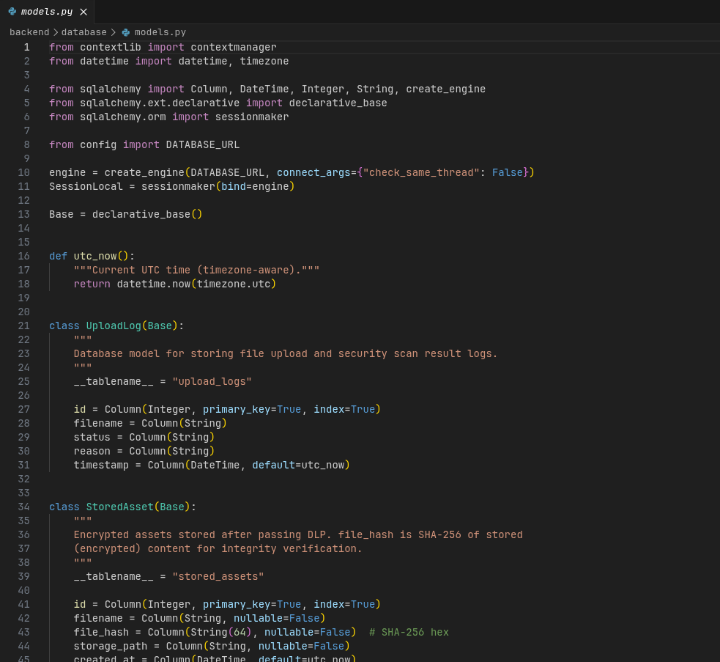
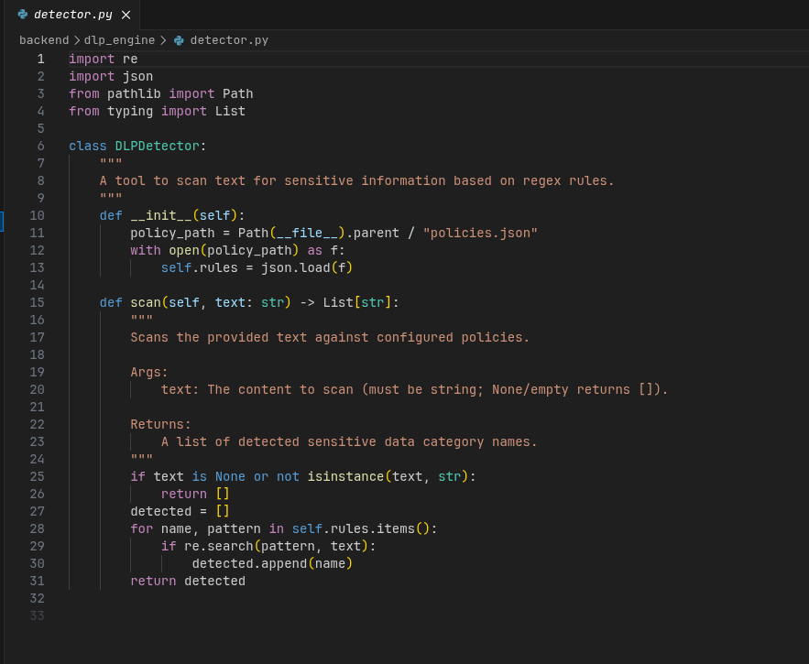
Screenshot: Source code

Slide 15
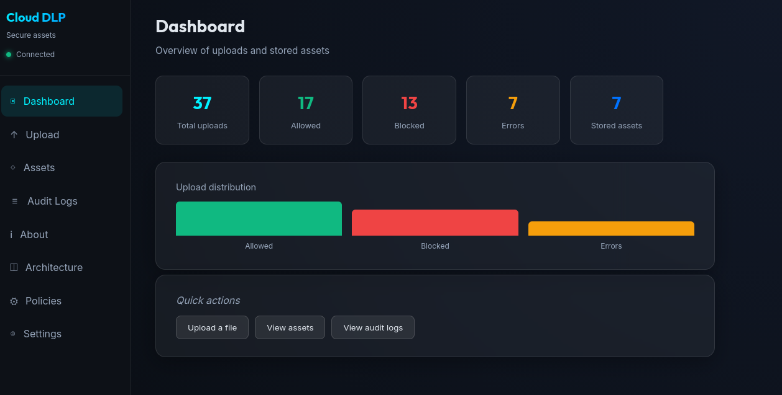
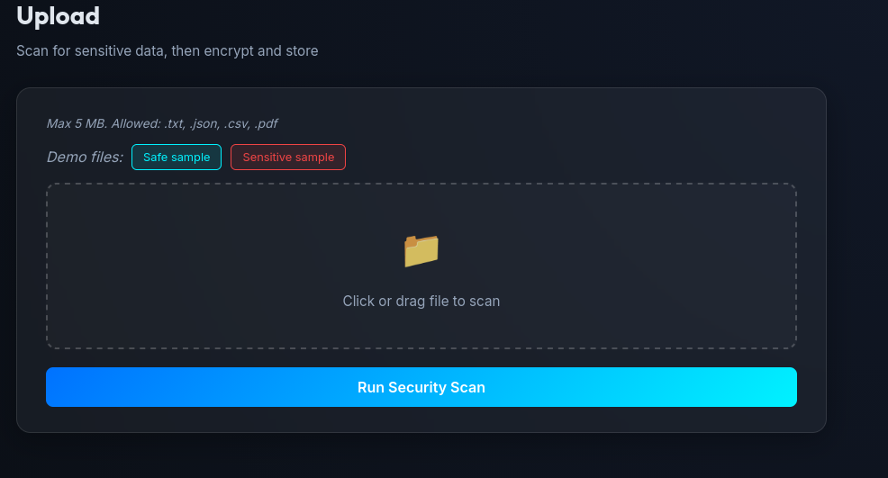
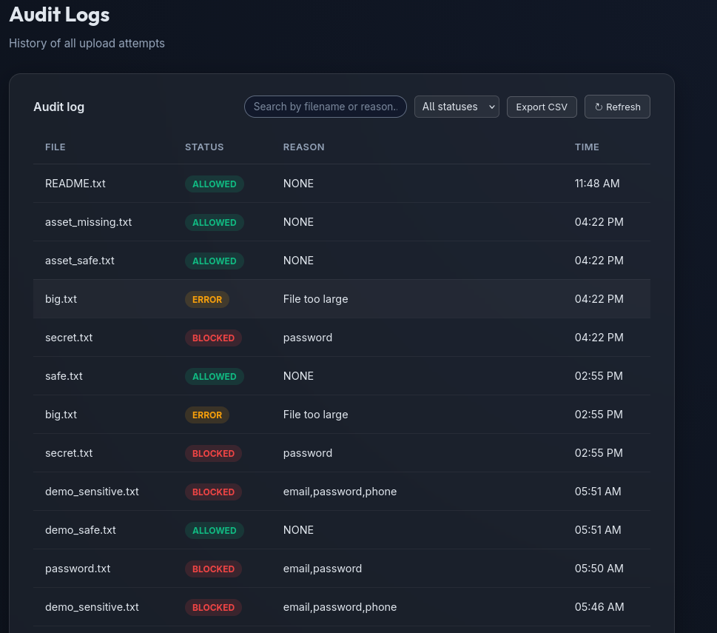
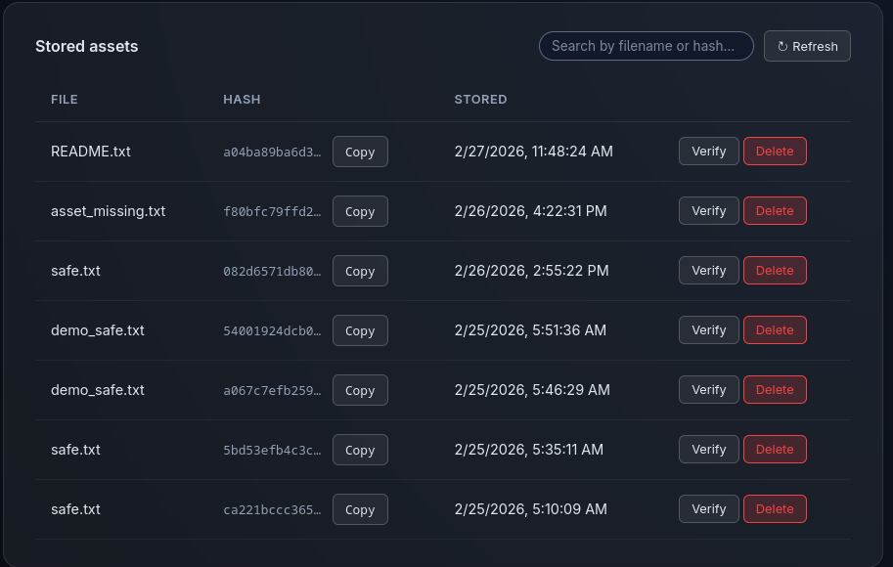
Screenshot: UI

Slide 16
Conclusion
Summary
Cloud DLP gateway that inspects, encrypts, and logs file uploads for cloud environments.
Key Benefits
Prevents many accidental leaks before data even reaches storage.
Provides clear, human‑readable reasons for blocked uploads.
Ensures stored files are encrypted and integrity‑checked.
Offers a transparent, searchable audit trail and simple UI.
Outcome
A solid foundation to extend into a production‑grade DLP solution with richer policies, real cloud backends, and access control.
THANK YOU !

