Slide 1
Minimal Linux Distribution for Cybersecurity
TEAM MEMBERS :
SRIDHARAN. T ( 620822205302 )
PRAVEEN RAJ. G ( 620822205078 )
SHANMUGA SRILAN. T ( 620822205097 )
MUGILAN. K ( 620822205066 )
GUIDE : Mrs. P. KARTHIKAYINI, AP/IT

Slide 2
Objective
The primary objectives of the Cogman framework are:
To design a fully metadata-driven package system
To replace traditional package managers with a controlled assistant-based workflow
To ensure deterministic, repeatable builds for all system components
To support secure toolchain bootstrapping from first principles
To provide a clean foundation for penetration-testing distributions
To enable future expansion toward AI-assisted security tooling

Slide 3
Existing System
Most existing Linux distributions use package managers such as APT, DNF, or Pacman. These systems rely on:
Prebuilt binary packages
Centralized repositories
Complex dependency solvers
Implicit trust in upstream maintainers
Disadvantage
Lack of full visibility into build processes
Difficult to reproduce identical systems across machines
High dependency bloat
Limited isolation between build and runtime
Security tools often introduce unnecessary attack surface

Slide 4
Proposed System :
Cogman introduces a metadata-centric and assistant-driven architecture where every package is explicitly defined by structured configuration files. Instead of installing packages directly into the system, Cogman enforces a staged workflow:
Source acquisition
Controlled build lifecycle
Isolated package root installation
Advantage
Complete transparency of build and install steps
Deterministic and reproducible builds
Strong separation between build, package, and system root
Fine-grained dependency verification
Improved system security and auditability

Slide 5
SYSTEM ARCHITECTURE/FLOW DIAGRAM
Cogman Assistant
Package Metadat Layer
Schema Verification Layer
Cogman build engine
Package rootinstall
Rootfs Deployment

Slide 6
Modules :
Metadata Loader and Verifier
Assistant-Based Command Interface
Builder and Toolchain Manager
Package Root Manager
System Deployment Manager

Slide 7
MODULE 1: Metadata Loader and Verifier
Purpose
Handles secure loading, validation, and integrity verification of system and package metadata.
Core Responsibilities
Parse structured metadata ( TOML )
Verify cryptographic signatures ( SHA-256 )
Validate schema and version compatibility
Detect tampering and corruption
Cache verified metadata securely
Key Features
Pluggable verification backends
Schema evolution support
Trust-chain validation
Deterministic parsing for reproducibility

Slide 8
MODULE 2: Assistant-Based Command Interface
Purpose
Natural language or structured assistant interface to control system operations.
Core Responsibilities
Parse user intent
Convert intent into validated system commands
Enforce permission boundaries
Provide contextual feedback
Maintain command audit logs
Key Features
AI-assisted task translation
Safe command sandboxing

Slide 9
Module 3: Builder and Toolchain Manager
Purpose
Manages compilation, dependency resolution, and reproducible builds.
Core Responsibilities
Toolchain version control
Dependency graph resolution
Cross-compilation support
Incremental builds
Artifact hashing and verification
Key Features
Deterministic builds
Build cache optimization
Environment isolation

Slide 10
Module 4: Package Root Manager
Manages isolated package root installation at /mnt/rogue/pkgroot.
Each package installs into its own subdirectory namespace — no cross-contamination.
Prevents build artifacts from one package interfering with another's installation.
Supports staged installation: package root built before merging into system root.
Rollback capability: remove a package by deleting its pkgroot subdirectory tree.
Package manifest (pkg_manifest.txt) tracks all installed components with hashes.
Validates installation completeness: all expected files present and hash-verified.
Foundation for clean rootfs assembly — packages aggregated deterministically.

Slide 11
Module 4: Implementation Details
Directory Structure:
/mnt/rogue/pkgroot/{package-name}/{bin, lib, share, include} — per-package namespacing.
base-files, busybox installed into pkgroot/base-files/, pkgroot/busybox/ respectively.
linux-headers in pkgroot/linux-headers/ for toolchain packages.
Installation via cogman-exec (C11):
Executor reads .plan steps: op=MKDIR, op=COPY_FILE, op=SYMLINK.
mkdir(pkgroot/{name}/{dir}) creates isolated namespace before file copy.
SHA-256 of each installed file verified against plan metadata hash.
On hash mismatch: executor fails-fast with error code 1 — no partial install.
Manifest Tracking:
pkg_manifest.txt updated after each successful package install.
Entry format: package_name | version | install_path | artifact_hash.
148+ packages tracked in current manifest (pkg_manifest.txt).

Slide 12
Module 5: System Deployment Manager
Orchestrates final rootfs assembly by merging isolated package roots into system tree.
Validates system completeness before deployment using pre-rootfs checklist.
Merges pkgroot/{package}/* into unified /mnt/rogue/rootfs/ directory tree.
Generates bootable ISO image from completed rootfs using standard Linux tools.
Supports deterministic rebuilds: same metadata → identical rootfs every time.
Pre-rootfs checklist (PRE-ROOTFS-CHECKLIST.md) validates all components present.
Handles symlinks, permissions, and file modes during merge phase.
Final ISO verified against expected size and checksum before distribution.

Slide 13
Module 5: Implementation Details
Deployment Pipeline:
Step 1: Validate all packages in pkg_manifest.txt are present in pkgroot.
Step 2: Run pre-rootfs checklist: required binaries, init, kernel, bootloader.
Step 3: Merge pkgroot/* → rootfs/ using cogman-exec MERGE_ROOT step.
Step 4: Configure system: /etc/passwd, /etc/group, hostname, fstab.
Step 5: Generate initramfs from rootfs using cpio + gzip.
Step 6: Package bootable ISO: syslinux/ISOLINUX + kernel + initramfs.
Cogman Integration:
cogman deploy command triggers planner to generate deployment.plan.
Planner validates all dependencies resolved before generating deploy steps.
Executor processes merge steps: COPY_TREE, APPLY_PERMS, CREATE_SYMLINK.
Verification:
SHA-256 checksum of final ISO computed and logged to build artifacts.
ISO tested in QEMU environment before release signing.

Slide 14
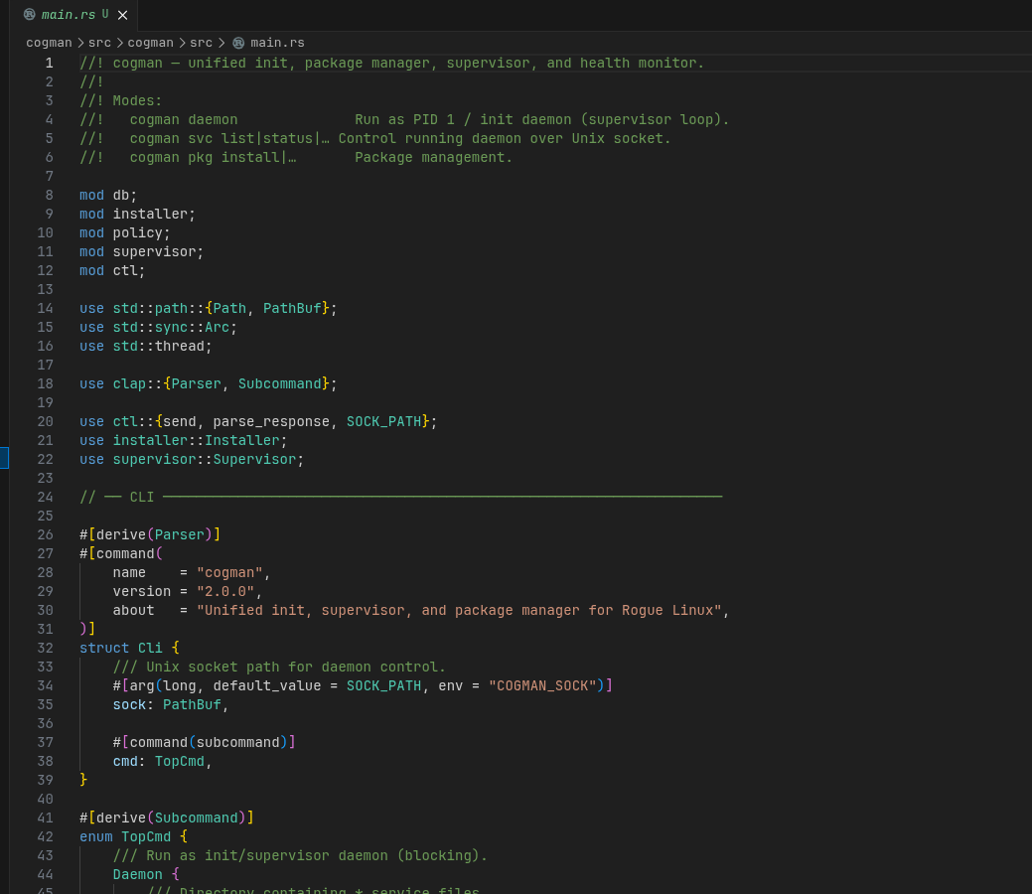
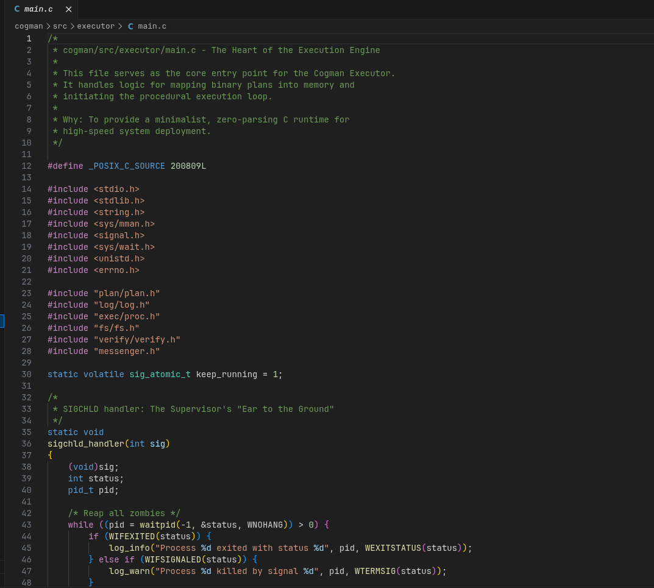
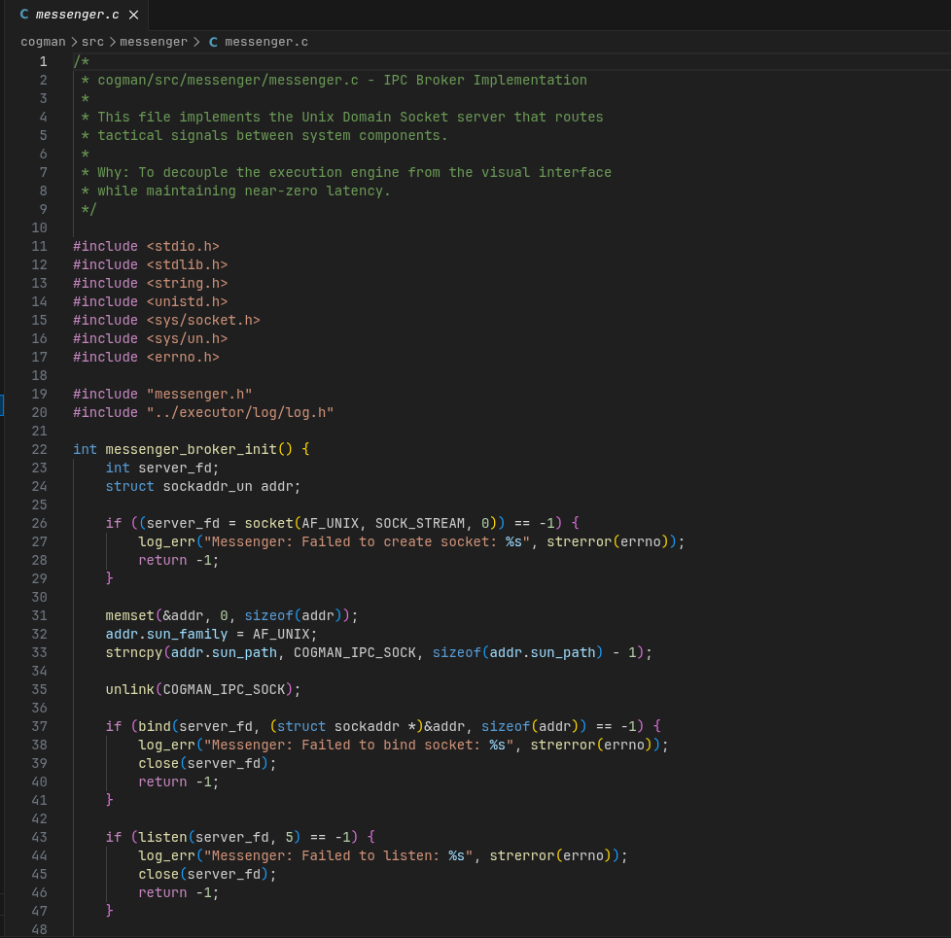
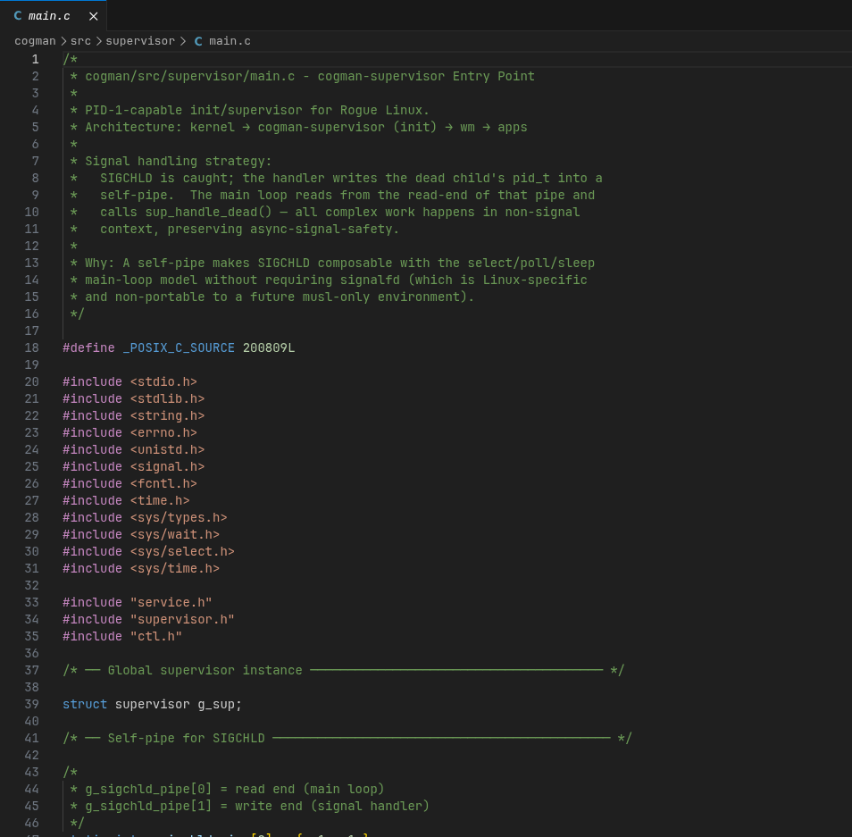
Screenshot: Source code

Slide 15
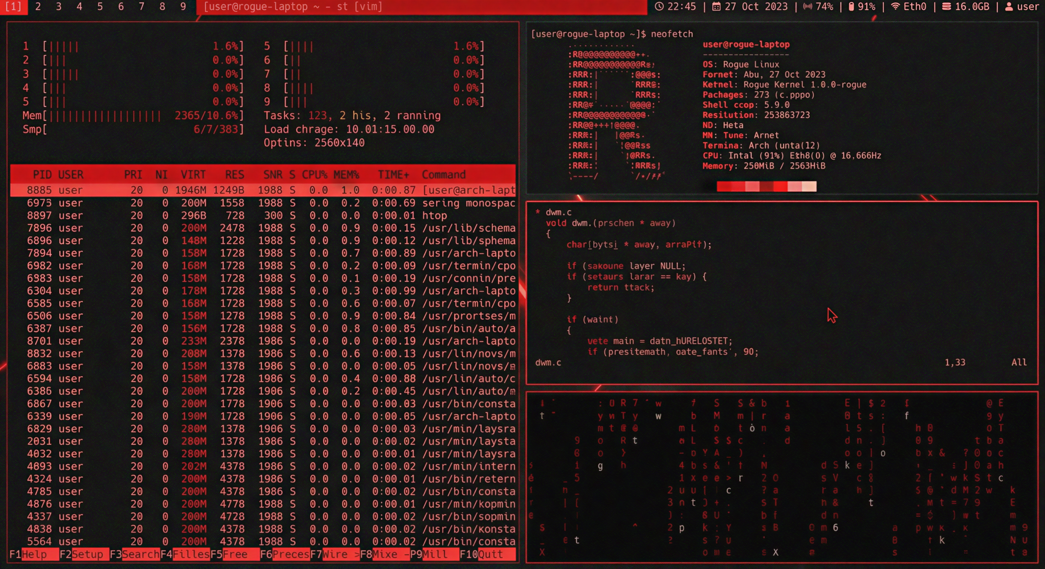
Screenshot: UI

Slide 16
Conclusion
Cogman demonstrates a new approach to building security-focused Linux distributions by prioritizing transparency, control, and reproducibility. By replacing traditional package managers with a metadata-driven assistant framework, Cogman provides a strong foundation for secure penetration-testing environments.
The system not only improves trust and auditability but also opens the door for future enhancements such as AI-assisted security analysis, automated hardening, and dynamic toolchain optimization.
Cogman represents a significant step toward next-generation security operating systems.
THANK YOU !

