Slide 1

DATA SCIENCE SALARY ESTIMATOR
PROJECT OVERVIEW
Nunoo Emmanuel Felix Landlord Nii Operku

Slide 2
PROJECT SUMMARY
Created a tool that estimates data science salaries (MAE ~ $ 12K) to help data scientists negotiate their income when they get a job.
Downloaded already scraped data of over 1000 job descriptions from glassdoor for my analysis.
Performed exploratory data analysis to establish relevant relationships between variables.
Built appropriate machine learning models (linear multiple regression, lasso regression, random forest regressor) and optimized using the GridsearchCV to reach the best model.

Slide 3
RESOURCES AND LIBRARIES USED
Python Version: 3.7
Packages: pandas, numpy, sklearn, matplotlib, seaborn.
Softwares: Spyder, Jupyter Notebook.

Slide 4
DATASET VARIABLES
Job title
Salary Estimate
Job Description
Rating
Company
Location
Company Headquarters
Company Size
Company Founded Date
Type of Ownership
Industry
Sector
Revenue
Competitors

Slide 5
DATA CLEANING
After importing the data, I needed to clean it up so that it was usable for our model. I made the following changes and created the following variables:
Parsed numeric data out of salary
Made columns for employer provided salary and hourly wages
Removed rows without salary
Parsed rating out of company text
Made a new column for company state
Added a column for if the job was at the company’s headquarters
Transformed founded date into age of company
Made columns for if different skills were listed in the job description:
Python
R
Excel
AWS
Spark
Column for simplified job title and Seniority
Column for description length

Slide 6
EXPLORATORY DATA ANALYSIS
I looked at the distributions of the data and the value counts for the various categorical variables.
Below are a few highlights from the pivot tables:

Slide 7
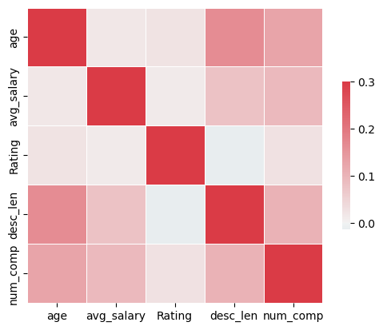
Correlation Heatmap comparing the relationship between age, average salary, rating, job description length and competitors count.

Slide 8
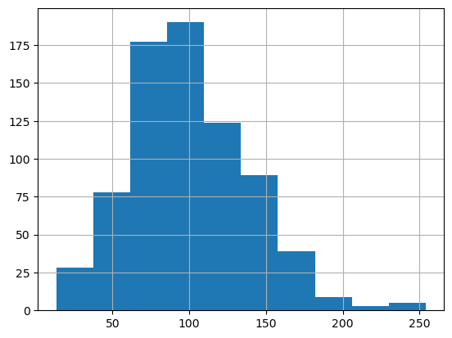
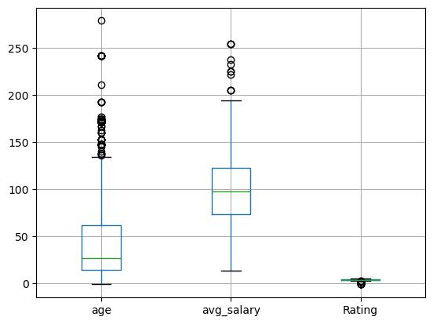
Histogram of the Average Salaries
Boxplot of Age, Average Salary and Rating

Slide 9
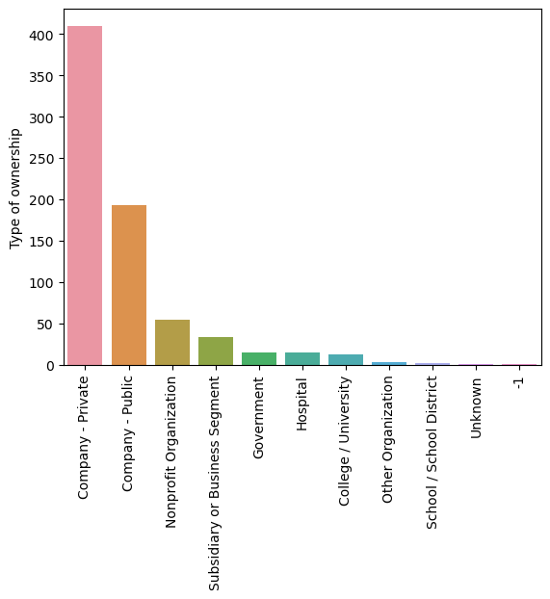
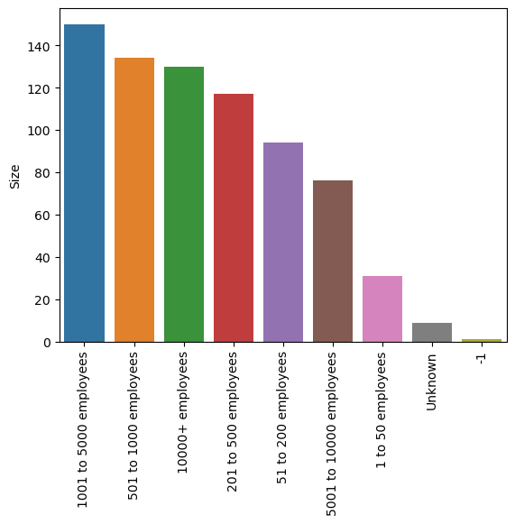
Bar plot comparing relationship between the type of ownership
Bar plot comparing relationship between company size

Slide 10
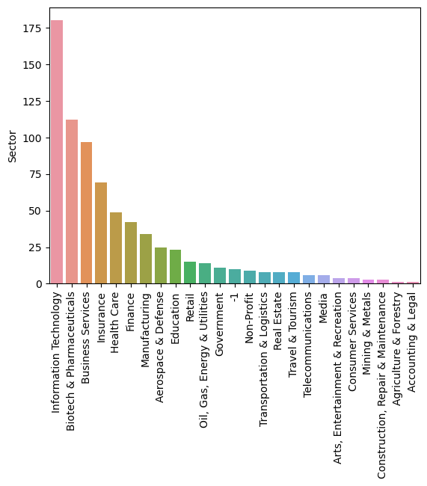
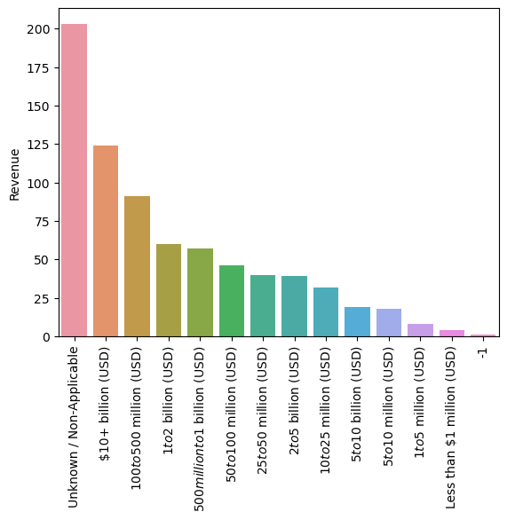
Bar plot comparing relationship between various sectors
Bar plot comparing relationship between company revenues

Slide 11
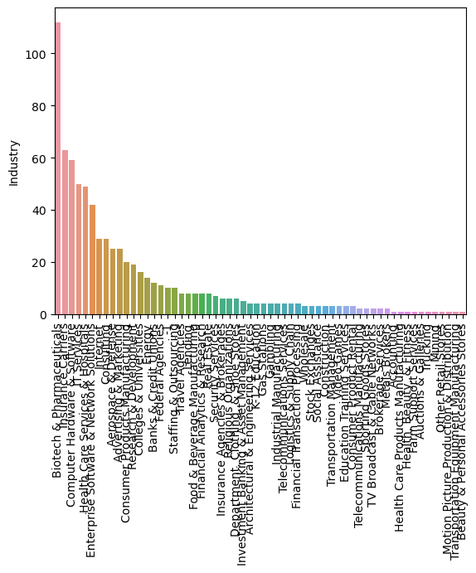
Bar plot comparing relationship between different company industries

Slide 12
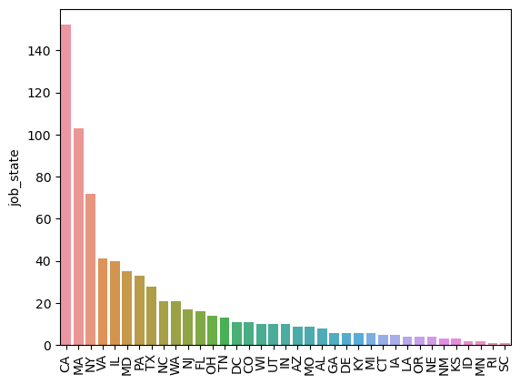
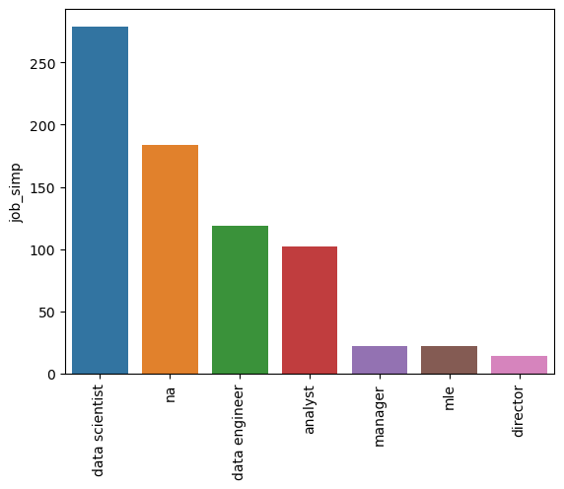
Bar plot comparing relationship between job in different states.
Bar plot comparing relationship between different job types.

Slide 13
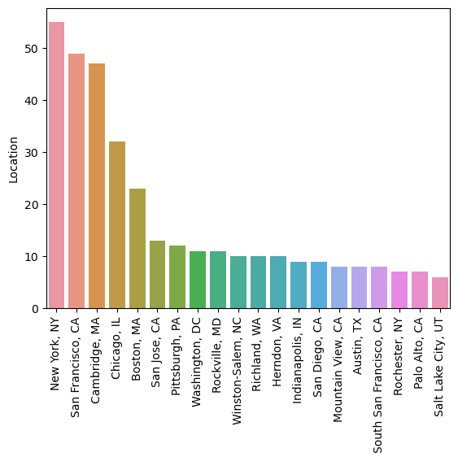
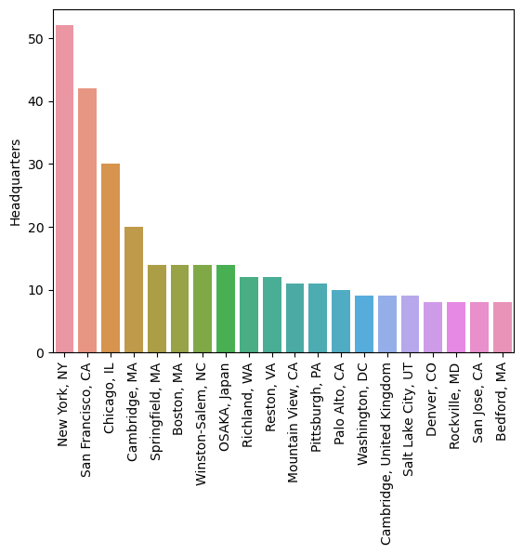
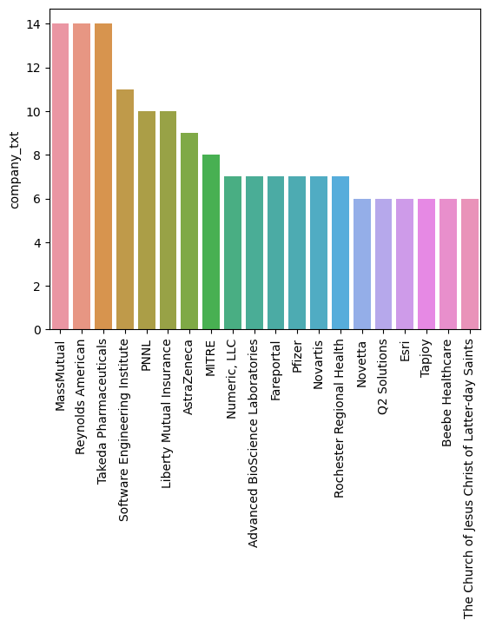
Bar plot comparing relationship between the top 20 company Location, company Headquarters, company Names.

Slide 14
MODEL BUILDING
First, I transformed the categorical variables into dummy variables. I also split the data into train and tests sets with a test size of 20%.
I tried three different models, performed cross-validation and evaluated them using Mean Absolute Error.
I chose MAE because it is relatively easy to interpret and outliers aren’t really bad.
models:
Multiple Linear Regression – Baseline for the model
Lasso Regression – Because of the sparse data from the many categorical variables, I thought a normalized regression like lasso would be effective.
Random Forest – Again, with the sparsity associated with the data, I thought that this would be a good fit.

Slide 15
MODEL PERFORMANCE
The Random Forest model far outperformed the other approaches on the test and validation sets.
Random Forest: MAE = 11.2
Linear Regression: MAE = 20.78
Lasso Regression: MAE = 19.3

