Slide 1



Analysis on Food Security Status
Project Overview
Nunoo Emmanuel Felix Landlord Nii Operku

Slide 2

Project summary
This project involves the analysis of household food security data to understand the factors influencing food security levels among different households.
The dataset contains information on various demographic and socioeconomic variables of households, such as site, education level, age, gender, ethnicity, household size, presence of children under 5 years old, poverty status, wealth index, and food security score.

Slide 3
Project objectives
Data Cleaning
Exploratory Data Analysis (EDA)
Identifying factor that influence food security
Building a predictive model
Evaluation of the performance of the models

Slide 4
Resources and libraries
Python Version: 3.11.
Packages: pandas, numpy, sklearn, matplotlib.
Softwares: Jupyter Notebook, Spyder.

Slide 5
Dataset variables
site
hhedu –household head eduation
hhhage - household head age
hhhsex – household head sex
hhethnic – household head ethnicity
hhsize – household size
u05 – number of people aged under 5
povline – below the poverty line?
windex3 – wealth tertile of household
windex5 – wealth quintile of household
FS_score – food security score
FS – food security status

Slide 6
Data cleaning
After downloading the data, I needed to clean it up so that it was usable for the models. I made the following changes:
Removed the ID column
Edited the povline column to remove “_(2)”, leaving the group with “yes” or ”no”.
Checked for missing values and removed them since the model will still be significant without them.

Slide 7
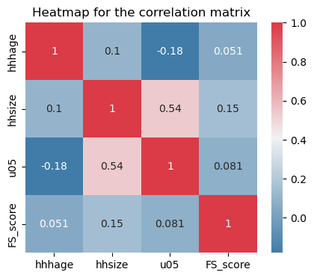
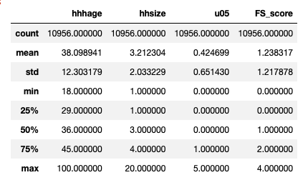
Exploratory data analysis
Summary statistics on numerical variables
Heatmap for the correlation matrix produced by the correlation of numerical variables

Slide 8
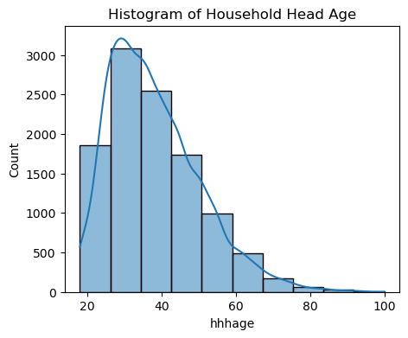
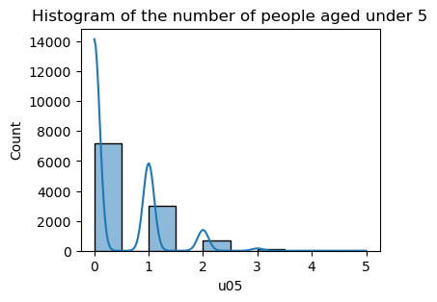
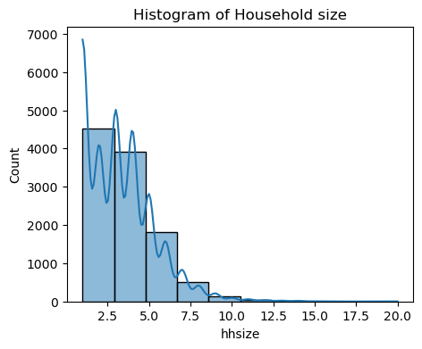
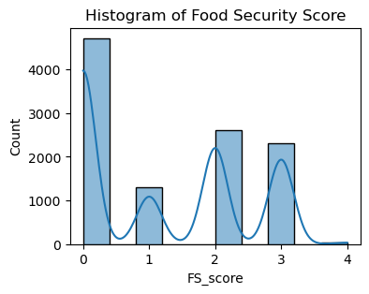
Exploratory data analysis
Histogram showing an overview of the distribution of household head age, household size, food security score, and number of people aged under 5.

Slide 9
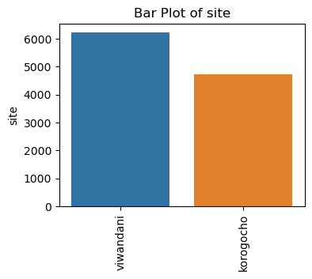
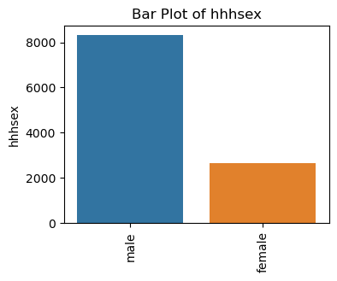
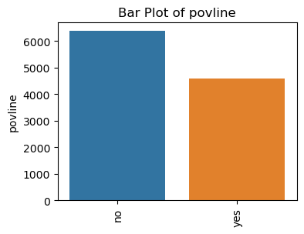
Exploratory data analysis

Slide 10
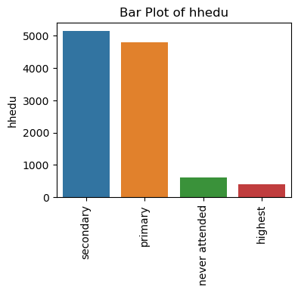
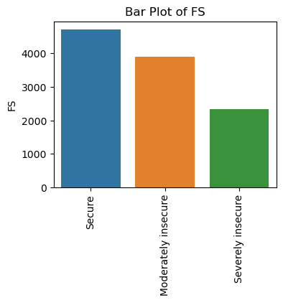
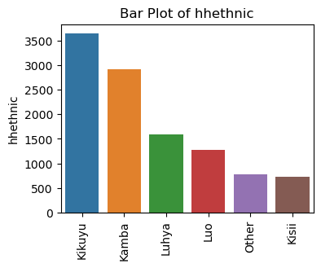
Exploratory data analysis

Slide 11
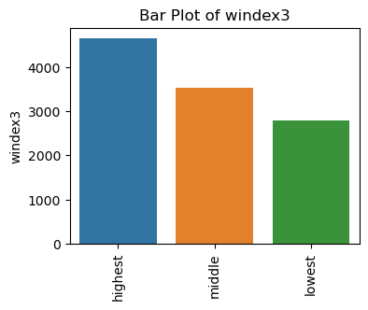
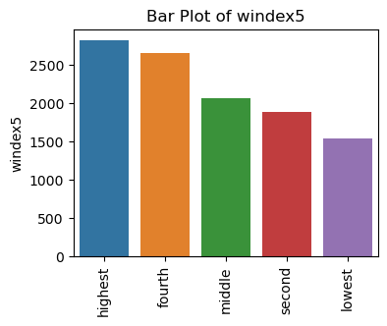
Exploratory data analysis

Slide 12
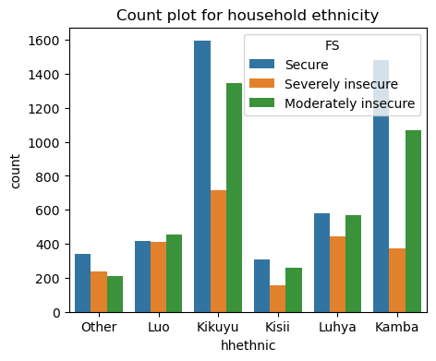
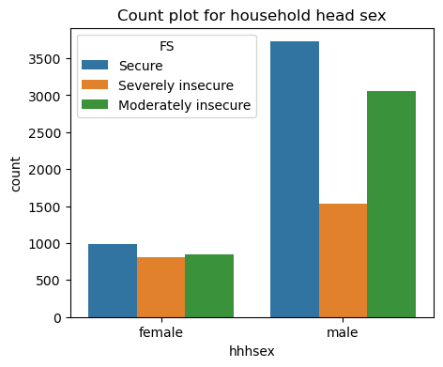
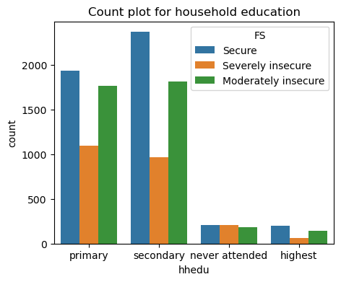
Exploratory data analysis
visualizing the distribution of hhethnic, hhhsex and hhedu to see how frequently each sub-category appears.

Slide 13
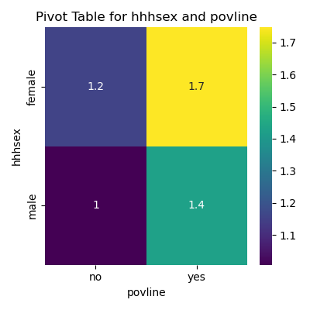
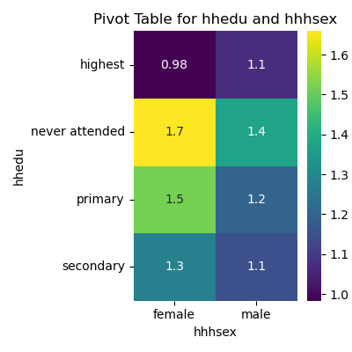
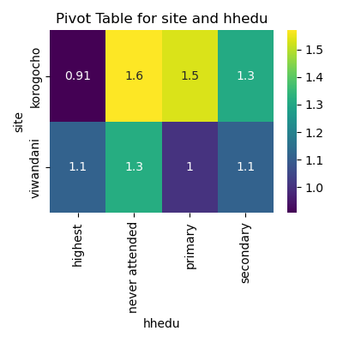
Exploratory data analysis
Exploring some heatmaps for pivot tables with 2 categorical variables to see relationships between each other.
Lower values explains a more secure food security status.

Slide 14
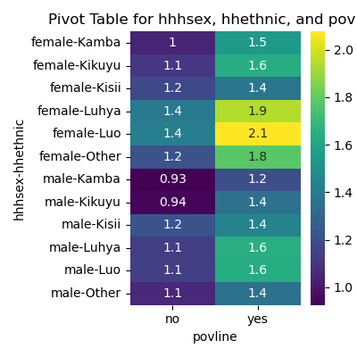
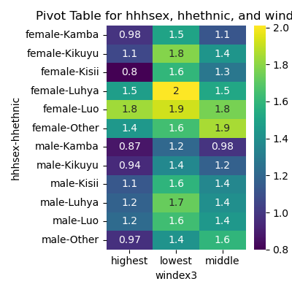
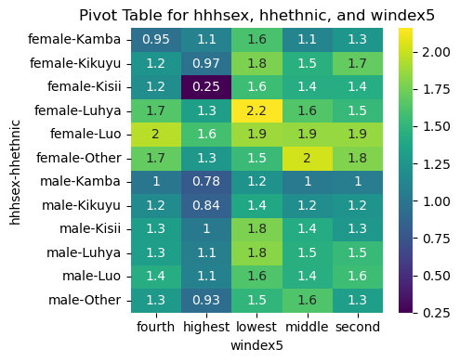
Exploratory data analysis
Exploring some heatmaps for pivot tables with 3 categorical variables to see relationships between each other.
Lower values explains a more secure food security status.

Slide 15
Feature importance comparison
Random Forest
Decision Trees
Gradient Boosting
site: 0.07983228748995211
hhedu: 0.04017644850421024
hhhage: 0.011458368658044902
hhhsex: 0.017390923854110885
hhethnic: 0.016893286896525802
hhsize: 0.0017701329433293133
u05: 0.0024977627115168326
povline: 0.005597281466912672
windex3: 0.0055353855427297816
windex5: 0.004532784336307618
FS_score: 0.0044630366473962955
FS: 0.005392018418302805
site: 0.07983228748995211
hhedu: 0.04017644850421024
hhhage: 0.011458368658044902
hhhsex: 0.017390923854110885
hhethnic: 0.016893286896525802
hhsize: 0.0017701329433293133
u05: 0.0024977627115168326
povline: 0.005597281466912672
windex3: 0.0055353855427297816
windex5: 0.004532784336307618
FS_score: 0.0044630366473962955
FS: 0.005392018418302805
site: 0.003824138553250663
hhedu: 0.012366556383994792
hhhage: 0.00037280183929922406
hhhsex: 0.014120550492593455
hhethnic: 0.02871278729993904
hhsize: 0.0001329215442317694
u05: 0.00011254493749318901
povline: 8.301701056545508e-05
windex3: 2.5523192742083517e-05
windex5: 0.00010392586307782732
FS_score: 0.00015144574976212074
FS: 0.0002707222979772874
features with higher importance scores have a stronger influence on the model's predictions.

Slide 16
Model building
First, I transformed the categorical variables into dummy variables. I also split the data into train and tests sets with a test size of 20% and a train size of 80%.
I built 3 classification machine learning models(decision trees, random forest and gradient boosting) and evaluated them accordingly with precision, recall and f1-score.
Used the GridsearchCV to find the best estimator and best parameters for the random forest model and evaluated the random forest to give the best f1-score.

Slide 17
Decision tree Model performance
--- Decision Tree ---
precision recall f1-score support
0 1.00 1.00 1.00 954
1 0.51 0.52 0.51 262
2 0.75 0.75 0.75 506
3 0.98 0.98 0.98 460
4 0.00 0.00 1.00 10
accuracy 0.87 2192
macro avg 0.65 0.65 0.85 2192
weighted avg 0.87 0.87 0.88 2192

Slide 18
Random forest Model performance
--- Random Forest ---
precision recall f1-score support
0 1.00 1.00 1.00 954
1 0.62 0.47 0.54 262
2 0.76 0.85 0.80 506
3 0.98 1.00 0.99 460
4 1.00 0.00 0.00 10
accuracy 0.90 2192
macro avg 0.87 0.67 0.67 2192
weighted avg 0.89 0.90 0.89 2192

Slide 19
Gradient boosting Model performance
--- Gradient Boosting ---
precision recall f1-score support
0 1.00 1.00 1.00 954
1 0.69 0.48 0.56 262
2 0.77 0.89 0.82 506
3 0.98 1.00 0.99 460
4 0.00 0.00 1.00 10
accuracy 0.91 2192
macro avg 0.69 0.67 0.88 2192
weighted avg 0.90 0.91 0.90 2192

Slide 20
Best Random forest Model performance
--- Best Random Forest ---
precision recall f1-score support
0 1.00 1.00 1.00 954
1 0.69 0.47 0.56 262
2 0.77 0.89 0.82 506
3 0.98 1.00 0.99 460
4 1.00 0.00 0.00 10
accuracy 0.91 2192
macro avg 0.89 0.67 0.68 2192
weighted avg 0.90 0.91 0.90 2192

