Slide 1





Real-Time Election Monitoring System

Slide 2

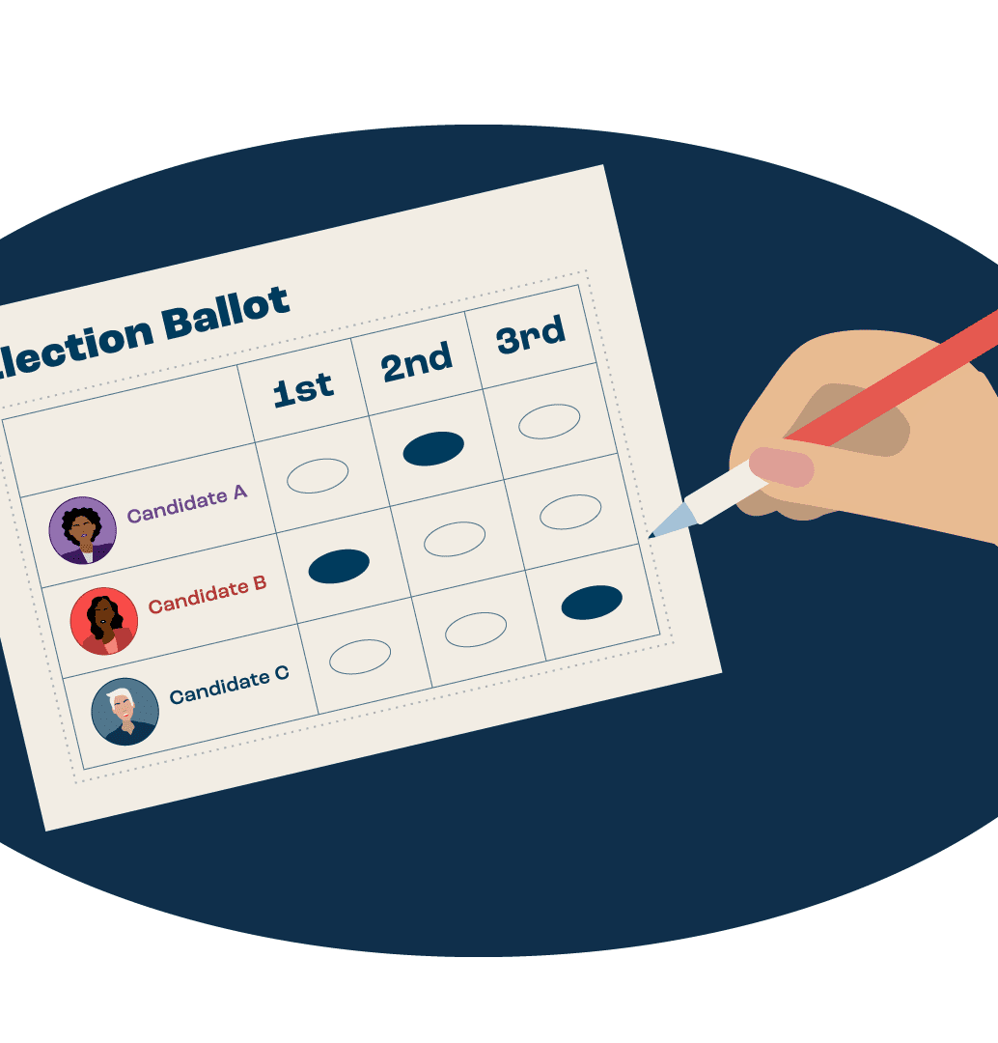
Project Overview
Project Goal:
To develop a scalable and reliable end-to-end solution for conducting and monitoring elections in real-time.
Project Focus:
Ensure transparency of election processes.
Provide up-to-date and accurate election results.
Enhance the efficiency and trustworthiness of the election process.

Slide 3
My Role
Designed and Implemented pipeline architecture.
Integrated Kafka for real-time streaming.
Ensured data integrity and security with PostgreSQL.
Created a user-friendly dashboard with Streamlit.
Deployed service using Docker Compose.

Slide 4
Technical Challenges
Challenges Faced:
Handling real-time data streaming and processing.
Setting up services for the pipeline architecture.
Acquiring real-world data for the voting system.
Creating a responsive and intuitive user interface.
Integrating multiple technologies (Kafka, PostgreSQL, Streamlit).

Slide 5
Solution Approach
Approach:
Data Streaming: Used Apache Kafka for real-time data streaming.
Data Storage: Employed PostgreSQL for robust database management.
User Interface: Developed an interactive dashboard using Streamlit.
Deployment: Utilized Docker Compose for containerized deployment.
Data Generation: Simulated real-world election data using randomuser.me API.

Slide 6
RESULTS
IMPACT
Successfully developed a real-time election monitoring system.
Achieved seamless integration and handling of voting data.
Provided an up-to-date, accurate representation of election results.
Enhanced transparency and efficiency in election processes.
Enabled election officials to monitor and analyze voting trends and outcomes effectively.

Slide 7
Lessons Learned
Key Takeaways:
Importance of real-time data processing in critical applications.
Significance of ensuring data integrity and security.
Value of a user-friendly interface for data visualization.
Benefits of containerization for scalable and flexible deployment.
Necessity of adaptability to evolving project requirements and data sources.

Slide 8
Adaptability
Iterated on the dashboard design to enhance user-friendliness and simplicity.
Iteratively refined data processing pipelines for improved efficiency.
Flexibly adjusted system architecture to accommodate changing project objectives and data dynamics.

Slide 9
Technical Tools And Technologies
Programming Language: Python
Data Streaming: Apache Kafka
Database Management: PostgreSQL
Data Visualization: Streamlit
Containerization: Docker (docker compose)
Data Simulation: randomuser.me API

Slide 10
Closing Statement
Adapted to evolving project needs and data sources, ensuring system relevance and effectiveness throughout.
Successfully addressed and overcame challenges in real-time data processing, ensuring the system's robustness and reliability.
Delivered a user-friendly dashboard that provides election officials with real-time, actionable insights, enhancing the transparency and efficiency of the election process.
THANK YOU
Link to github repo for the project:
https://github.com/fyxx10/realtime_voting

