Slide 1
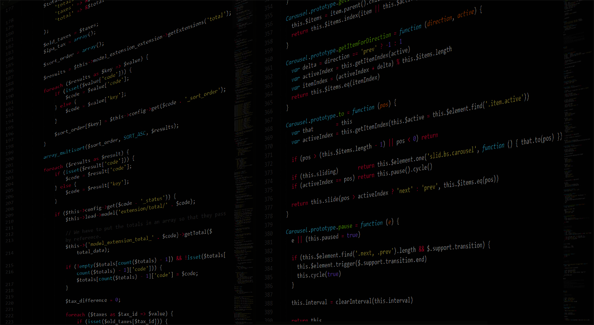
C/C++ 基礎程式設計班
標頭檔的建立與使用
李耕銘
C/C++基礎班
李耕銘

Slide 2

程式碼太長怎麼辦
typedef struct{
string name;
float englishScore;
float mathScore;
}Student;
ostream& operator<< (ostream &os, Student s){
os << "Name: " << s.name << endl;
os << "English Score: " << s.englishScore << endl;
os << "Math Score: " << s.mathScore << endl;
return os;
}
....................................................................
....................................................................
C/C++基礎班
李耕銘

Slide 3
課程大綱
標頭檔的
建立與使用
extern
C/C++基礎班
李耕銘

Slide 4
課程大綱
標頭檔的
建立與使用
extern
C/C++基礎班
李耕銘

Slide 5
標頭檔
會把函示拆解成宣告與定義兩個部分
宣告─函式的介面
定義─函式的實作
宣告放在header file中(.h)
定義放在cpp file中(.cpp)
需要用到就include header file
C/C++基礎班
李耕銘

Slide 6
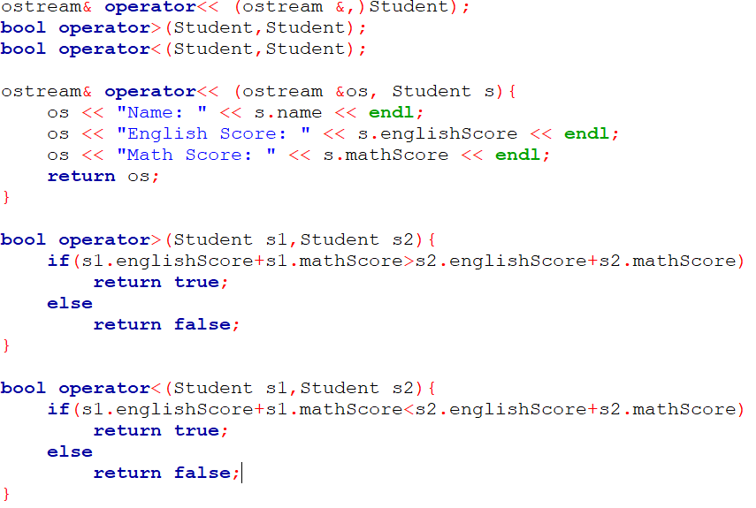
標頭檔
宣告(.h)
定義
(.cpp)
C/C++基礎班
李耕銘

Slide 7
compiler
main.cpp
main.o
AAA.cpp
compiler
AAA.o
Linker
exe
compiler
BBB.cpp
BBB.o
compiler
CCC.cpp
CCC.o
C/C++基礎班
李耕銘

Slide 8
include到兩次會怎麼樣?
C/C++基礎班
李耕銘

Slide 9
課程大綱
main.cpp
AAA.h
BBB.h
重複宣告?
include
C/C++基礎班
李耕銘

Slide 10
課程大綱
main.cpp
AAA.h
iostream
重複宣告?
include
C/C++基礎班
李耕銘

Slide 11

ifndef, define
留下足跡表示這段程式碼已經被include過
ifndef = if not define
在header file中留下麵包屑！
#ifndef XXXXX_H_INCLUDED
#define XXXXX_H_INCLUDED
要宣告的函式
#endif
C/C++基礎班
李耕銘

Slide 12
ifndef, define
第一次include
關鍵字沒有被定義過
#define 關鍵字
宣告函式
第二次include
關鍵字被定義過了(代表來過了)
跳到endif結束
#ifndef XXXXX_H_INCLUDED
#define XXXXX_H_INCLUDED
要宣告的函式
#endif
C/C++基礎班
李耕銘

Slide 13
總結
宣告放在.h
定義放在.cpp
標頭檔的位置在資料夾內要用" "
#include "file.h“
資料夾內
#include <file.h>
Compiler的路徑內
使用ifndef避免重複宣告
C/C++基礎班
李耕銘

Slide 14
Example Code
Split codes into .h and .cpp, and try to use it on main.cpp
#include <iostream>
using namespace std;
typedef struct{
string name;
float englishScore;
float mathScore;
}Student;
ostream& operator<< (ostream &os, Student s){
os << "Name: " << s.name << endl;
os << "English Score: " << s.englishScore << endl;
os << "Math Score: " << s.mathScore << endl;
return os;
}
bool operator>(Student s1,Student s2){
if(s1.englishScore+s1.mathScore>s2.englishScore+s2.mathScore)
return true;
else
return false;
}
bool operator<(Student s1,Student s2){
if(s1.englishScore+s1.mathScore<s2.englishScore+s2.mathScore)
return true;
else
return false;
}
int main () {
Student s1 = {"David",95,92};
Student s2 = {"John",90,96};
cout << s1;
cout << s2;
if(s1>s2)
cout << s1.name << " is better!" << endl;
else if(s2>s1)
cout << s1.name << " is better!" << endl;
}
C/C++基礎班
李耕銘

Slide 15
Practice 1
Split codes into .h and .cpp, and try to use it on main.cpp
#include <iostream>
using namespace std;
typedef struct{
float x;
float y;
}Point2D;
ostream& operator<< (ostream &os, Point2D p){
os << "x: " << p.x << endl;
os << "y: " << p.y << endl;
return os;
}
Point2D operator+(Point2D p1,Point2D p2){
Point2D result = {p1.x+p2.x,p1.y+p2.y};
return result;
}
Point2D operator-(Point2D p1,Point2D p2){
Point2D result = {p1.x-p2.x,p1.y-p2.y};
return result;
}
int main () {
Point2D p1 = {5,6};
Point2D p2 = {2,3};
cout << "p1=" << endl;
cout << p1;
cout << "p2=" << endl;
cout << p2;
cout << "p3=p1+p2=" << endl;
Point2D p3 = p1+p2;
cout << p3;
}
C/C++基礎班
李耕銘
Notes:
#include <iostream>
using namespace std;
typedef struct{
float x;
float y;
}Point2D;
ostream& operator<< (ostream &os, Point2D p){
os << "x: " << p.x << endl;
os << "y: " << p.y << endl;
return os;
}
Point2D operator+(Point2D p1,Point2D p2){
Point2D result = {p1.x+p2.x,p1.y+p2.y};
return result;
}
int main () {
Point2D p1 = {5,6};
Point2D p2 = {2,3};
cout << "p1=" << endl;
cout << p1;
cout << "p2=" << endl;
cout << p2;
cout << "p3=p1+p2=" << endl;
Point2D p3 = p1+p2;
cout << p3;
}

Slide 16
課程大綱
標頭檔的
建立與使用
extern
C/C++基礎班
李耕銘

Slide 17
如果我們需要在cpp間傳遞變數呢?
C/C++基礎班
李耕銘

Slide 18
compiler
main.cpp
main.o
variable
AAA.cpp
compiler
AAA.o
Linker
exe
variable
compiler
BBB.cpp
BBB.o
variable
compiler
CCC.cpp
CCC.o
C/C++基礎班
李耕銘

Slide 19
extern
變數要在多個cpp之間共用
用extern告訴compiler：這個變數不在此宣告
會有某個cpp檔include後去宣告他
include之後，便可以直接使用該變數
#ifndef XXXXX_H_INCLUDED
#define XXXXX_H_INCLUDED
extern 資料型別 識別字;
#endif
C/C++基礎班
李耕銘

Slide 20

extern
test.h
main.cpp
#ifndef XXXXX_H_INCLUDED
#define XXXXX_H_INCLUDED
extern int a;
void print_a();
#endif
#include <iostream>
#include "test.h"
using namespace std;
int main () {
print_a();
a = 5;
print_a();
}
test.cpp
#include <iostream>
#include "test.h"
using namespace std;
int a = 10;
void print_a(){
cout << "a=" << a << endl;
}
C/C++基礎班
李耕銘

Slide 21
Practice 2
enum status{
isYoung,
isMiddle,
isOld,
};
void distinguishAge(){
status age;
int N;
cout << "Please enter your age:" << endl;
cin >> N;
if(N<=18)
age = isYoung;
else if(N<65)
age = isMiddle;
else
age = isOld;
switch(age){
case isYoung:
cout << "Young" << endl;
break;
case isMiddle:
cout << "Middle" << endl;
break;
case isOld:
cout << "Old" << endl;
break;
}
}
Split the left codes into .h and .cpp.
Modify the two thresholds: 18 and 65 into variable.
Set them to extern on .h. Let the user can change the 2 threshold on main.cpp!
Try to use it on main.cpp.
C/C++基礎班
李耕銘

Slide 22
Take Home Message
如何指定標頭檔的來源地址？
如何建立標頭檔？
標頭檔(.hpp)、原始碼(.cpp)各存放甚麼東西？
如何避免重複宣告？
編譯過程中會產生哪些中間產物？
如何在cpp檔之間傳遞變數？
C/C++基礎班
李耕銘

