Slide 1

Final Exam

Slide 2
Principle
Internet , toilet or filling the water are always allowed.
Plagiarism and discussion is strictly prohibited.
Your final score = The score in this exam * 0.5
+Score of assignments * 0.3
+Score of attendance (maximum 20)
70 is the threshold to get the final certification.
You can ask for explaining the meaning of the problem, but no instruction on how to solve it.
Once you finish your exam, you can hand in your solution before time. If you would like to know the score / pass or not immediately, please stay in the classroom after 12:00.

Slide 3
Introduction
I feel sorry about that I cannot customize the lecture to everybody. So I adjust the exercise of final exam. This final exam comprise 6 problems, you can choose the adequate problems for you.
The full marks is 600 scores.
If you attended all the class and submitted all the assignments, 40 scores is enough for you to get the certification.
If you cannot connect to the Internet, tell me and I will transmit the data needed in this final exam to you by USB.
Each problem has its own motivation to make it more than an exam.

Slide 4
How to submit your result.
Email me the result to the following address.
lkm543@gmail.com
Please name the title of the email by [324][c++][Name]
[324][c++][王小明]
Please send me your codes befoe 02/09 (Sun.) 24:00
You can also attach a Readme File (txt) to tell me how to execute your code, or what difficulty you are faced with (Option)
I need about 1 week to revise all the codes you submit, please wait me for a while. The official will inform you pass or not later.

Slide 5
I will start to explain each problem, and you can listen to me or just do it by yourself.

Slide 6
Problem 1&2
Ideal candidate：
Students who are not major in CS or still senior high school students.
Laymen who are first time to coding.
The lecture before seems a little challenging to you.
Motivation：
Help you review what you learned in the past 9 classes.
Make you be able to learn another coding language or deeper c++ skill.
The mission can be completed by following the hint.

Slide 7
Problem 1 (100%) Basic syntax(1)

Slide 8
Problem 1-1 (20%)
Key words：File In and Array
Download the Test Data：
https://goo.gl/PMyjjj
Mission：
Read the data each row, show it on the screen and store each element in a 2D array, which will be used later.
Hint：
It will looks like a 2D array like this array[M][N]
The example code is in comment, change the filename.
Notes:
#include <iostream>
#include <fstream>
#include <sstream>
#include <stdlib.h>
using namespace std;
int main() {
string str;
ifstream ifile;
//This array is used to deposit the data importing from csv
int data[100][11];
//You can change the filename to open the specific data
string filename="";
ifile.open(filename);
if (ifile)
{
int c = 0;
while (getline (ifile,str)){
stringstream ss(str);
string temp;
// ss → 每一行資料轉成串流
for(int i=0;i<11;i++){
getline(ss,temp,',');
//atoi is used to transform string to int
data[c][i]=atoi(temp.c_str());
}
c++;
}
cout << "Finish reading data" << endl;
//Now, you can start to use the data array to complete this problem
}
else
{
cout << "Error" <<endl;
}
ifile.close();
return 0;
}

Slide 9
Problem 1-2 (20%)
Key words：for/while/function
Mission：
Print the average value of each row.
Hint：
for (int i=0; i<len;i++)……

Slide 10
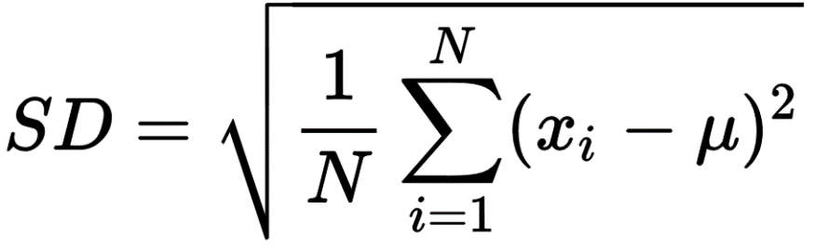
Problem 1-3 (30%)
Key words：for/while/function
Mission：
Print the Standard Derivation(SD) of each row.
Hint：
for (int i=0; i<len;i++)……
#include <math.h>
a^b=pow(a,b);

Slide 11
Problem 1-4 (30%)
Key words：File out
Mission：
Write the data you collected in Problem 1-1~1-3, write it to a csv like this：
Origin Data： 2 3 2 5 3 9
Output Data： 2,3,2,5,3,9,avg,SD

Slide 12
Problem 2 (100%) Code a game of Pokemon

Slide 13
Problem 2-1 (15%)
Key words：Structure,Enum
Define a structure and enum of your pokemon with the following variables:
The structure can be cout directly. (It will be used later！)
structure
name(str)
attack(int)
defense(int)
maxLife(int)
nowLife(int)
experience(int)
level(int)
attribute(enum)
Enum
fire
grass
water

Slide 14
Problem 2-2-1 (10%)
Key words：Fuction
Mission：
Write a function with can generate an random integer within a given range.
Input：Max and Min
Output：A random integer within Max and Min
Hint：
#include <stdlib.h>
#include <time.h>
rand(),srand(time(NULL))
int randomInt(int Min,int Max);

Slide 15
Problem 2-2-2 (10%)
Key words：Fuction
Mission：
Write a function with can level up your pokemon.
Input：Pokemon(Structure)
Output：void(pass by ref) or Structure(pass by value)
Level UP Benefit：
maxLife += 10~12
attack += 4~6
defense += 4~6
level += 1
experience = experience - 100

Slide 16
Problem 2-3 (20%)
Key words：Operator Overloading
Mission：
2 pokemon(structure) should be able to attack each other by ‘–’ operator, like pokemon_1 - pokemon_2
The demage to life of pokemon_2 should be：
Weight*(attack of pokemon_1) – defense of pokemon_2
The weight should be (0.8~1.2) if 2 pokemon have same attribute
The weight should be (0.9~1.3) if the attack has a additional impact by attribute
The weight should be (0.7~1.1) if the attack has a weaken impact by attribute
Once the result is negative, it should be zero.
Print the damage to each other in every attck.
Hint：
#include <stdlib.h>
#include <time.h>
rand(),srand(time(NULL))

Slide 17
Problem 2-4 (15%)
Key words： Control flow, for, while,switch
Mission：
Before the game, let user name his pokemon and pick up its attribute at first.
In every round, users can choose what to do：
I→See the information of his pokemon.
H→Go to the hospital and heal the life of his pokemon.
T→Train his pokemon by wild pokemon.
G→Go to the gym and try to get a championship！
The pokemon of the user at first is：
maxLife = 50
attack = 10
defense =10
The pokemon of the gym is：
maxLife = 300
attack = 150
defense =130

Slide 18
Problem 2-5 (15%)
Key words：function,for, while
Mission：
Have a function to fight！Let 2 pokemon attack each other until one of life is zero.
Once the user wins, give him 30 experience.
Once the experience is over 100, try to level up his pokemon by the fuction your wrote before.
Try to use it and finish your control flow @ problem 2-4

Slide 19
Problem 2-6 (15%)
The last mission：
Try to move your functions, structures, enums to a new header file and cpp file.

Slide 20
Problem 3 & 4
Ideal candidate：
Students who have the experiences of coding before this class.
The lecture before seems a piece of cake to you.
Motivation：
Help you wreck one's brain by exercise.
Make you have the slight knowledge of Google Code Jam, ACM, or algorithms.

Slide 21
Problem 3 (100%) Google Code Jam Africa 2010, Qualification Round (Medium)

Slide 22
Problem 3 (100%) Google Code Jam
Google Code Jam is an international programming competition hosted and administered by Google. The competition began in 2003 as a means to identify top engineering talent for potential employment at Google but these days mostly attracts sport programmers. The competition consists of a set of algorithmic problems which must be solved in a fixed amount of time. Competitors may use any programming language and development environment to obtain their solutions, but top places usually require careful preparation of fast utility libraries for common tasks such as IO, data structures, and prepared solutions for typical classes of problems just as in other programming competitions.

Slide 23
Problem 3 Store Credit (100%)
You receive a credit C at a local store and would like to buy two items. You first walk through the store and create a list L of all available items. From this list you would like to buy two items that add up to the entire value of the credit. The solution you provide will consist of the two integers indicating the positions of the items in your list (smaller number first).

Slide 24
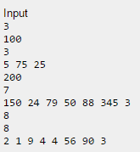
Problem 3 (100%) Store Credit - Input
Please download the test data (Small and Big)
https://goo.gl/Wyjc8f
https://goo.gl/kyoWgD
The first row of input gives the number of cases, N. N test cases follow. For each test case there will be:
One row containing the value C, the amount of credit you have at the store.
One row containing the value I, the number of items in the store.
One row containing a space separated list of I integers. Each integer P indicates the price of an item in the store.
Each test case will have exactly one solution.

Slide 25

Problem 3 (100%) Store Credit - Output
For each test case, output one row containing "Case #x: " followed by the indices of the two items whose price adds up to the store credit. The lower index should be output first.
Limits
5 ≤ C ≤ 1000 1 ≤ P ≤ 1000
Small dataset
N = 10 3 ≤ I ≤ 100
Large dataset
N = 50 3 ≤ I ≤ 2000

Slide 26
Problem 3 (100%) Store Credit – Grading Standard
Read the data successfully. (25%)
Noted the length of each set of data is different.
Hint : You may use array of pointer.
Able to handle one set of data. (25%)
Able to handle small set of data and write your result to a txt. (25%)
Able to give the answer of big set of data within 10 seconds. (25%)

Slide 27
Problem 4 (100%) ACM Programming Contest

Slide 28
Dr. Y has travelled to an ancent ruin in which a large number of circular-shaped (‘o’) and cross-shaped (‘+’) pebbles are scatterd on an open field. Being a puzzle enthusiast, Dr. Y tried to figure out if she can draw one straight line so that circular-shaped pebbles and cross-shaped pebbles are on the opposite side of the line and no pebbles on the line. For example, in Fig. 1 (left), Dr. Y can draw a stright line to separate the two types of pebbles, whereas in Fig. 1 (right), it would not be possible. Please write a program to determine if a given group of pebbles can be separated by a single straght line.

Slide 29
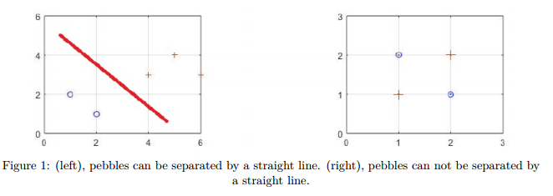

Slide 30
Problem 4 (100%) Seperating Pebbles
Input:
The number of pebbles of kinds A
The positions (x,y) of these kinds A pebbles
The number of pebbles of kinds B
The positions (x,y) of these kinds B pebbles
Output:
Whether the two kinds of pebbles can be seperated by a line or not.

Slide 31
Problem 5 & 6
Ideal candidate：
Students who work as an engineer, especially the software engineer.
Students who would like to be an engineer in the future.
Motivation：
Make you have the slight knowledge of Data Structure and Algorithm (DSA).
Make you know how to develop and regulate a program.

Slide 32
Problem 5 (100%) Data Structure

Slide 33
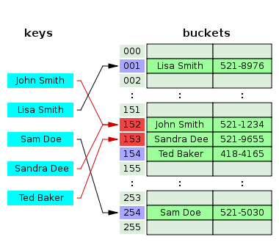
Problem 5 (100%) Building a Hash Table
In computing, a hash table (hash map) is a data structure used to implement an associative array, a structure that can map keys to values. A hash table uses a hash function to compute an index into an array of buckets or slots, from which the desired value can be found.

Slide 34
Problem 5 (100%) Building a Hash Table
Objective : If we would like to calculate how many words of each kind of word in Red_Mansions (紅樓夢), we have to build and use hash table; otherwise, the time consuming will be not tolerable.

Slide 35
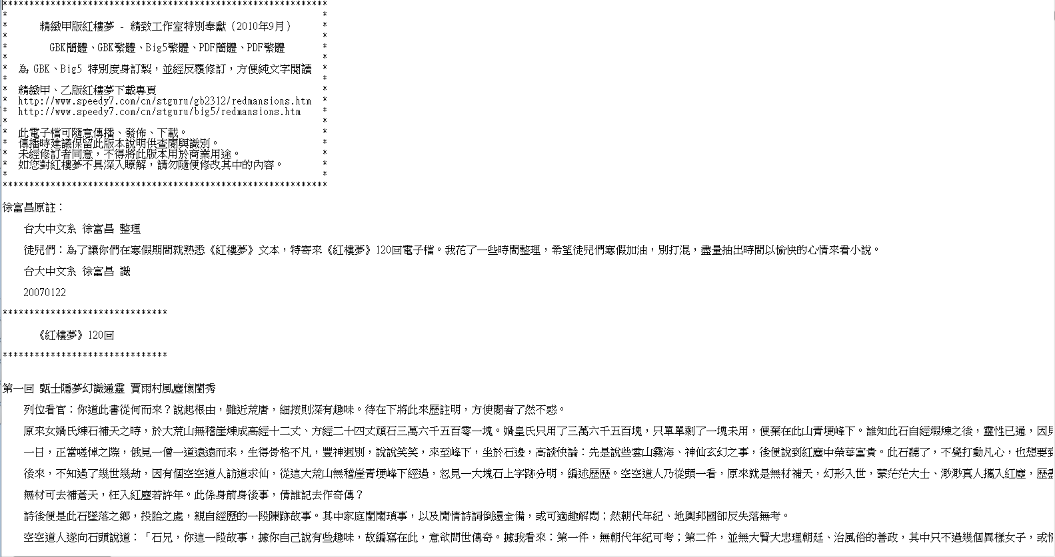
Problem 5 (100%) Building a Hash Table
Download the txt：
https://goo.gl/5yQTTb

Slide 36
Problem 5-1 (30%) Building a Hash Table-Traditional Way
Key words：File In and Array
Mission：
Download and read the data , calculate the number of each different word with array.
Hint：
You can make a 2D array, the first column store the word, the second store the times.
If the time consumes too much, try a smaller data made by yourself.

Slide 37
Problem 5-2 (20%) Building a Hash Table-Hash Function
Mission：
Build a Hash Function, which means the parameter of this function is a word and its return value is an integer.
Your function should look like this :
int hashFunction (string str) {Your codes here……}
We use string here, for the char can only deposit English alphabet.
The method to transfer a word to an integer is shown in the next slide.
Every word encoded in UTF-8 has its own value, so we can use it to manufacture a simple hash table.
Hint：
To reduce every return integer uniformly, you may use %
Ref about UTF-8
https://zh.wikipedia.org/wiki/UTF-8

Slide 38
Problem 5-2 (25%) Building a Hash Table-Hash Function
// This function will transfer your word to an integer.
//The value ranges from 0~256^4
unicode_to_int(std::string &utf8)
{
uint32_t unicode = 0;
uint8_t first_byte = (uint8_t)utf8[0];
uint8_t len =
(first_byte & 0xf0) == 0xf0 ? 4 :
(first_byte & 0xe0) == 0xe0 ? 3 :
(first_byte & 0xc0) == 0xc0 ? 2 : 1;
int k = 1;
unicode = 0;
for(auto i = 0; i <= len; ++i) {
if (((int)utf8[i])>0)
unicode += ((int)utf8[i])*k;
else
unicode += ((int)utf8[i])*-1*k;
k*=256;
}
return (int) unicode;
}
I have written an function for you to transfer the Chinese word to int by unicode.
You can use it by copy & past.
By calling this function, your hash function can be achieve in just one line.

Slide 39
Problem 5-3 (50%) Building a Hash Table
Mission：
Modified the code on problem 7-1 to a Hash Table
Hint：
You have to judge how big the array you need and the range of the integer returned by hash function.
Collision avoidance or handler, which means two different words point to same hash value. You can take a look at the next slide.

Slide 40
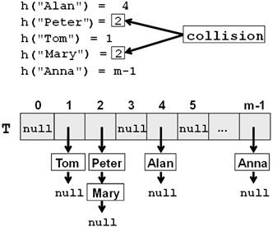
Problem 5-3 (50%) Building a Hash Table
Hash Collisions:
Sometimes, the hash function will transfer two different words into the same hash value.
(Like Peter and Mary on the left hand)
Solution:
We will make it a 2D array, once the collision happened, deposit the later one in the array.

Slide 41
Problem 6 (100%) Algorithm

Slide 42
Problem 6 (100%) Quick Sort
There are many kinds of sorting, the fastest one is quick sort, you can take a look on animation on left first.
Sorting is always used as an interview question once you apply for an algorithm / software developer.

Slide 43
Problem 6 (100%) Quick Sort (from wikipedia)
Quicksort is an efficient sorting algorithm, serving as a systematic method for placing the elements of an array in order. When implemented well, it can be about two or three times faster than its main competitors, merge sort and heapsort.
Quicksort is a comparison sort, meaning that it can sort items of any type for which a "less-than" relation (formally, a total order) is defined. In efficient implementations it is not a stable sort, meaning that the relative order of equal sort items is not preserved. Quicksort can operate in-place on an array, requiring small additional amounts of memory to perform the sorting.
Mathematical analysis of quicksort shows that, on average, the algorithm takes O(n log n) comparisons to sort n items. In the worst case, it makes O(n2) comparisons, though this behavior is rare.

Slide 44
Problem 6 (100%) Quick Sort
The steps are:
Pick an element, called a pivot, from the array.
Partitioning: reorder the array so that all elements with values less than the pivot come before the pivot, while all elements with values greater than the pivot come after it (equal values can go either way). After this partitioning, the pivot is in its final position. This is called the partition operation.
Recursively apply the above steps to the sub-array of elements with smaller values and separately to the sub-array of elements with greater values.

Slide 45
Problem 6-1 (20%) Quick Sort – Data Reading
Download the test data :
https://goo.gl/4CpCpe
Mission :
Read the Data in csv to a 2D array that will be used later.
These data are in the same length to make it friendly for you to achieve this mission.
Hint :
Modified the code from Problem 1

Slide 46
Problem 6-2 (20%) Quick Sort – Coding Functions
In this part, you need to code two functions which will be used later.
The first one is swap, it will help you arrange the positions of two elements in an array
Mission 1 (10%)
Write a function that can help you swap two input values. Your function should like below :
void swapFunction (int &a, int &b) {Your codes here}

Slide 47
Problem 6-2 (20%) Quick Sort – Coding Functions
The second one is that we have to decide a pivot, which means a comparing standard in this algorithm. We can use the left, right, or a random as the pivot. In this exercise, we use random pivot.
Mission 2 (10%)
Write a function that can return the random pivot index and value to you. Your function should like below :
void pivot (int *arr, int length, int &pivotIndex, int &pivotValue ){
Your codes here……
}
Hint :
#include <stdlib.h> #include <time.h>
srand (time(NULL)) ; rand();
You may also use % to regulate the range of output

Slide 48
Problem 6-3 (25%) Quick Sort – Partitioning
Mission : Write a function that will partition the array into two part by a random pivot. Below is one example.
If we choose the pivot 26, it will partition the origin array into left (smaller than 26) and right (bigger than 26)
Origin: After :
Hint :
To simplify your algorithm, each integer is qnique
Your function should like it below. It will use the two function you wrote before.
void partitioning (int *arr, int length){
Your codes here……}

Slide 49
Problem 6-4 (25%) Quick Sort – Recursion
Mission :
Modified the previous codes (partitioning) you wrote. Use the recursion to achieve the sorting.
Hint :
Your can use *(p+i) to regulate the start of array as a parameter in partitioning.
The partitioning should stop once the amounts of elements which are smaller or larger than the pivot is only one.
Your function should like this below.
void partitioning (int *arr, int length){
if (length !=1)
Your codes here…}

Slide 50
Problem 6-5 (10%) Quick Sort – Sort all Test Data
Mission :
Sort all the data you deposit in an array on Problem 6-1 by the function you wrote on Problem 6-4.
Write your result to a csv file.

Slide 51
-------The End -------
Sorry I can not reveal all the solutions of this final exam to you. For I will need to use it in the future courses.
But if you would like to know the answer, send messages and codes to me. I will revise it and send back to you. Or we can discuss about the solution after 12:30.
Please help us fill in the survey.

Slide 52
期末教學問券
https://bit.ly/2PBX2TE
本期開課日:2019/09/21
學號:CB3241XX
講師姓名:李耕銘
教室號碼:223B

