Slide 1





Deep Crossing Network
Feng Ying

Slide 2

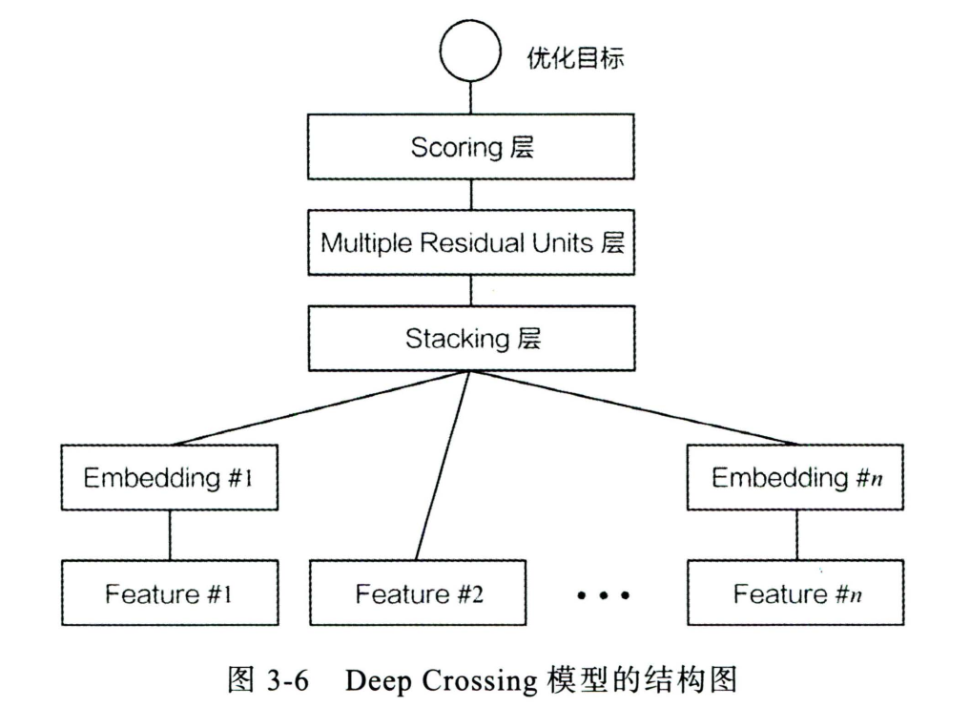


Model Structure
Data Processing
One-hot coding
Embedding Layer
Fitting & Optimizing
MLP
ResNet.

Slide 3

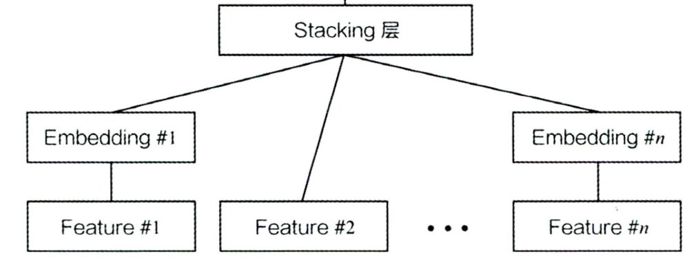
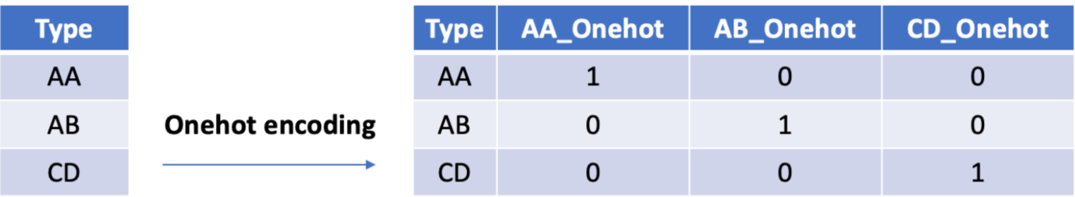

Data Processing
Features
Categorical
One-hot coding
Numbers
One-hot Coding
Convert each categorical value into a new categorical column and assign a binary value of 1 or 0 to those columns.
Benefit:
Scale the features, easier for training
Drawback:
Sparse, little information
Embedding

Slide 4
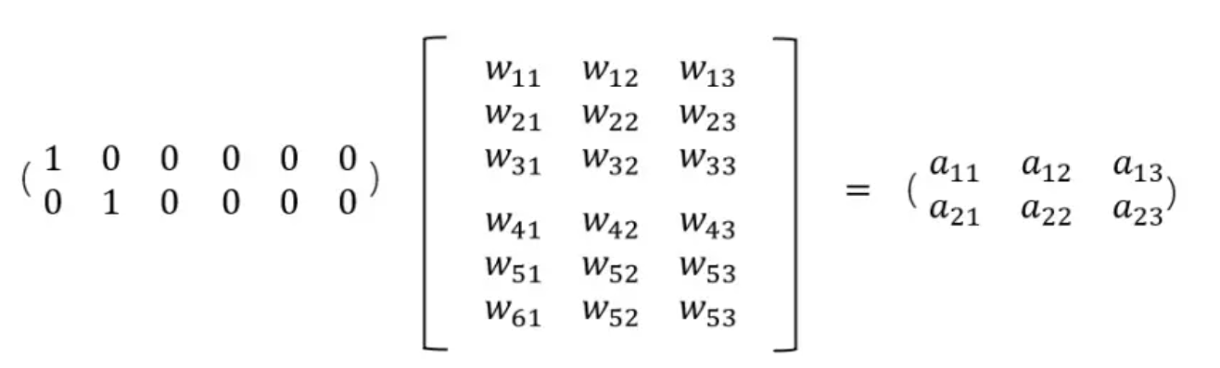

Embedding Layer
Function
Change sparse vector into dense vector, to decrease the size of data
Show more information
Stacking Layer
Splice different Embedding features and numerical features together to form a new feature vector containing all features

Slide 5

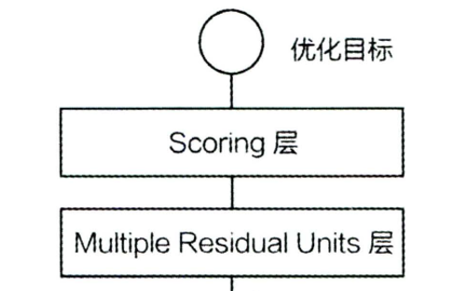

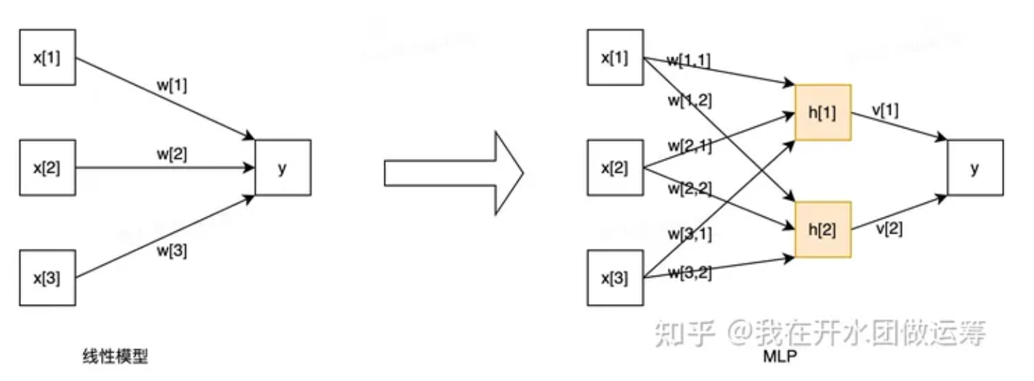

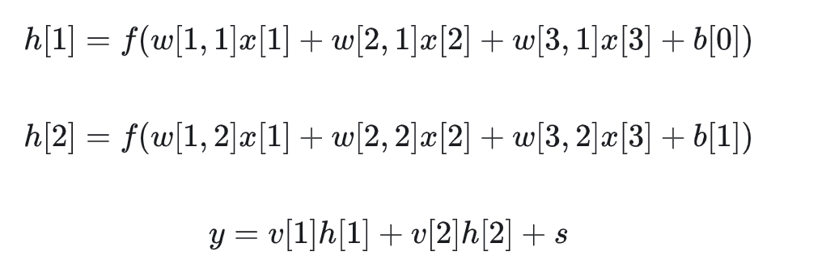
Fitting & Optimizing
Multi-Layer Perceptron (MLP)
f(·): activation function
Add non-linearity to the function

Slide 6

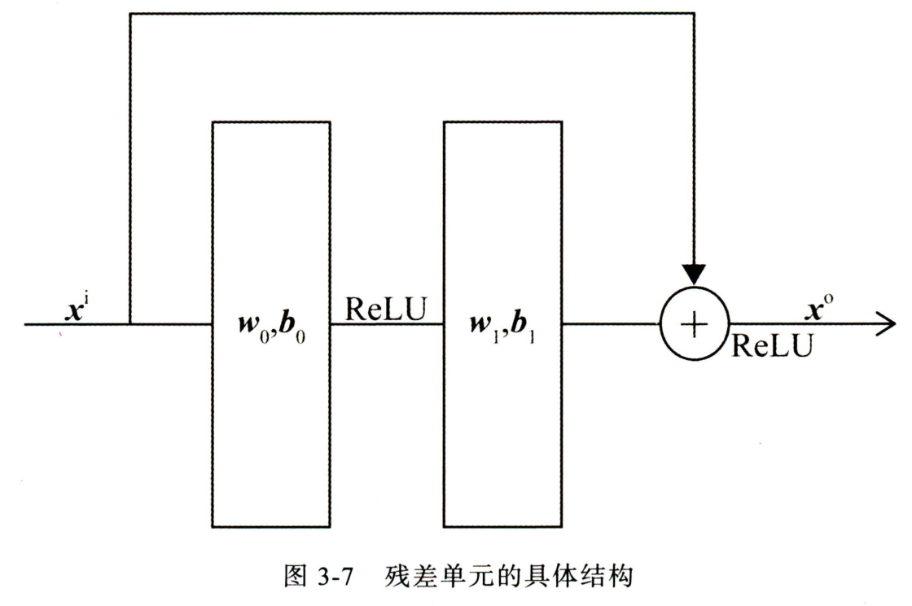


Residual Unit
Characteristic
The input passes through two fully connected layers with ReLU as the activation function and obtain output vector.
The input directly added element-wise to the output vector through a shortcut path.
Function
During backpropagation, the closer to the input end, the smaller the magnitude of the gradient, and the slower the parameter convergence speed.
Directly pass the gradient to the next layer without any change, making the residual network converge faster..

Slide 7



Code Realization

