Slide 1
Go deeper into glucose-insulin system
Feng Ying

Slide 2
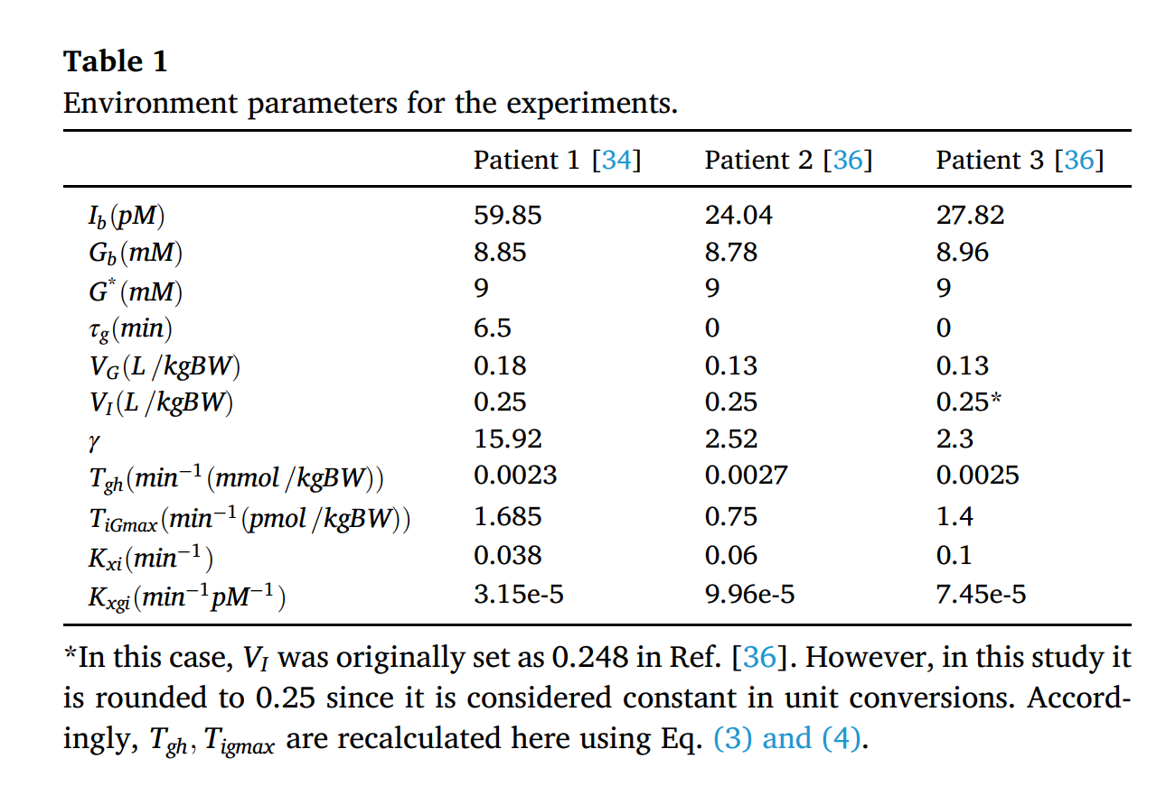
Environment parameters
---- representing DM patients
How to get the data?
Original Data
Make Proper Adjustment
Final Data

Slide 3
Advantages of the single delay model for the assessment of insulin sensitivity from the intravenous glucose tolerance test
ORIGINAL DATA
Panunzi, S., De Gaetano, A., & Mingrone, G.
CNR-Institute of Systems Analysis and Computer Science (IASI), BioMathLab, Rome, Italy
Theoretical Biology and Medical Modelling, 2010•Springer

Slide 4
ORIGINAL DATA
Volunteers’ Background:
Not suitable for the new research
Different BMI:
19 lean individuals (BMI ≤ 24 Kg/m2)
22 overweight (24< BMI ≤ 30 Kg/m2)
22 obese (30 <BMI ≤ 40 Kg/m2)
11 morbidly obese (BMI > 40 Kg/m2)
Healthy:
Negative family/personal histories for Diabetes Mellitus & other endocrine diseases
On no medications, had no current illness
Maintain a constant body weight for 6 months
Experiment Setup:
Diet in first 3 days:
Follow a standard composition diet (55% carbohydrate, 30% fat, 15% protein)
At least 250 g carbohydrates per day
Conduct an Intra-Venous Glucose Tolerance Test (IVGTT)
Administer intra-venously a glucose bolus at 8 a.m. after an overnight fast
Sample plasma glucose and serum insulin concentration in 3 hours, with varying sampling time

Slide 5
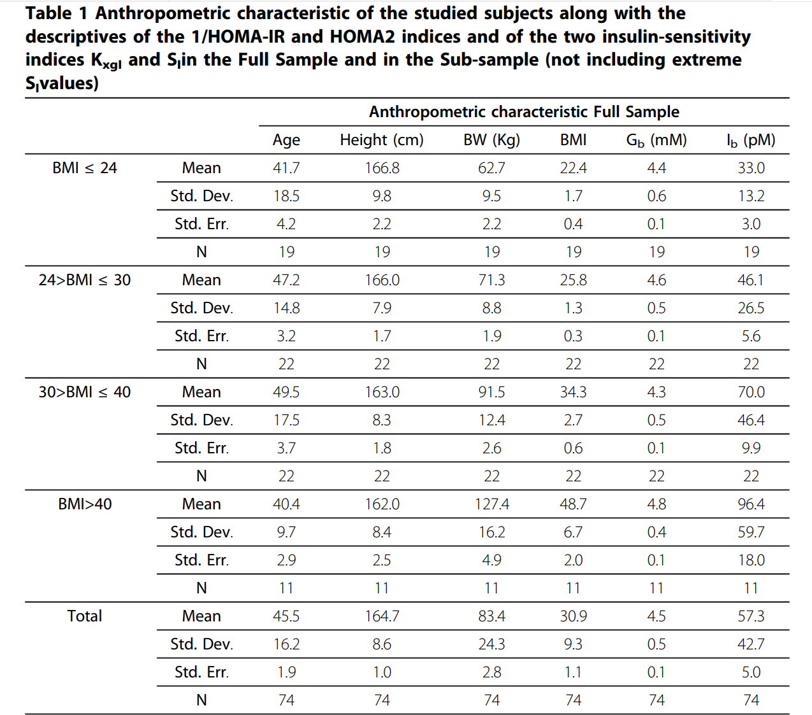
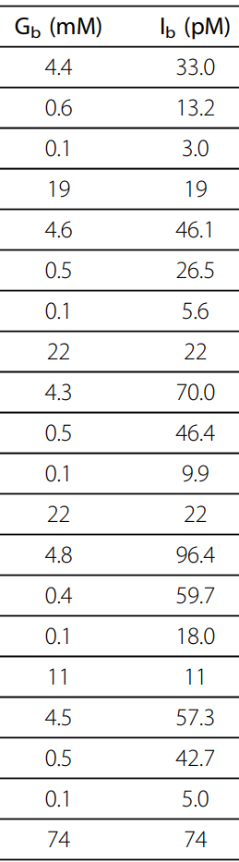
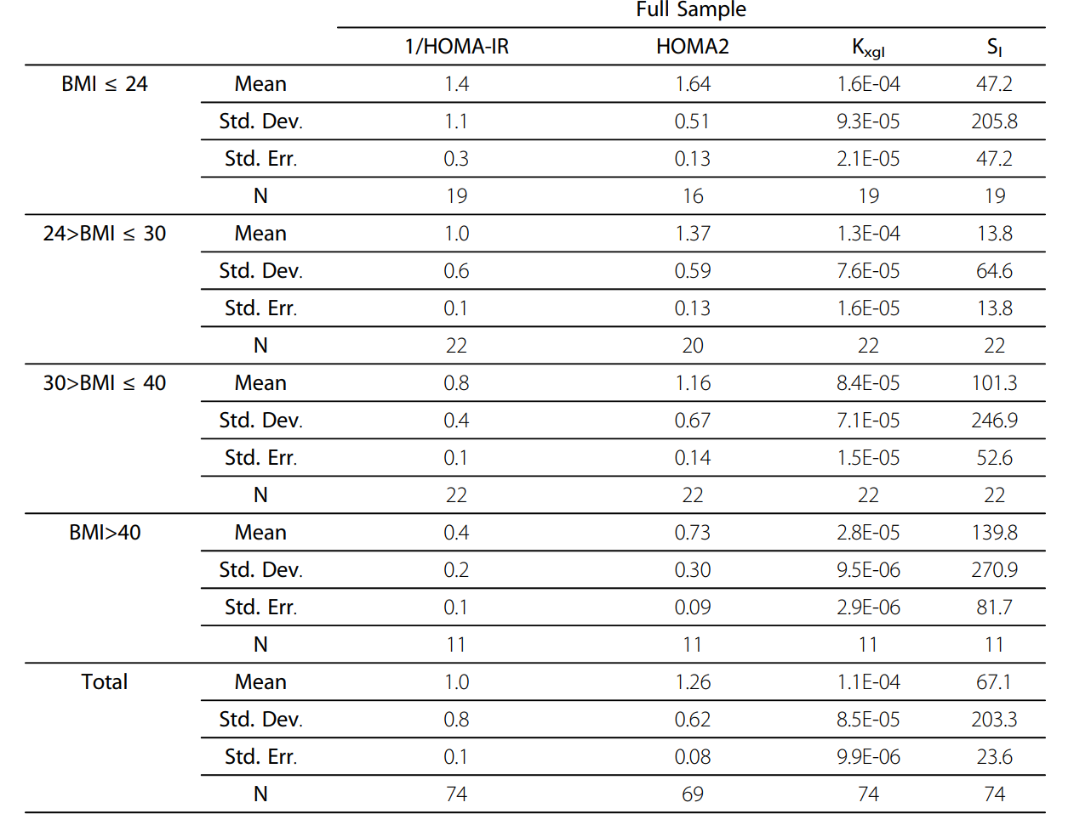
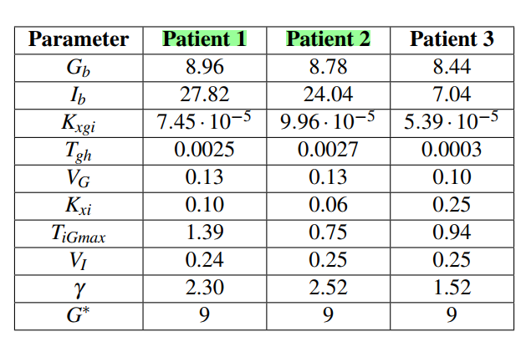
ORIGINAL DATA
Chosen DATA

Slide 6
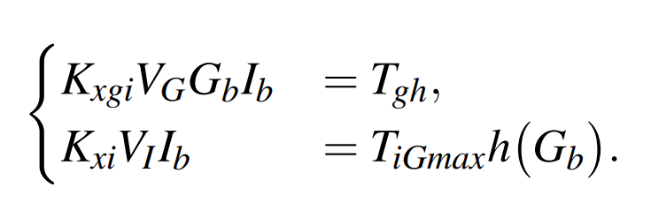
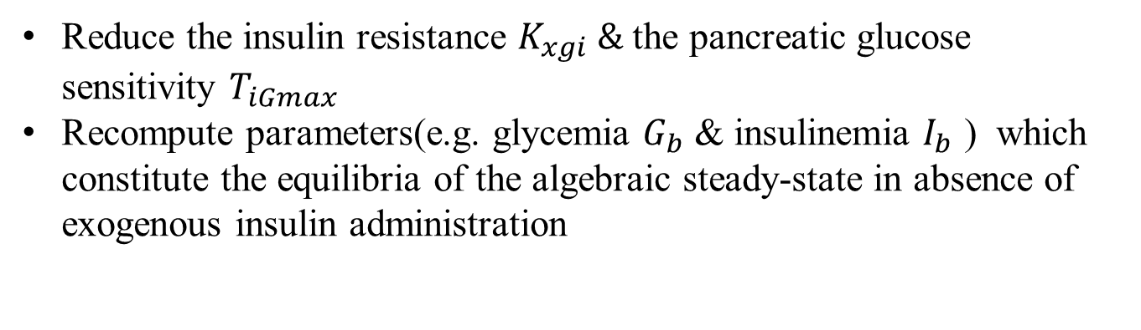
Make Proper Adjustment
Reason:
The considered subjects are not diabetic (but some of them are pre-diabetic)
Solution:
Take a perturbation of the parameters that simulates a natural progression of the disease towards diabetes
Reduce the insulin resistance $K_{xgi} \&$the pancreatic glucose sensitivity $T_{iGmax}$
Recompute parameters(e.g. glycemia $G_{b}$ & insulinemia $I_{b}$ ) which constitute the equilibria of the algebraic steady-state in absence of exogenous insulin administration

Slide 7
Sampled-data Observer-based Glucose Control for the Artificial Pancreas
FINAL DATA
------- Build a more realistic simulation setup by imposing a quantization error both in the sampling and actuation
Borri, A., Palumbo, P., Manes, C., Panunzi, S., & De Gaetano, A.
CNR-IASI Biomathematics Laboratory, Italian National Research Council (CNR), 00168 Rome, Italy
DISIM Department, University of L’Aquila, 67100 L’Aquila, Italy
Acta Polytechnica Hungarica, 2017

Slide 8
Evolution of model of glucose-insulin system ----Minimal Model
Minimal Model: Perspective from 2005
Define a model representing the glucose-insulin relationship based on physiology
Richard N. Bergman
University of Southern California, Los Angeles, Calif. , USA
RN Bergman - Hormone research,
Improve the model
Conduct IVGTT Experiment
Mathematical modelling of the intravenous glucose tolerance test
Andrea De Gaetano,w, Ovide Arino
CNR, Centro Fisiopatologia Shock, Universita` Cattolica del Sacro Cuore, Largo A. Gemelli, 8, 00168 Roma, Italy.
Laboratoire de MatheHmatiques AppliqueHes, UPRES A 5033 IPRA, Pau, France
Journal of mathematical biology, 2000•Springer
Describe experimental data with the smallest set of identifiable and meaningful parameters

Slide 9
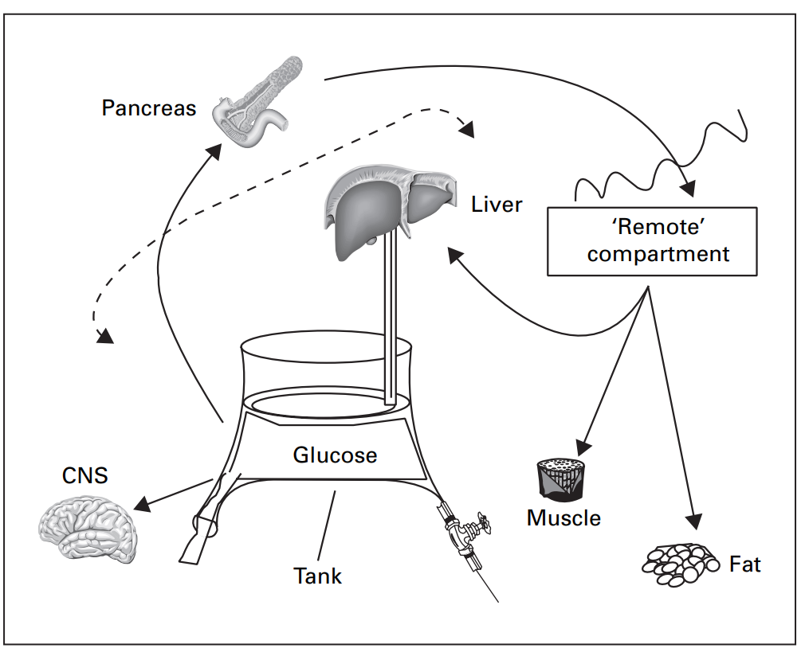
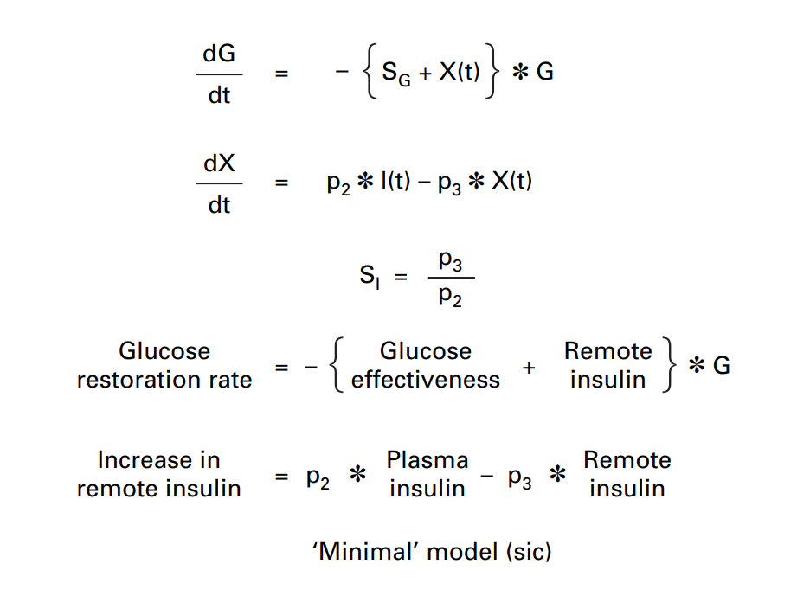
Minimal Model
Insulin acts slowly because it must first move to a remote compartment to exert its action on glucose disposal
Insulin Release
Glucose Source
Glucose Level
Glucose Consumption

Slide 10
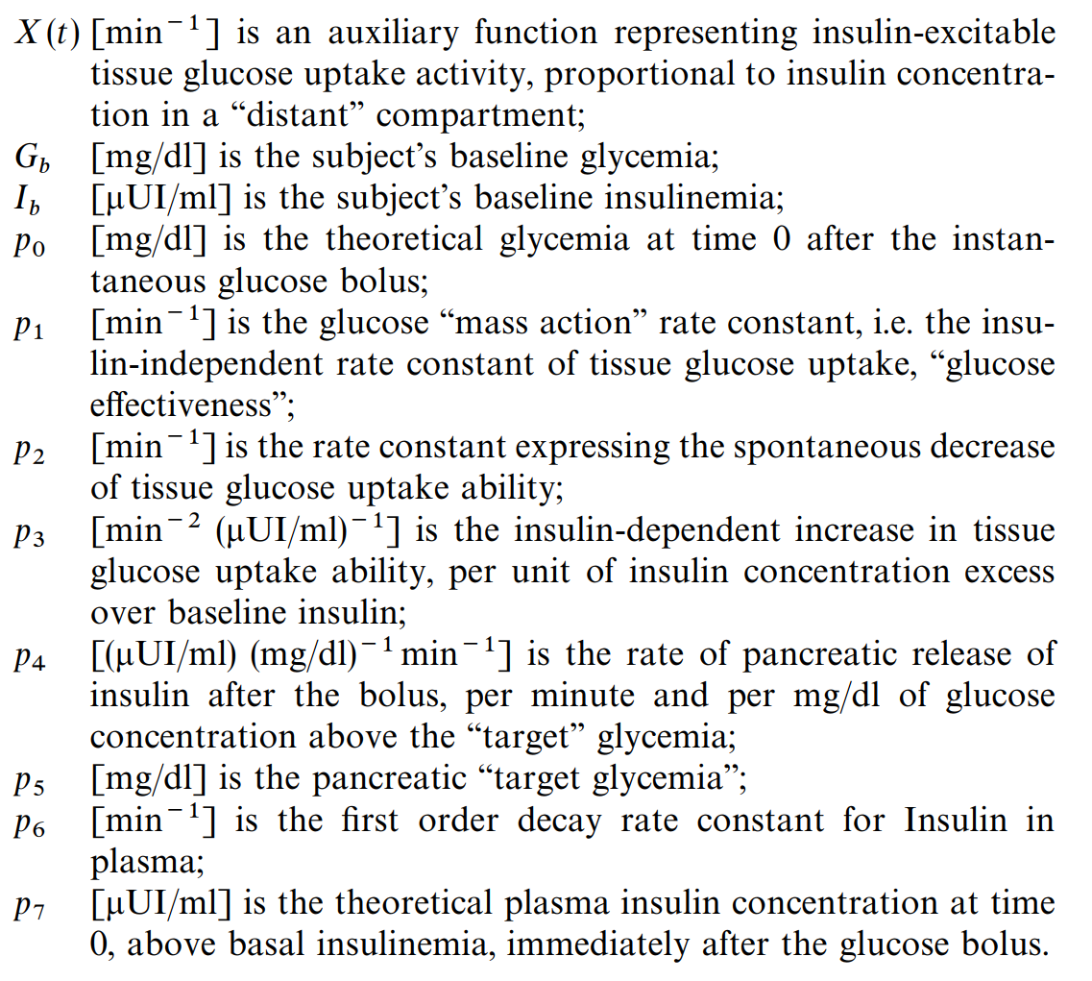
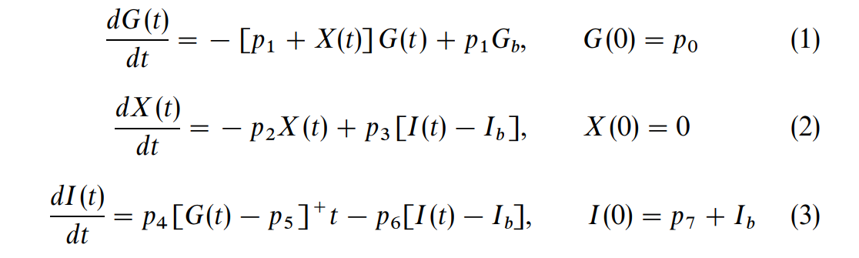
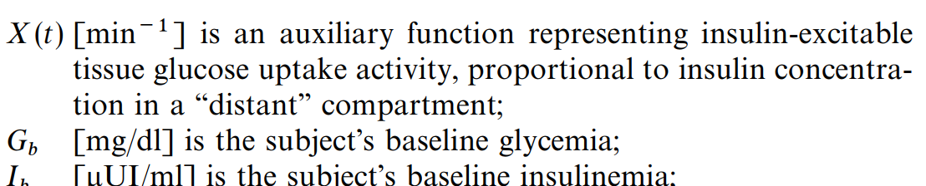
Parameter Fitting
standard formulation of the minimal model

Slide 11
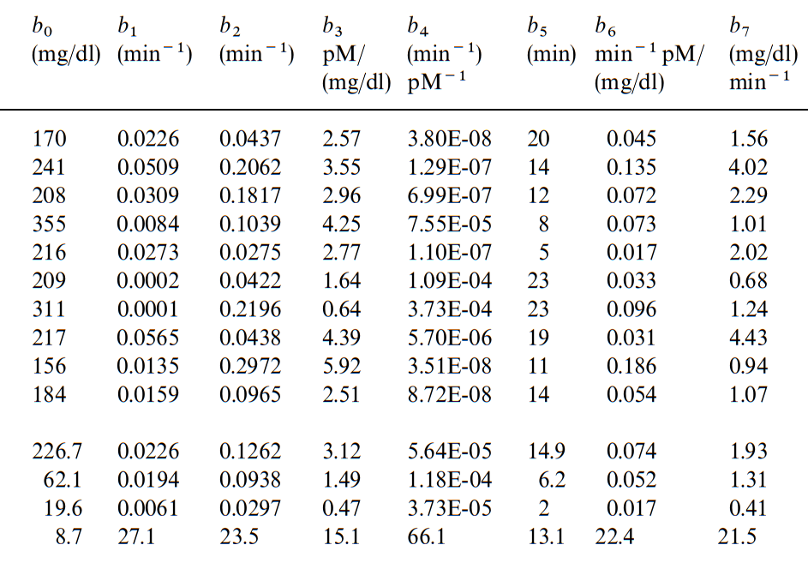
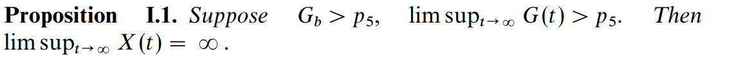
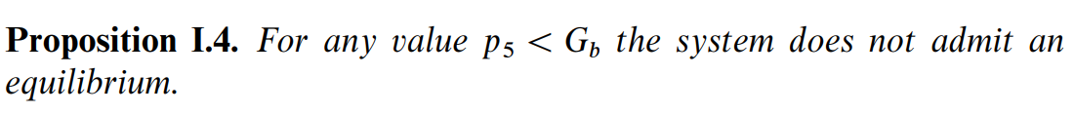
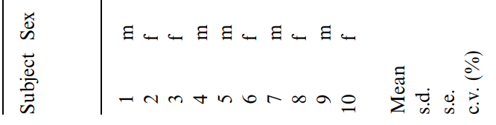
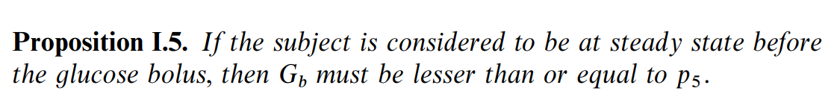
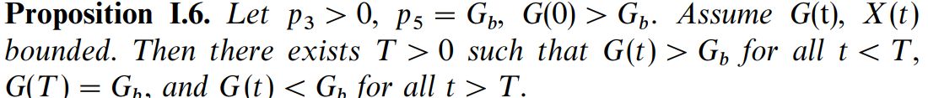
Parameter Fitting
Values of Parameter from
IVGTT experiment
Limitations on the parameters

Slide 12
Delay-differential System:
--------- It introduces the possibility of generally considering delays both in the insulin action on tissue glucose uptake and in the glucose action on pancreatic insulin secretion.
Qualitative behavior of a family of delay-differential models of the glucose-insulin system.
Palumbo, P., Panunzi, S., & De Gaetano, A. (2007).
Italian National Research Council and Óbuda University
Discrete and Continuous Dynamical Systems Series B, 7(2), 399.

Slide 13
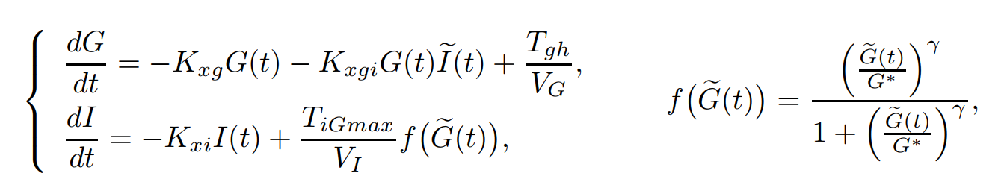
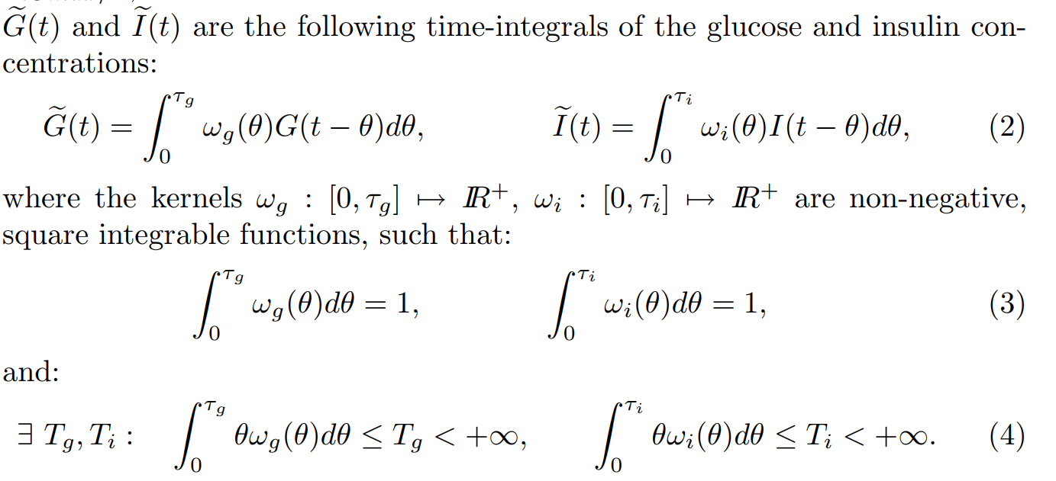
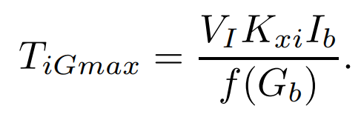

Delay-differential System:
ω likely decay as θ increases, indicating the effect of glucose or insulin level diminishes as time passes after its occurrence.
concentration of glucose in the bloodstream at θ time before the current time t.
exist a unique equilibrium point, reflecting the basal levels of Gb and Ib, both basal levels are measured, so that a pair of model parameters need not be estimated, but are computed according to the equilibrium equations:

Slide 14
Comparative Methods --- Sliding Mode Controller (SMC)

Slide 15
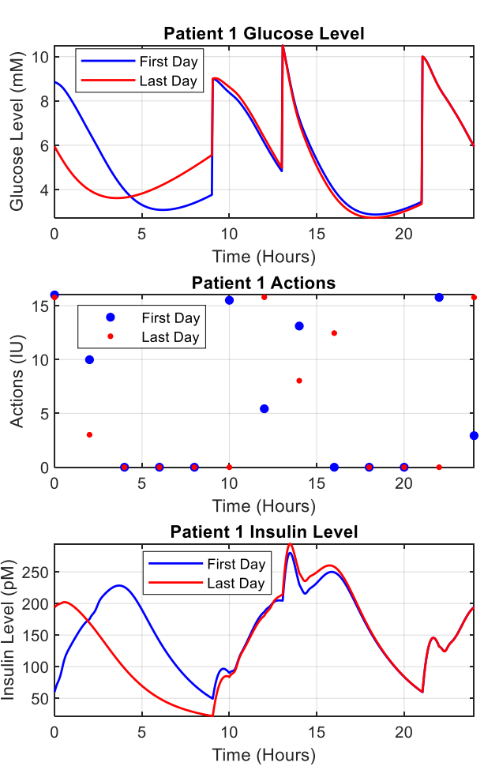
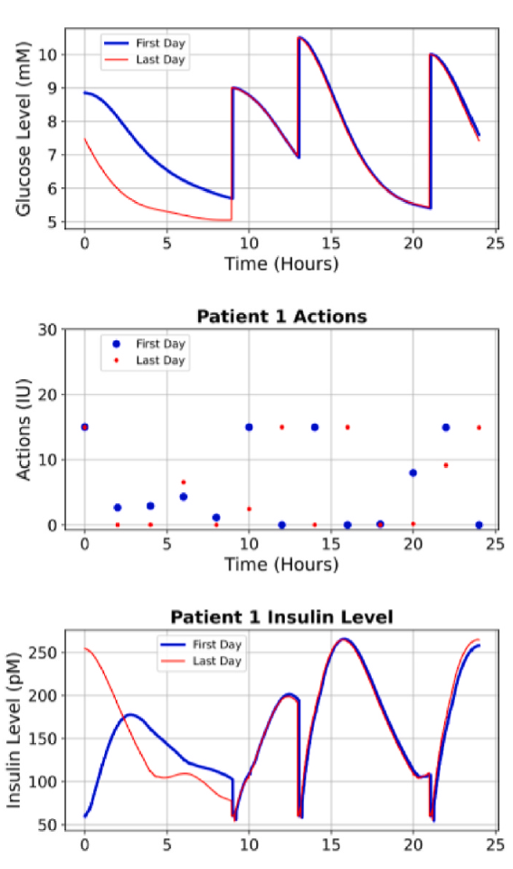
NAF
SMC
Compare with NAF:
infer and handle the effect of the delay
learn from the past actions
predict the future
What does SMC do?
use instantaneous feedback values for decision-making
robustness : not handle parameter difference between patients

Slide 16
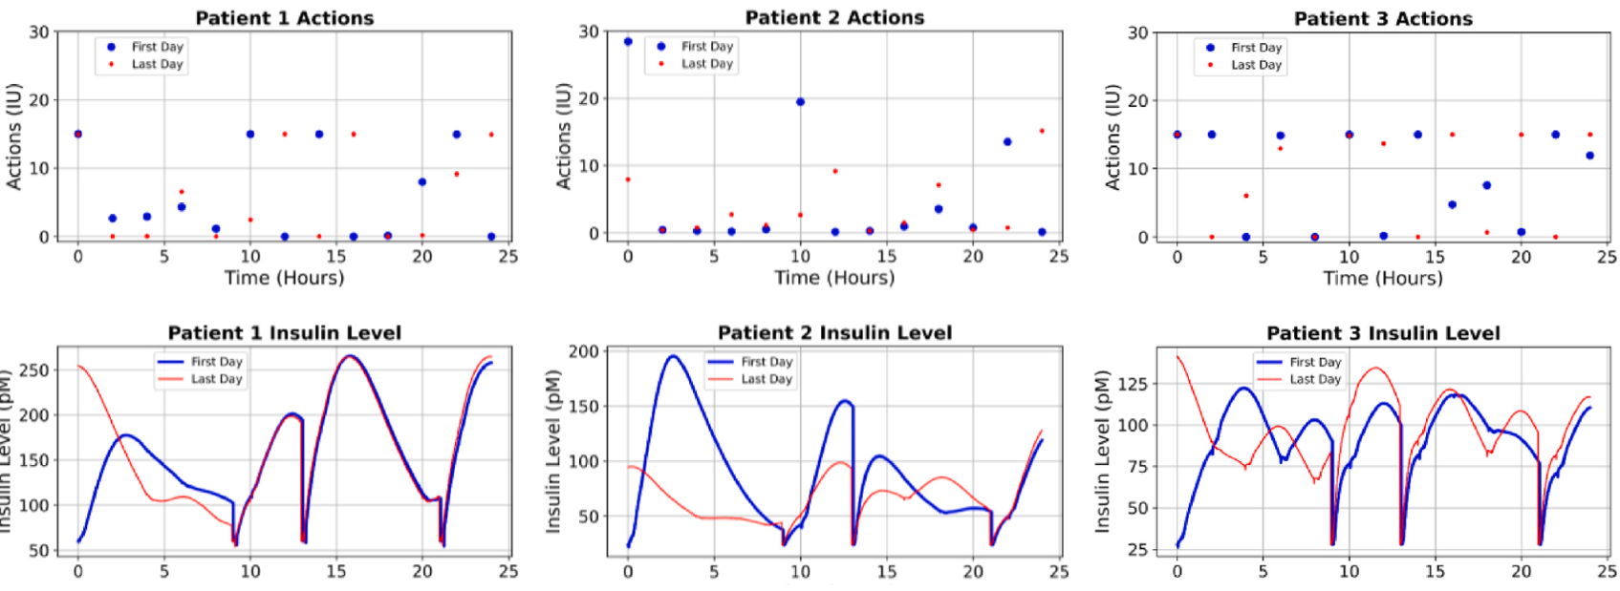
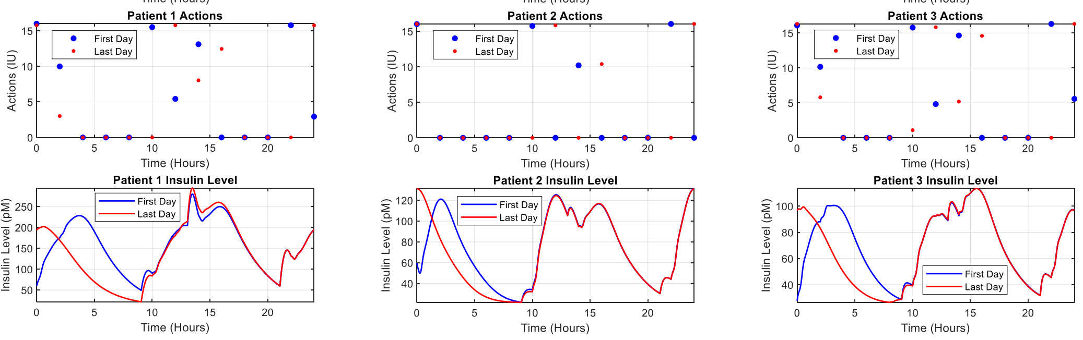
NAF
Various actions
SMC
Similar actions

Slide 17


SMC
--- Strong robustness, fast convergence rate, simplicity
Switching Function:
Define the desired dynamic behavior (Stabilization of Glucose Levels), when the system's state reaches this surface, it will remain on it for all future time steps, despite uncertainties or disturbances.
Terminal Sliding Function:
β could be a design parameter that influences the rate at which the sliding function converges to the desired surface or trajectory

Slide 18

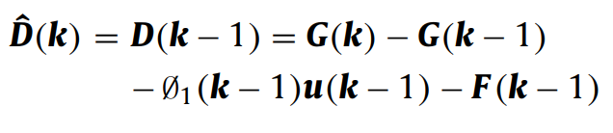
SMC
time-varying
External Disturbance
Switching Function:

