Slide 1
Subcutaneous insulin administration by deep reinforcement learning for blood glucose level control of type-2 diabetic patients
Computers in Biology and Medicine, 2022
MA Raheb, VR Niazmand, N Eqra, R Vatankhah
School of Mechanical Engineering, Shiraz University, Shiraz, Iran Department of IT and Computer Engineering, School of Electrical and Computer Engineering, Shiraz University, Shiraz, Iran Department of Mechanical Engineering, Sharif University of Technology, Tehran, Iran

Slide 2
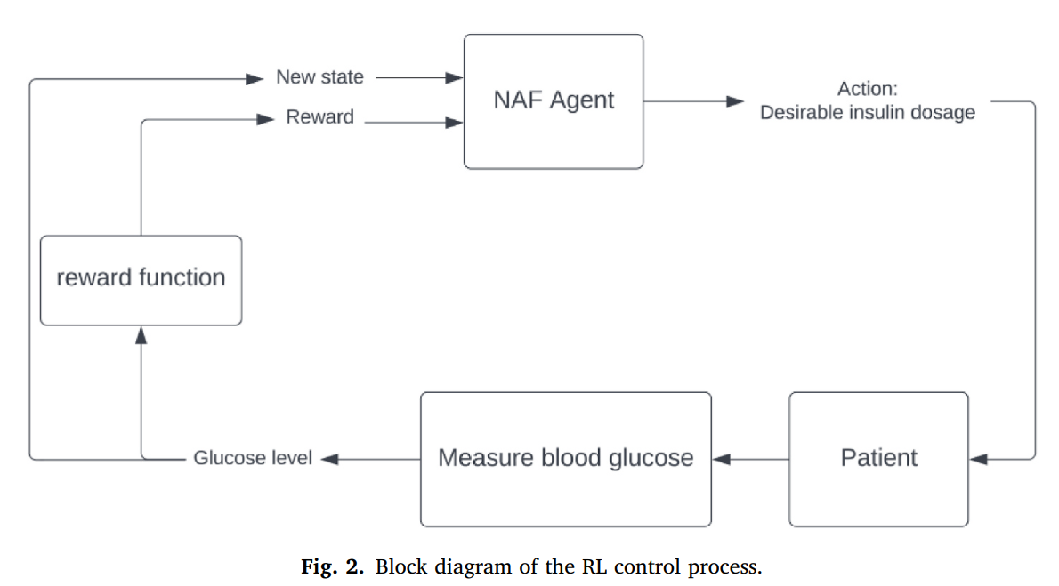
Implementation of code
Part 2:
DQN model
Goal: Decide the optimal action
Part 1:
Glucose-Insulin System
Goal: optimize the parameters

Slide 3
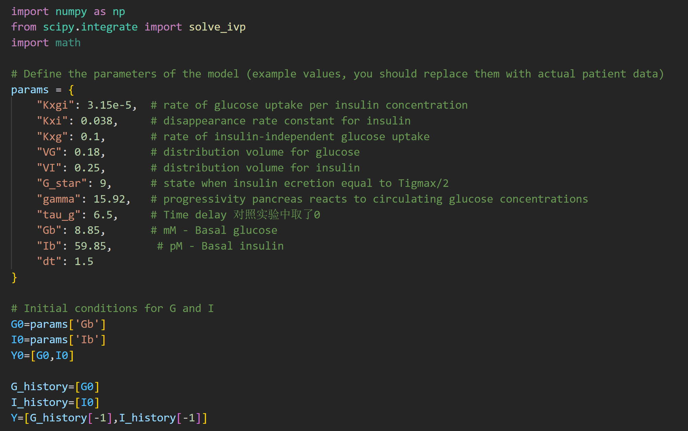
Glucose-Insulin System

Slide 4
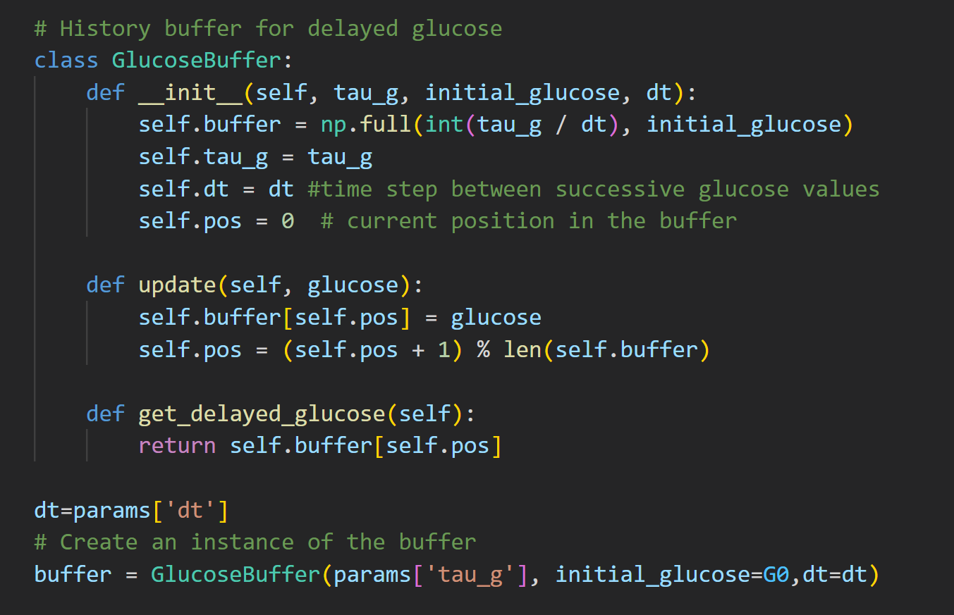
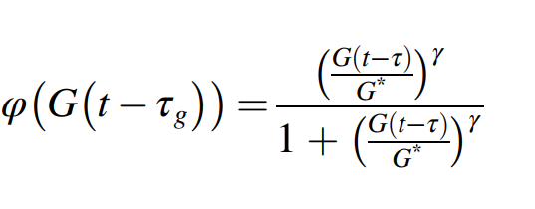
Time Delay

Slide 5
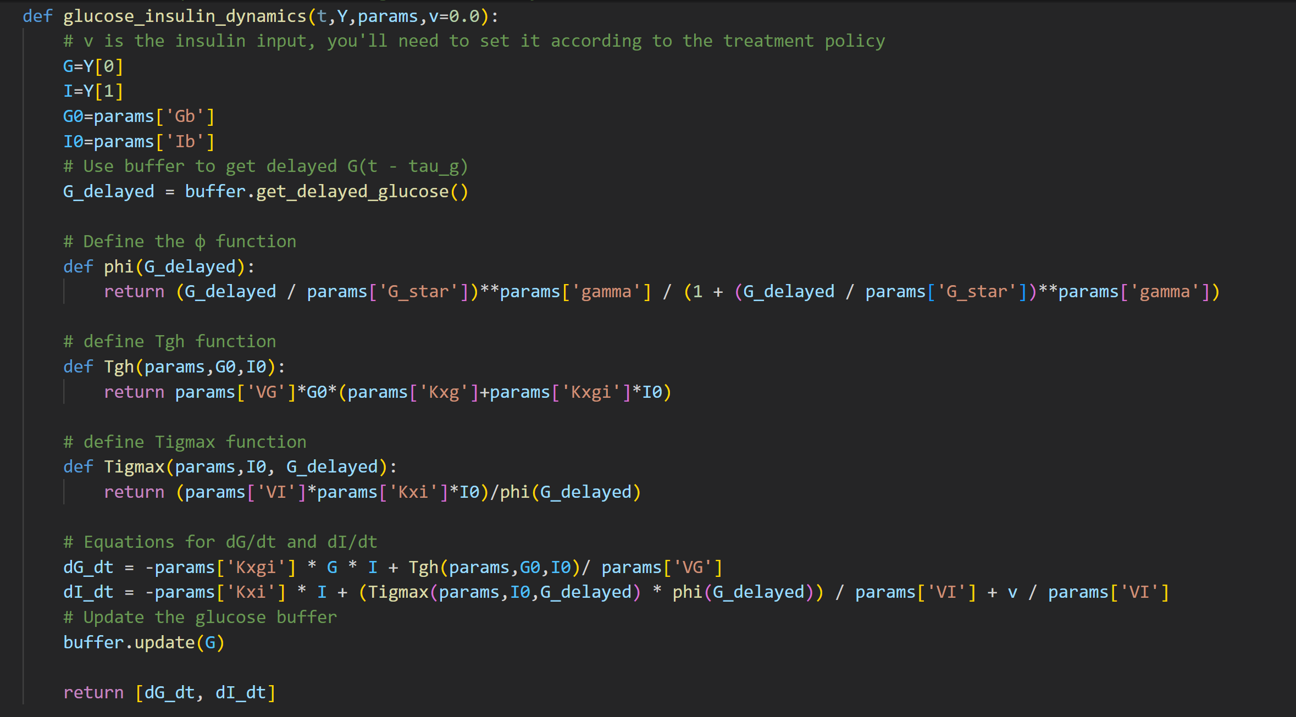
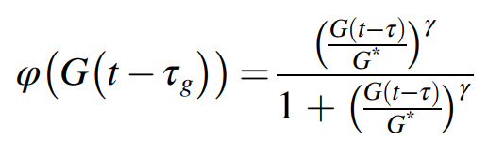
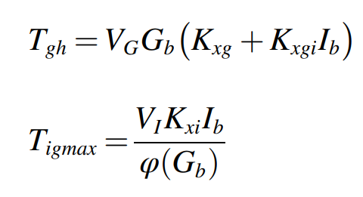
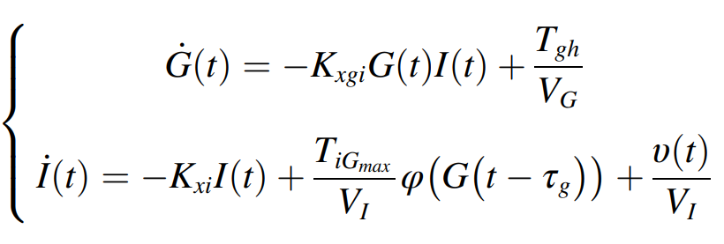

Slide 6
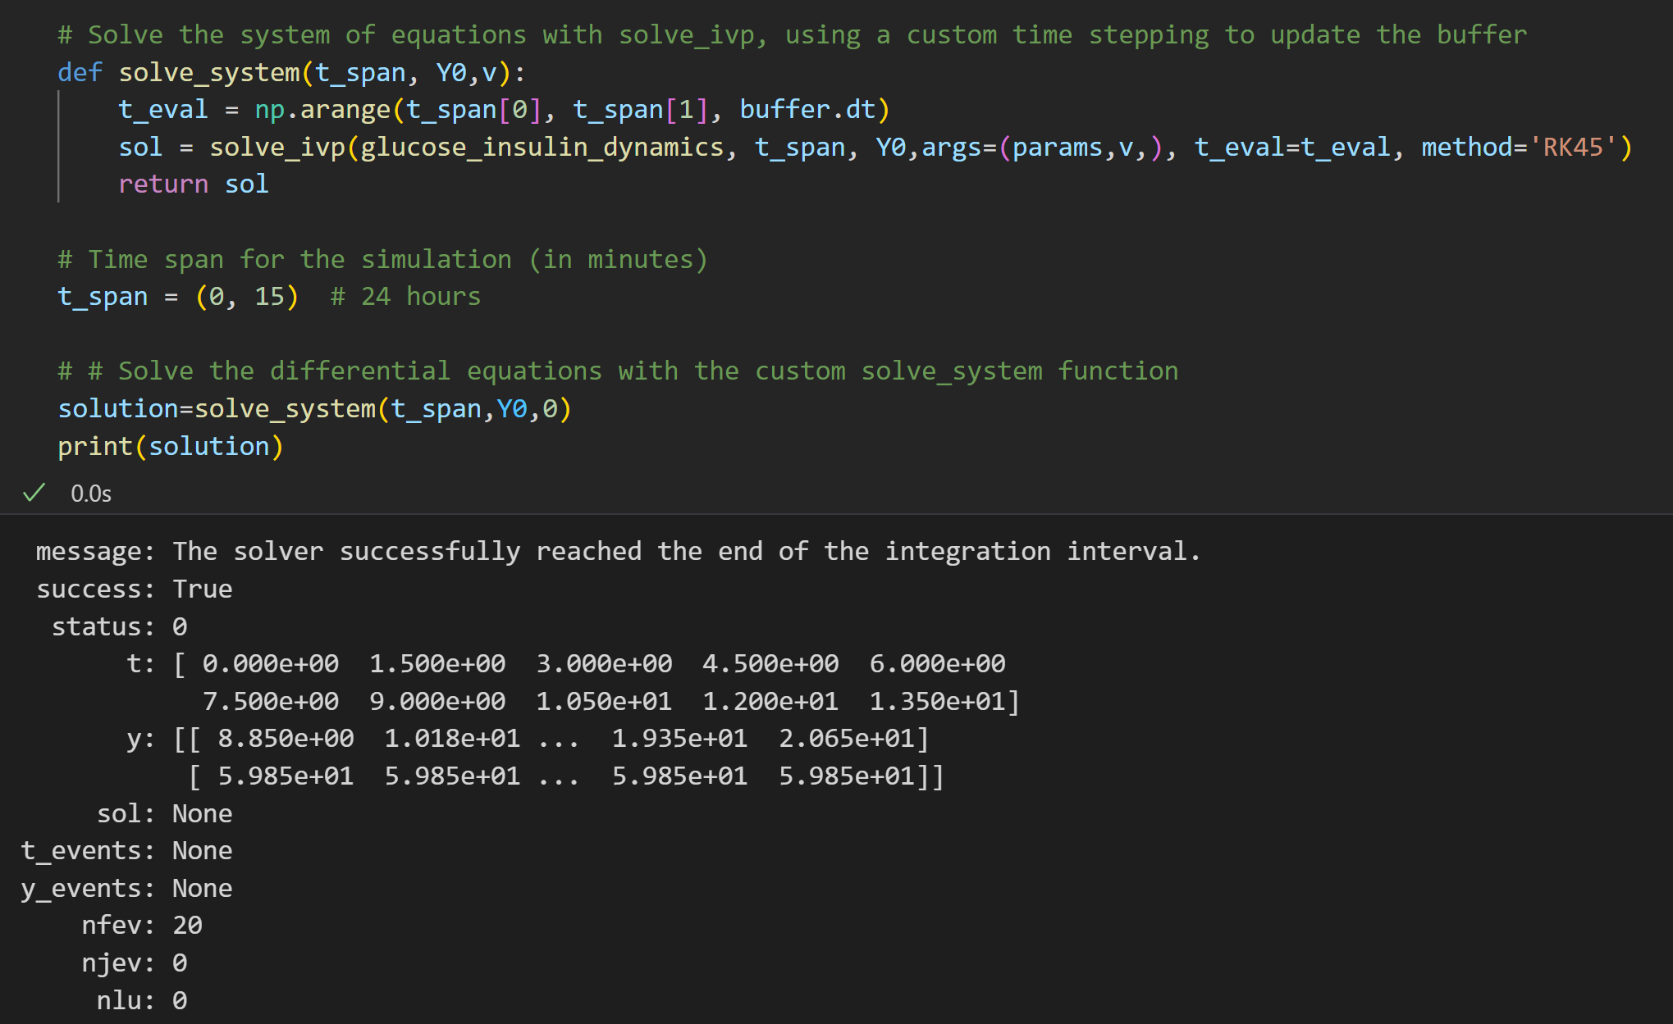

Slide 7
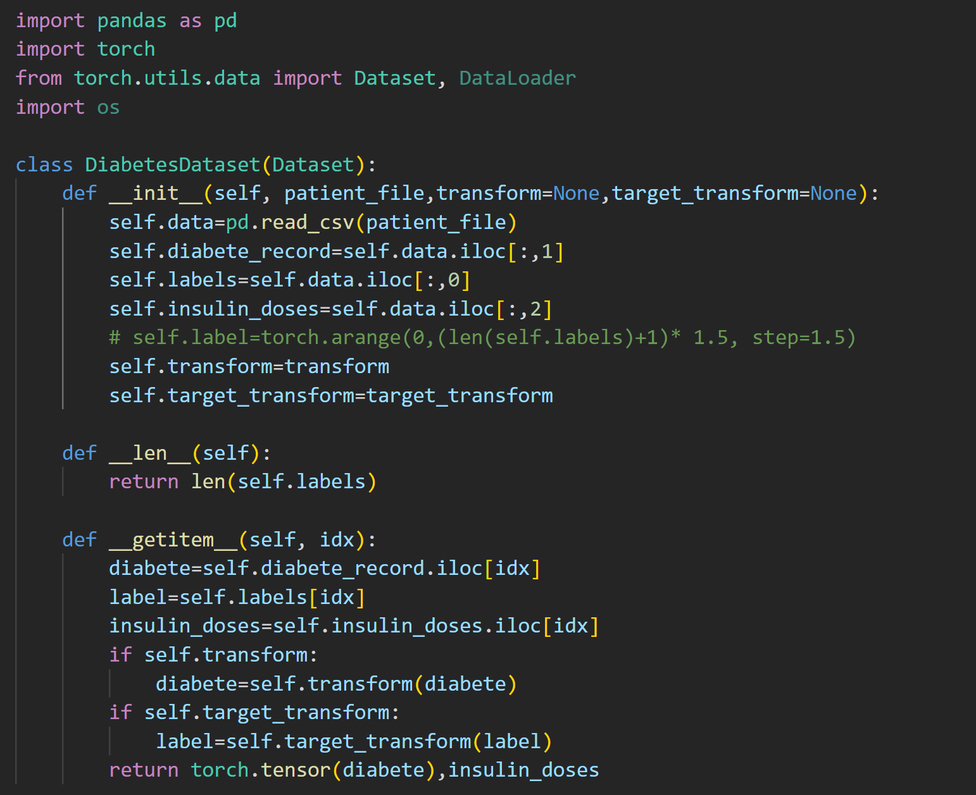
Import
Data

Slide 8
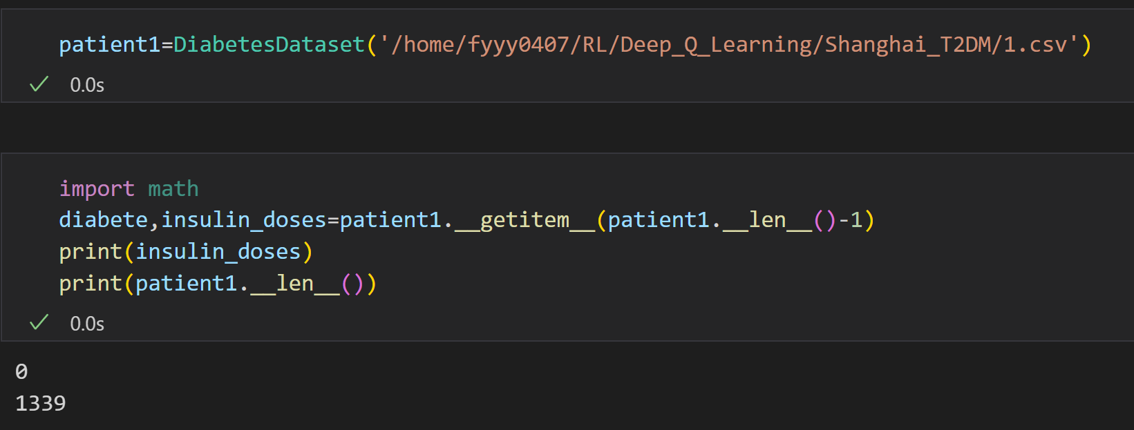
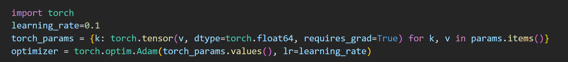

Extract
Data
Optimizer
Loss Function

Slide 9
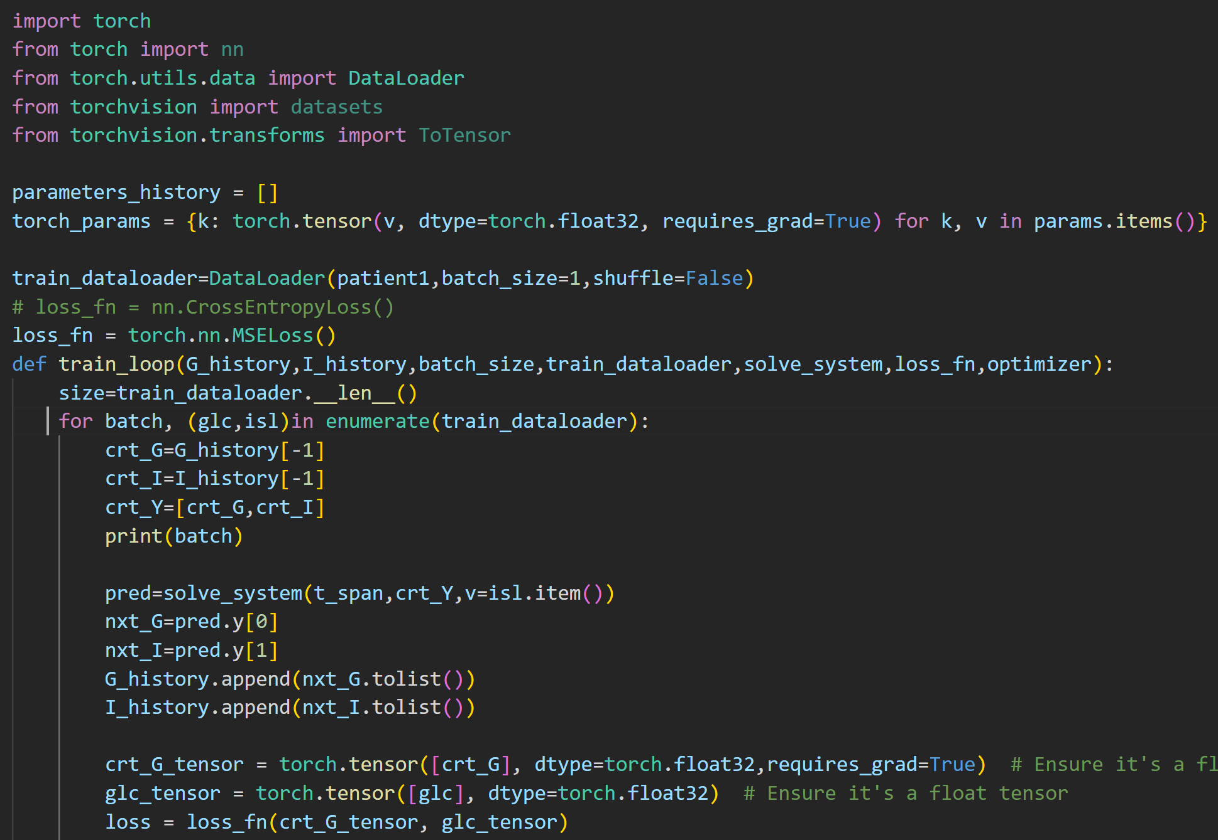
Training

Slide 10
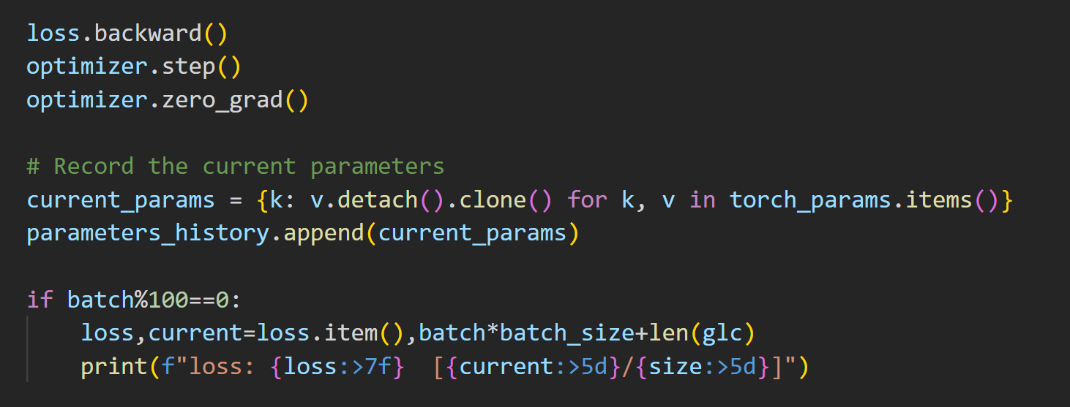
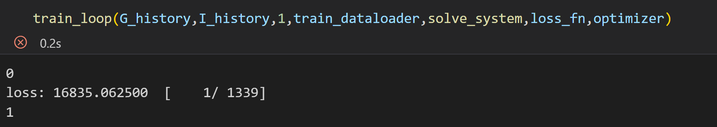
Training

