Slide 1
Robust and efficient parameter estimation in dynamic models of biological systems
Gábor, A., & Banga, J. R. (2015).
BMC systems biology, 9, 1-25.

Slide 2
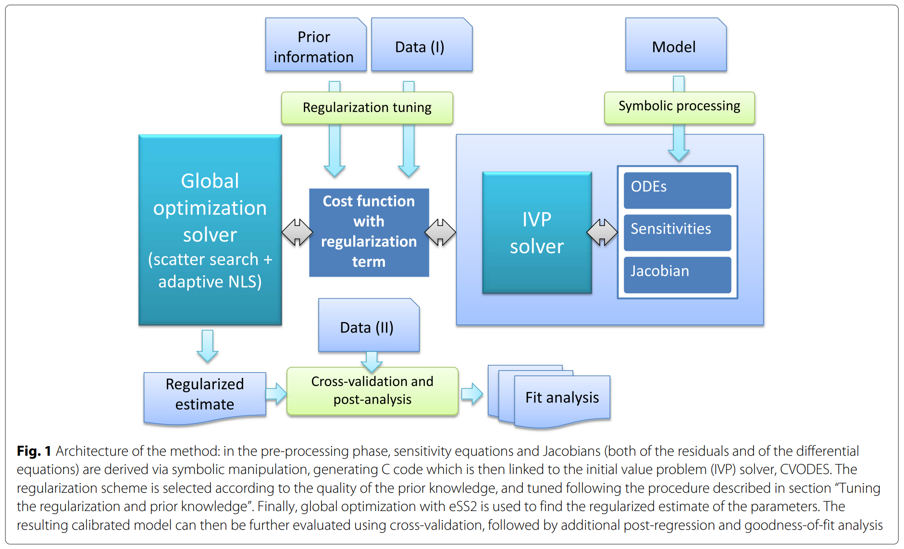
Method

Slide 3
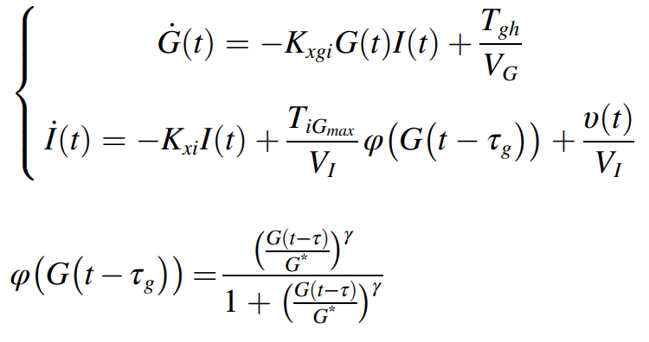
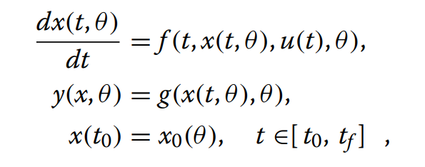
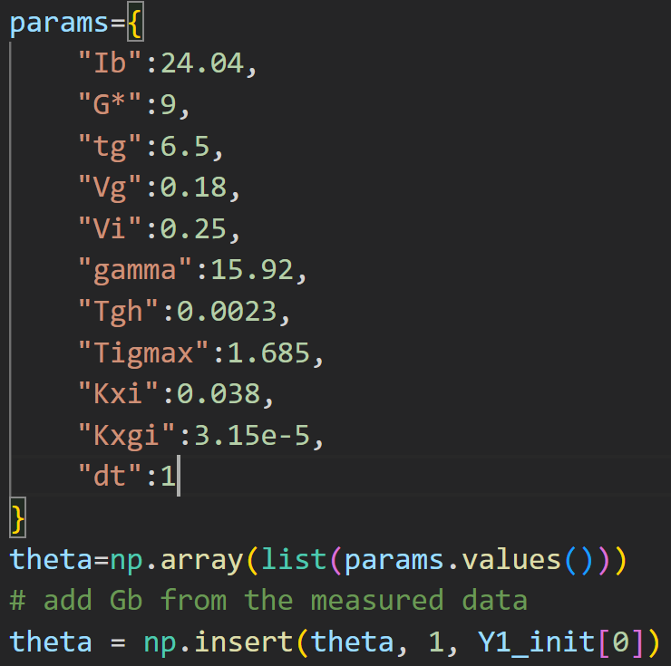
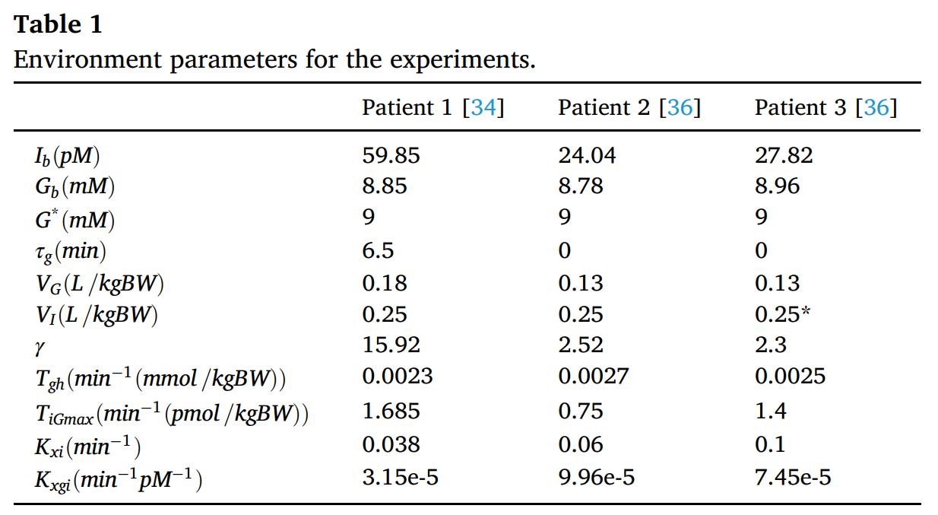
Mathematical Model

Slide 4
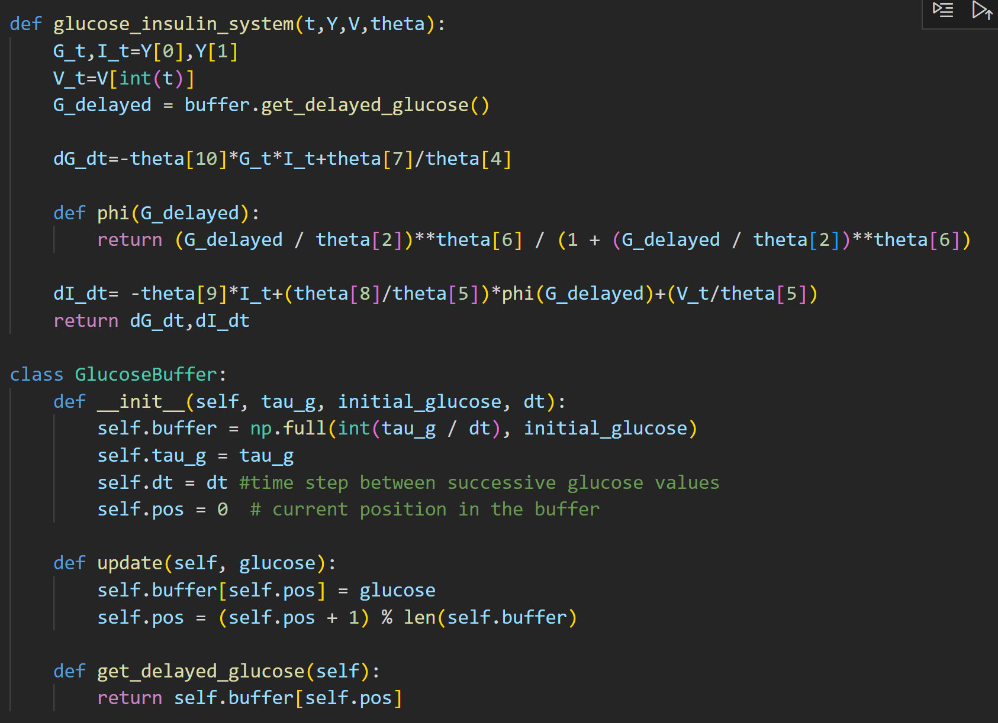

Slide 5
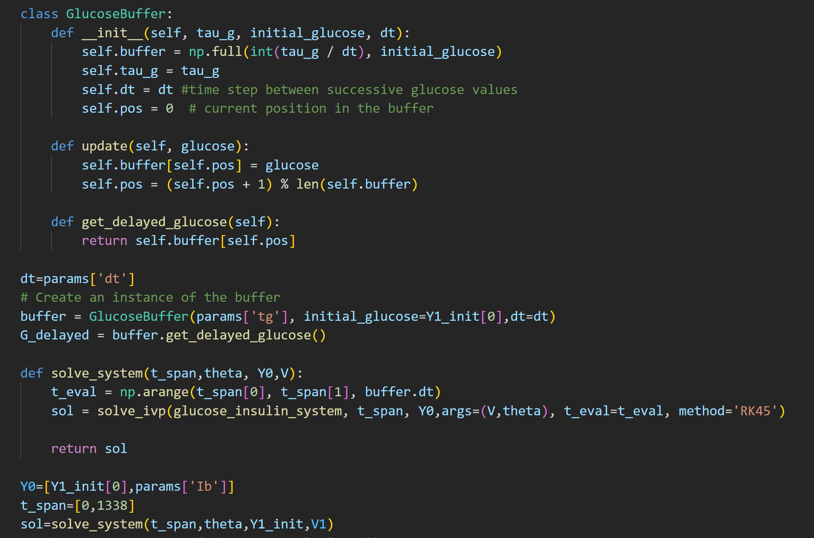

Slide 6
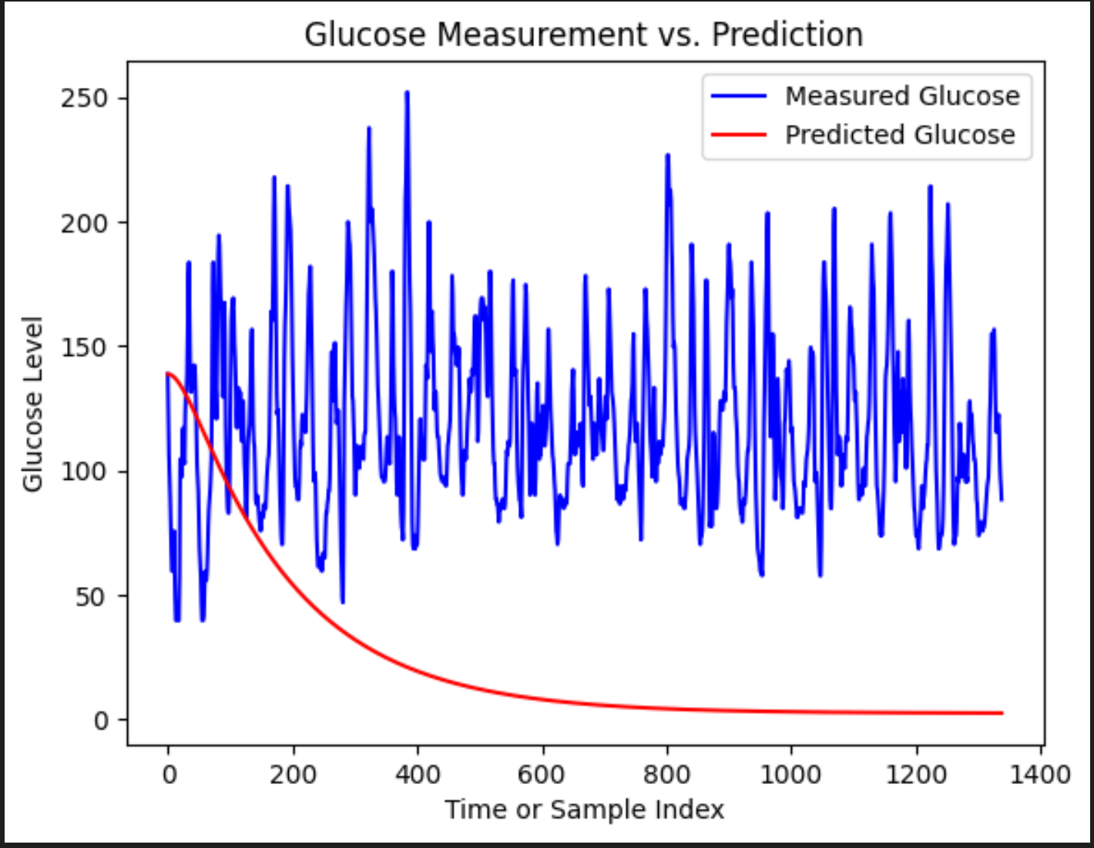
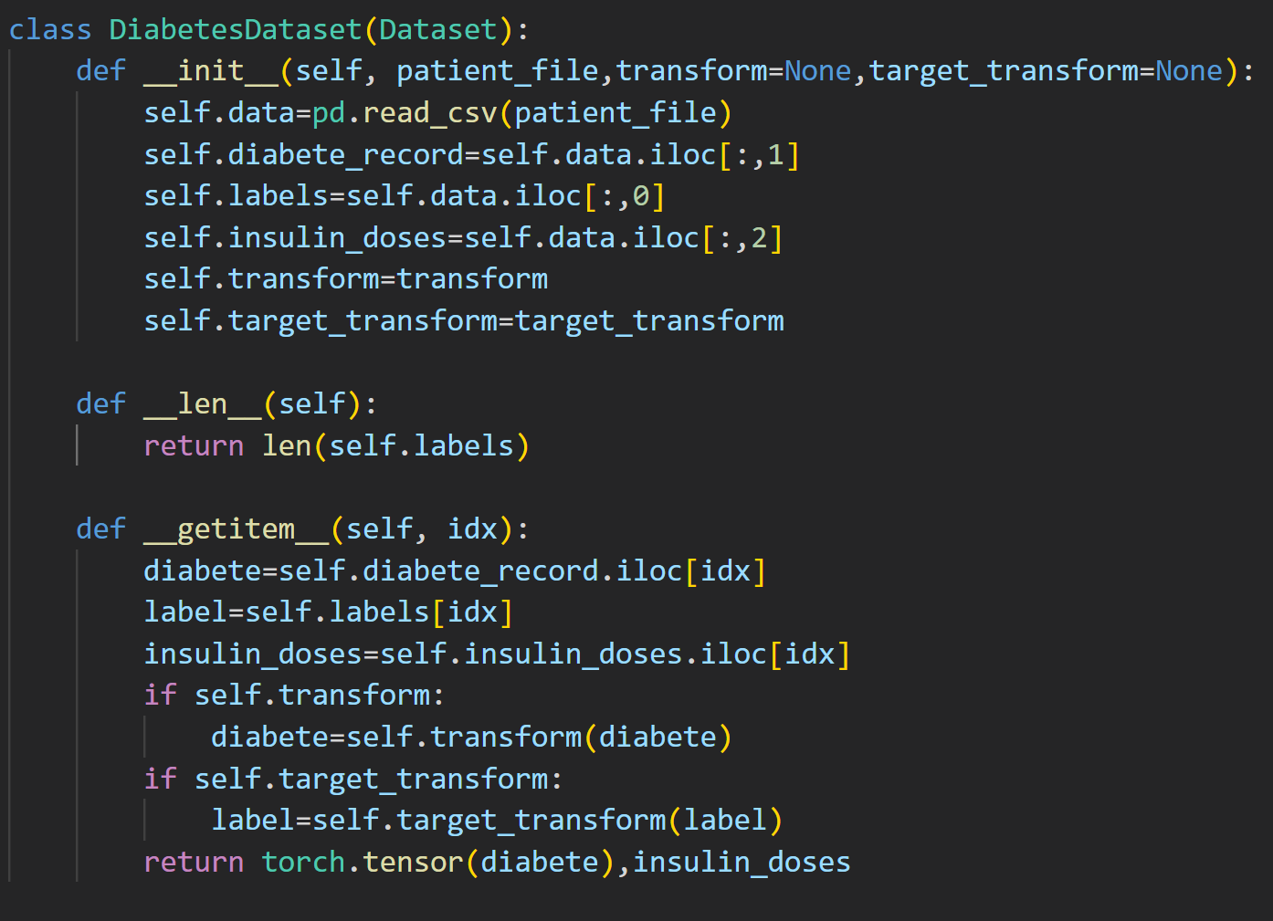
Data Import
Question:
How to take meal plan into consideration?

Slide 7
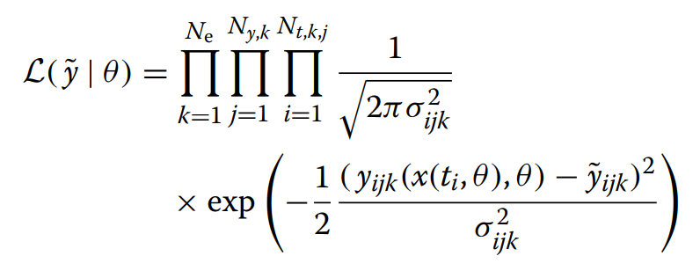
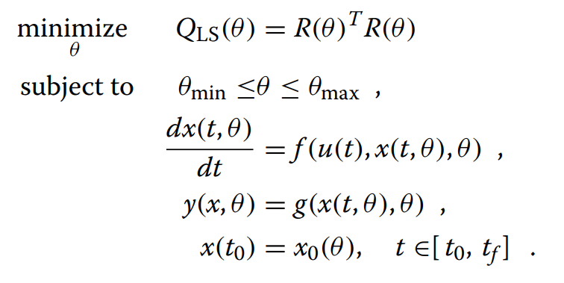
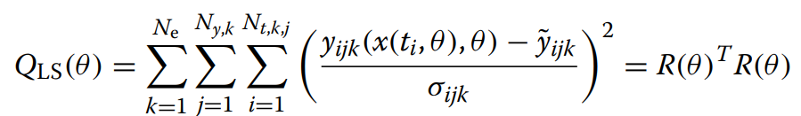
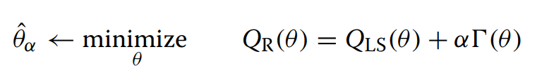
Cost Function with Regulation Part
Goal: Maximize Likelihood Function
Minimize Cost Function
Question:
How to decide the value of α
Regulation: Prevent Overfitting
α ∈ R+ is the non-negative regularization parameter and Ț(·) the regularization penalty function.

Slide 8
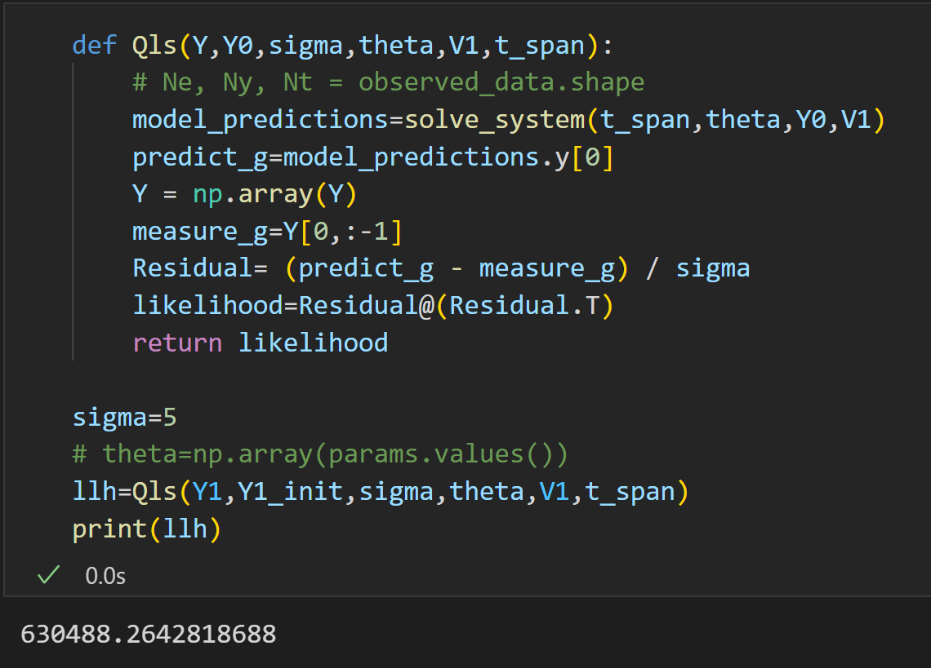
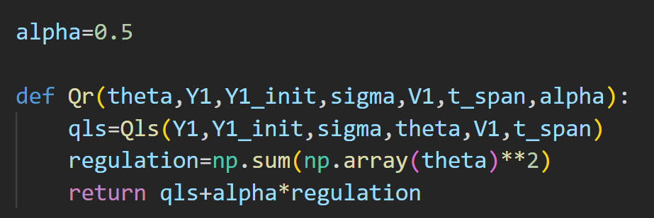

Slide 9
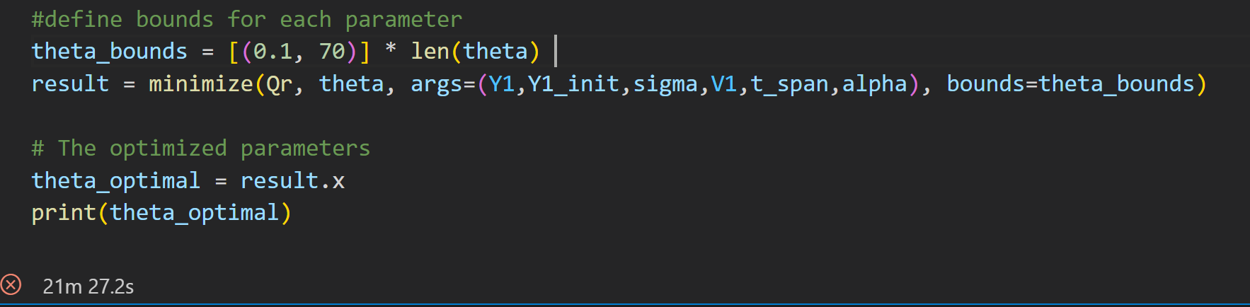
Optimization

