Slide 1
4.2 Model Improvement
Feng Ying

Slide 2
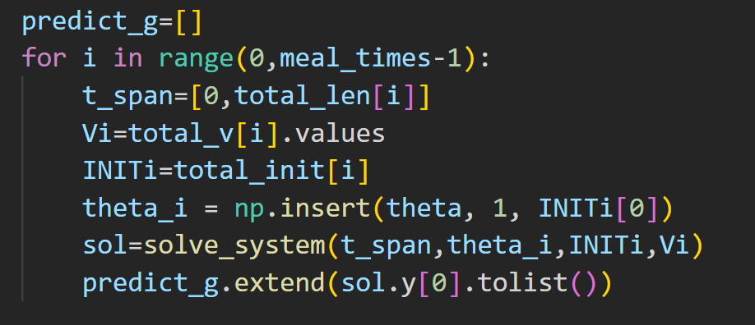
Data Processing
Data Dividing According to Meal Plan
Concatenate Data after Predicting with solve_ivp Function
Parameter Optimization and Comparision

Slide 3
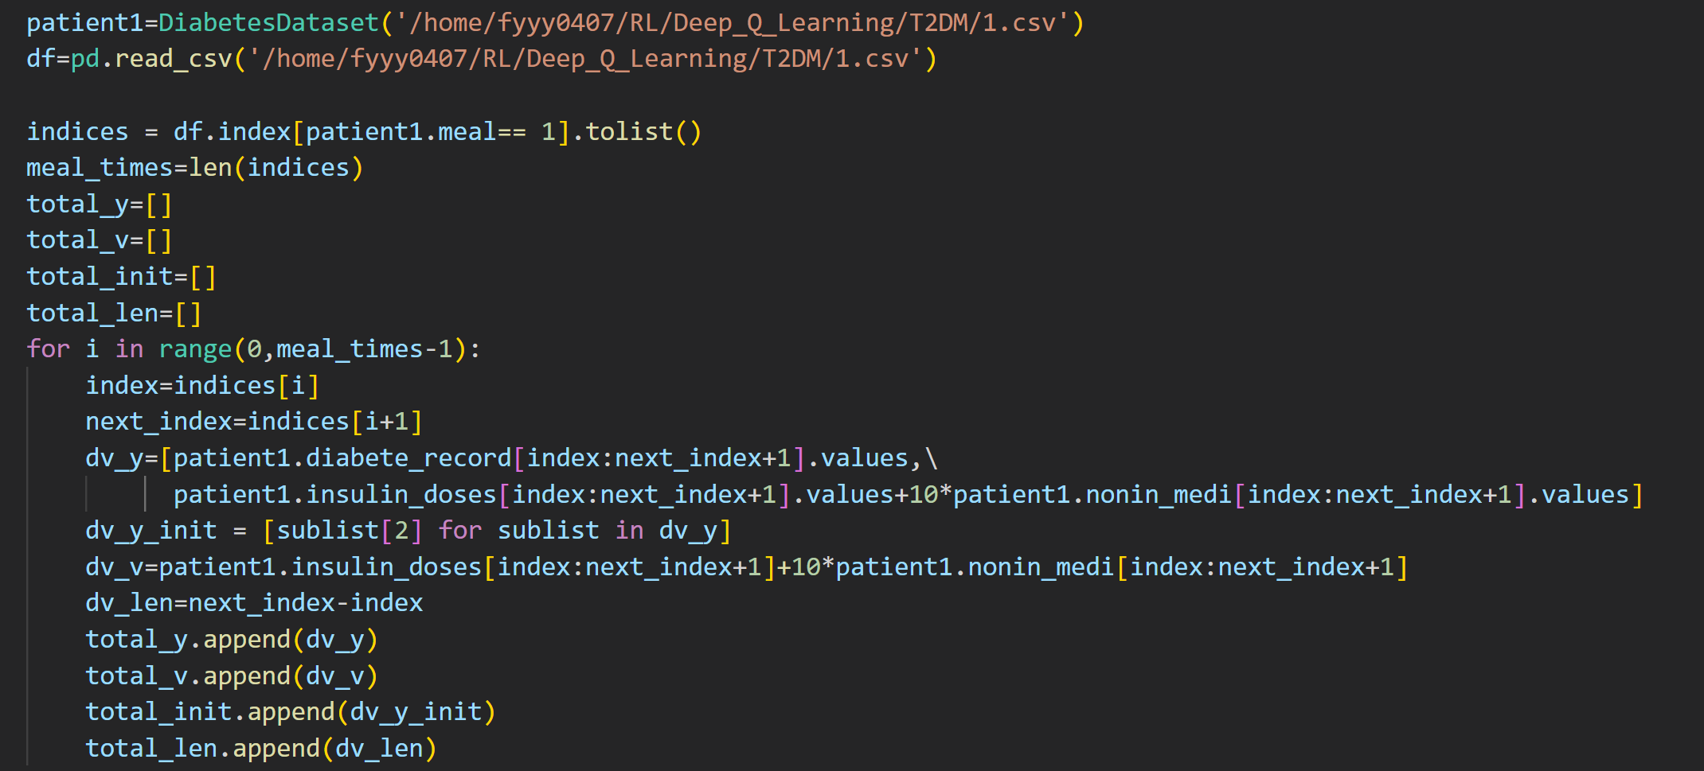
Data Dividing
Simulate the delay of glucose level rise after meal

Slide 4
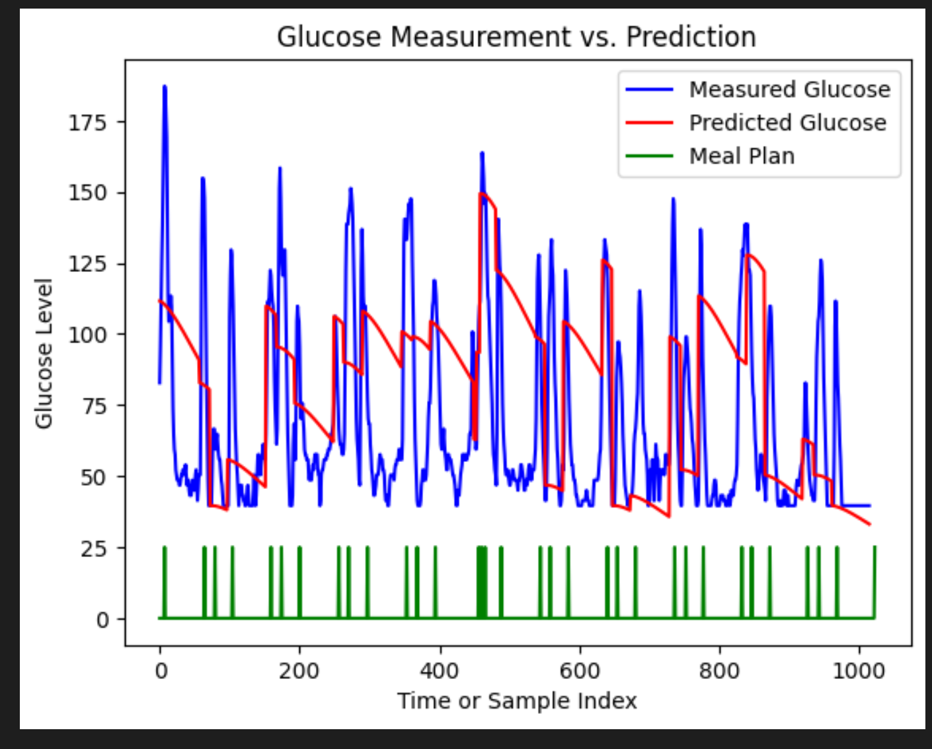
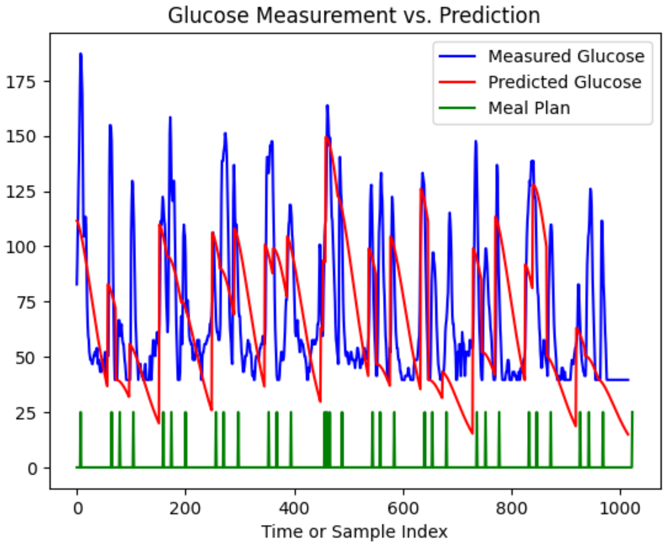
Parameter Optimizing and Results
Before Optimizing
After Optimizing

Slide 5
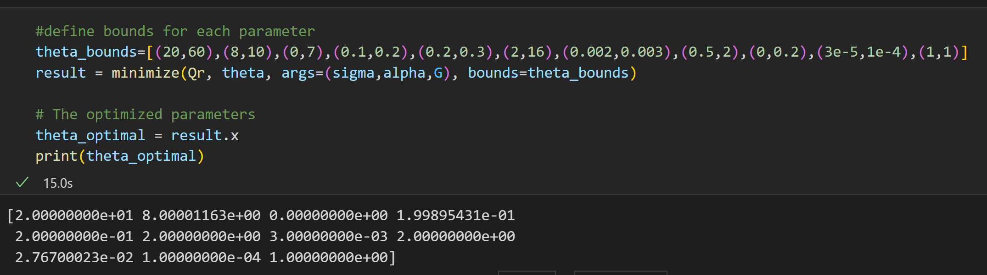
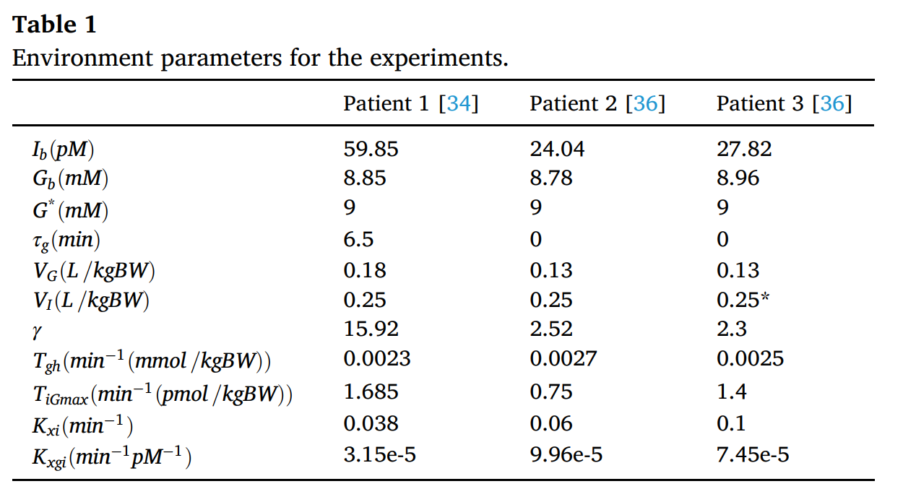
Parameter Boundaries and Values after optimizing

Slide 6
Future Work
Learn how does the Solve_ivp function work so as to modify and optimize the model
Find out the exact boundaries for the parameters by searching the articles
Find out the effect of non-insulin medicine
Question：由于之前的模型是多年前提出的，当时可能没有非胰岛素药物的使用。能否在原模型的基础上加入非胰岛素药物的影响？暂时没有找到关于非胰岛素药物和直接注射胰岛素的效果比较的研究

