Slide 1


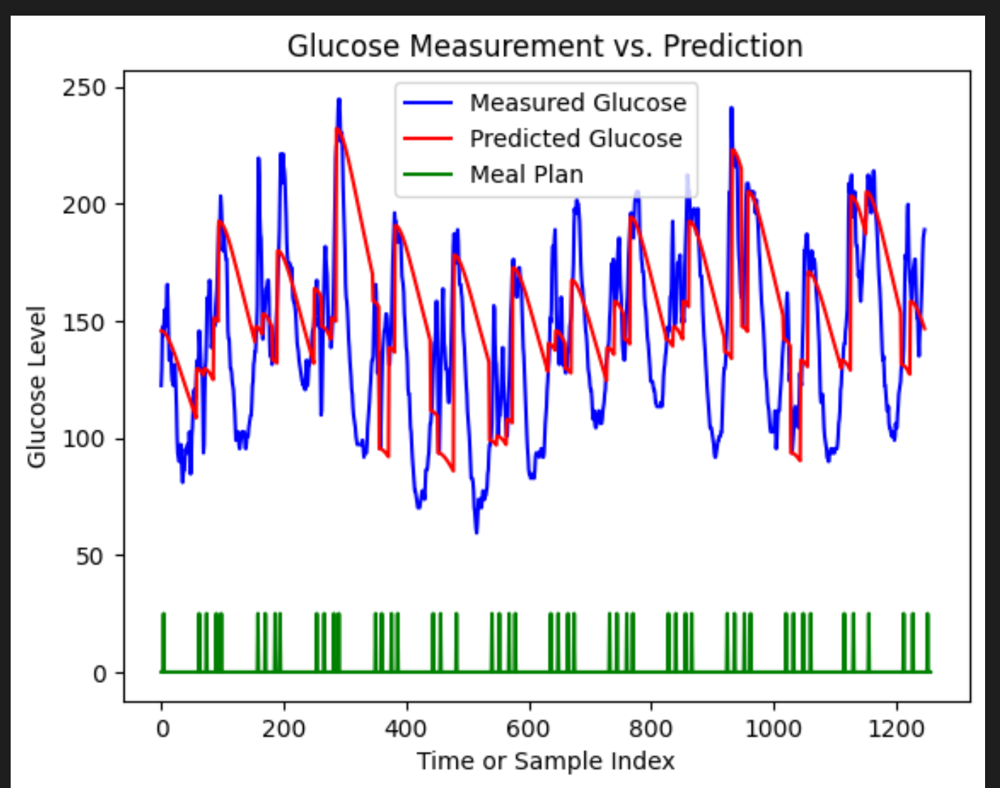
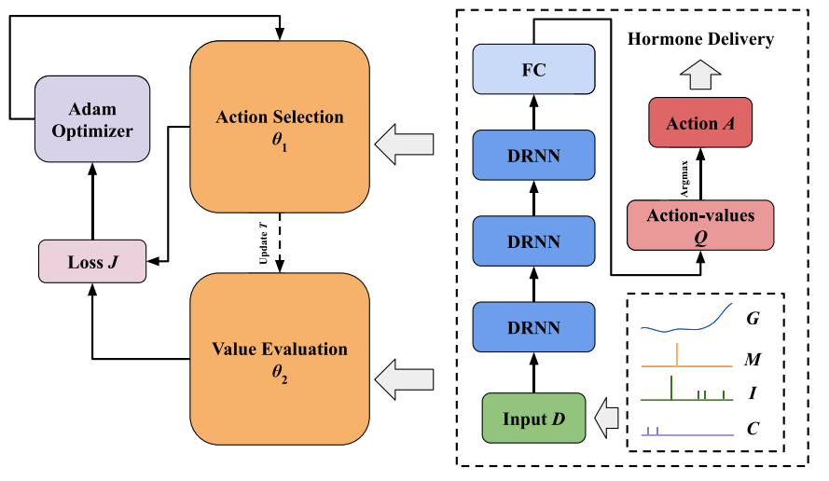
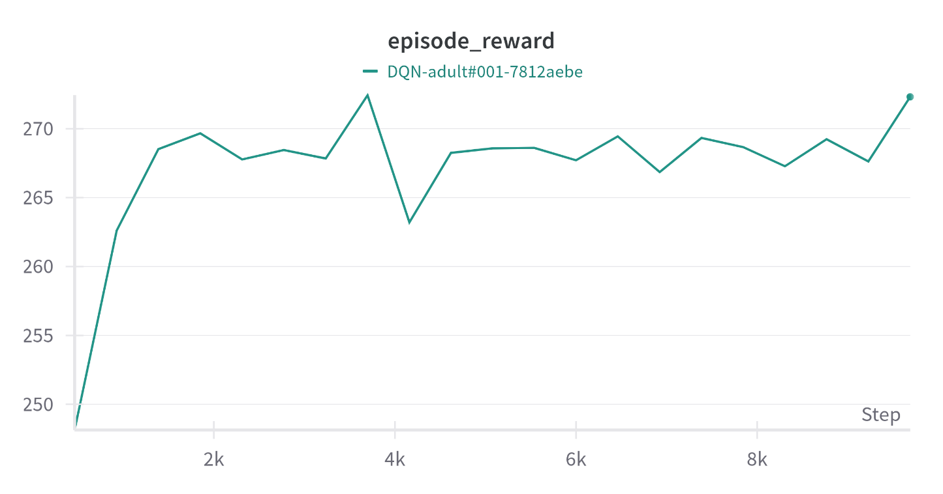
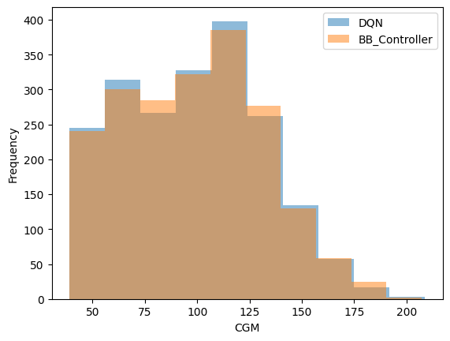
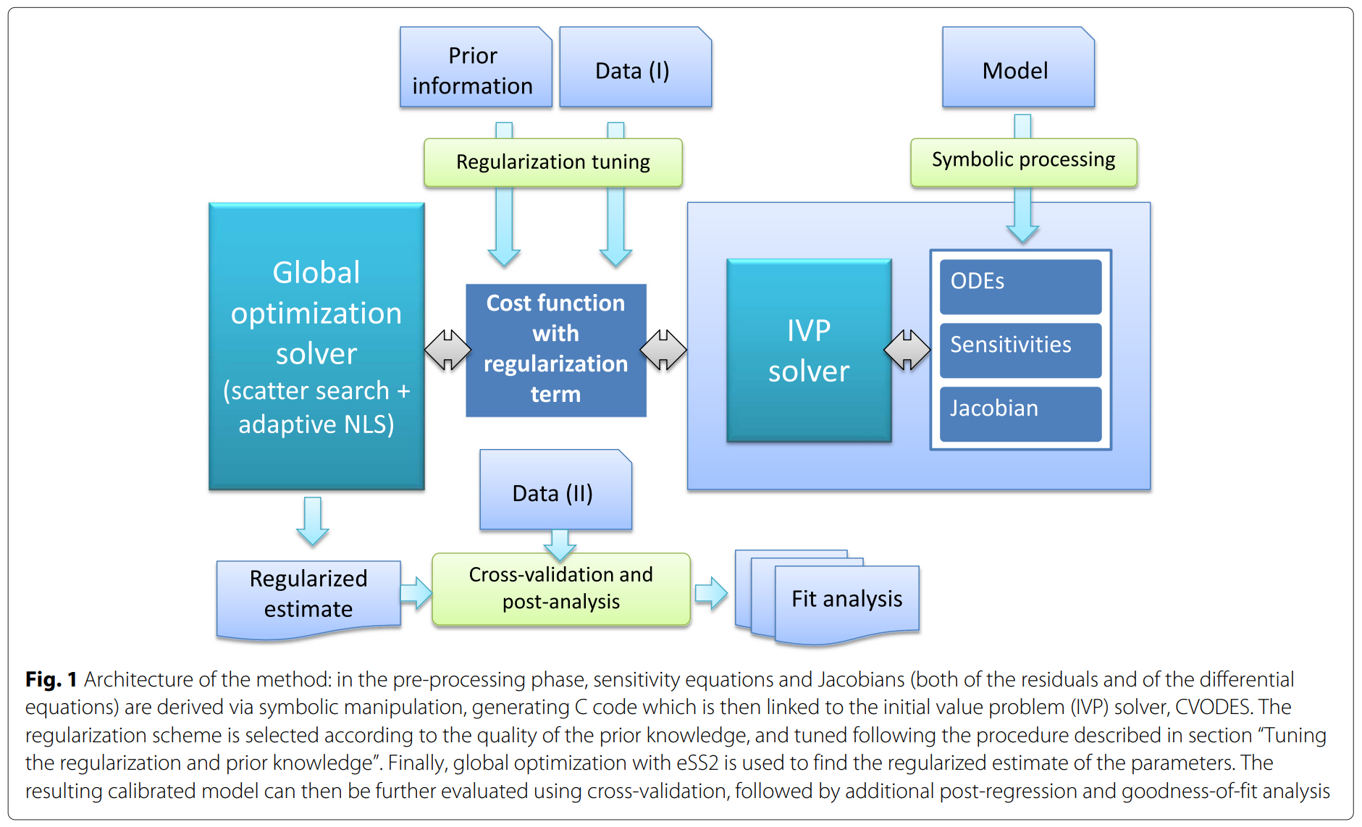
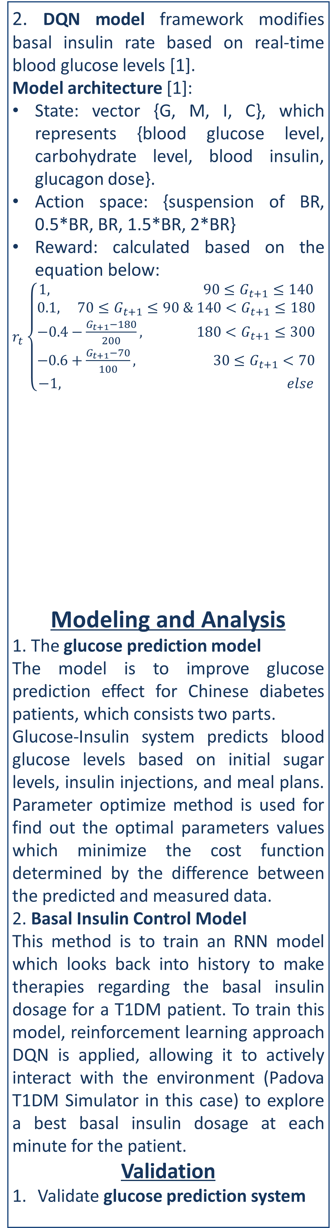
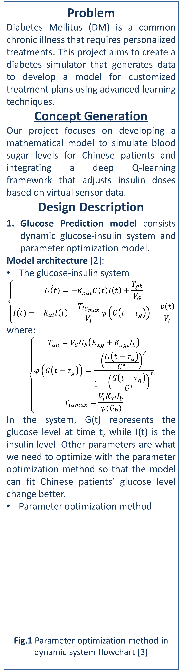
ENGR4903J
JI Undergraduate Research Program
Reinforcement Learning and Supervised Learning for efficient diabetes glucose prediction and control
Instructors: Prof. Yifei Zhu
Team Members: Ruizhe Wang, Ying Feng, Yixuan Chen
Problem
Diabetes Mellitus (DM) is a common chronic illness that requires personalized treatments. This project aims to create a diabetes simulator that generates data to develop a model for customized treatment plans using advanced learning techniques.
Concept Generation
Our project focuses on developing a mathematical model to simulate blood sugar levels for Chinese patients and integrating a deep Q-learning framework that adjusts insulin doses based on virtual sensor data.
Design Description
Glucose Prediction model consists dynamic glucose-insulin system and parameter optimization model.
Model architecture [2]:
The glucose-insulin system
$$\left\{\begin{aligned}\dot{G\left(t\right)}=−K_{xgi}G\left(t\right)I\left(t\right)+\frac{T_{gh}}{V_{G}} \\ \dot{I(t)}=−K_{xi}I\left(t\right)+\frac{T_{iG_{max}}}{V_{I}}φ\left(G\left(t−τ_{g}\right)\right)+\frac{v\left(t\right)}{V_{I}}\end{aligned}\right.$$
where:
$$\left\{\begin{aligned}T_{gh}=V_{G}G_{b}\left(K_{xg}+K_{xgi}I_{b}\right) \\ φ\left(G\left(t−τ_{g}\right)\right)=\frac{{\left(\frac{G\left(t−τ_{g}\right)}{G^{∗}}\right)}^{γ}}{1+{\left(\frac{G\left(t−τ_{g}\right)}{G^{∗}}\right)}^{γ}} \\ T_{igmax}=\frac{V_{I}K_{xi}I_{b}}{φ(G_{b})}\end{aligned}\right.$$
In the system, G(t) represents the glucose level at time t, while I(t) is the insulin level. Other parameters are what we need to optimize with the parameter optimization method so that the model can fit Chinese patients’ glucose level change better.
Parameter optimization method
Fig.1 Parameter optimization method in dynamic system flowchart [3]
2. DQN model framework modifies basal insulin rate based on real-time blood glucose levels [1].
Model architecture [1]:
State: vector {G, M, I, C}, which represents {blood glucose level, carbohydrate level, blood insulin, glucagon dose}.
Action space: {suspension of BR, 0.5*BR, BR, 1.5*BR, 2*BR}
Reward: calculated based on the equation below:
$r_{t}$ $\left\{\begin{aligned}1, 90≤G_{t+1}≤140 \\ 0.1, 70≤G_{t+1}≤90 & 140<G_{t+1}≤180 \\ −0.4−\frac{G_{t+1}−180}{200}, 180<G_{t+1}≤300 \\ −0.6+\frac{G_{t+1}−70}{100}, 30≤G_{t+1}<70 \\ −1, else\end{aligned}\right.$
Modeling and Analysis
1. The glucose prediction model
The model is to improve glucose prediction effect for Chinese diabetes patients, which consists two parts.
Glucose-Insulin system predicts blood glucose levels based on initial sugar levels, insulin injections, and meal plans. Parameter optimize method is used for find out the optimal parameters values which minimize the cost function determined by the difference between the predicted and measured data.
2. Basal Insulin Control Model
This method is to train an RNN model which looks back into history to make therapies regarding the basal insulin dosage for a T1DM patient. To train this model, reinforcement learning approach DQN is applied, allowing it to actively interact with the environment (Padova T1DM Simulator in this case) to explore a best basal insulin dosage at each minute for the patient.
Validation
Validate glucose prediction system
Data from 40 patients were used to train the model and optimize parameters. The effectiveness of the optimized model was then validated using another patient's data, as shown in Fig. 3.
Fig.3 Effect of glucose prediction system
2. Validate DQN model
We compared our results with a bolus-basal controller using a low-glucose suspension (LGS) strategy. As shown in Fig. 4, the episode reward increases over time, indicating improving performance.
Fig. 5 shows a comparison between our DQN model and traditional low-glucose suspension method (BB_Controller).
Conclusion
The first model predicts glucose levels based on Chinese patient data, while the second controls basal insulin with an RNN network. Both models show improved accuracy and adaptability, demonstrating their potential in diabetic care.
Acknowledgement
Prof. Yifei Zhu from UM-SJTU Joint Institute
Reference
[1] T. Zhu et al., "Basal Glucose Control in Type 1 Diabetes Using Deep Reinforcement Learning: An In Silico Validation,“ IEEE Journal of Biomedical and Health Informatics, 2021, vol. 25, no. 4, pp. 1223-1232, doi: 10.1109/JBHI.2020.3014556.
[2] Mohammad Ali Raheb, Vahid Reza Niazmand, Navid Eqra, and Ramin Vatankhah, “Subcutaneous insulin administration by deep reinforcement learning for blood glucose level control of type-2 diabetic patients,” Computers in Biology and Medicine, vol. 148, pp. 105860–105860, Sep. 2022, doi: https://doi.org/10.1016/j.compbiomed.2022.105860.
[3] A. Gábor and J. R. Banga, “Robust and efficient parameter estimation in dynamic models of biological systems,” BMC Systems Biology, vol. 9, no. 1, Oct. 2015, doi: https://doi.org/10.1186/s12918-015-0219-2.
Fig. 2 The DQN Framework [1]
Fig. 4 The episode reward
Fig.5 Comparison between DQN and LGS

