Slide 1
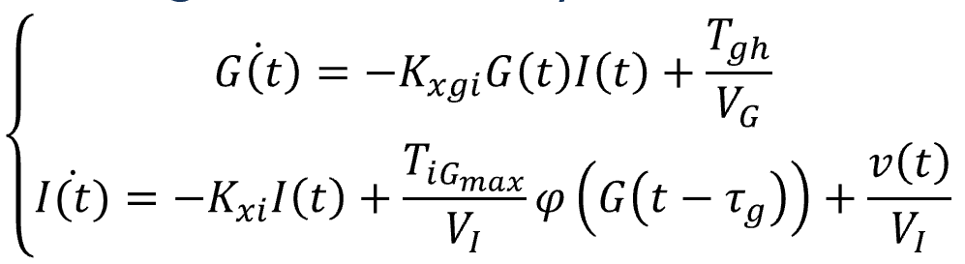
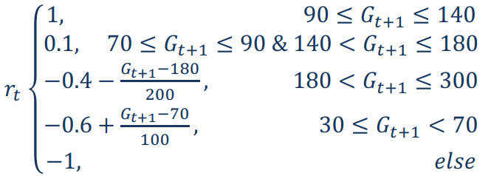
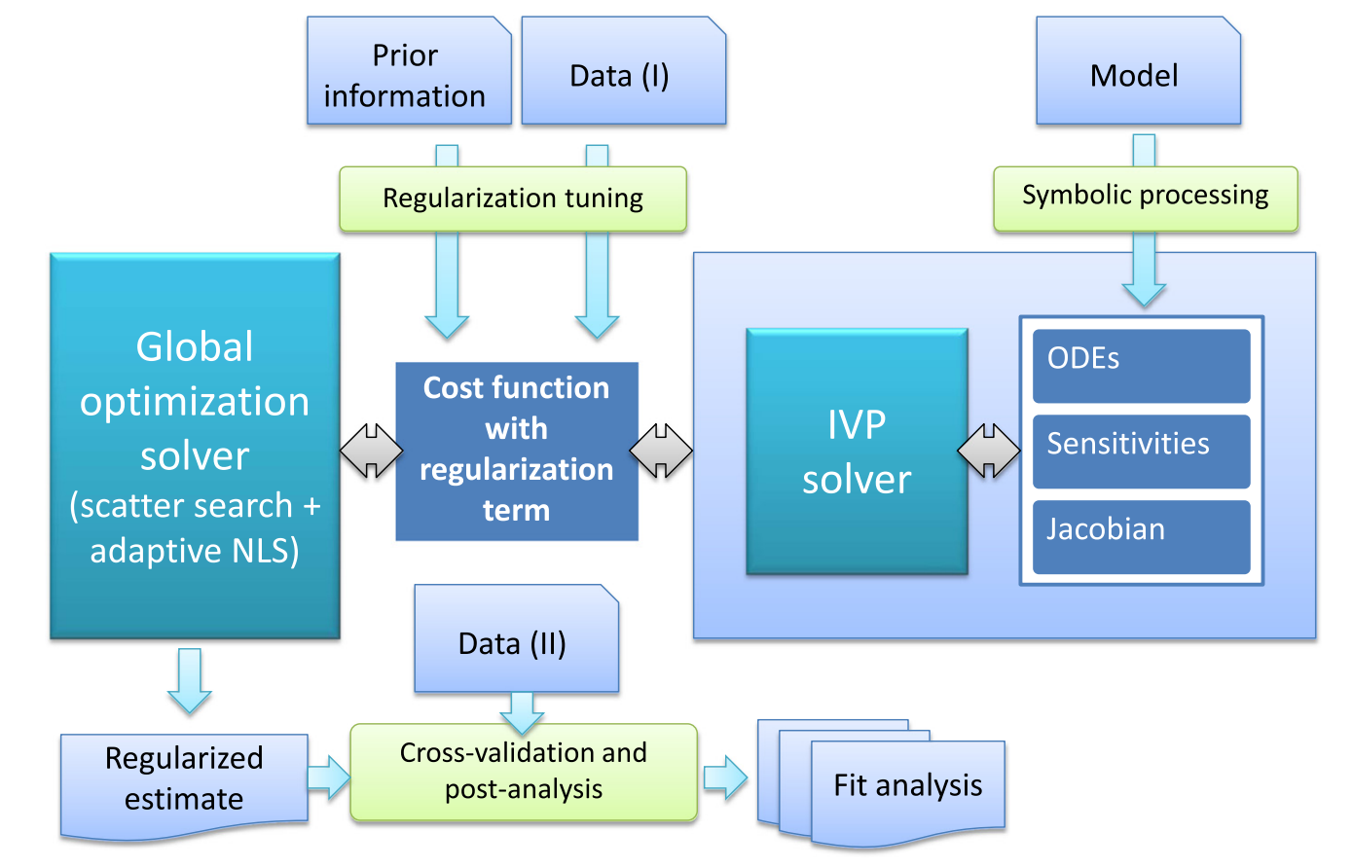
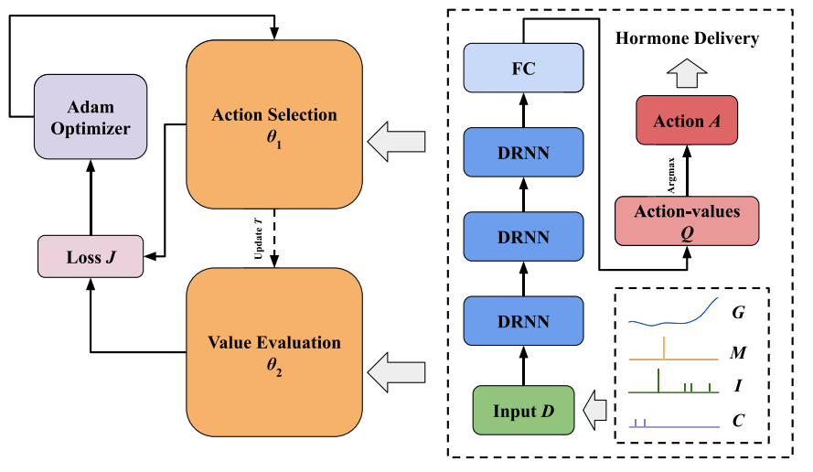
Modeling and Analysis
Glucose Prediction Model
Basal Insulin Control Model
Predict
glucose level
Reward
Optimize
Parameter in
dynamic system

