Slide 1
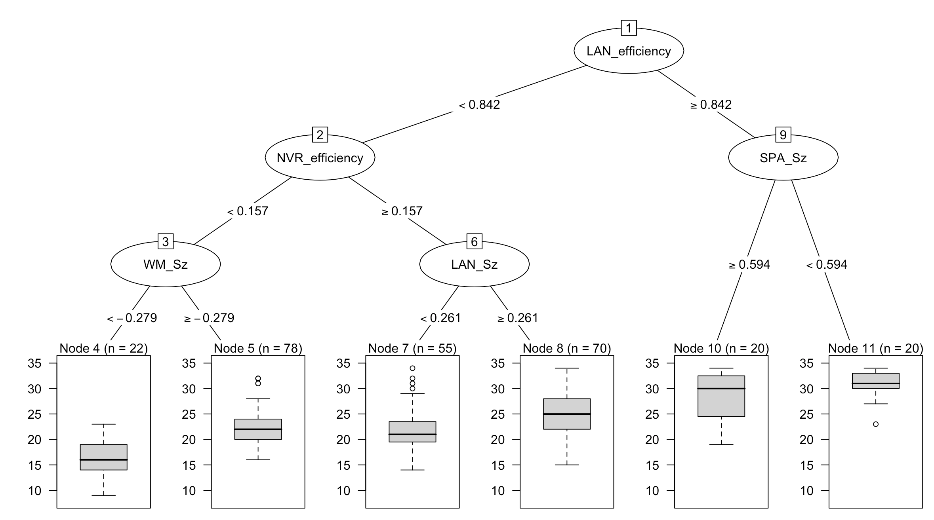
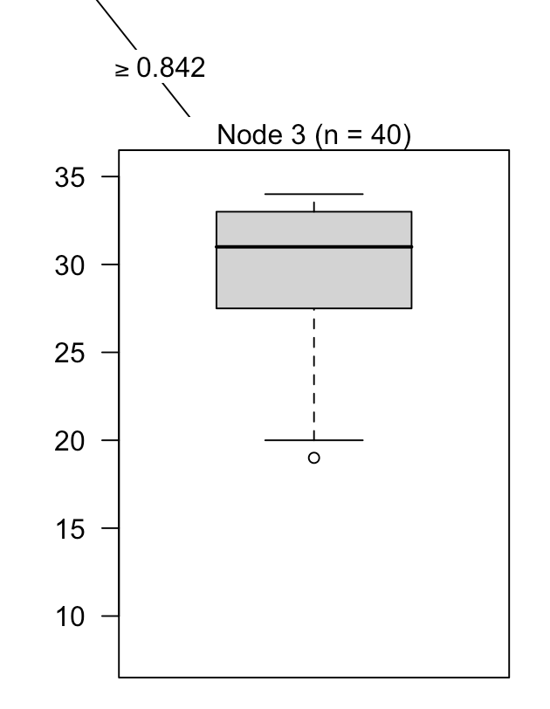
Reading—Extra time students excluded-larger samples
Avg = 29.60
SD = 4.16
95% CI =
24.9 – 34.31
Avg = 16.23
SD = 3.98
95% CI =
14.57 – 17.89
Avg = 22.27
SD = 3.75
95% CI =
21.44 – 23.1
Avg = 21.98
SD = 4.28
95% CI =
20.85 – 23.11
Avg = 24.89
SD = 4.04
95% CI =
23.94 - 25.83

Slide 2
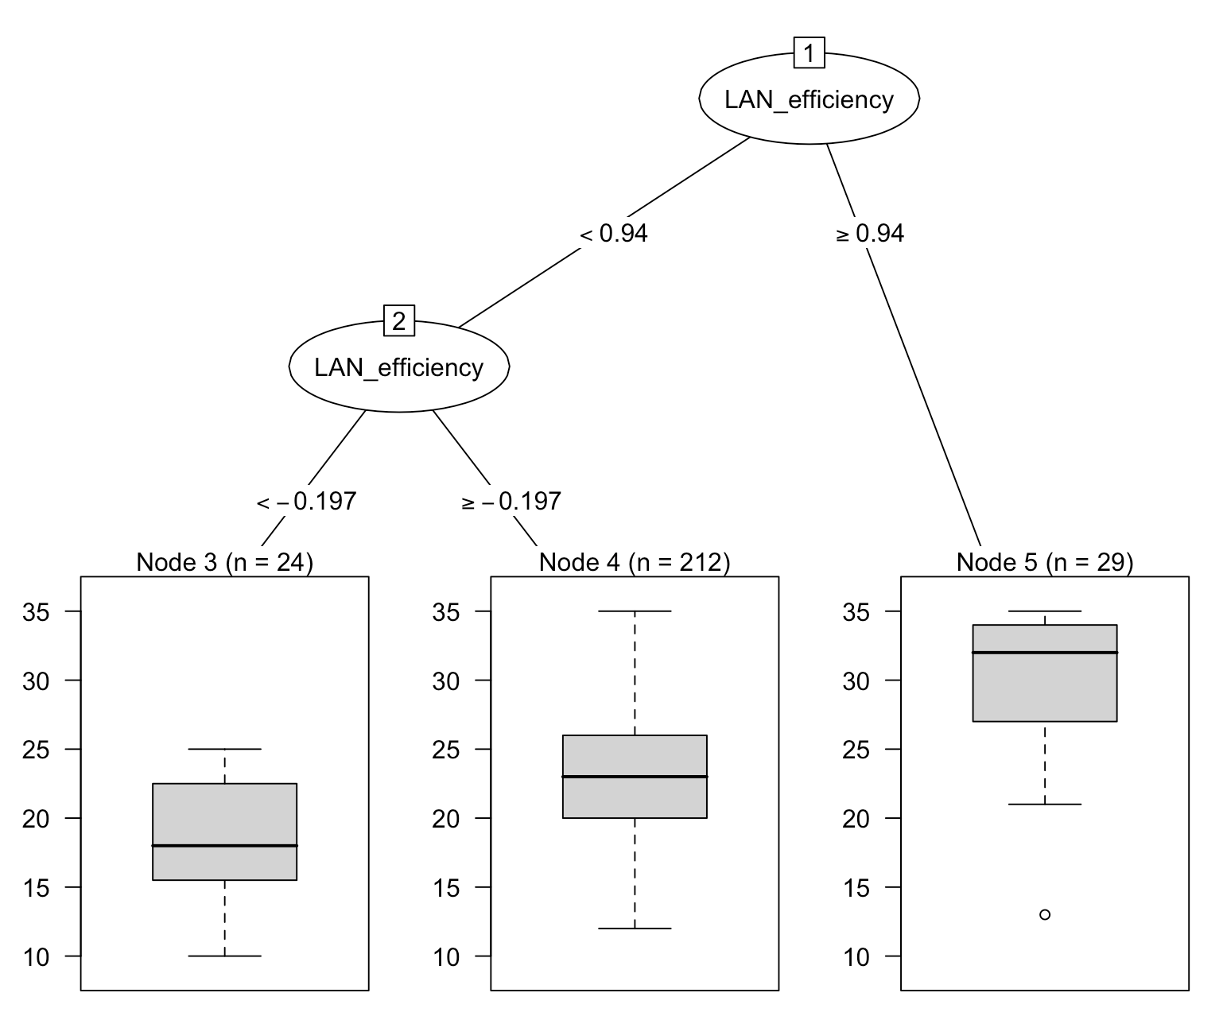
English—Extra time students excluded-larger samples
Avg = 18.54
SD = 3.95
95% CI =
16.96 – 20.12
Avg = 23.12
SD = 4.60
95% CI =
22.50 – 23.74
Avg = 30.41
SD = 5.09
95% CI =
28.56 – 32.27

Slide 3
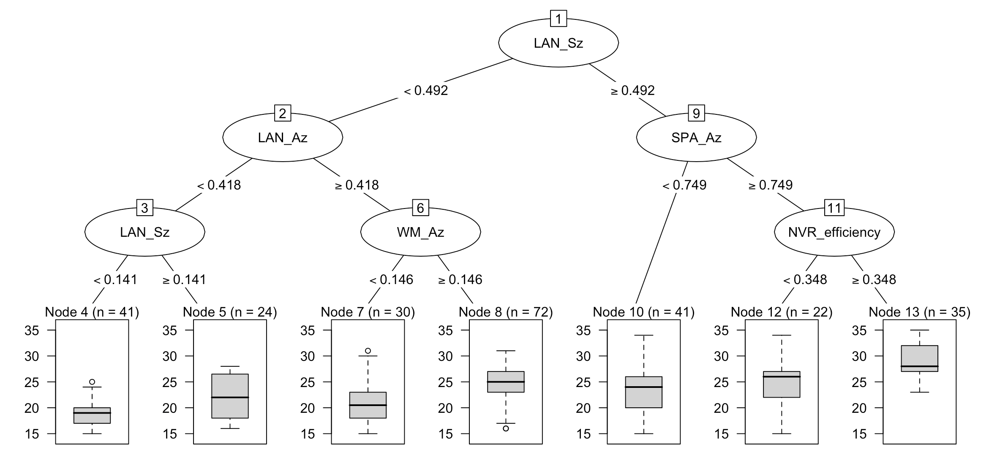
Math—Extra time students excluded-larger samples
Avg = 19.17
SD = 2.74
95% CI =
18.33 - 20.00
Avg = 21.92
SD = 4.17
95% CI =
20.25 – 23.58
Avg = 21.07
SD = 4.18
95% CI =
19.57 – 22.56
Avg = 24.20
SD = 3.33
95% CI =
23.44 – 24.98
Avg = 23.24
SD = 4.06
95% CI =
22 – 24.49
Avg = 25.00
SD = 4.83
95% CI =
22.98 – 27.02
Avg = 28.91
SD = 3.32
95% CI =
27.81 – 30.01

Slide 4
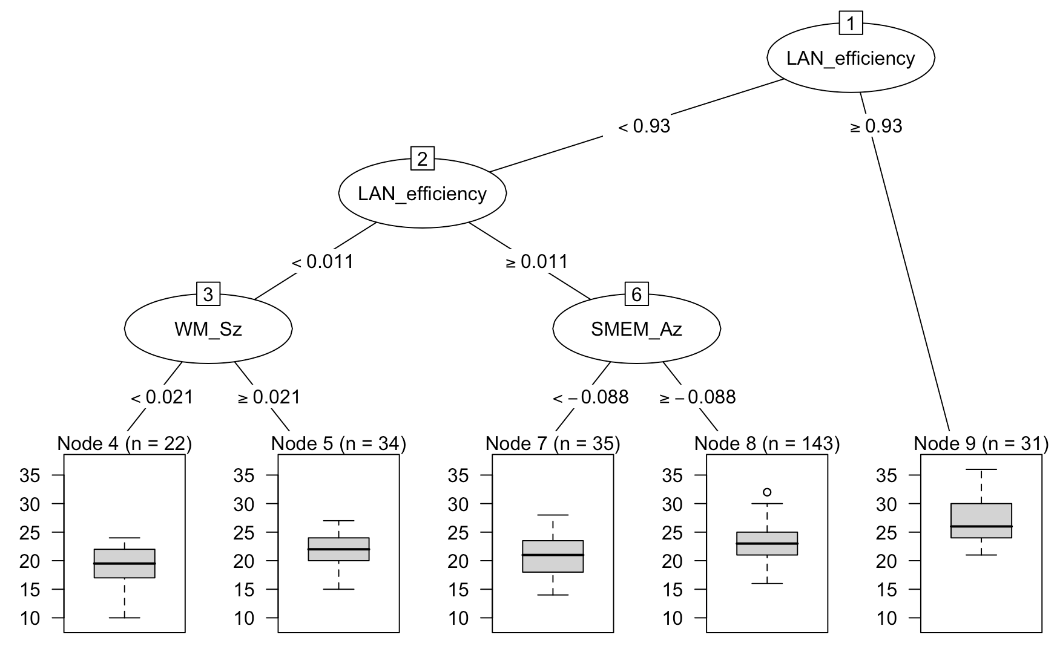
Science—Extra time students excluded-larger samples
Removed SM_Sz
Avg = 18.68
SD = 4.04
95% CI =
16.99 – 20.37
Avg = 21.62
SD = 2.72
95% CI =
20.70 – 22.53
Avg = 20.83
SD = 3.63
95% CI =
19.62 – 22.03
Avg = 22.93
SD = 3.06
95% CI =
22.44 – 23.44
Avg = 27
SD = 3.87
95% CI =
25.64 – 28.36

