Slide 1
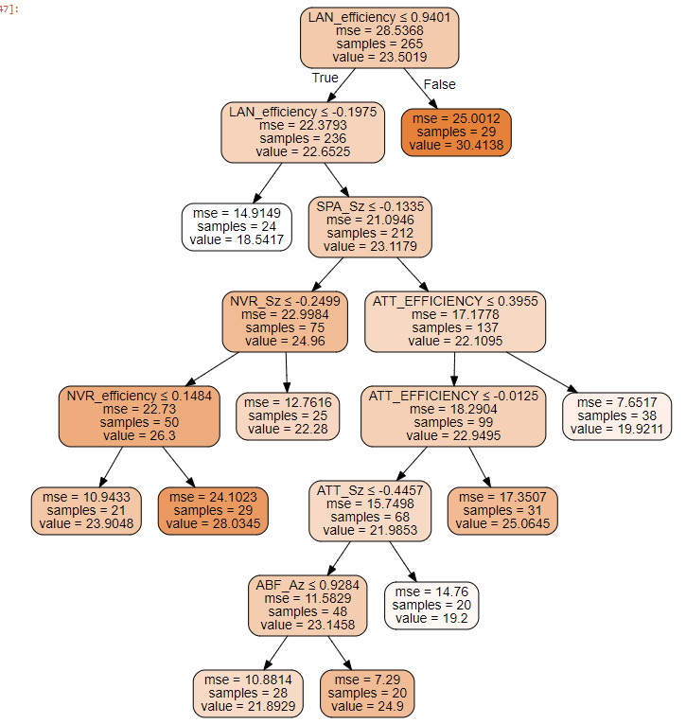
English—Extra time students excluded-larger samples

Slide 2
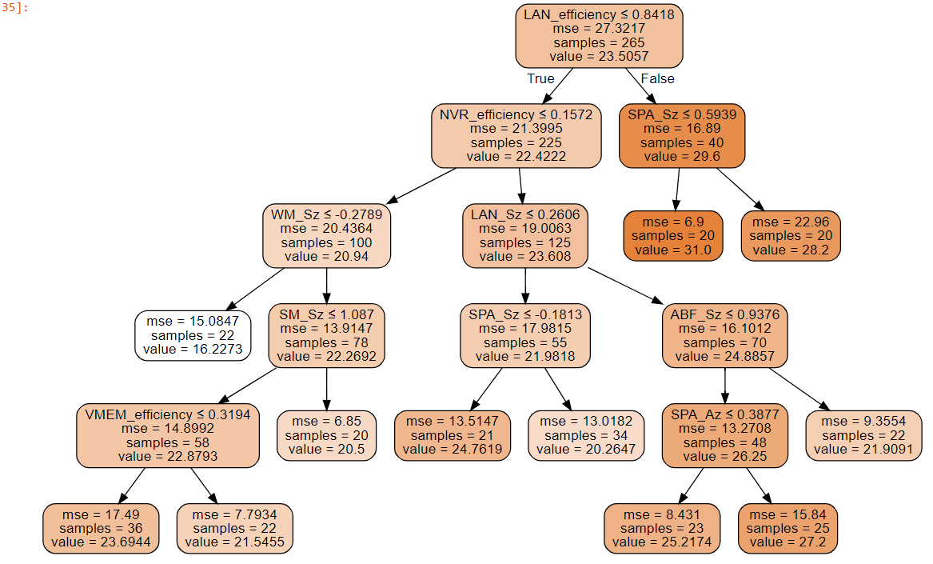
Reading—Extra time students excluded—larger samples

Slide 3
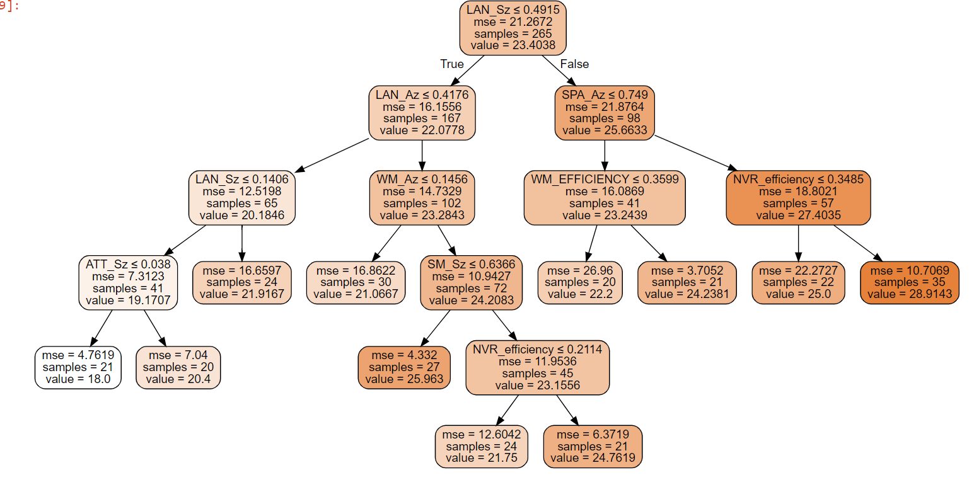
Math—Extra time students excluded—larger samples

Slide 4
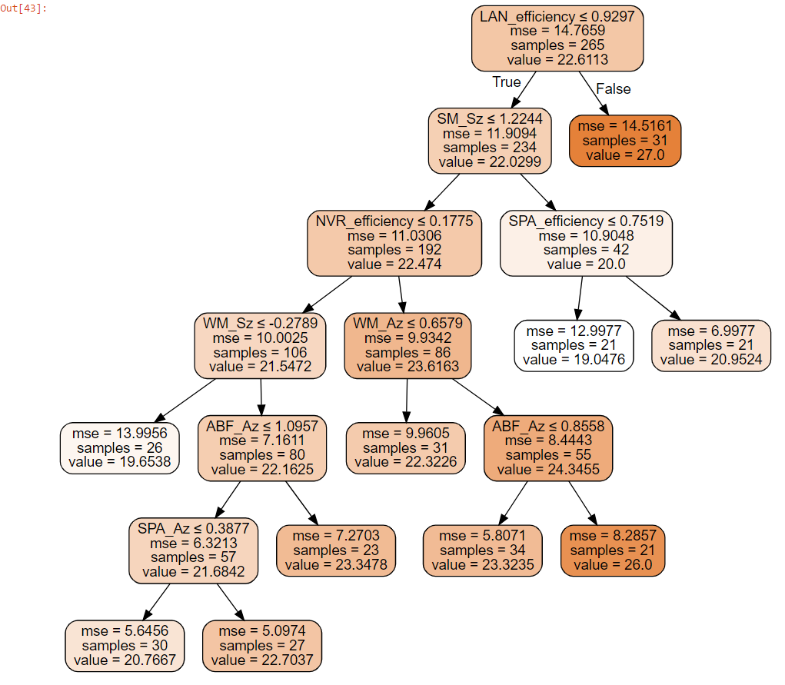
Science—Extra time students excluded—larger samples
This one just makes no sense. I’m inclined to run it without SM and see what we get

Slide 5
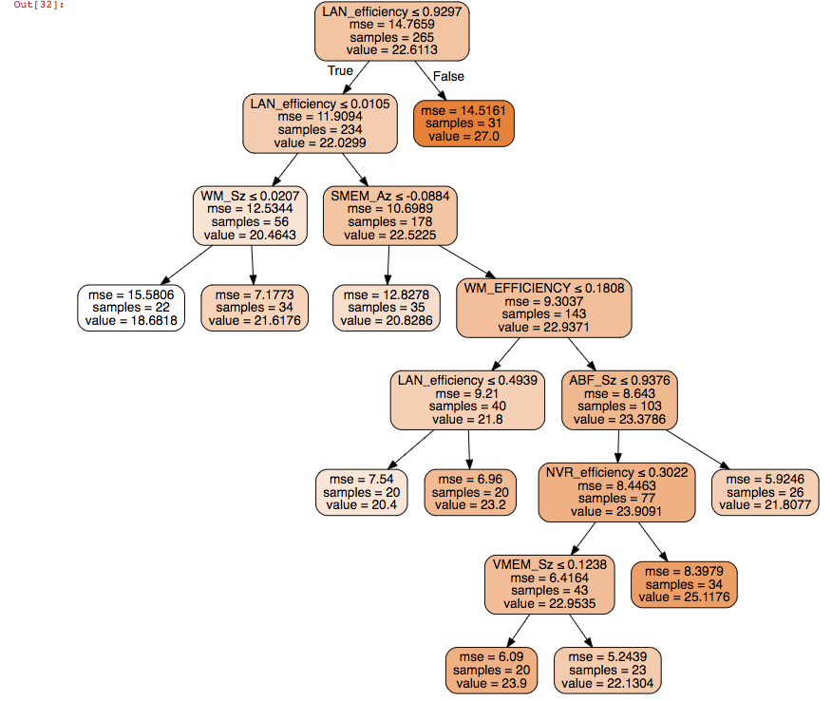
Science—Extra time students excluded—larger samples
Removed SM_Sz

