Slide 1
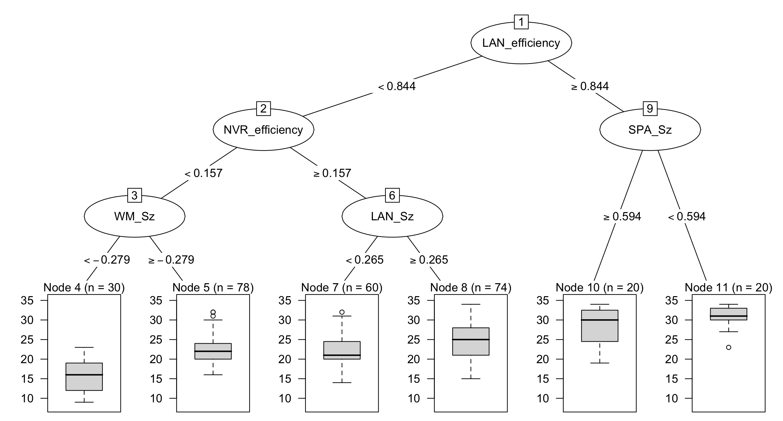
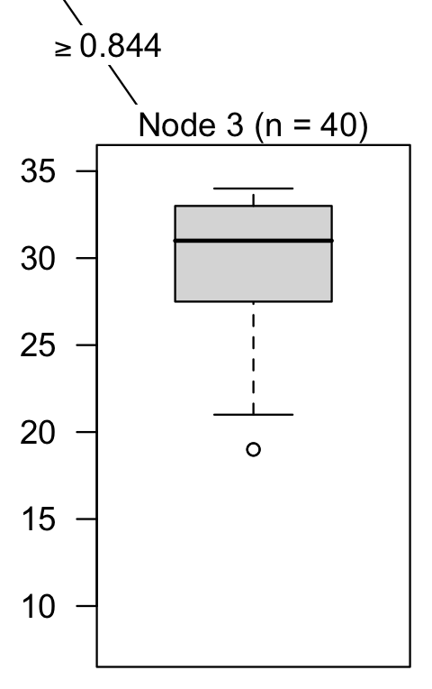
Reading—Extra time students excluded-larger samples
Avg = 30
SD = 4
Outlier = 8144, 8870,
11599
Avg = 16
SD = 4
Avg = 22
SD = 4
Outlier = 512
10062, 10062,
10796 10796
Avg = 22
SD = 4
Outlier = 8106,
8186
Avg = 25
SD = 4

Slide 2
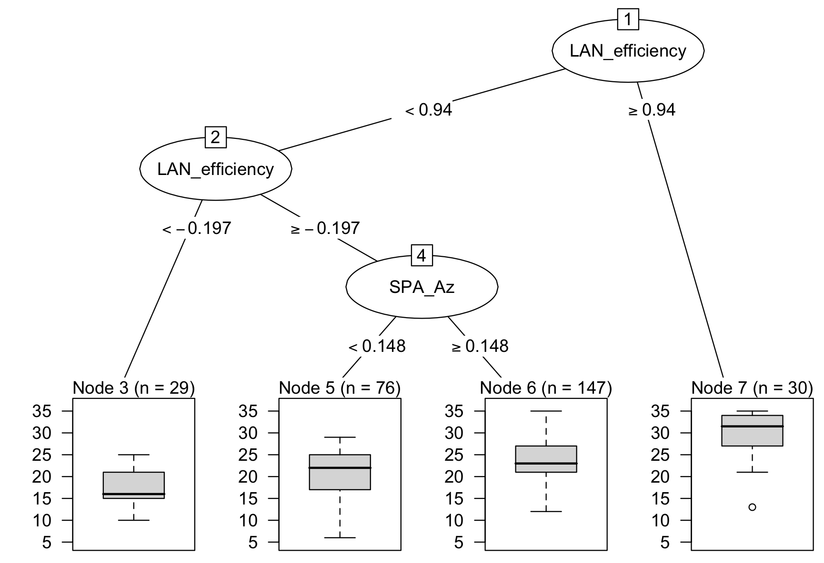
English—Extra time students excluded-larger samples
Avg = 18
SD = 4
Avg = 21
SD = 4
Avg = 24
SD = 5
Avg = 30
SD = 5
Outlier = 8144

Slide 3
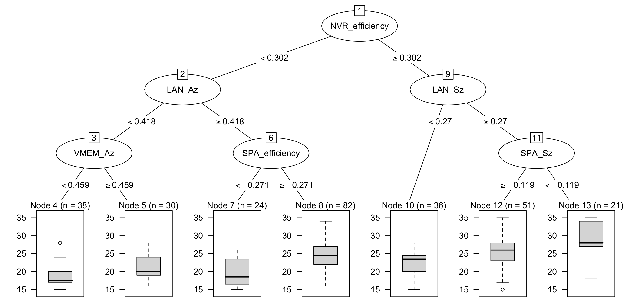
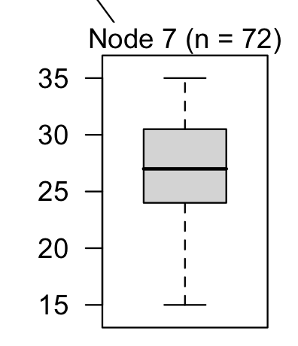
Math—Extra time students excluded-larger samples
Node 11 (n = 72)
Avg = 27
SD = 5
Avg = 19
SD = 3
Math = 6615
Avg = 21
SD = 4
Avg = 20
SD = 4
Avg = 24
SD = 4
Avg = 22
SD = 3

Slide 4
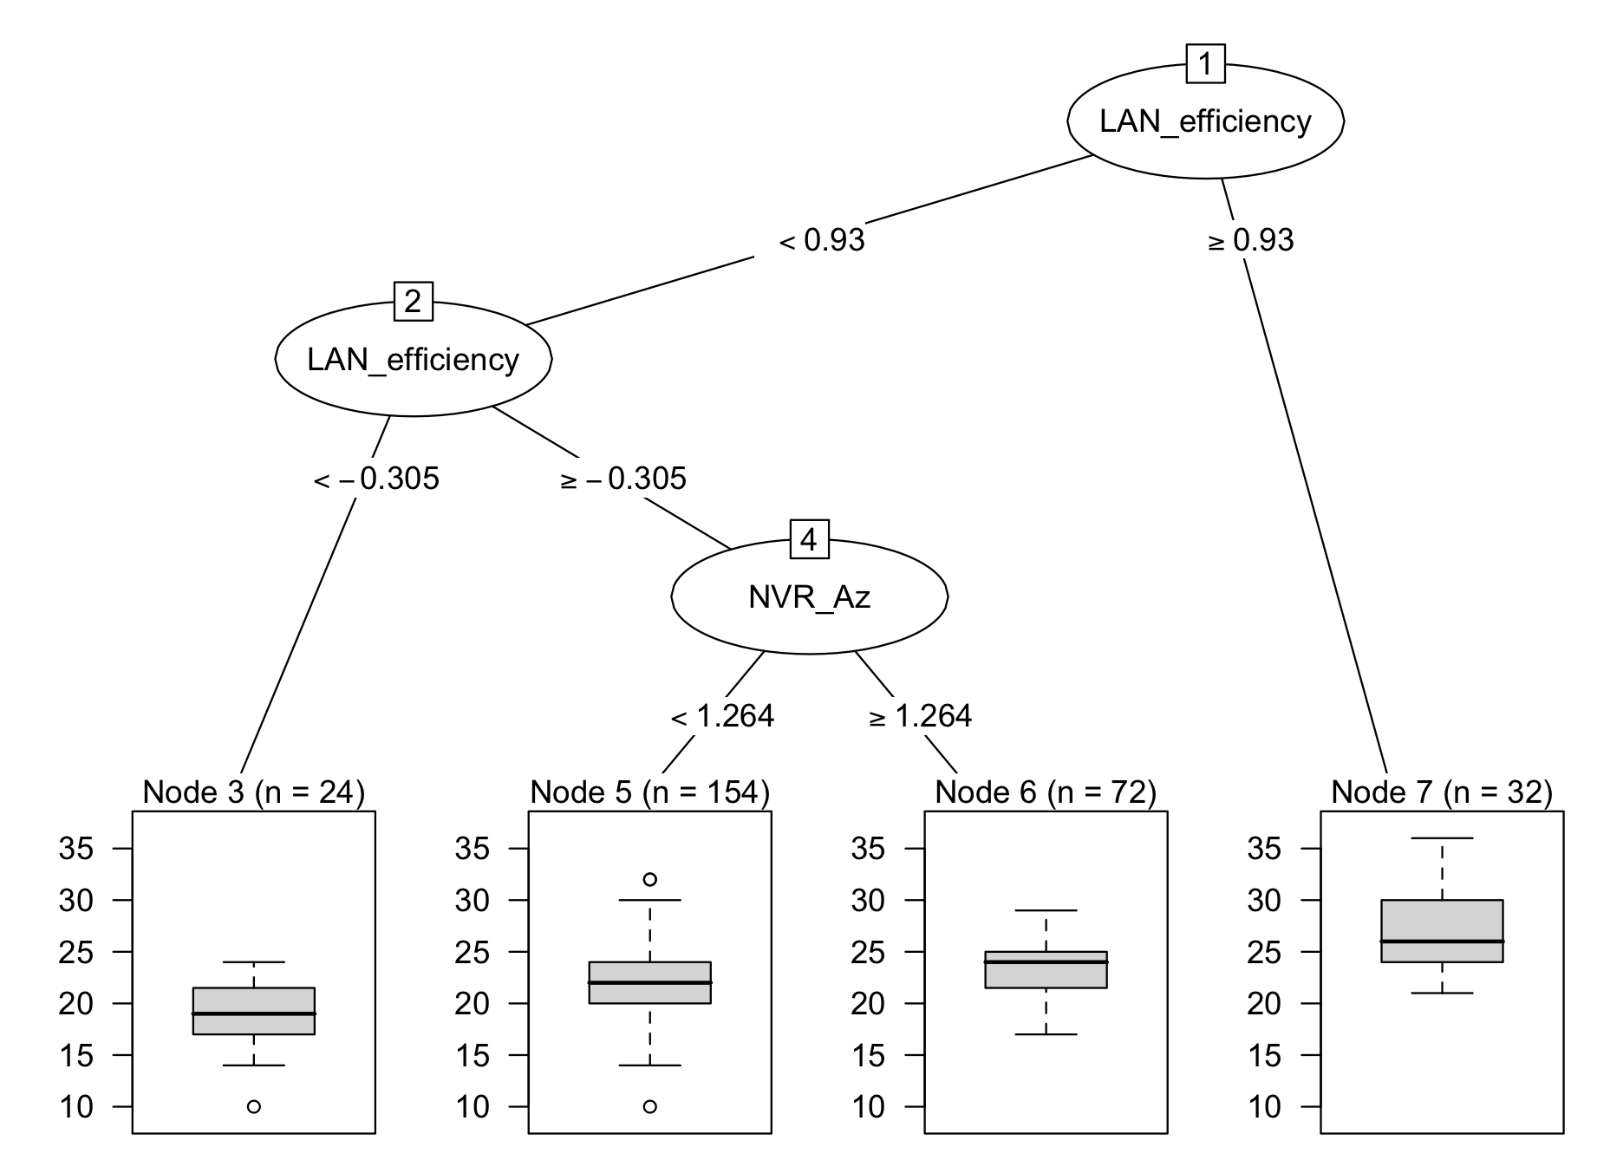
Science—Extra time students excluded-larger samples
Removed SM_Sz
Avg = 19
SD = 3
Outlier = 6970
Avg = 22
SD = 4
Outlier = 6381, 7680,
8356, 6905, 8664
Avg = 23
SD = 3
Avg = 27
SD = 4

