Slide 1
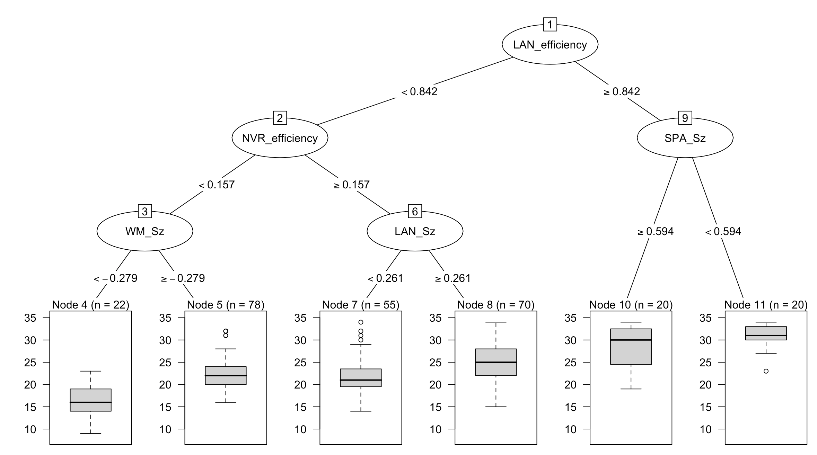
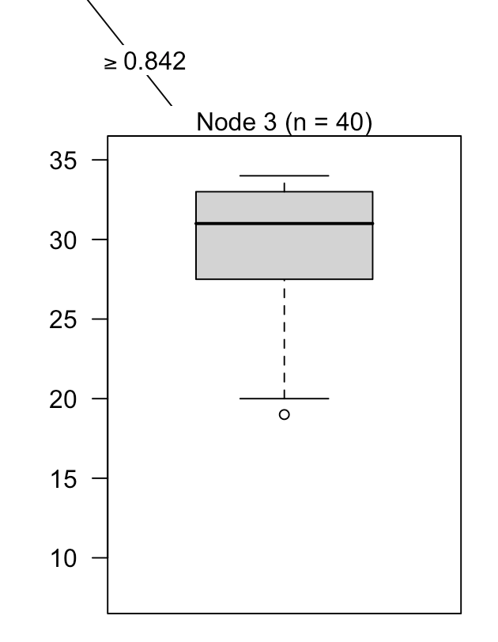
Reading—Extra time students excluded-larger samples
n = 265
11/28/18
Avg = 29.60
SD = 4.16
Avg = 16.23
SD = 3.98
Avg = 22.27
SD = 3.75
Avg = 21.98
SD = 4.28
Avg = 24.89
SD = 4.04

Slide 2
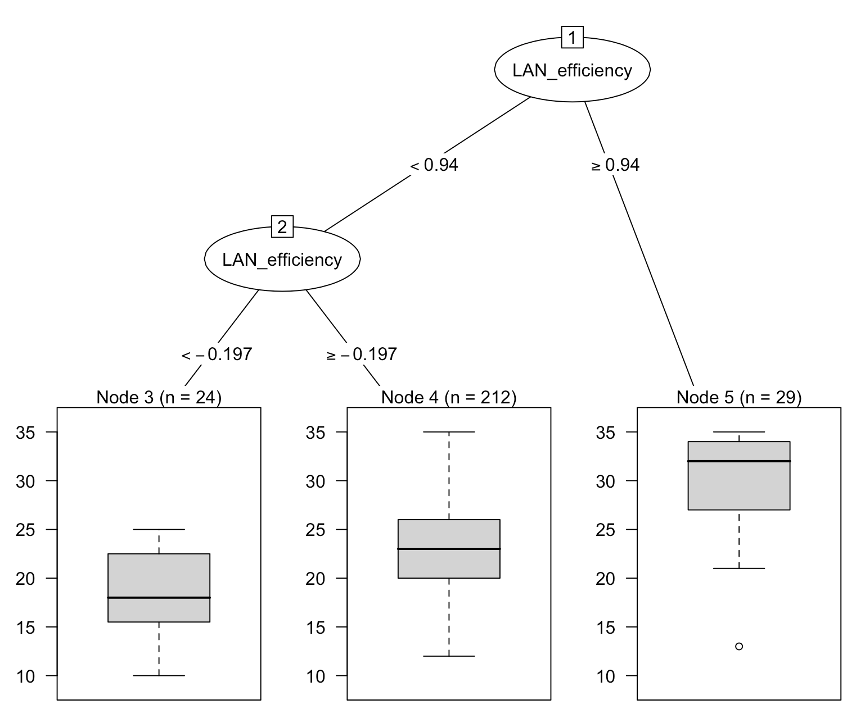
English—Extra time students excluded-larger samples
Avg = 18.54
SD = 3.95
Avg = 23.12
SD = 4.60
Avg = 30.41
SD = 5.09

Slide 3
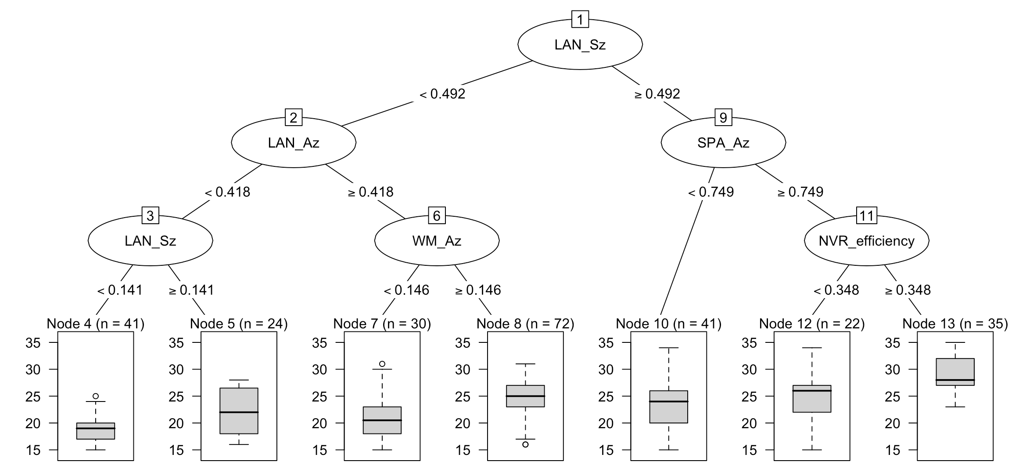
Math—Extra time students excluded-larger samples
Avg = 19.17
SD = 2.74
Avg = 21.92
SD = 4.17
Avg = 21.07
SD = 4.18
Avg = 24.20
SD = 3.33
Avg = 23.24
SD = 4.06
Avg = 25.00
SD = 4.83
Avg = 28.91
SD = 3.32

Slide 4
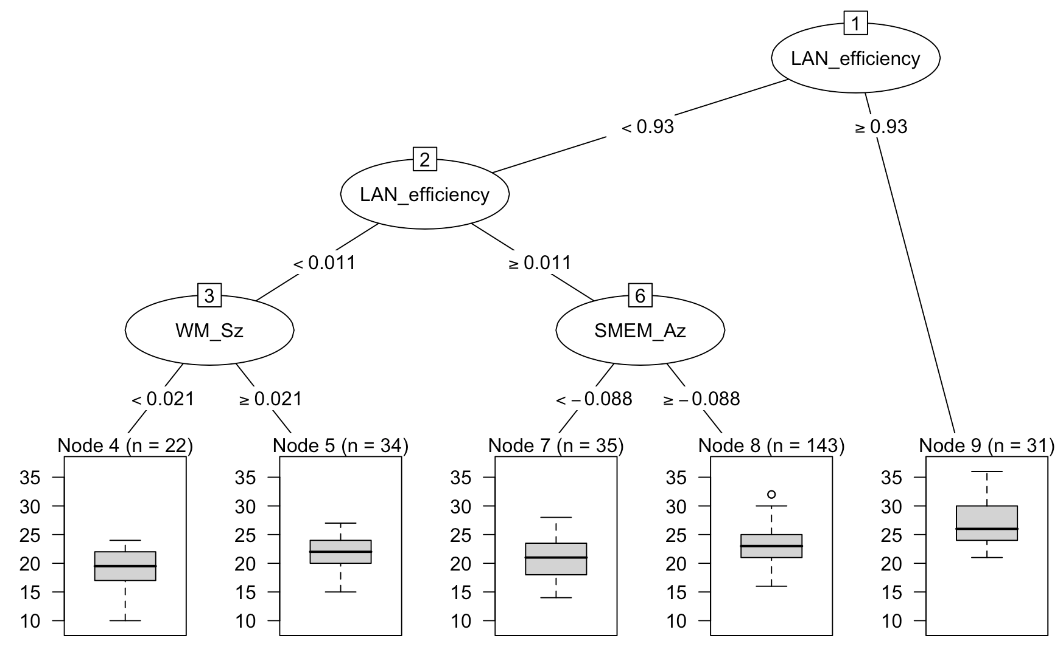
Science—Extra time students excluded-larger samples
Removed SM_Sz
Avg = 18.68
SD = 4.04
Avg = 21.62
SD = 2.72
Avg = 20.83
SD = 3.63
Avg = 22.93
SD = 3.06
Avg = 27
SD = 3.87

