Slide 1
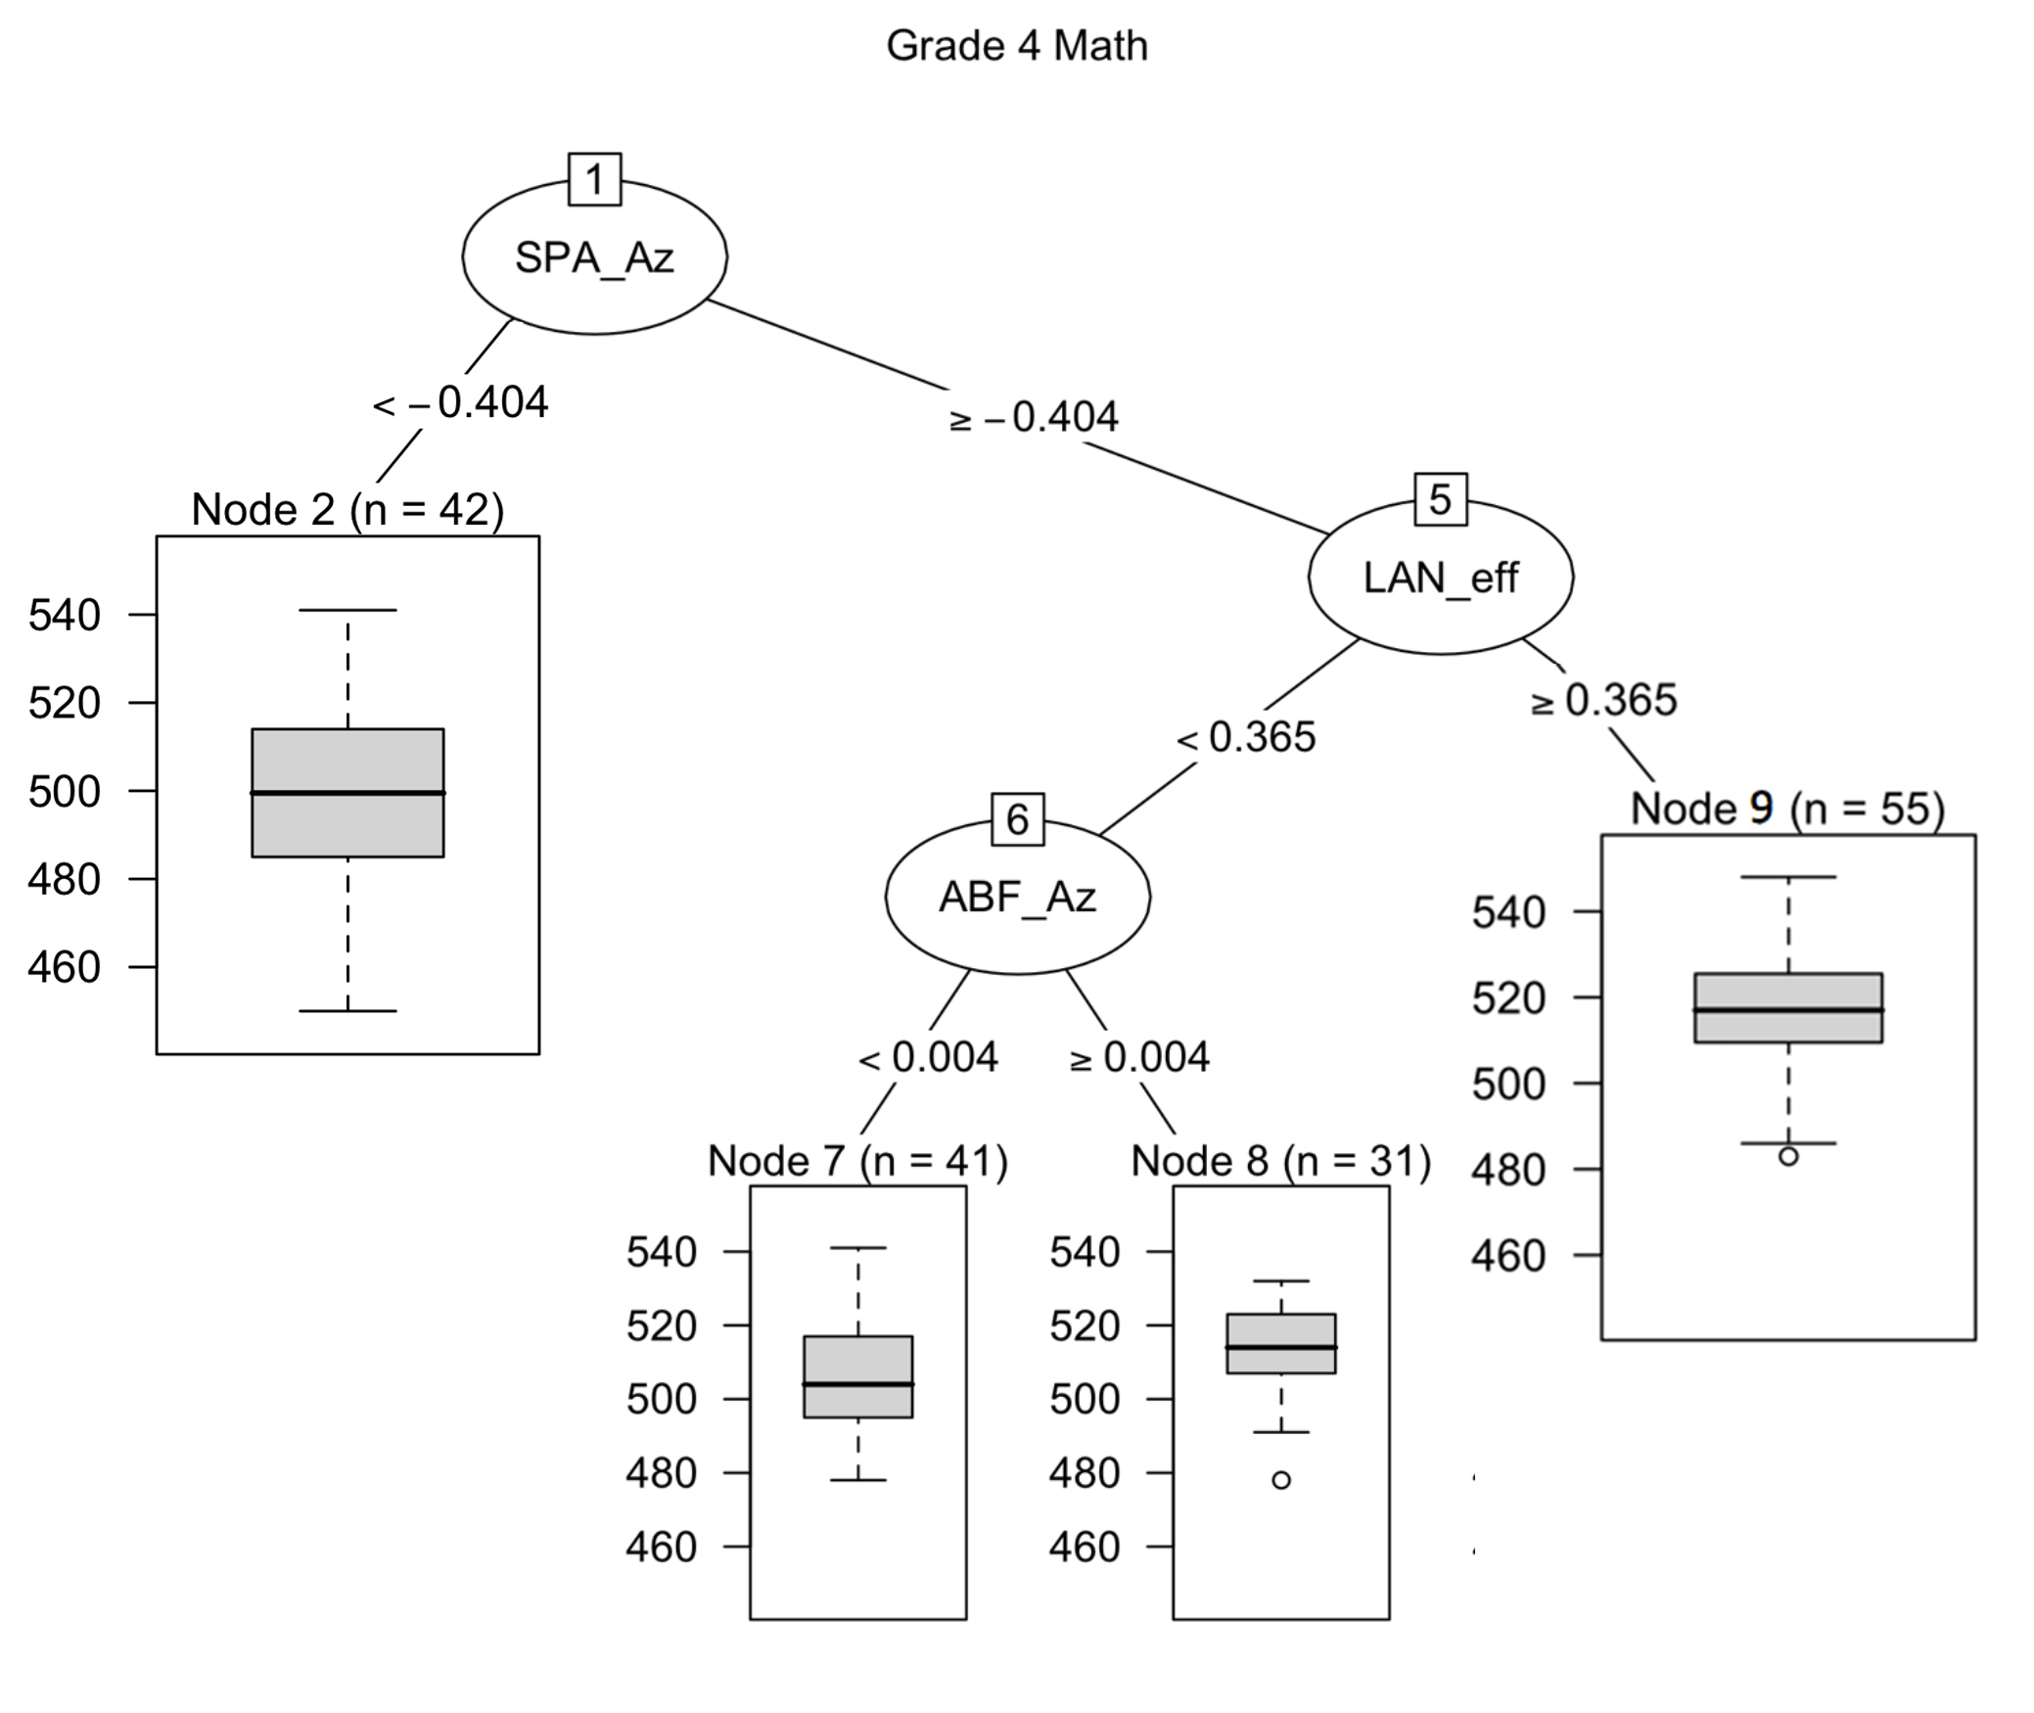
node | sd | mean
2 | 19.11505 | 499.0714
7 | 14.75908 | 505.3415
8 | 12.12125 | 512.5161
9 | 14.43357 | 516.9273

Slide 2
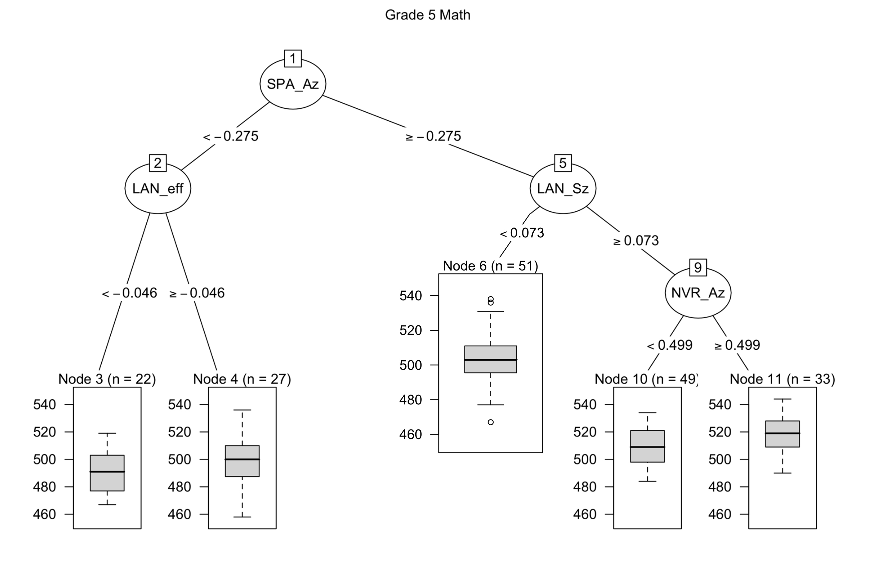
node | sd | mean
3 | 14.7569 | 491.3636
4 | 17.4565 | 499.963
6 | 14.14896 | 504.3529
10 | 13.81692 | 507.7347
11 | 13.01929 | 518.5758

Slide 3
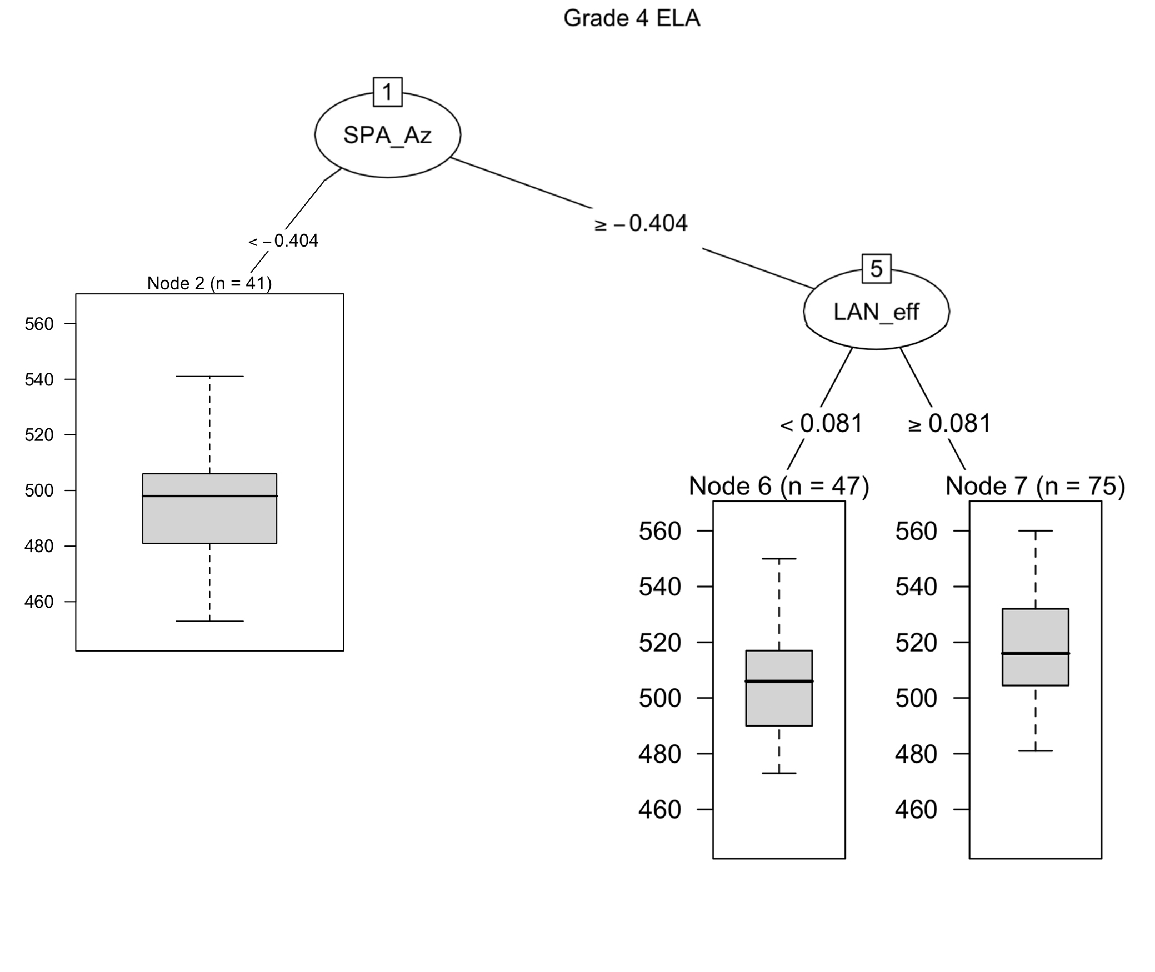
node | sd | mean
2 | 19.37556 | 495.7073
6 | 17.51484 | 504.7234
7 | 18.80265 | 518.9733

Slide 4
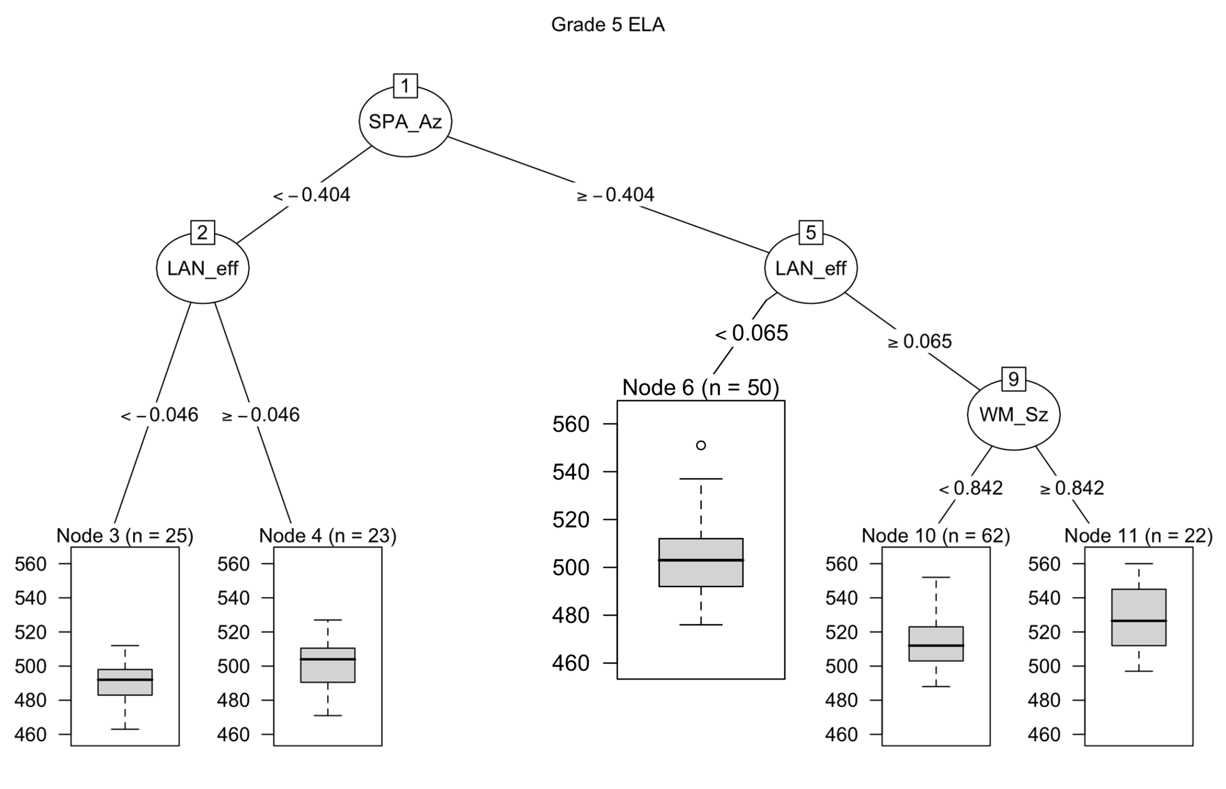
node | sd | mean
3 | 12.57802 | 490.96
4 | 14.22865 | 501
6 | 16.30111 | 503.78
10 | 15.50504 | 512.7097
11 | 19.25861 | 528.6818

