Slide 1
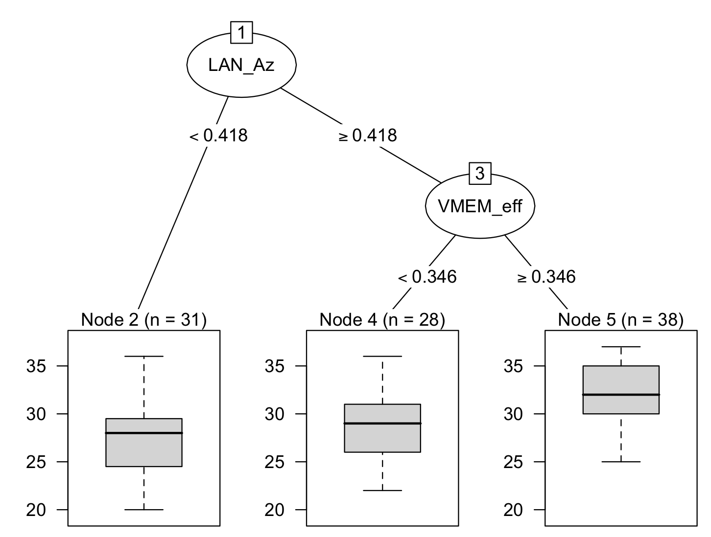
Reading—Extra time students excluded-larger samples
Avg = 27
SD = 4
Avg = 29
SD = 4
Avg = 32
SD = 3

Slide 2
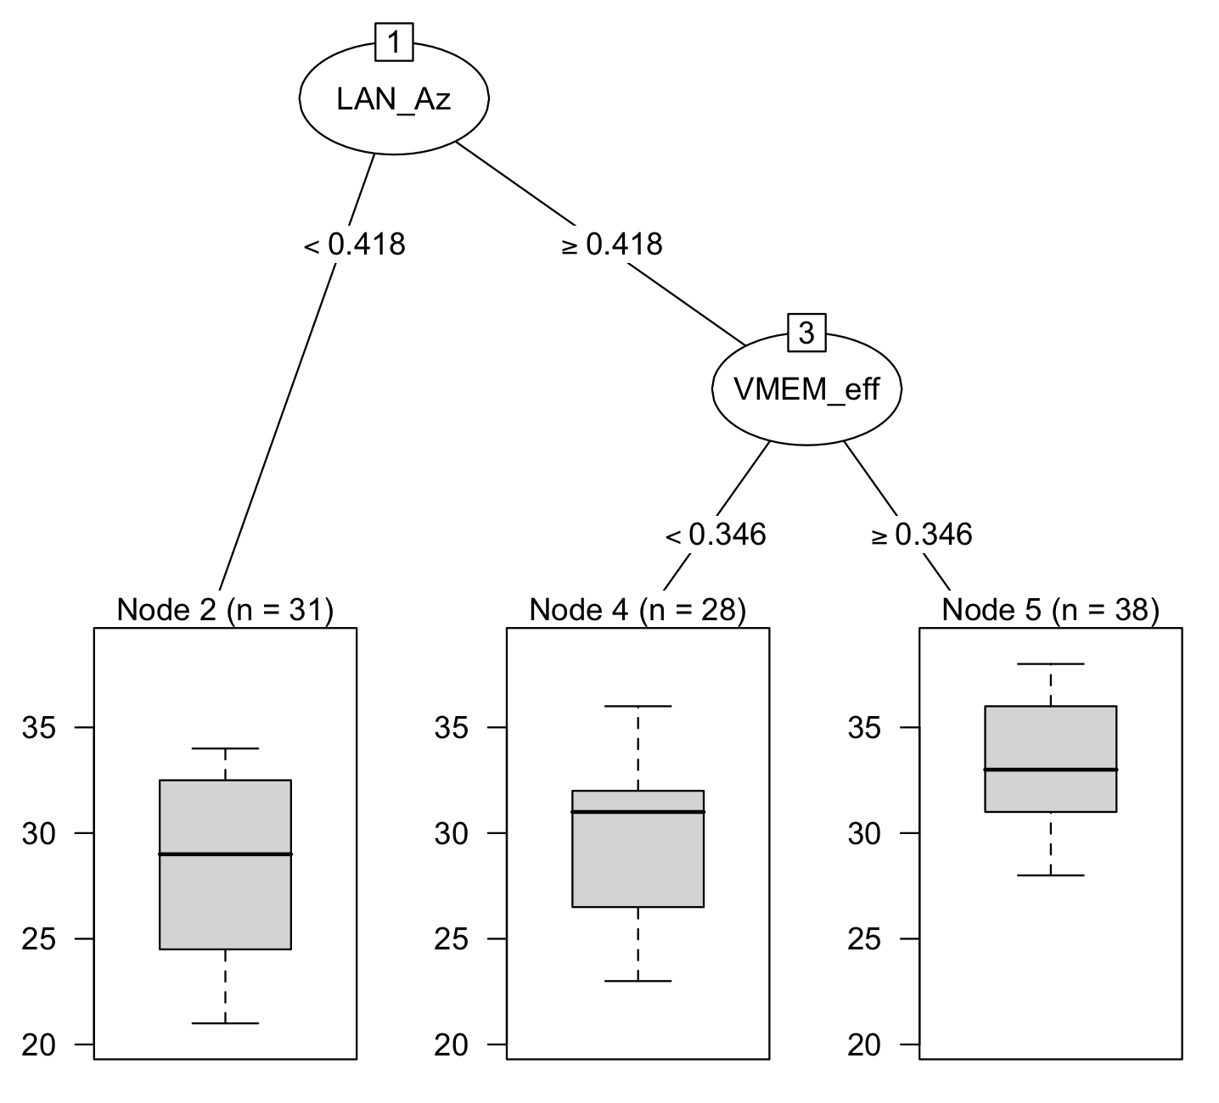
Writing—Extra time students excluded-larger samples
Avg = 27
SD = 4
Avg = 29
SD = 4
Avg = 32
SD = 3

Slide 3
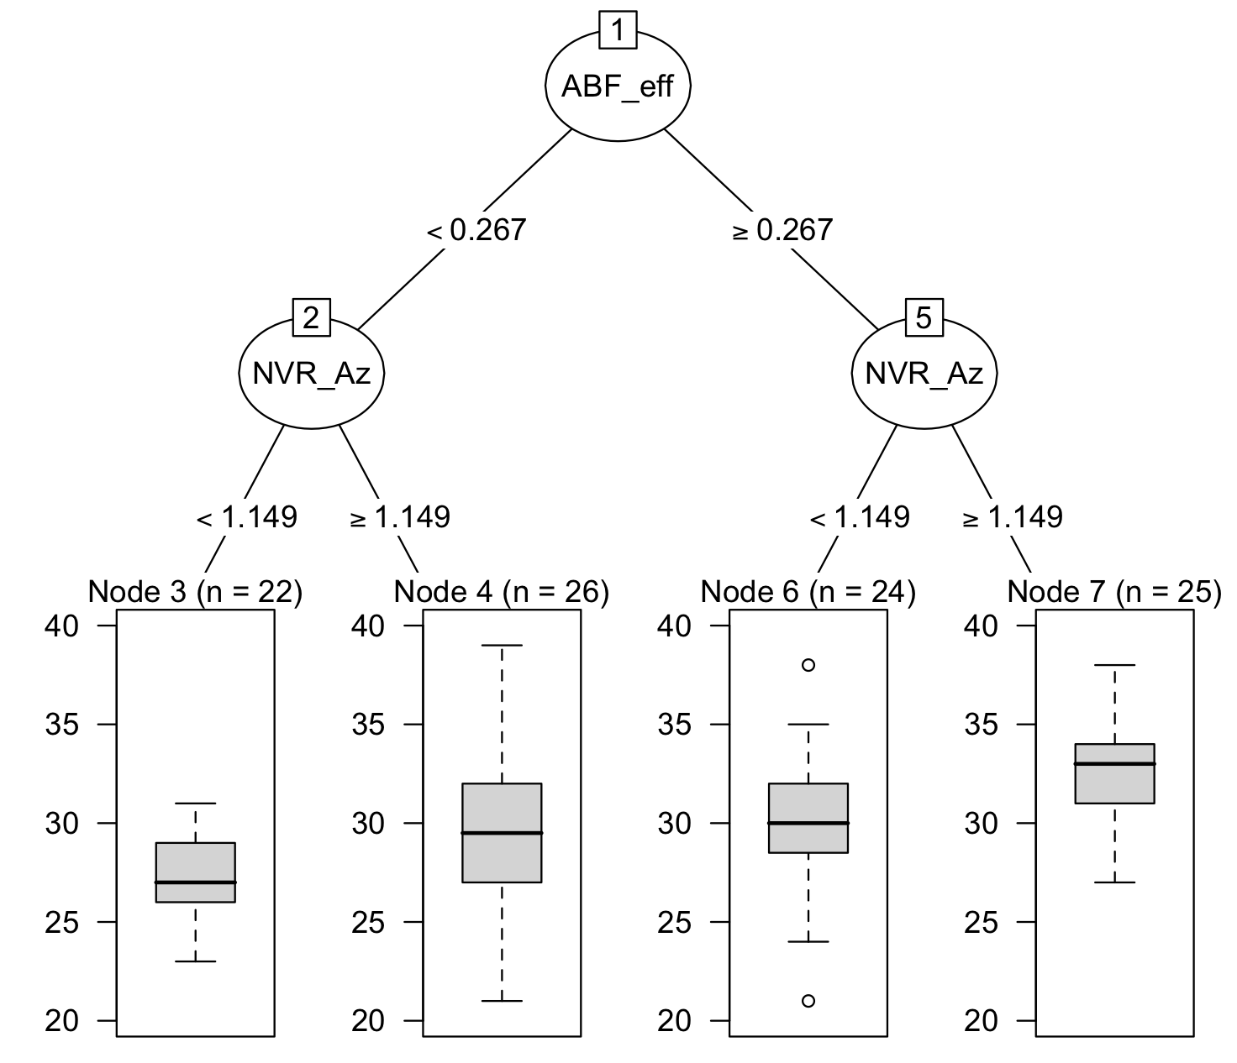
Math—Extra time students excluded-larger samples
Avg = 27
SD = 2
Avg = 30
SD = 4
Avg = 30
SD = 4
Avg = 33
SD = 3

