Slide 1
1
Udemy courses descriptive analysis
Data Analytics Course
Fateme Zahra Alinejad
810100420

Slide 2
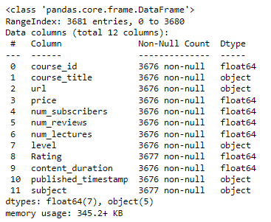
Overview of data
2
Subjects:
Business Finance
Graphic Design
Musical Instruments
Web Developement
Levels:
All Levels
Beginner Level
Intermediate Level
Expert Level

Slide 3
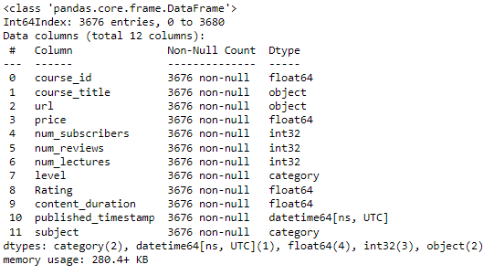
Data Cleaning
3
Removing Null values
Changing the name of one of the subjects from ‘subject: web development’ to ‘web development’
Changing types of Columns
Dropping duplicated rows

Slide 4
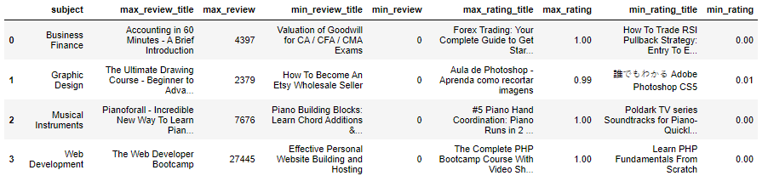
Highest & lowest reviews & ratings per subjects
4

Slide 5
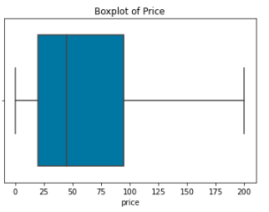
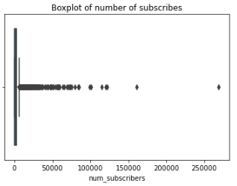
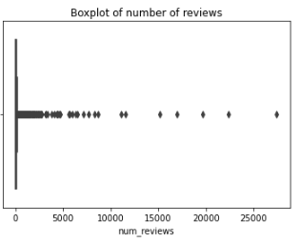
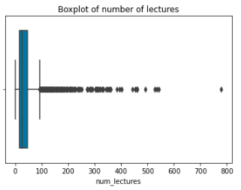
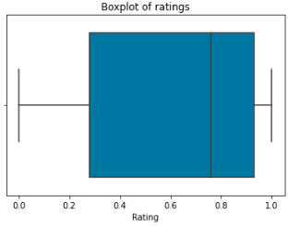
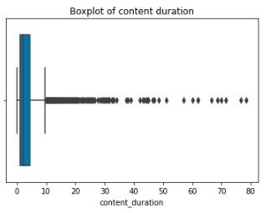
Detecting Outliers
5

Slide 6
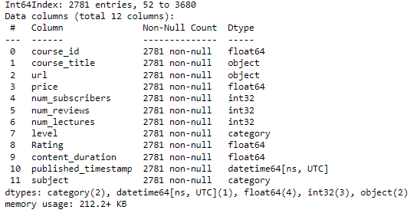
Removing Outliers
6

Slide 7
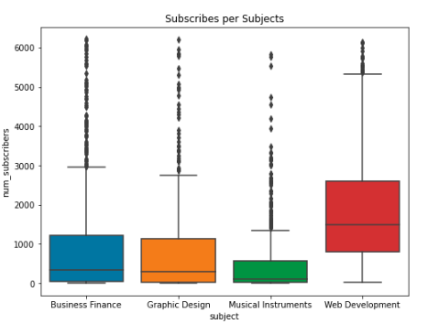
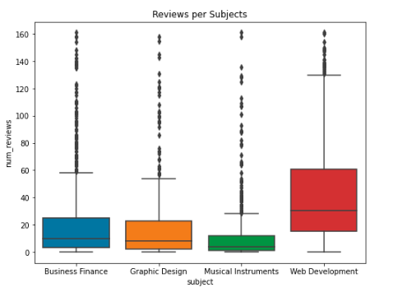
Subscribes and reviews per subjects
7

Slide 8
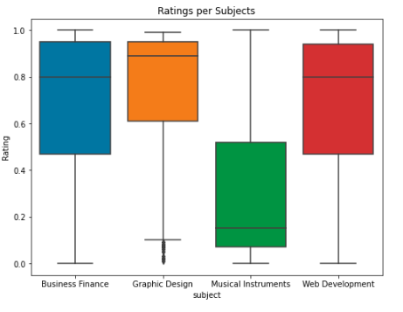
Ratings per subjects
8

Slide 9
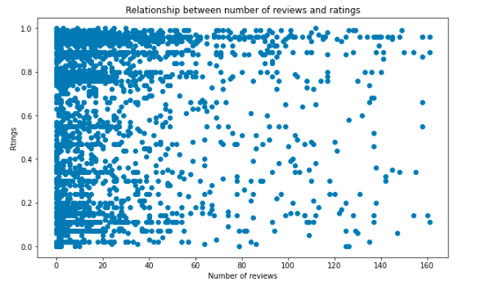
Relationship between number of reviews and ratings
9

Slide 10
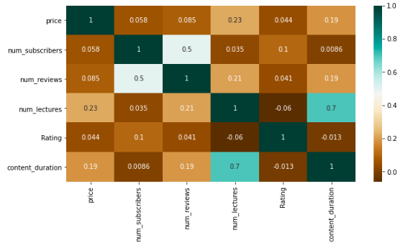
Correlation between numerical columns
10

Slide 11
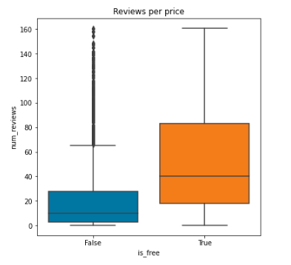
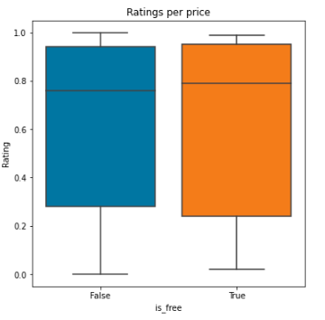
Ratings & Number of reviews per free or paid courses
11

Slide 12
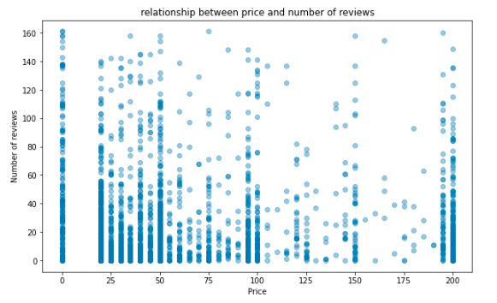
Relationship between price and number of reviews
12

Slide 13
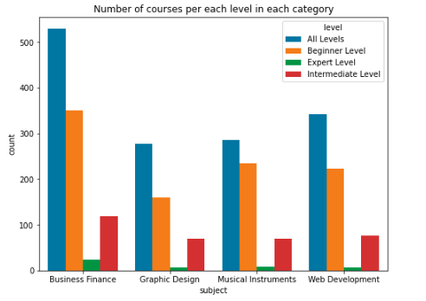
Number of courses per each level in each category
13

Slide 14
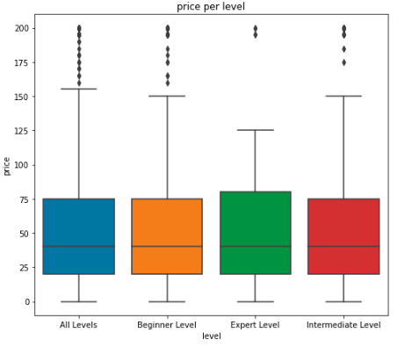
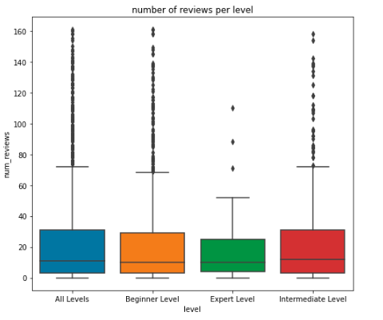
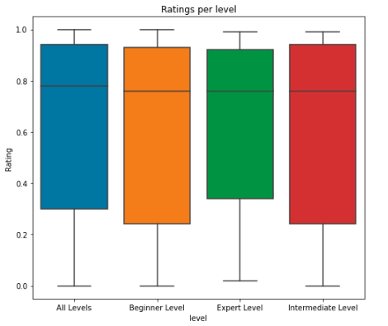
Price, num of reviews and ratings per levels
14

Slide 15
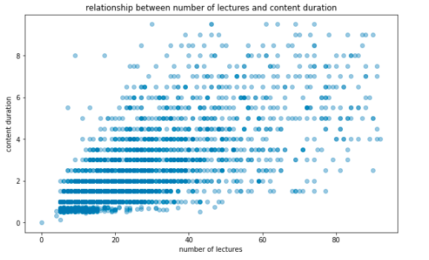
Relationship between number of lectures and content duration
15

Slide 16
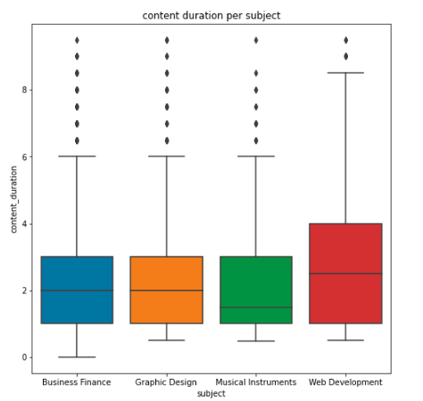
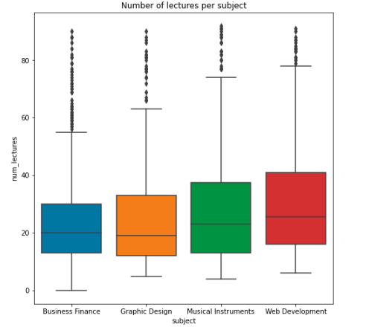
Content duration and number of lectures per subjects
16

Slide 17
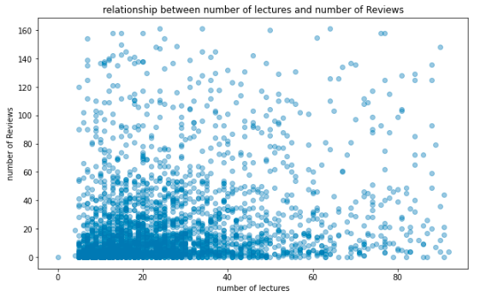
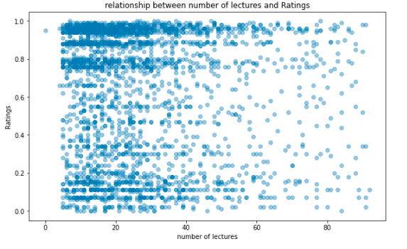
Relationship between number of lectures and number of reviews/ratings
17

Slide 18
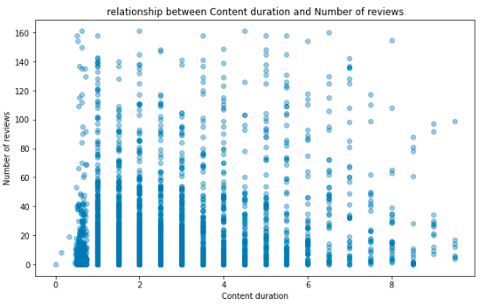
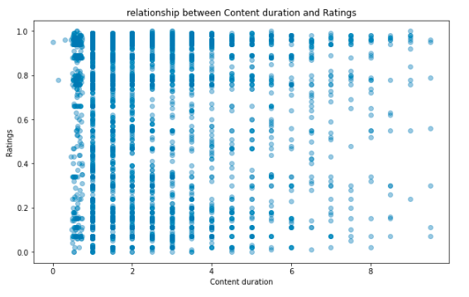
Relationship between content duration and number of reviews/ratings
18

Slide 19
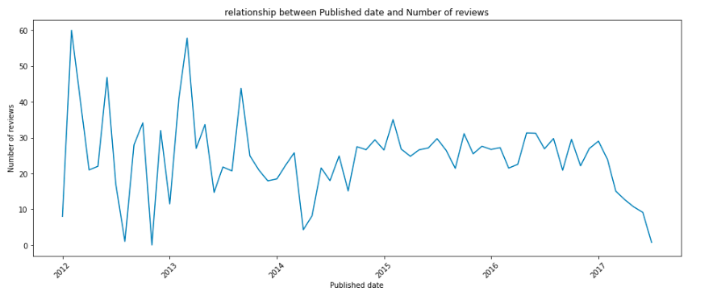
Relationship between Published date & number of reviews
19

