Slide 1
ExtJS: An Introduction (and then some!)
Frank W. Zammetti

Slide 2








The Obligatory Ego Stroke Slide
Lead architect/developer/team lead for BNY Mellon
Author of 8 books on web dev and mobile topics, a number of articles on various topics in various publications
Contributor and founder of a number of open-source projects including Struts, DataVision, Java Web Parts, PocketFrog, PocketHobbit, Apache Commons, DWR etc.
Professional developer for almost 25 years, developer in general for right around 35

Slide 3
So, What Is This ExtJS Thing?!
How do you pronounce it?! I dunno!
A little hard to classify (even Sencha, who created it, doesn’t seem to be sure!)
Has components of a framework, library and toolkit
Largely depends on how you use it
Let’s go with platform!
Bottom line: ExtJS enables the creation of very rich HTML5-based applications that are cross-platform (even including mobile if you want) that look, feel and function like a native app

Slide 4

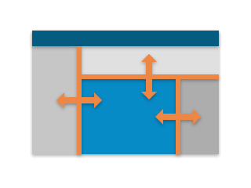

The Pieces Make The Whole
A world-class collection of widgets (components) covering virtually every possible need
A layout manager that provides powerful, flexible, responsive, cross-browser layouts with little dev effort
A data package that decouples the model from the view and consumes data from any provider

Slide 5



The Pieces Make The Whole
Powerful chart generation capabilities built right on top of the data package
Multiple out-of-the-box themes and an “easily” customizable theme engine
Accessibility package provides ARIA support for section 508 compliance

Slide 6
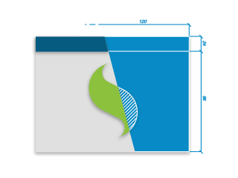
The Pieces Make The Whole
A variety of (completely optional) application templates provide consistency and coherence in application architecture

Slide 7
The Pieces Make The Whole
Sencha CMD: a custom command-line tool
IDE plugins for multiple environments
Sencha Architect
Sencha Inspector
Some of the best documentation in the industry
A highly evolved object-oriented API

Slide 8
Licensing And Cost
Available commercially, though it ain’t cheap ($4,475 on the LOW end?!) - but at least it includes support
Licensed per-developer, but no limitation on actual usage (i.e., number of apps, deployments, etc.)
Also a GPL v3 option, if you’re cool with that license (but they don’t make it easy to find)
You can’t start with GPL and then go commercial?!

Slide 9
Waaaaah, enough boring words, I want some code! So be it: Fisher Price’s My First ExtJS Example™

Slide 10
jQuery? What’s jQuery? (an example of ExtJS being just another library of utilities)

Slide 11
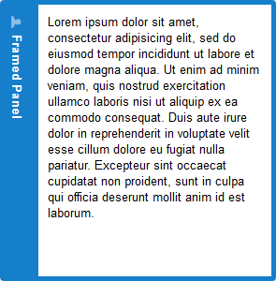
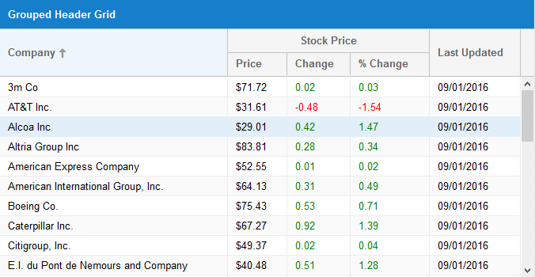
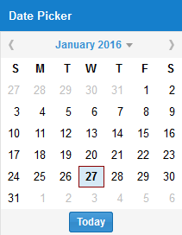
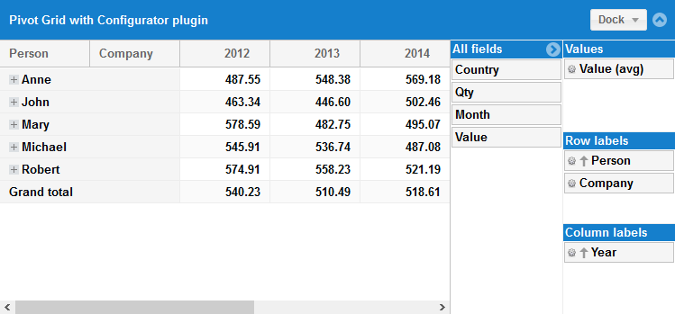

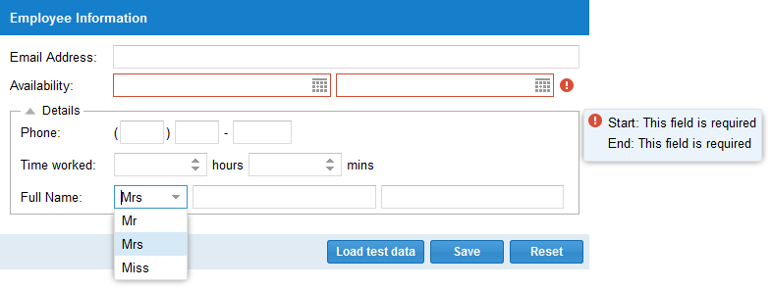
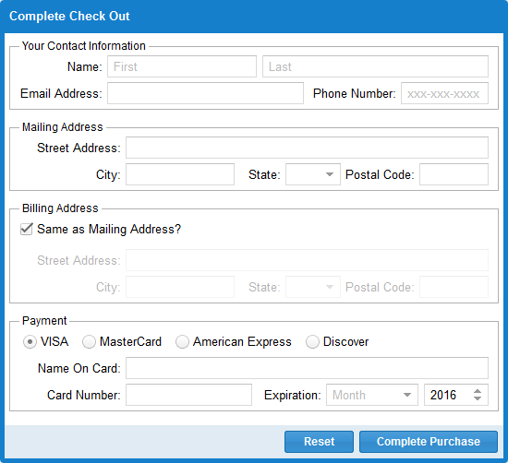
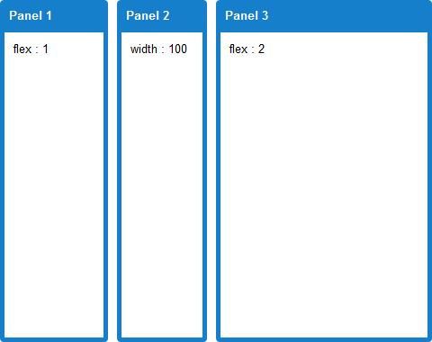

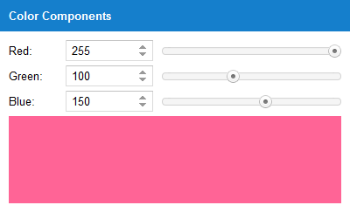
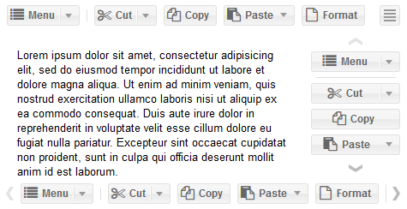
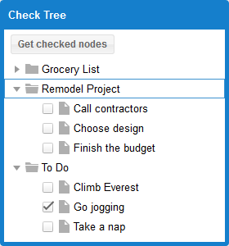
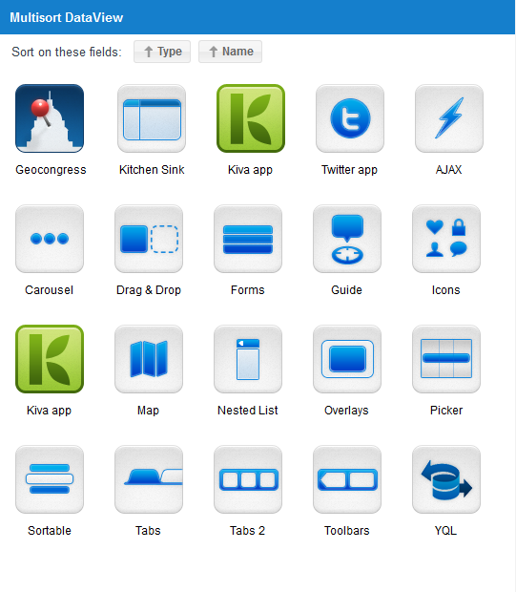
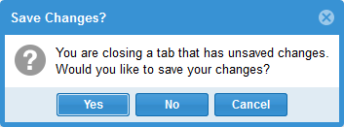
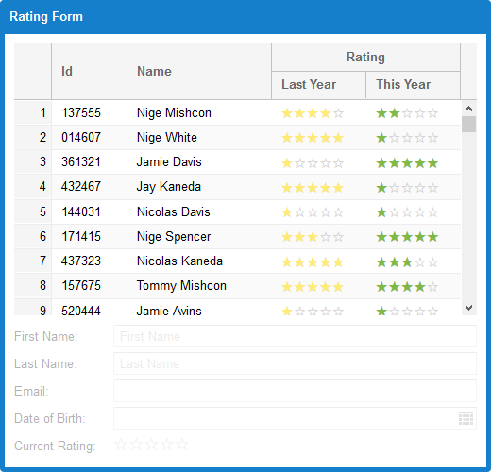
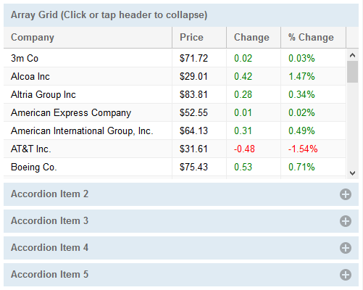
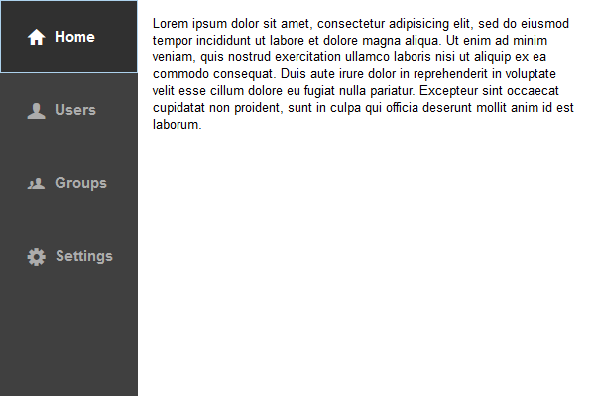
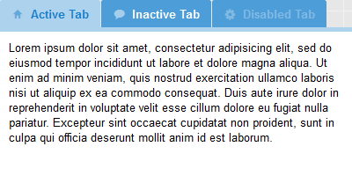
Widgets

Slide 12
Widgets
Highly object-oriented brings great consistency
Very powerful without writing much “code”
Relatively easy to customize as needed
Cross-browser (even cross-mobility) and pretty good about supporting older browsers (IE8 in standards mode only, Safari 6, pretty much any version of FF, Chrome or Opera)
Two “toolkits”: classic (desktop) and modern (mobile)

Slide 13
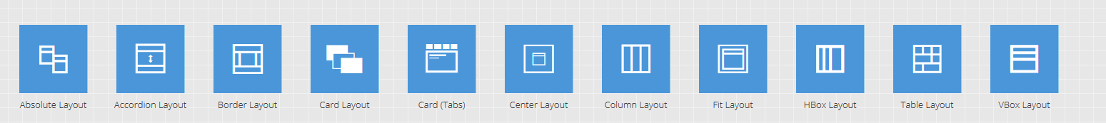
Layouts Bring The Power
Just inserting bits and pieces of ExtJS into an existing app is all well and good…
…but really embracing ExtJS means using layouts, one of the key elements of what makes ExtJS so powerful.

Slide 14
Example, round 2: A “proper” ExtJS UI

Slide 15
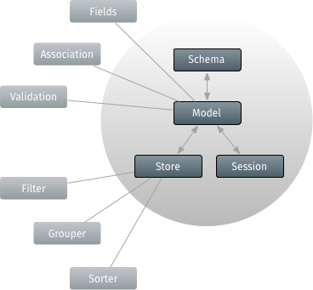
Let’s Talk Data
Stores contain Records
Records are instances of Models and represents entities in your application. They contain fields and optionally validators.
When Records have relationships to one another they form a Schema (and this is when Sessions can come into play)
Stores can perform operations on Records including filtering, grouping, sorting and searching
Proxies deal with loading Records into a Store, whether from a local source or a remote source

Slide 16
A 3rd example: Data in action

Slide 17
Charts
A package that includes a hierarchy of classes for data visualization functionality
Not included with ExtJS by default
Three types of charts:
Cartesian (Bar, Area, Scatter, Line)
Polar (Pie, Radial)
Spacefilling
A Chart component manages axes, series, interactions and legends
Charts are backed by Stores and are created like any other component

Slide 18
Fourth time’s a charm: Pretty, pretty charts

Slide 19
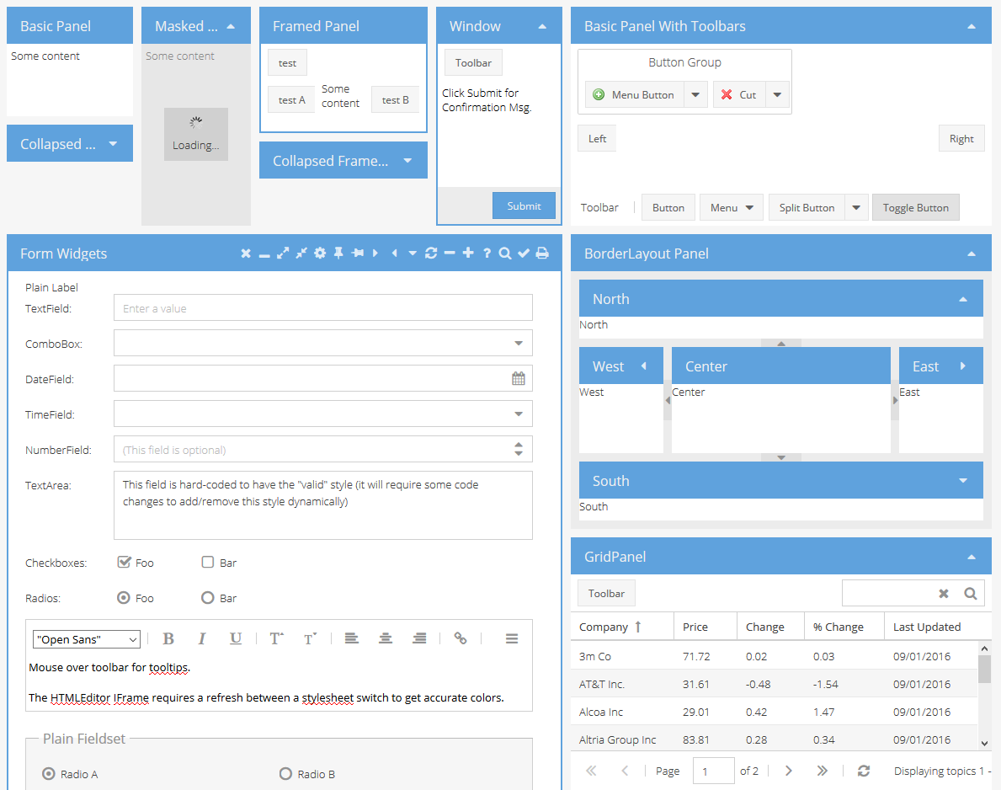
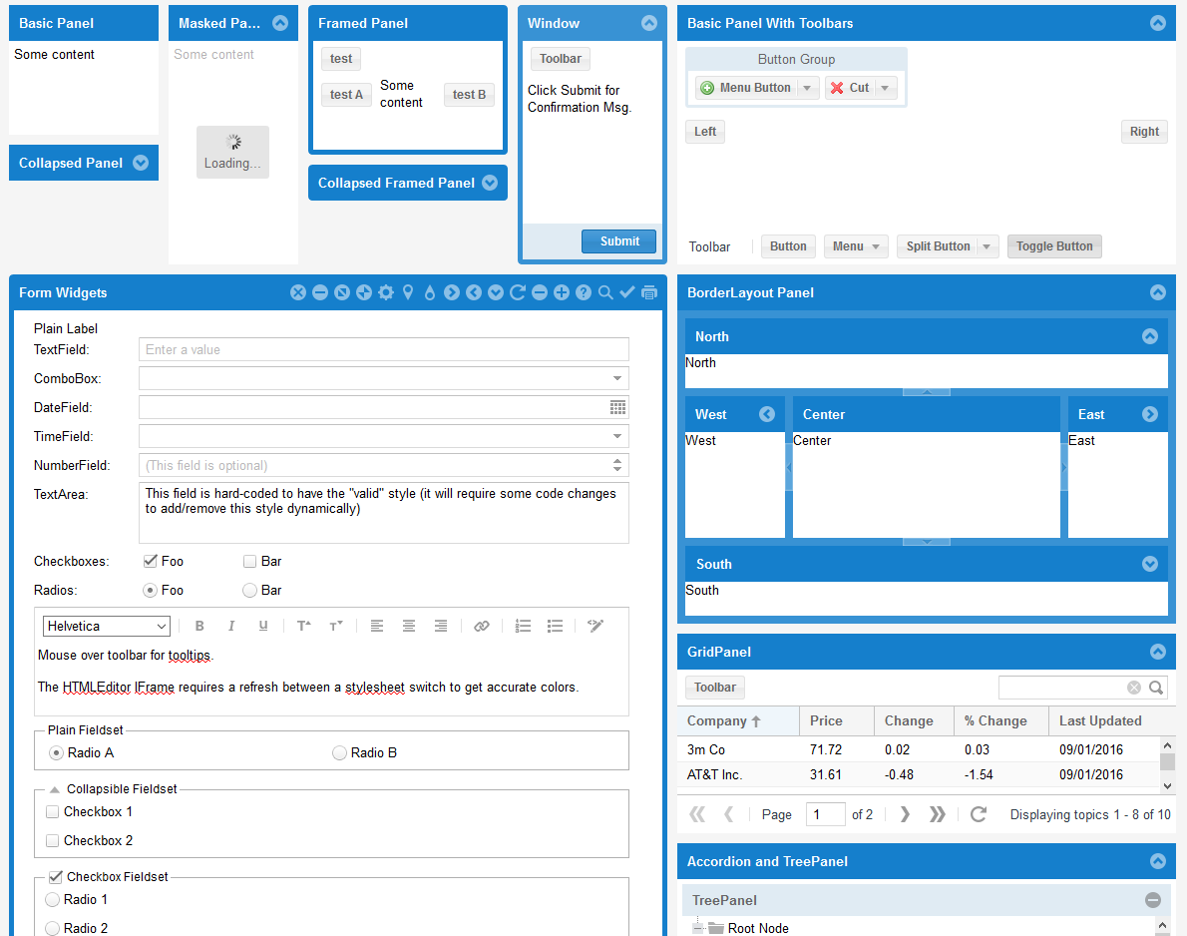
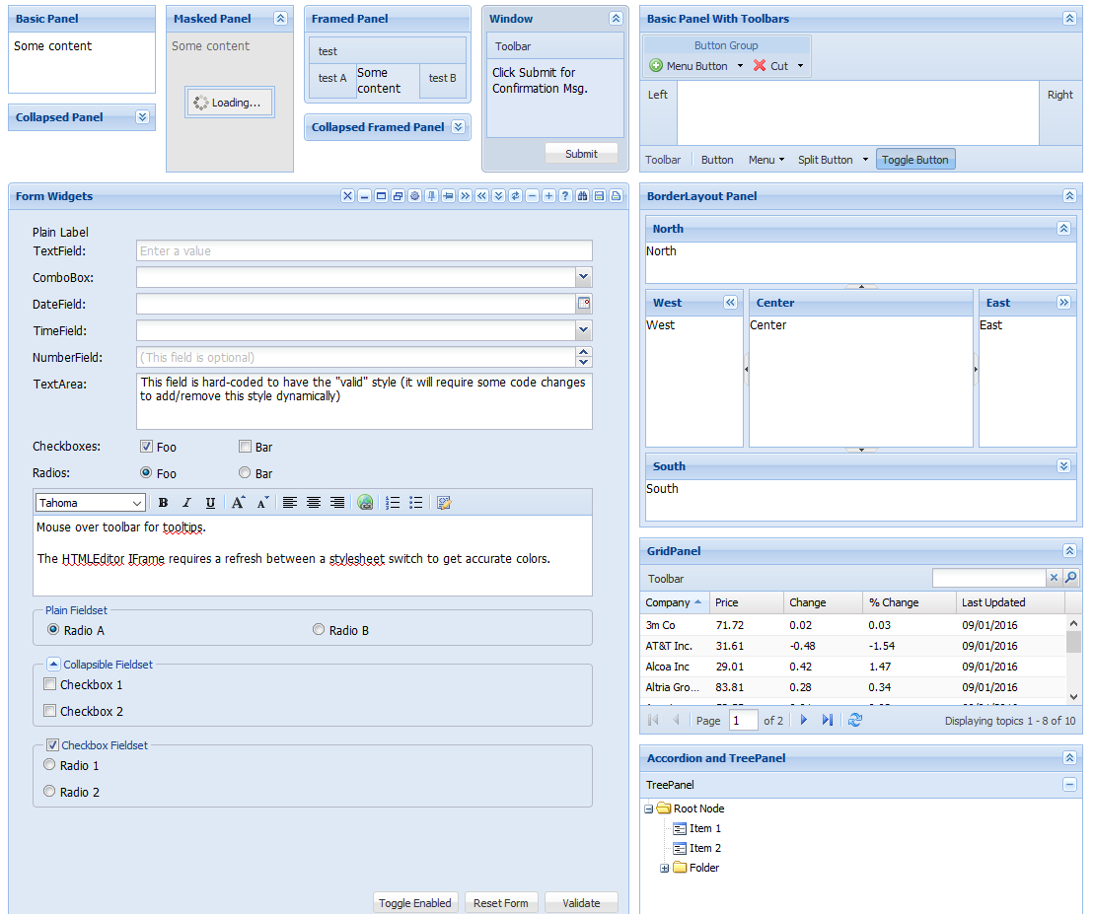
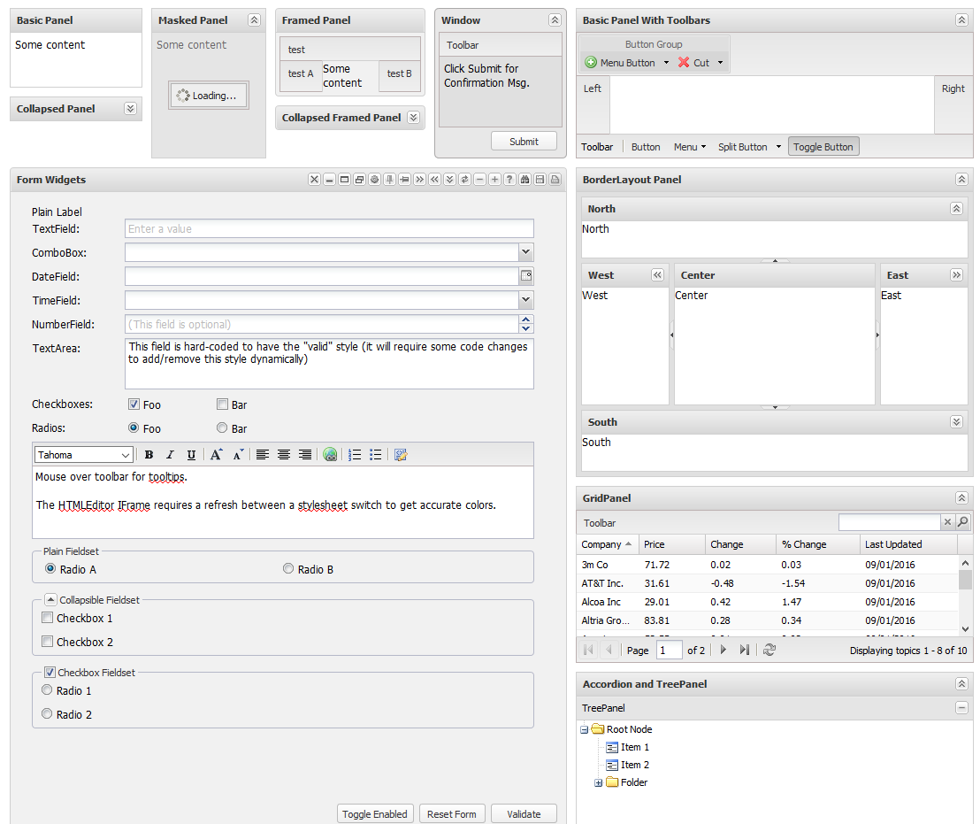
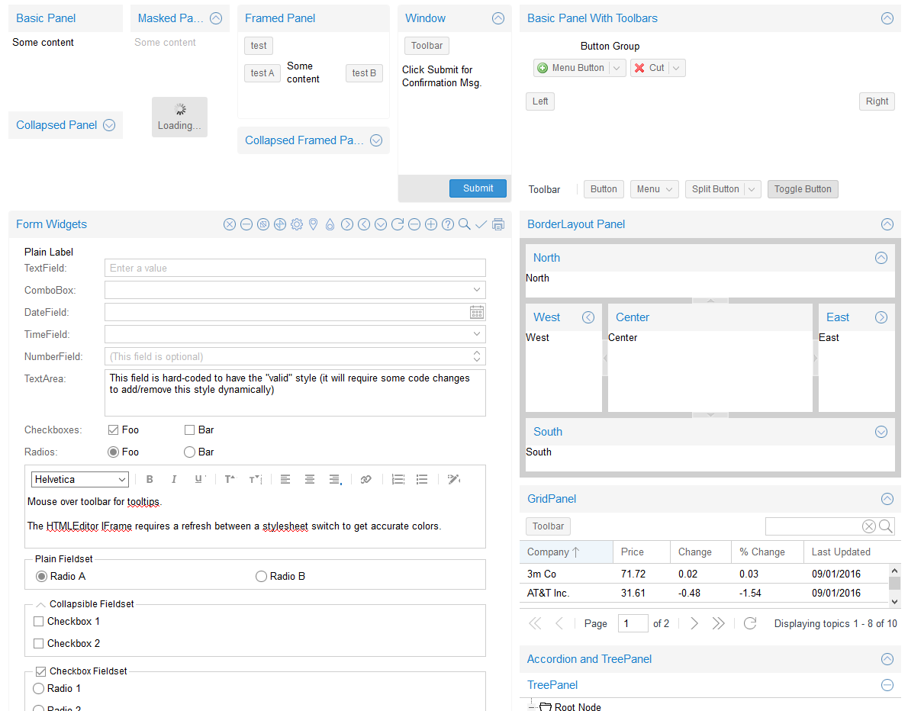
One Look Doesn’t Fit All: Themes

Slide 20
Theming Support
If the built-in themes don’t suite your needs you can enhance them or build your own
Sencha has built tooling specifically for working with themes (CMD) and an API specifically for theming
Build it’s ultimately based on SASS
All themes extend from a base theme
Using the API largely insulates you from future structural changes

Slide 21

One App to rule them all, One App to find them, One App to bring them all and in the darkness bind them (here’s the “and then some” I was referring to in the title)

Slide 22
Resources
zammetti.com (slide deck and all sample code there in Presentations section)
Twitter: fzammetti
eMail: fzammetti@etherient.com

Slide 23
Fin. (Don’t applaud, just throw money! … or ask questions I guess)

