Slide 1

Android: Rise Of The Machines
Frank W. Zammetti
Notes:
Android… Terminator…. Terminator 3: Rise of the machines… get it? I know, lame ☺

Slide 2

A Cyborg From The Future?
What it’s not: an operating system?!
It’s a stack: OS, middleware and standard applications
#1 mobile “operating system” in terms of market share world-wide, more than half a million activations per day!
Notes:
An operating system is part of the stack technically
Developer tools are sometimes considered part of the “Android Platform” too
But that’s just semantics, nobody but Google is likely to call Android anything but an OS

Slide 3

Stack It Up, Baby!
Linux kernel 2.6 underlying it all
Mobile-optimized Dalvik Java Virtual Machine
Application framework on top of C/C++ libraries
Integrated WebKit-based browser engine
SQLite for data storage
Media support for most common formats
Robust graphics subsystem
A default set of applications (eMail, browser, etc.)
Notes:
Kernel provides hardware abstraction layer
Dalvik allows for multiple instances to be run efficiently, runs compiled Java classes transformed into Dalvic EXecutable (.dex) files which are optimized for low memory footprint
System BSD-derived standard C (libc) library, OpenCORE for audio/video support, web browser uses custom LibWebCore engine, SGL for 2D graphics, OpenGL ES 1.0 for 3D (optional hardware acceleration, FreeType for bitmap and vector font rendering
Application framework: views (UI components), Content Providers for accessing things like contacts, Resource Manager for accessing non-code elements, Notification Manager allowing for custom alerts and status bar messages to the user, Activity Manager that manages application lifecycle

Slide 4
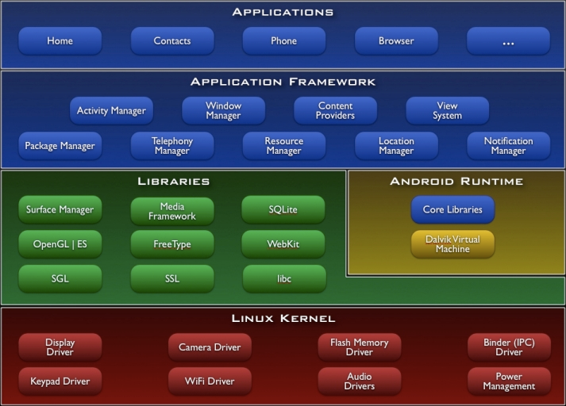

Slide 5
Just the Basics, Ma’am
Write code in Java, create an Android Package (.apk file) with SDK tools
Each application is a different unique user in Linux, permissions set on application resources for that user
Each application runs in its own Linux process, which gets its own Dalvik VM instance
Notes:
Class files ARE NOT generated from Java source per se, .dex files are, which is a custom form of bytecode
Applications are sandboxed using the principle of least privilege
Applications CAN be created to share a Linux user ID and even process to allow for sharing of resources
The OS starts processes and can shut them down as required, so important for your app to handle lifecycle events properly

Slide 6
A World of Components
Applications are built up from components
Point from which your application can be entered
May or may not have a visual representation
Four types:
Activities
Services
Content Providers
Broadcast Receivers
Notes:
Can enter an application via a given component but that doesn’t mean the entire application proper is involved

Slide 7
Activities
A single screen in a user interface
Although they form a whole application, they an independent
Other applications can start your activities
Subclass of Activity
Notes:
Example – eMail application – One activity to show a list of eMails, another to read an eMail, another to compose a new eMail

Slide 8
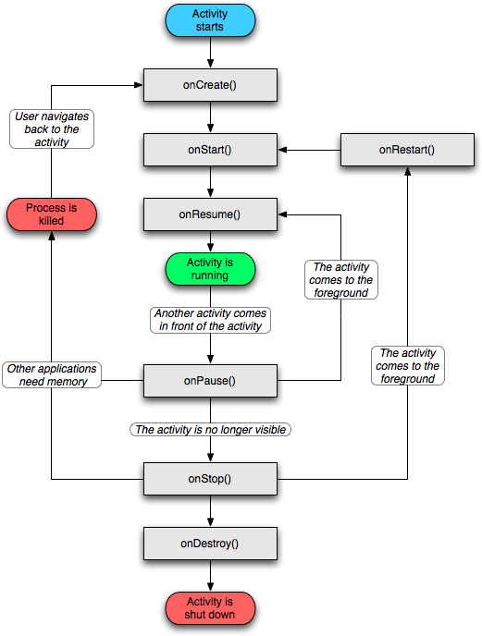
Notes:
If you think you spotted a big security flaw in Android with regard to launching other apps’ components, you’d be right… if there wasn’t more to the story! (talking about permissions)

Slide 9
Services
Background task for long-running operations
No user interface
Other components can start services and let it run, or “bind” to it to interact with it
Subclass of Service
Notes:
Example: fetch data from a network resources in a non-blocking fashion

Slide 10
Content Providers
Manages a set of application data
Data can be stored in SQLite database, file system, web, etc.
Provides access to your app’s private data
Subclass of ContentProvider
Notes:
Android provides a data provider for accessing contacts for example
Like services, no user interface for content providers either
Any persistent storage mechanism your app can access can back up a content provider
A content provider may provide no external access to your app’s data, read-only access or full access
Must implement a standard API that enables apps to perform transactions

Slide 11
Broadcast Receivers
Responds to system-wide announcements
Ostensibly no UI, but frequently interact with the status bar
Broadcast messages can be system or app-generated
Subclass of BroadcastReceiver
Notes:
System messages: screen turning off, battery low, background data sync completed, etc.
Receivers are meant to be very light “gateways” to other functions, such as starting a service when data is received in the background

Slide 12
More On Components
Applications can start components from other applications, if permissions allow
Component runs in process of target application, not source application
Simultaneously provides high reuse and low coupling
Notes:
A new process is spawned if the target application doesn’t already have one, otherwise its reused

Slide 13
Just What Are Your Intentions, Sir?
To launch components you use “intents”
Yes, even components from your own application
An Intent object serves as both input and output:
Pass an Intent object to startActivity(), or startActivityForResult() to get an Intent back
Pass an Intent object to startService()
Pass an Intent object to sendBroadcast()
Call query() on a ContentProvider to get an Intent object back
Notes:
You activate activities, services and broadcast receivers with intents, but not content providers
An Intent object is a bundle of information including things like what action to perform and data to be acted upon (a text file to be edited, or the camera app returning a photo)

Slide 14
More On Intents
Can be explicit or implicit
For activities and service an intent is an action to perform
For broadcast receivers its an announcement being broadcast
Content receivers not activated by intents
Notes:
Implicit is where you get the popup dialog because you specify only a type of component to launch, explicit names a specific component to launch (the later is usually only used within your own app)
An action such as to “view” or to “send” something… usually you pass a URI pointing to the data to operate own
Content receivers are activated by requests from a ContentResolver object, which provides a layer of abstraction between calling components are receivers (operations against a receiver goes through the resolver)

Slide 15
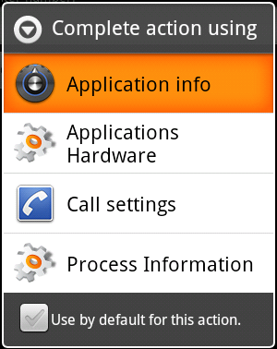
Notes:
If you think you spotted a big security flaw in Android with regard to launching other apps’ components, you’d be right… if there wasn’t more to the story! (talking about permissions)

Slide 16
The Tools Of The Trade
SDK available for Windows, Mac or Linux
Provides everything you need
android tool for managing Android Virtual Devices (AVD’s), creating projects, updating SDK and tools
Android emulator
Android Debug Bridge (ADB) for manipulating emulator or physical device from command line
All the class libraries
Notes:
AVD’s are emulator configurations that represent a device configuration you’re developing against (screen, memory, API level, etc)
Android emulator, or as I like to call it: chilled molasses trying to flow uphill with a strong wind against it (vis a vis, it’s VERY slow)

Slide 17
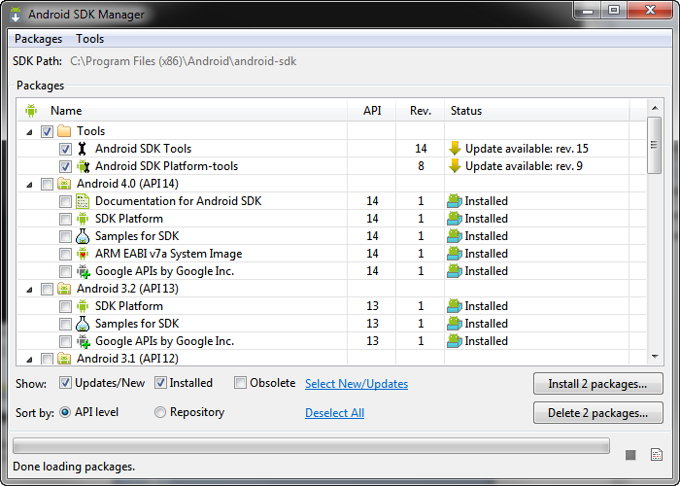

Slide 18
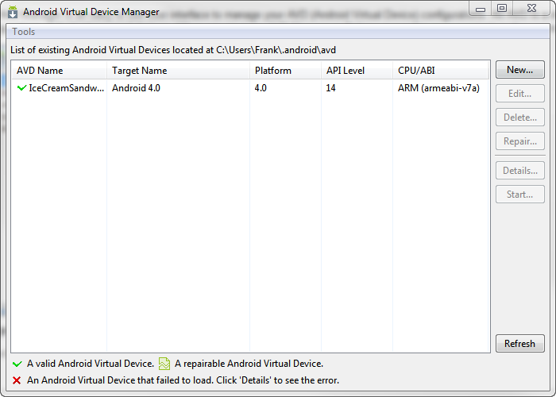
Notes:
* Can have as many AVDs as you need, all different variations… if using an IDE like Eclipse it will pick the appropriate one automatically in most cases

Slide 19
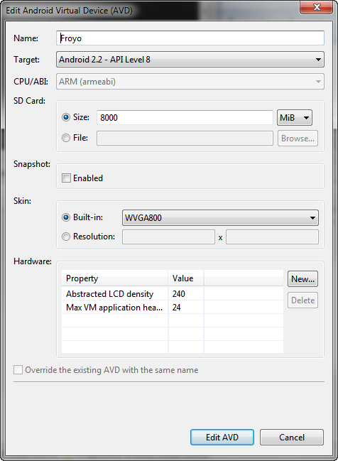

Slide 20
A Better Option
Eclipse Android Developer Tools (ADT) plugin is preferred
No longer need to know how to use android, adb and other tools directly
Beware: quirky!!
Notes:
Probably the best IDE option for no other reason than the GUI designer. IDEA doesn’t have it, NetBeans neither.
Literally everything ADT does is running things against adb in the background

Slide 21
Code Monkey, GO!
Notes:
GoodbyeWorld

Slide 22
Structural Integrity
Follow a standard directory structure
Manifest and other config files in root
assets directory for unstructured files
bin directory for class and other generated files
gen directory has tool-generated files (like R.java)
res directory are resources accessed via IDs
src directory is of course your source code
Notes:
ProGuard and project property files also go in root
assets directory stores any file you want to later retrieve as raw byte streams, no rules for what you put here or how you use it
bin directory has things like dex and apk files generated by tooling

Slide 23
Manifest Destiny
AndroidManifest.xml in root directory required
All activities, services, receivers and providers declared here
Intent filters to declare capabilities
Permissions
Device/API level requirements
Lots of other gobbledygook
Notes:
Gobbledygook: libraries the app links against, minimum API level supported, process hosting information, instrumentation classes for profiling, etc.

Slide 24
Manifest Destiny, Part Deux
<?xml version="1.0" encoding="utf-8"?>
<manifest xmlns:android="http://schemas.android.com/apk/res/android"
package="com.etherient.goodbyeworld“ android:versionCode="1"
android:versionName="1.0" >
<uses-sdk android:minSdkVersion="8" />
<application android:icon="@drawable/ic_launcher“ android:label="@string/app_name" >
<activity android:label="@string/app_name“ android:name=".GoodbyeWorldActivity" >
<intent-filter >
<action android:name="android.intent.action.MAIN" />
<category android:name="android.intent.category.LAUNCHER" />
</intent-filter>
</activity>
</application>
</manifest>
Notes:
Probably most important intent filters is one with action android.intent.action.MAIN and category android.intent.category.LAUNCHER which defines the entry point into an application that the user launches
Will always have at least one of <activity>, <service>, <receiver> or <provider> (can have as many of all of them as you want though)

Slide 25
Hey You Kids, Off My Grass!
Permissions give further fine-grained control over access by applications
User must approve permissions
Permissions declared in manifest:
<manifest
xmlns:android=http://schemas.android.com/apk/res/android
package="com.android.app.myapp" >
<uses-permission
android:name="android.permission.RECEIVE_SMS" />
</manifest>

Slide 26
More On Permissions And Security
Can also control what other apps can do:
<manifest
xmlns:android="http://schemas.android.com/apk/res/android"
package="com.me.app.myapp" >
<permission android:name="com.me.app.myapp.permission.DEADLY_ACTIVITY"
android:label="@string/permlab_deadlyActivity"
android:description="@string/permdesc_deadlyActivity"
android:permissionGroup="android.permission-group.COST_MONEY"
android:protectionLevel="dangerous" />
</manifest>
Apps must be signed (self-signing is typical)
Notes:
This allows you to limit who can launch your activities for example.
“name” is a unique string that identifies the permisson that other apps will reference
“label” and “description” should be supplied and in plain English as they are displayed to the user when necessary
“permissionGroup” optional, allows the system to display more information to the user
“protectionLevel” required, tells system how user is to be informed (or not- some permissions can be granted automatically)

Slide 27
Intent Filters
<manifest>
<application>
<activity>
<intent-filter>
<action android:name="android.intent.action.MAIN" />
</intent-filter>
<intent-filter>
<action android:name="android.intent.action.VIEW"/>
<category android:name="android.intent.category.DEFAULT"/>
</intent-filter>
</activity>
</application>
</manifest>
Notes:
In the first case, android.intent.action.MAIN can be handled by the activity
In the second case, both the action AND category would have to match (they mimic the fields in an Intent object)
Only implicit intent essentially bypasses filters, they are simply delivered immediately
There’s also a <data> tag, like <action> and <category>, that let you determine what type of data a filter will accept (so maybe that first filter will only accept text files but not images for example)

Slide 28
1 + 1 = 3
Notes:
WorldDestroyer

Slide 29
Its All About Appearances
Everything extends from View
Can defines UIs via code or XML
XML is compiled to a view resources
Field added in R
Load in onCreate()
Call to setContentView()
Wide variety of widgets (Views) to work with including all the usual suspects
Notes:
While you CAN create a UI strictly from code like Swing, in practice pretty much no one does it (although augmenting and manipulating via code is common enough)
ViewGroup objects are a special type of View that contains other Views. Widgets are created by extending View.
View objects are leaves in the UI hierarchy, ViewGroups are branches, conceptually.

Slide 30
Layout Objects
Most layout XML files begin with one of these
FrameLayout – single child, fills the layout space
LinearLayout – lays children out stacked one after another either vertically or horizontally
TableLayout – columns and rows
RelativeLayout – elements are positioned with respect to their parent, and/or each other
AbsoluteLayout – Precise X/Y (deprecated)
Notes:
These are akin to the layout managers you know and… err… love? … in Swing
Strictly-speaking it’s not required to use one of these, but nearly always your will begin with one of these (it’ll be the root element in your layout XML file)
Some others too: GridLayout

Slide 31
UI Elements
TextView (plus large, medium and small variants)
Various buttons, checkboxes, radios, toggles, etc.
Specialized text fields (eMail, phone, etc)
Lists, grids, scrolling areas
Multimedia widgets
Specialized (ratings, contacts, etc)

Slide 32
Event Handlers
Event handlers are attached in your code
Typical pattern is to use OnClickListener member
Can also have your Activity class implement the appropriate listener interface:
public class MyActivity extends Activity implements OnClickListener { protected void onCreate(Bundle savedValues) { Button b = ((Button)findViewById(R.id.myButton)).setOnClickListener(this); } public void onClick(View v) { // Do something here } }
Notes:
Usually they get attached in onCreate()
Member of your activity that is of type OnClickListener… can also do it anonymously inline
Which you prefer is a matter of personal preference by and large

Slide 33
Being Resourceful
All go in res directory
res/values/strings.xml contains your default strings
Can have other versions to provide localization
These, and all resources, get added to generated R class
This is how you access your resources
Notes:
Almost never directly edit these files, do it through the IDE (GUI designer in Eclipse allows for adding/changing strings on-the-fly)
Although, you certainly CAN edit them directly (if you do, 99 times out of 100 you only edit strings.xml directly, let R.java be generated)

Slide 34
A Bit More Meat
Notes:
Meatier

Slide 35
A Bit More On Services
Must extend the Service class (or its descendants)
IntentService is important
Two forms: Started and Bound
Runs in the same thread as the hosting process
CPU-intensive or blocking operations should spawn a new thread in the service
Service can be run in the foreground, which shows up under “Ongoing Tasks”
Notes:
Started service run in the background and can continue to execute even after the starting component is gone
Bound services are bound to by other components and offers a client/server interface to access its functionality, but only for the life of the calling component
Can also be both
With IntentService, you only usually have to implement the onHandleIntent(). It handles spawning a new thread, managing a work queue to allow for thread safety, and a lot of other housekeeping for you
A Foreground Service is still, from the code perspective, a background task, but the user is aware of it more (think of ongoing downloads or a music player maybe)

Slide 36
At Your Service
Notes:
ServiceMe

Slide 37
In It For The Long Haul
Shared Prefs, SQLite, Internal/external storage
Shared Prefs are simple key-value (properties)
SQLite is full (more or less) relational DB
Internal storage is direct file access
External storage is world-shareable files on external device (SD card)
By default, all but External storage is app-private
Cache files is another mechanism
Notes:
Cache files are files you directly access, private to your application, which can be destroyed by the OS when space is needed (all other mechanisms are not subject to automatic destruction)
You can make even the private data public by exposing it via a content provider
Have to be careful with external storage because it isn’t locked down like the rest, user can edit or delete via USB Mass Storage access, and it may not be present when your app runs

Slide 38
A Squirrel And His Nuts (err, wait)
Notes:
Nuts

Slide 39
Quick Hits, Part I
Internal storage: app-private, not accessible by user and removed along with your application: FileOutputStream fos = openFileOutput("MyFile", Context.MODE_PRIVATE); fos.write("I'm being stored!".getBytes()); fos.close();
External storage: shared, accessible by user and not removed with any application: String state = Environment.getExternalStorageState(); if (Environment.MEDIA_MOUNTED.equals(state)) { File path = getExternalFilesDir(Environment.DIRECTORY_PICTURES); File file = new File(path, "MyPicture.jpg"); }

Slide 40
Quick Hits, Part II
Android Device Administration API for “enterprise” features
Allows IT to administer device at a low level
Example: eMail application uses API to allow IT to enforce password policies
Remote wipe
Need to write a device admin app
Notes:
System admin writes app and distributes it somehow (Android doesn’t currently have a proper provisioning service so must be distributed some other way)
System prompts user to enable app (how and when depends on how the app is implemented)
Once app is enabled user is subject to its policies and enforcement
Up to the app what to do if the user doesn’t comply with its policies
Multiple apps are allowed, but in the case of conflicts the most strict wins
Only a limited set of policies currently provided, mostly dealing with passwords (also camera control and encryption of external storage, and remote wipe)

Slide 41
Quick Hits, Part III
App Widgets can be embedded in other apps, most usually a home screen
Really just views with more metadata involved
AppWidgetProviderInfo is the metadata
AppWidgetProvider gives you hooks into lifecycle events and interaction events to code for
Can also provide a configuration activity that will be launched when the widget is added
Notes:
You don’t actually write an AppWidgetProviderInfo class. Instead you add a receiver element to your manifest, which references an XML resource file which provides all the metadata. An AppWidgetProviderInfo object is created in the background from that.
AppWidgetProvider extends BroadcastReceiver and adds convenience methods for things like widget updates (including when its added) and removal from its host.

Slide 42
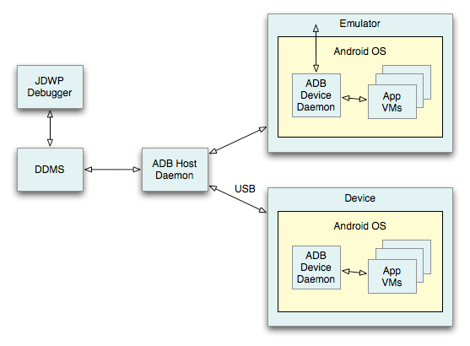
Quick Hits, Part IV
adb, DDMS, JDWP for debugging
Hierarchy Viewer, Traceview, Dev Tools
Notes:
adb is the “middleman” that allows other utilities to talk to a device, be it an emulator image or a real device. Also allows things file manipulation and shell commands
DDMS, or Dalvik Debug Monitor Service, is a graphical tool that provides things like screenshot ability, thread and stack information and spoofing of calls, SMS, etc.
Any JDWP-compliant debugger can be used to attach to the VM
Hierarchy viewer helps you optimize your UI by showing the layout hierarchy so you can optimize it (i.e., avoid over-nesting) so your layouts don’t slow your apps down
Traceview allows you to view trace logging information that you add to your app via DDMS in a graphical form to find pain points
Dev tools allows you to turn on and off things on the device to aid in debugging including things like showing parts of the screen that update in real-time, CPU usage monitoring and telling Android to immediately destroy activities that stop (useful for testing state saving code, since the activity may not be immediately destroyed by the system normally)

Slide 43
Quick Hits, Part V
NDK (Native Development Kit?)
C/C++ embedded in a Java app (Hello JNI!)
NativeActivity convenience class sends activity lifecycle events to your native code
NDK includes system headers for stable native APIs such as libc, libz (zip support), liblog (Android logging), OpenGL ES, OpenSL (audio) and libm
Also includes build system
Notes:
“Stable” here means guaranteed to not go away or have breaking changes… these are the only libraries you should make use of or risk the wrath of the app breakage gods
You don’t have to worry about directly dealing with the toolchain… you write a short build file and the build system takes care of everything including adding your library to your projects

Slide 44

Fin.
On “The Twitter” - @fzammetti
fzammetti@etherient.com
www.zammetti.com

